Slide 1
Geometric and Spatial Characterization Methods: Examples from Planet and WV-3
Presented by Ajit Sampath
KBR, Contractor to US Geological Survey EROS Data Center
JACIE 2019
9/26/2019
Notes:
I will talk about geometric and spatial characterization methods to understand the quality of sensors.

Slide 2
Assessment Outline
Assessment Methods
Geometry, Spatial/MTF
Data Sets
Planet data from various launches
Skysat Scenes
WorldView 3 Data

Slide 3
Geometric Assessment
Reference image
A point P, where alignment is tested
Search image
Error in Search image
P’s actual location in search band determined from Image matching
P’s estimated location in search image
Moving search template that determines cross correlation matching measure

Slide 4
Geometric Assessment (2)
For a multi-spectral remote sensing product, this involves the assessment of the external geodetic accuracy of the product
The external geodetic accuracy assessment can be performed using three methods: manual, automated, and semi-automated.
The internal relative registration of the bands to each other.
Notes:
We are talking about the geolocation accuracy of features. We would like to point out that the methods of assessment depend on the particular sensor being characterized. For e.g. to assess the quality of WV-3, we can use GPS based measurements on photo identifiable targets. That may work for Skysat scenes too, but may not be very useful for Planet data, simply because of the GSD differences.

Slide 5
External Geometry
Manual methods:
GPS based survey points as well as high resolution reference data (aerial photogrammetry based)
Used when high-resolution reference and search images are available or when ground control points (GCPs) are available within the image.
Conjugate points are manually located and their coordinates are then compared and summarized.
Automated geometric assessment methods
Implemented in tools developed from the Landsat’s Image Assessment System (IAS) .
The tool uses methods based on cross-correlation for the image data analysis.

Slide 6
Semi-automated methods
Used when dealing with reasonably high-resolution images, particularly over urban areas.
Automated methods can choose points that may lie on roof tops, which are not acceptable locations (due to building lean, etc.).
User manually chooses locations for comparisons between reference and search images
Small sub-images are cut around these locations, and image-based correlation methods described earlier are used for comparisons.
Used corner detection software for high resolution data

Slide 7
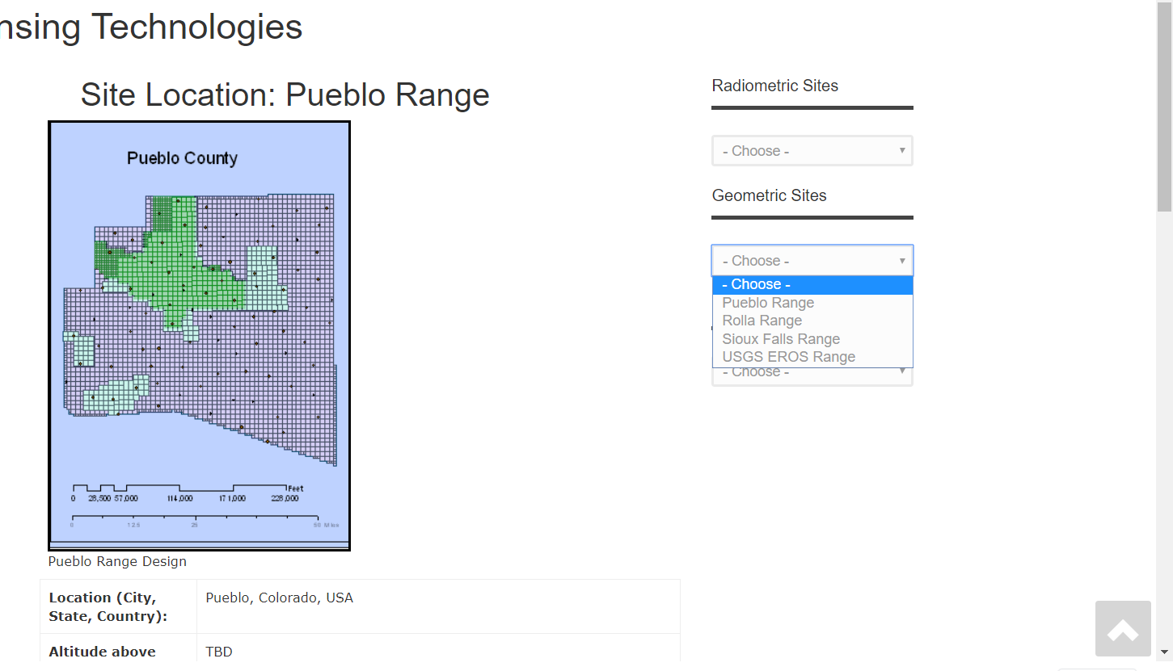
Geometric Test Ranges
Three test ranges in the US
Mostly suitable for data with 1-5 m GSD
Established using GPS based measurements over visually identifiable targets

Slide 8
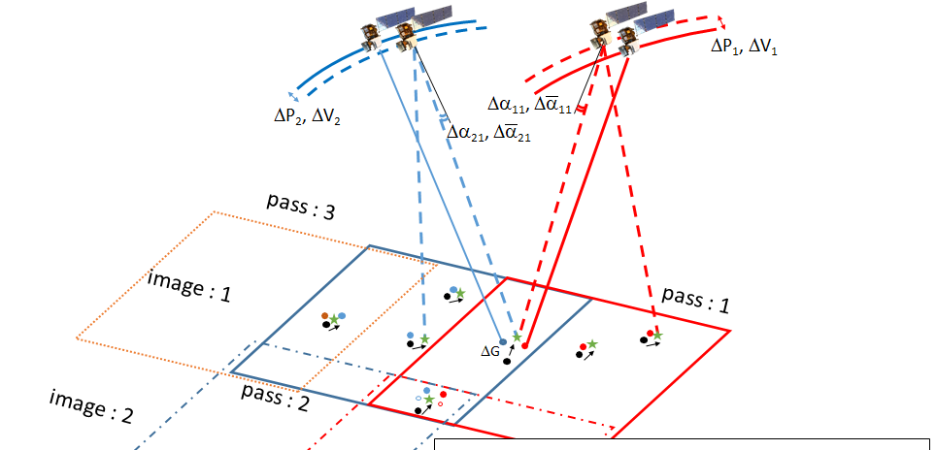
Establish New Test Ranges
Outside USA
Assess data with GSD in 1-6 m range (initially)
Use block adjustment to generate higher accuracy reference data
WV-3, others etc.
Mostly Flat regions

Slide 9
Band Registration
Assessment is typically accomplished by registering each band against the other bands.
Provides a numerical evaluation of the accuracy of the band registration within an image.
Carried out by using automated cross-correlation techniques between the bands to be assessed.
Reference image is taken to be the image data from one of the bands in the multi-spectral image product and the rest of the bands are considered search images.
Process is repeated cyclically by considering image data from a different band to be the reference image.
The analysis measures the relative alignment of the bands to each other.

Slide 10
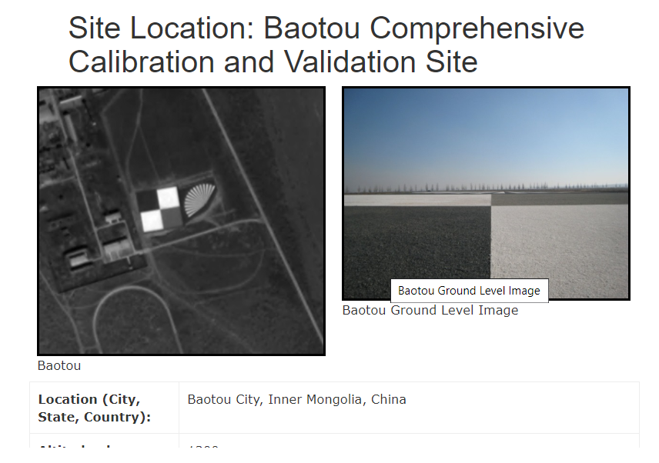
Spatial Analysis
Measures the ability of the system to resolve spatial objects.
There is no “one method to rule them all”
We use specially designed “Edge targets”
Landsat uses pulse targets e.g. bridges etc.
https://calval.cr.usgs.gov/rst-resources/sites_catalog/spatial-sites/
Target should 7-10 IFOV’s beyond the edge.

Slide 11
Spatial Analysis: Theoretical Basis
“In-flight characterization of spatial quality using point spread functions”
by Helder, D.; Choi, T.; Rangaswamy, M.
In Proceedings of the International Workshop on Radiometric and Geometric Calibration, Gulfport, MS, USA, 2–5 December 2003; pp. 151–170.
Dr. Donghan Lee’s Matlab software
IQE software from I2R

Slide 12
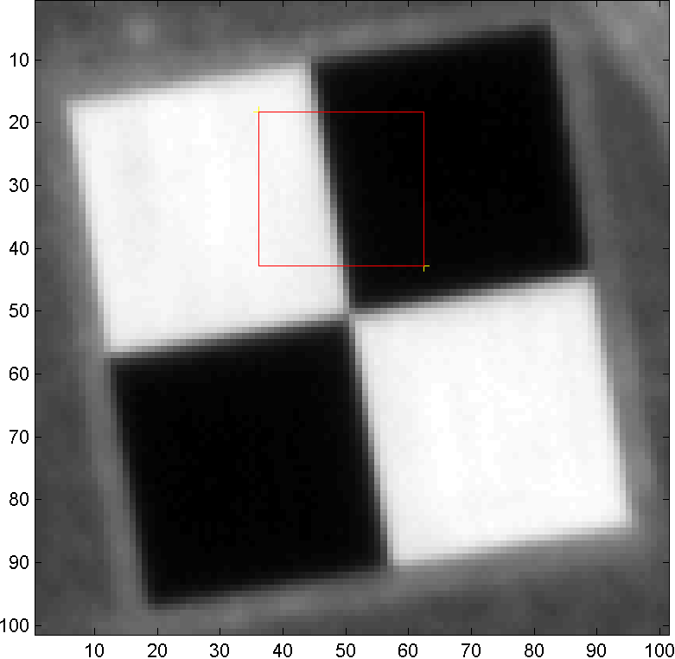
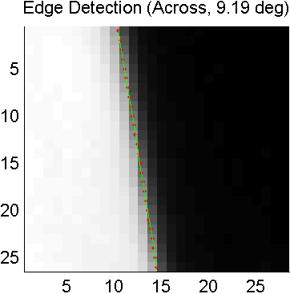
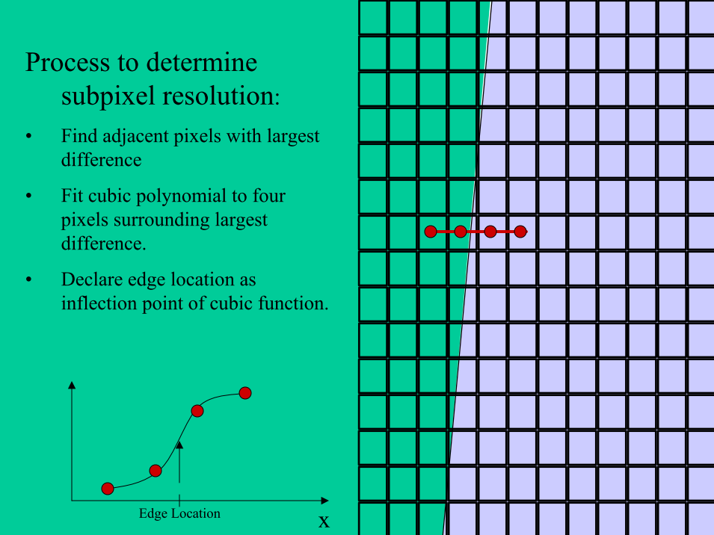
Spatial Analysis (2)
Select and Determine ROI of Edge on the Edge image data
Detect the Edge line on ROI
Get & Plot Edge Spread Function (ESF) with Pixel data
Decide the Staring point of the Bright & Dark area
Calculate and Plot ESF by Fitting from the Trimmed ESF pixel data
Calculate Relative Edge Response (RER) (by one pixel)
Calculate and Plot Line Spread Function
Calculate Full Width at Half Maximum
Calculate and Plot MTF (Modulation Transfer Function)

Slide 13
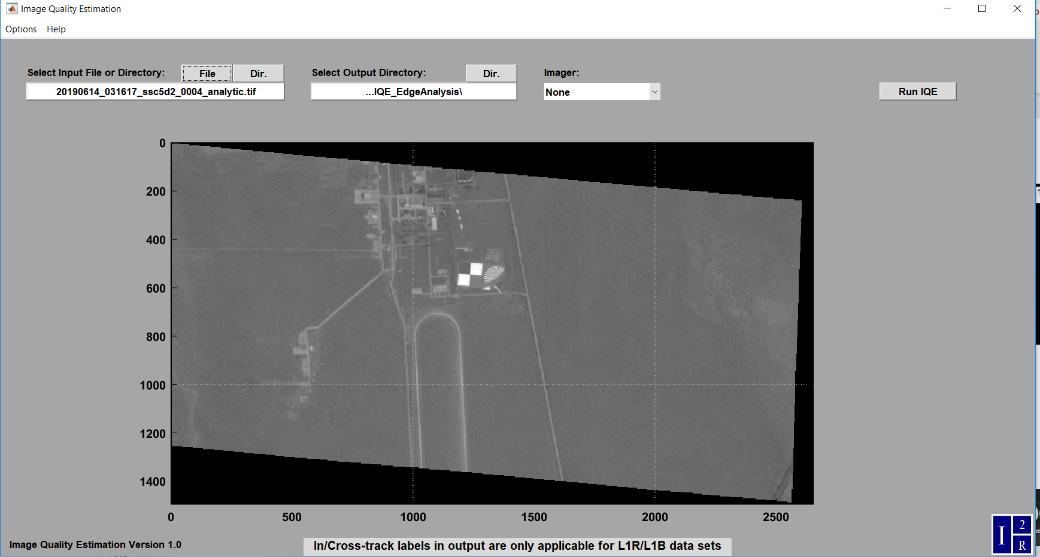
Spatial Analysis: Using IQE

Slide 14
Data Analysis
Planetscope, Skysat -8 scenes
Planet Nominal GSD: 3.9 m, Skysat-8: 1 m
WorldView 3 Data
PAN: 0.3 m, MSS: 1.25 m

Slide 15
Geometry Analysis
Sioux Falls, SD
Reference Data: Orthorectified aerial imagery collected in 2017
GPS based survey performed in 2019
Shadnagar, Baotuo and Buenos Aires
Used Multiple WV-3 estimates of same features as reference for Planet scenes
Multiple Planetscope and World View 3 data sets
Manual and Semi-Automated methods used
Notes:
Can we be more precise than “few”? And which pixels – Planet pixels or aerial data pixels?

Slide 16
External Geometry (2)
WV- 3
2.2 m and 2.3 m RMSE (Line, Sample) observed in Sioux Falls
GPS based measurements as reference
Planet
Sioux Falls, USA
Mean Error(x, y): (0.6 m, 4.7 m) and RMSE (x, y): (0.7 m, 4.9 m)
Shadnagar, India
Mean Error(x, y): (6.6 m, 0.7 m) and RMSE (x, y): (2.4 m, .5 m)
Baotuo
Mean Error(x, y): (2.4 m, 0.5 m) and RMSE (x, y): (2.6 m, .7 m)
Argentina: observed to 2-pixel errors, but more testing required

Slide 17
Band Analysis
WorldView 3 appears well registered
~ 0.1 pixels
We have access to SWR (3.7 m), will be testing band alignment going forward
Planet Bands are also sub pixel registered
1,2,3 appear well registered (~.15 pixels)
Band 4 measured to have higher mis registration
This measurement could be due poorer MTF slides
Notes:
The Geometric accuracy, when compared against orthographically rectified aerial photographs appears to be consistent with the analysis performed on data obtained from our CGA partnership.

Slide 18
Spatial Characterization test site
Baotou range selected from USGS test site catalog
Only one (in test site catalog) whose dimensions seem to be practical for spatial testing (among the test sites)
Edge semi automatically identified
Multiple profiles across the edge used to perform analysis

Slide 19
Spatial test site
ISRO Shadnagar test range
Appears to be a large MTF and other target site
Each square ~ 50 m in dimensions

Slide 20
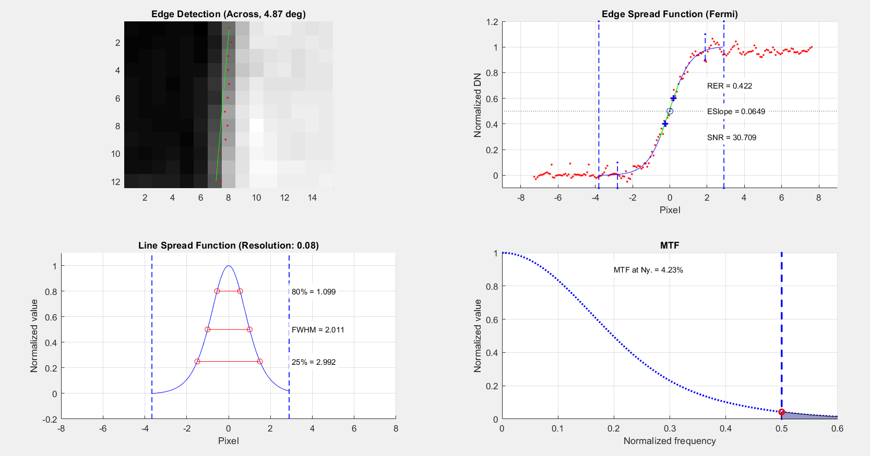
MTF Results for Bands 1-3
FWHM ~ 2
RER ~ 0.4
Notes:
20180503_052307_1051\20180503_052307_1051_3B_AnalyticMS.tif

Slide 21
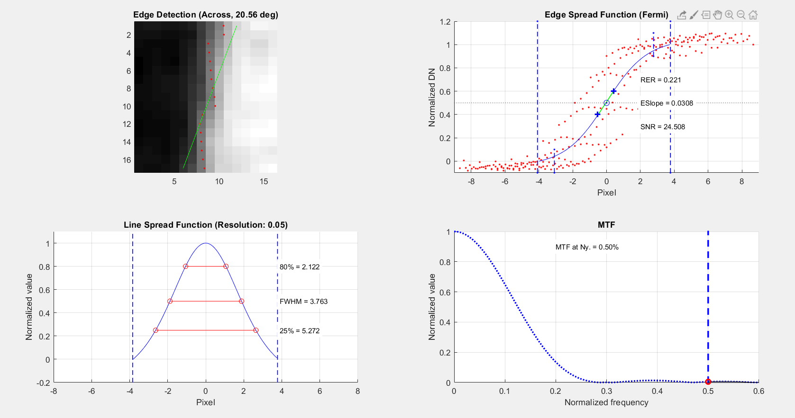
MTF Band 4 (NIR)
Notes:
20180503_052307_1051\20180503_052307_1051_3B_AnalyticMS.tif

Slide 22
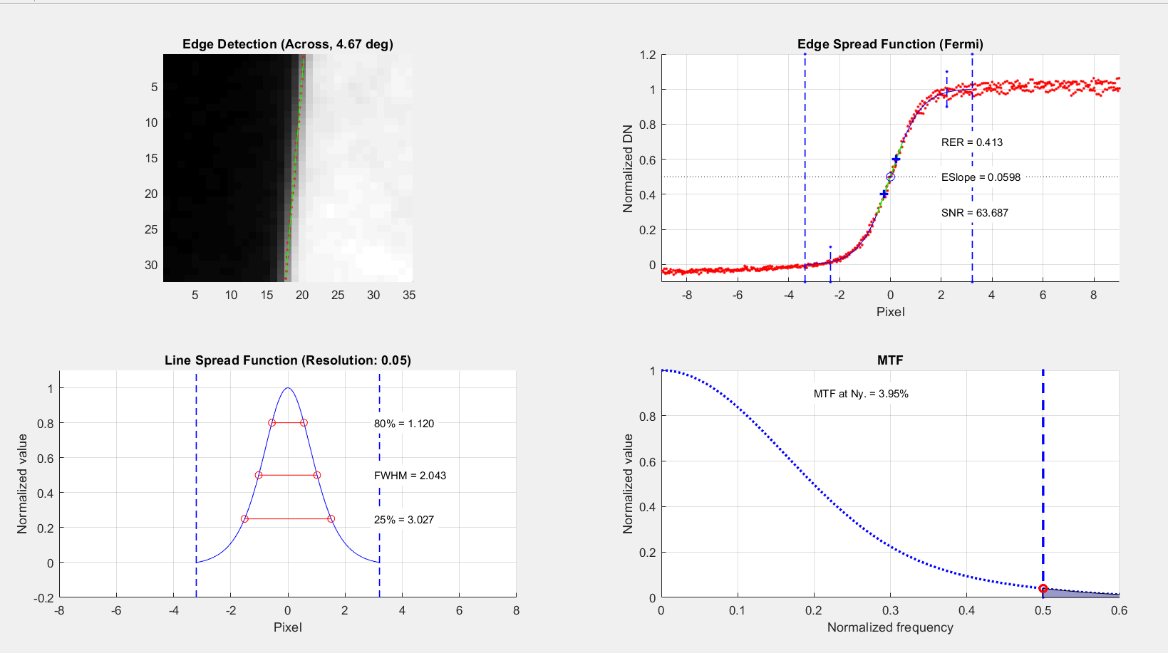
Skysat
FWHM 1.9-2.1
RER~0.4
IQE Analysis provided similar RER and MTF values using non target

Slide 23
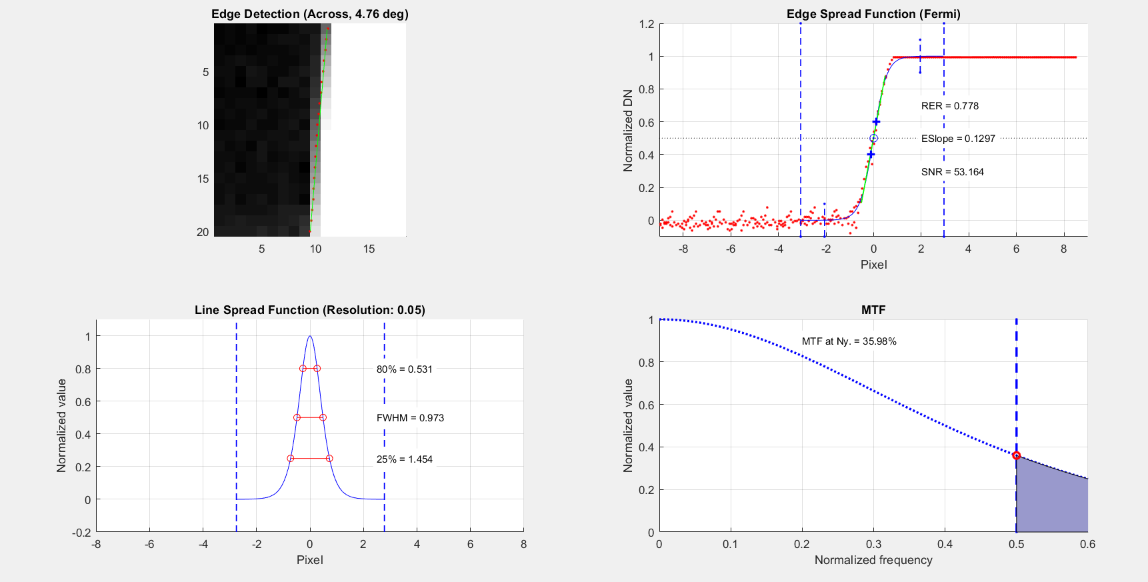
WV-3 VNIR Bands
FWHM-0.9-1 range
RER Mean: 0.7
Notes:
SWIR band kept failing to process for MTF. Could not get access to the higher resolution SWIR bands

Slide 24
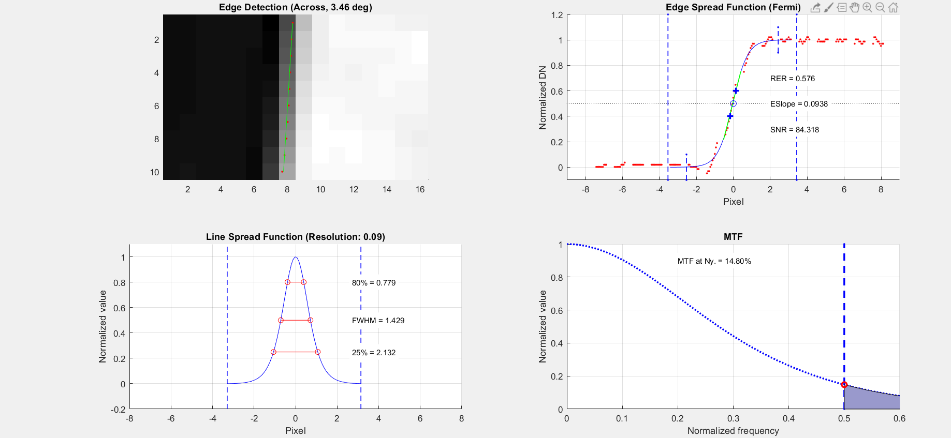
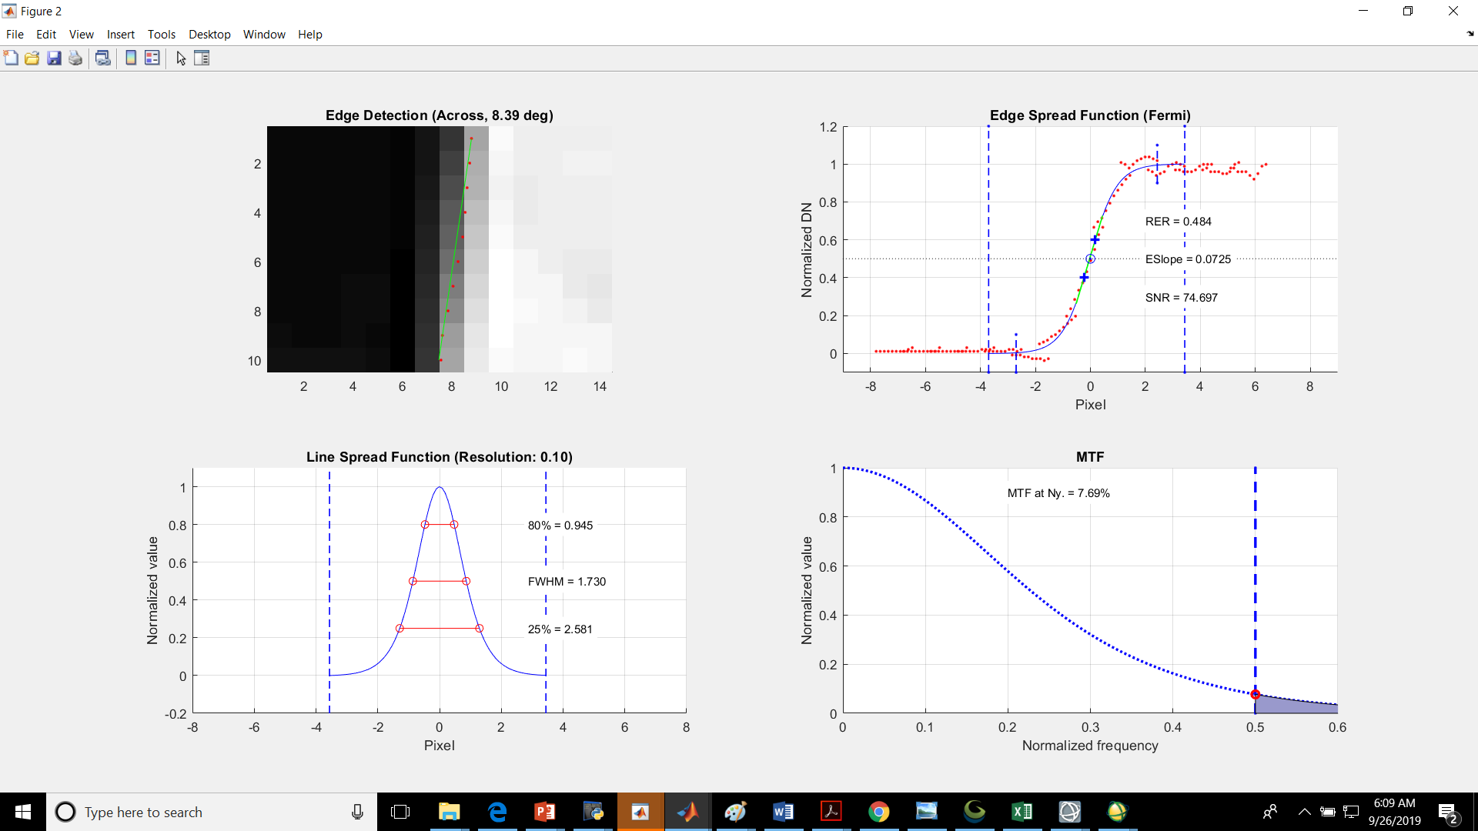
WV-3 SWIR bands
FWHM 1.4-1.7 range

Slide 25
Summary of Data Analysis
Planet
Band to Band
Band 4 had higher measured misalignment
Known issue as was explained
Geodetic accuracy
~ 1-1.1 pixel in Sioux Falls and sub pixel shifts over Baotuo
1.5-2 pixel shifts over other locations (Shadnagar, Buenos Aires)
Spatial
Tested over Baotuo and Shadnagar.
Consistent with previous results.

Slide 26
Summary of Data Analysis (2)
WV-3
Band to Band (VNIR regions)
well aligned
SWR needs to be performed
Geodetic accuracy
2.2 m and 2.3 m RMSE (Line, Sample)
Spatial
Tested over Baotuo and Shadnagar,
Results look good

