Slide 1
S2 Geometric Calibration
Sentinel-2 Geometric Calibration
S. Clerc (ARGANS) and the MPC Team
Sioux Falls, 13 November 2017

Slide 2
Sentinel 2 Geometry: definitions
Sentinel 2 Geometry: definitions
Main Sentinel 2 products:
Level 1B: radiances, in sensor geometry: not publicly disseminated
Level 1C: TOA reflectances in cartographic projection (UTM – MGRS)
Level 2A: BOA reflectances – same projection: currently produced systematically over Europe only
Definitions
MSI detector = OLI module
MSI pixel = OLI detector
GRI (Global Reference Image): set of reference images used for geometric refinement
Sentinel 2 Tile or L1C Granule: a 110 x 110 km tile based on the MGRS tiling
Notes:
Could be moved to Ferran’s part

Slide 3
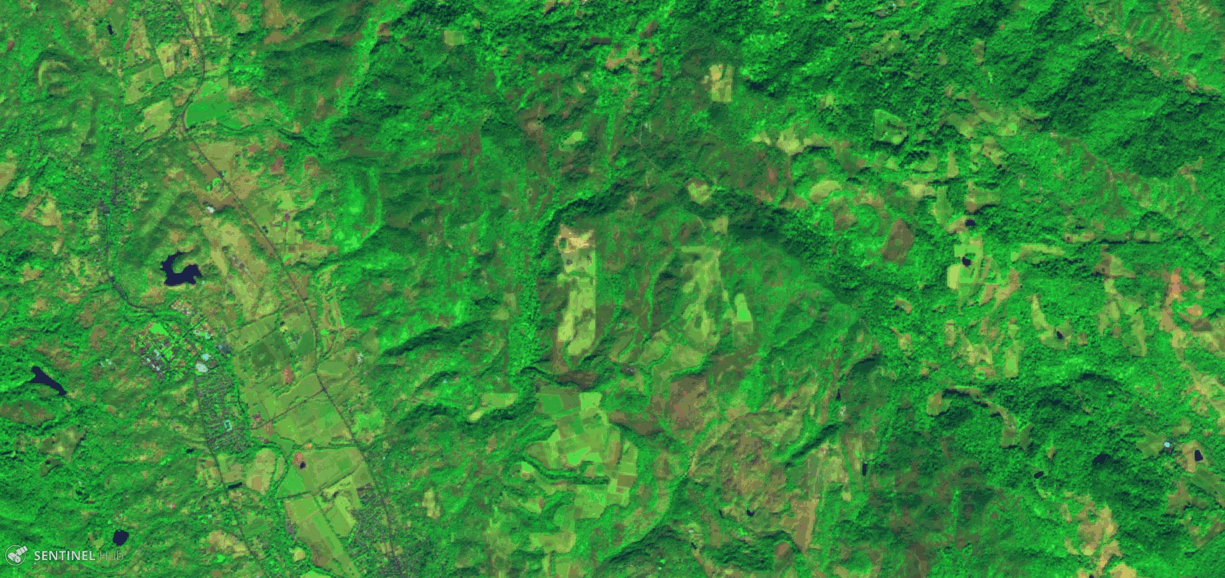
Sentinel 2 Geometric Accuracy Requirements
Sentinel 2 Geometric Accuracy Requirements
Geometric requirement justification
Sentinel 2 is designed to produce high revisit time series at medium resolution
Geometric requirements ensure the repeatability of images
And contribute to image quality (multi-spectral registration)
Notes:
To be reviewed by Airbus
Illustration of Sentinel 2 hardware (me)

Slide 4
Sentinel 2 Geometric Accuracy Requirements
Sentinel 2 Geometric Accuracy Requirements
Design considerations
MSI Instrument with SiC structure ensures very good thermo-elastic stability
Sentinel 2 has a high-performance Attitude and Orbit Control System
High-precision fibre optics gyro
Multi-head star tracker, mounted on instrument - 2 / 3 heads cold redundancy
Gyro-stellar estimator
2-band GNSS receiver
Geometric refinement with a Global Reference Image to reach multi-temporal registration performance
Global Reference Image
Notes:
To be reviewed by Airbus
Illustration of Sentinel 2 hardware (me)

Slide 5
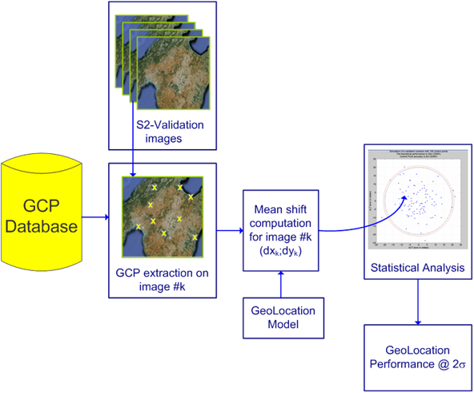
Sentinel 2 Geometric Accuracy Requirements
Sentinel 2 Geometric Accuracy Requirements
Absolute geolocation
Without GCP (current processing baseline):
< 20 m at level 1B (i.e. in sensor geometry)
With GCP (geometric refinement - activation planned in 2018)
< 12.5 m at level 1C (cartographic projection)
Measurement methodology
B04 (Red) is the reference band for geolocation measurements
At tile level: average error over all GCPs
Mission performance: 95% value of all tiles
Notes:
To be checked by Thales
Illustration of the verification method (Thales)

Slide 6
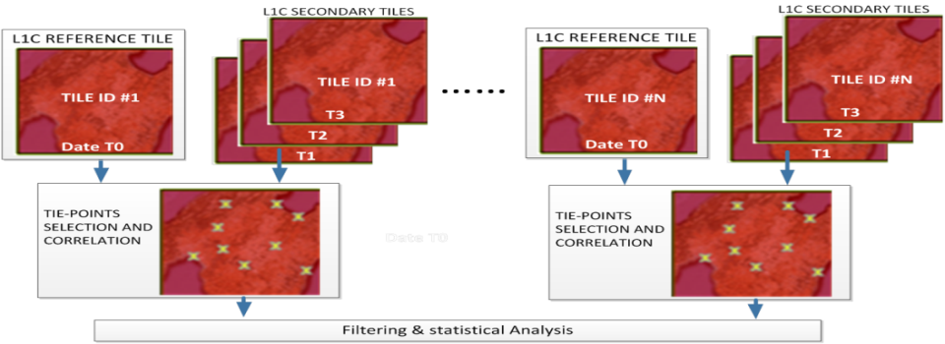
Sentinel 2 Geometric Accuracy Requirements
Sentinel 2 Geometric Accuracy Requirements
Multi-temporal (relative) geolocation
Without GCP (current processing baseline):
No specification, but performance continuously monitored
With GCP (geometric refinement - activation planned in 2018)
< 3 m at Level 1C
Measurement methodology
B04 (Red) is the reference band for geolocation measurements
Using a pair of recent images of the same tile, for the same repeat orbit
At tile level: 95.5% percentile Circular Error over all control points
Mission performance: 95% value for all tiles
Notes:
Idem slide 4

Slide 7
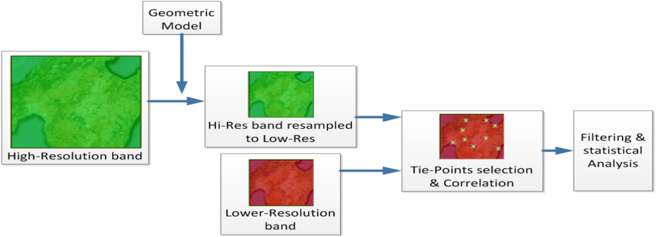
Sentinel 2 Geometric Accuracy Requirements
Sentinel 2 Geometric Accuracy Requirements
Multi-spectral registration
For any pair of spectral bands, < 0.3 of the coarser pixel size
At Level 1B
Measurement methodology
Performance measured for textured, cloud-free images
Measurements done for a set of band pairs – results depend on correlation performance (landscape dependent). Measurement at L1B Measurements more difficult for B10 (cirrus band)
99.7% percentile Circular Error over all control points
Notes:
Idem Slide 4

Slide 8
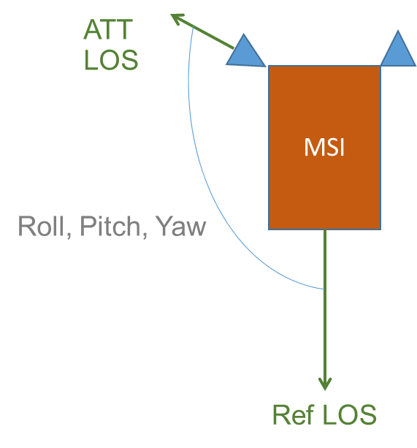
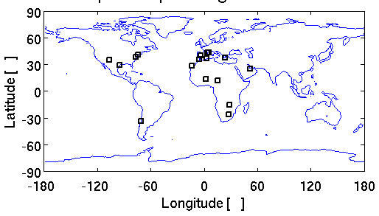
Sentinel 2 Geometric Calibration Approach
Sentinel 2 Geometric Calibration Approach
Relative line of sight calibration:
A set of Roll, Pitch, Yaw biases (actual to reference viewing frame)
Adjusted regularly in the first year after launch
A time-lag (actual to on-board time reference)
Characterized during commissioning phase
How?
Acquisition on a small sites very well localized
Compute the localization error
Find the 3 correction angles minimizing rms error
Notes:
To be reviewed by Airbus (CNES ?)

Slide 9
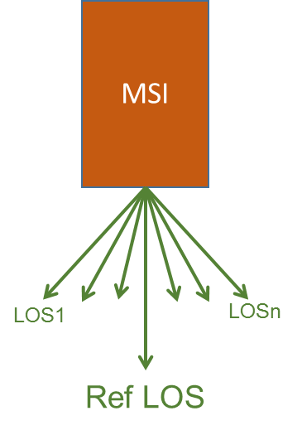
Sentinel 2 Geometric Calibration Approach
Sentinel 2 Geometric Calibration Approach
Spacecraft model bias calibration coefficients:
Relative Line-of-Sights for each pixel of each detector and each band
Corrects optical distortions and aberrations
Characterized during commissioning phase
How?
Acquisition on a large site covering the full swath equipped with GCPs
Estimation and correction of all biases
Notes:
To be reviewed by Airbus (CNES ?)

Slide 10
Sentinel 2 Geometric Calibration Approach
Sentinel 2 Geometric Calibration Approach
The Global Reference Image
Each data-strip is co-registered with images from the GRI, in order to refine the viewing model
On GRI for the whole mission (TBC), elaboration in progress
Same GRI for S2A and S2B
The Digital Elevation Model
The DEM contributes to the geolocation error budget in mountainous areas
Current DEM is Planet DEM (90 m horizontal resolution)
Notes:
To be reviewed by Airbus

Slide 11
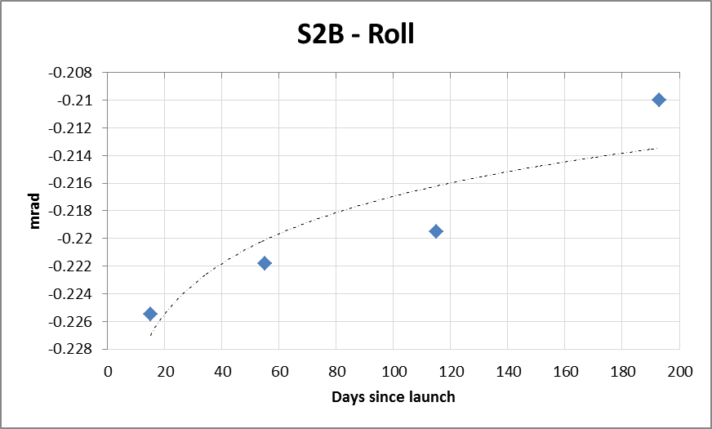
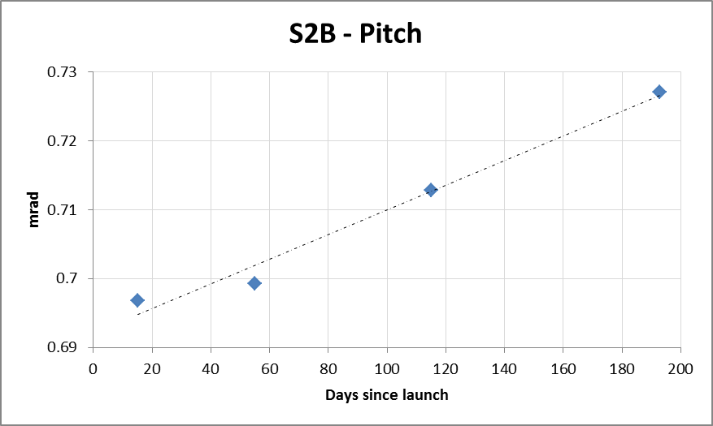
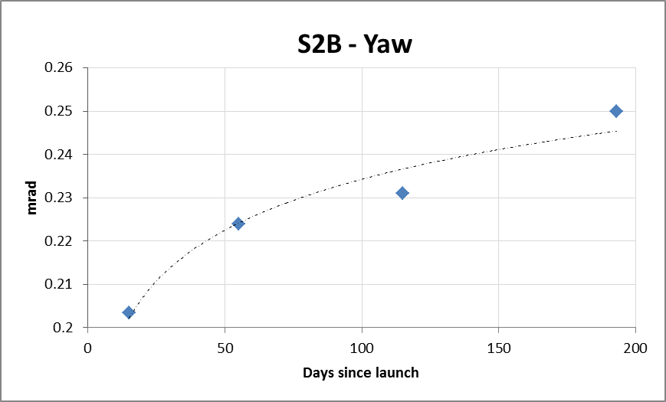
Sentinel 2 Geometric Calibration Experience
Sentinel 2 Geometric Calibration Experience
The viewing biases evolve slowly during the first year in orbit
Slow stabilization for yaw bias for S2A and S2B
Slow stabilization for S2B pitch angle
Small orbital trend for the pitch angle
Latitude dependence of the pitch bias, due to Star Tracker thermo-elastic deformations
Amplitude changes seasonally
This orbital effect will be cancelled after activation of the GRI
Pitch Bias calibrated for 20° N latitude to account for the North/South emerged land imbalance.
Notes:
To be reviewed by Airbus (CNES) and Thales
Illustration of evolution of R,P,Y (me or Thales)
latitude dependence of pitch (Thales)

Slide 12
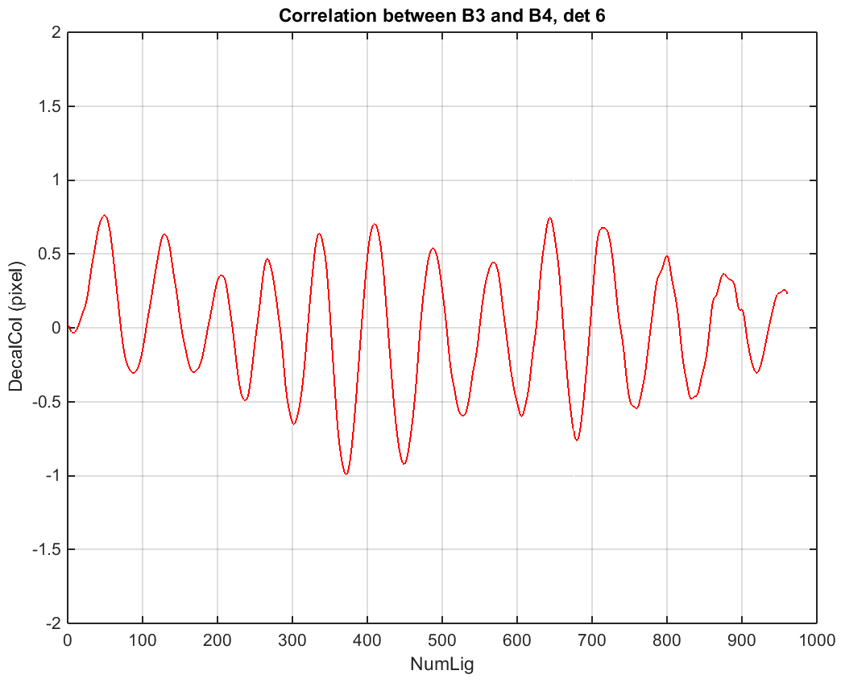
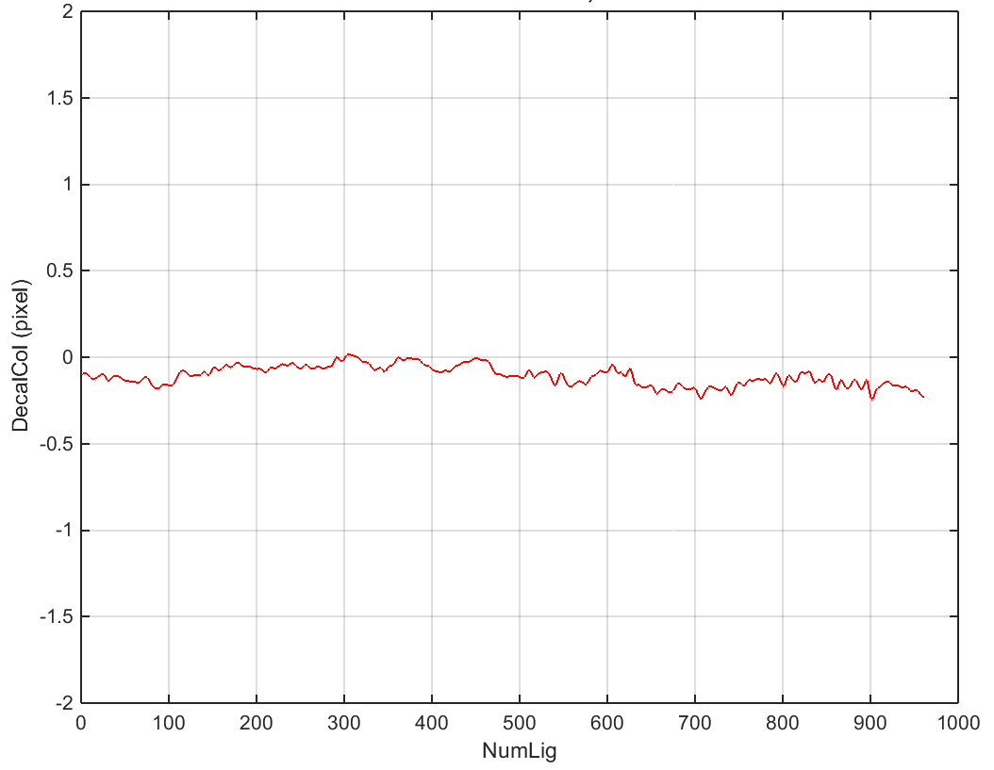
Sentinel 2 Geometric Calibration Experience
Sentinel 2 Geometric Calibration Experience
Oscillations due to control error
Spectral co-registration
Biases are very stable over time, confirming the excellent instrument stability
Main contributor: disturbances from rotating solar panel
Oscillations uncontrolled by accurately measured by AOCS
Reduced on S2B (vs S2A) thanks to design improvement
Filtering of AOCS measurements
Notes:
To be reviewed by Airbus / Thales

Slide 13
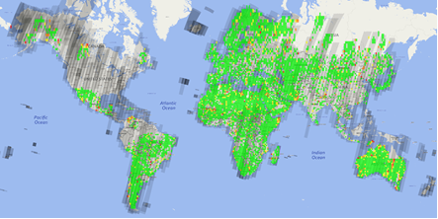
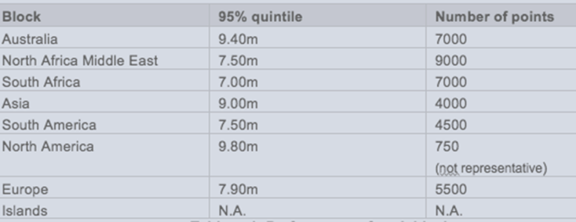
Sentinel 2 Geometric Calibration Experience
Sentinel 2 Geometric Calibration Experience
Global Reference Image 1/2
Nominal GRI completed
Validation in progress
Accuracy of the GRI so far is in line with expectations
Extension to small islands and Northern latitudes (Greenland – Siberia) in progress
If no reference Ground Control Points are available, the GRI is built on a “best-effort” basis: still ensures the fulfilment of multi-temporal performance
Geometrical refinement algorithm is currently tested and fine-tuned
Improve robustness before activating systematic production
Notes:
To be reviewed by IGN / Airbus
Illustration of GRI coverage and/or performance validation (IGN)

Slide 14
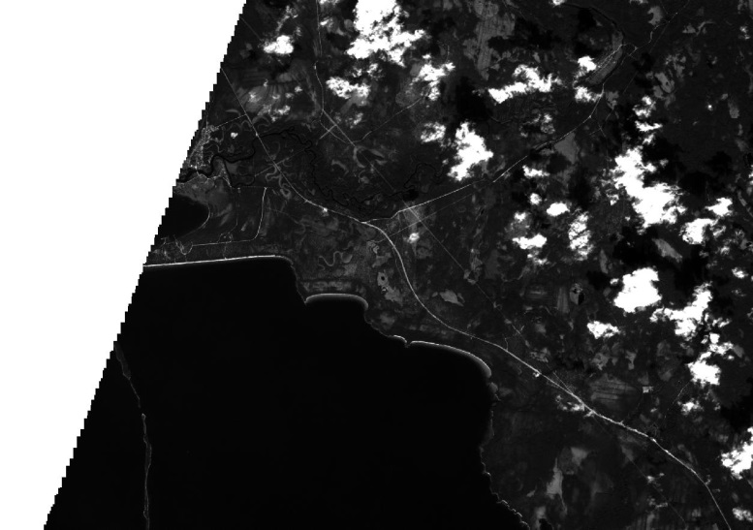
Sentinel 2 Geometric Calibration Experience
Sentinel 2 Geometric Calibration Experience
Global Reference Image 2/2
After activation, a reprocessing campaign of the 2015-2018 archive is planned
Users have requested a “product” version of the GRI: global set of L1C products with optimal geolocation => in progress
Long-term evolution of the GRI, under discussion:
Evolution of the landscape ?
Winter/summer GRI ?
Collaborative GRI (with contributed ground control points) ?
Original image
Notes:
To be reviewed by IGN / Airbus / CS (Sébastien Harasse)
Illustration of the converted L1C GRI ? (CS)

Slide 15
Sentinel 2 Geometric Calibration Experience
Sentinel 2 Geometric Calibration Experience
Global Reference Image 2/2
After activation, a reprocessing campaign of the 2015-2018 archive is planned
Users have requested a “product” version of the GRI: global set of L1C products with optimal geolocation => in progress
Long-term evolution of the GRI, under discussion:
Evolution of the landscape ?
Winter/summer GRI ?
Collaborative GRI (with contributed ground control points) ?
Reference image
Notes:
To be reviewed by IGN / Airbus / CS (Sébastien Harasse)
Illustration of the converted L1C GRI ? (CS)

Slide 16
Sentinel 2 Geometric Calibration Experience
Sentinel 2 Geometric Calibration Experience
Digital Elevation Model
Some quality issues found in mountainous areas, leading to significant geolocation errors locally
DEM accuracy not uniform, especially at high latitudes
Evaluation of a new DEM for the Copernicus programme in progress
Some users would like to create customized products with a proprietary DEM
On-demand processing service ?
DEM 1 DEM 2 DEM3 DEM4 DEM5 DEM6
Notes:
To be reviewed by IGN

Slide 17
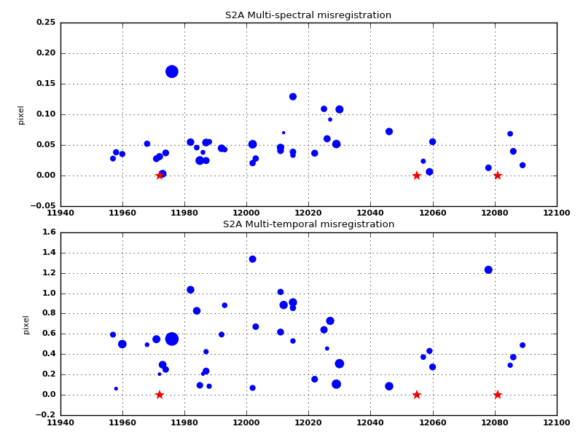
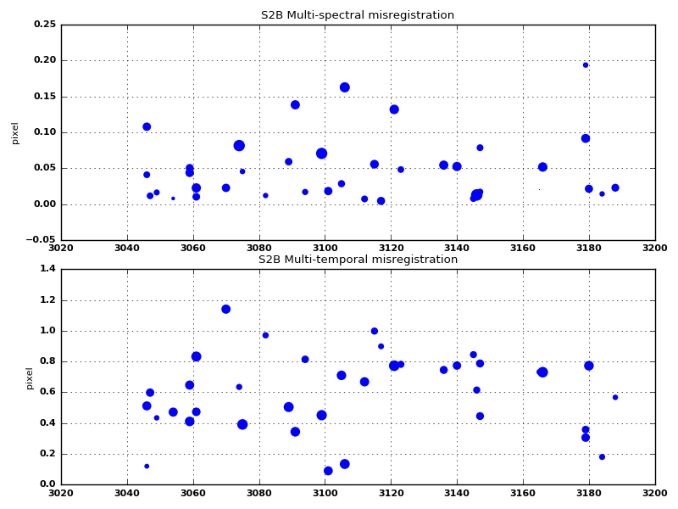
Sentinel 2 Geometric Calibration Experience
Sentinel 2 Geometric Calibration Experience
Anomalies
On-board anomalies have led to temporary degradation of the geolocation performance at the beginning of the mission
Most recent one due to a sub-optimal alignment of the redundant Star Tracker head (August 2016)
No anomaly impacting geometric performance since then
Geometric performance is continuously monitored in real time for S2A and S2B
Notes:
Illustration s2check plots (me)

Slide 18
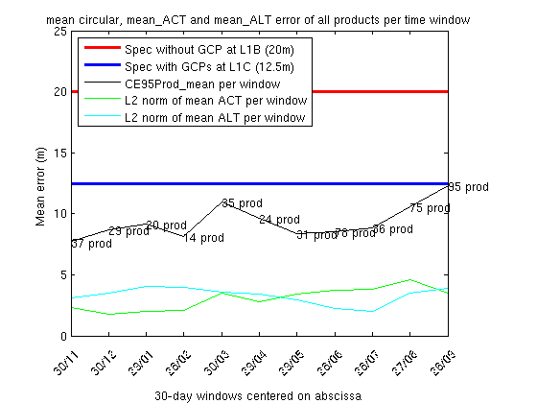
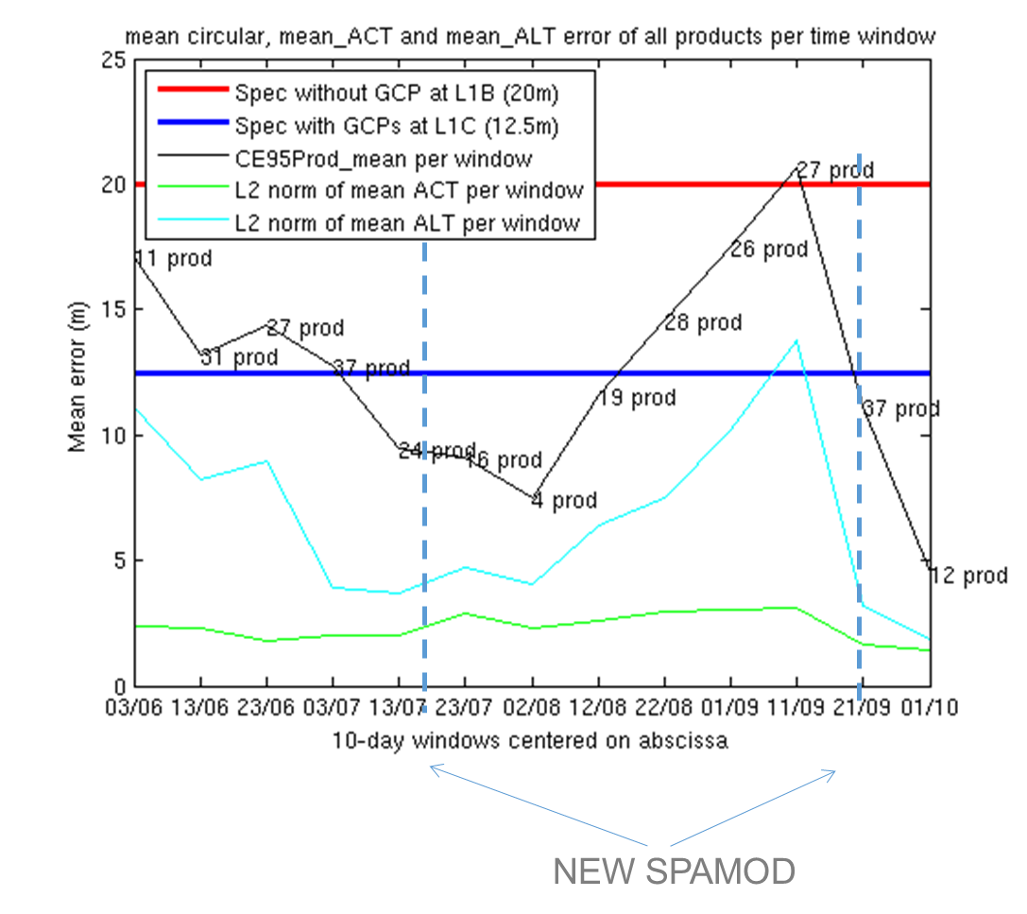
Sentinel 2 Geometric Performances
Sentinel 2 Geometric Performances
Absolute Geolocation
Current best estimate: S2A: 10.5 m – S2B: 11.1 m
Performance computed over a sliding window
Geometric calibrations
S2A
S2B
Notes:
TBW Thales

Slide 19
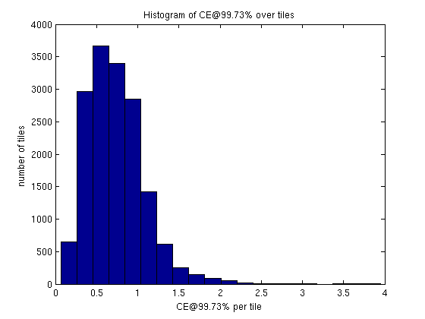
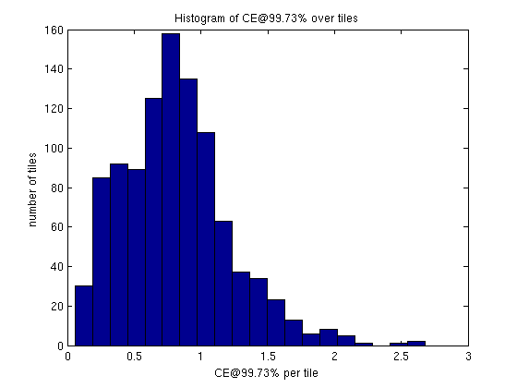
Sentinel 2 Geometric Performances
Sentinel 2 Geometric Performances
Multi-temporal Geolocation
Current best estimate: S2A: 11. 5 m – S2B: 13.8 m
Histogram of co-registration performance (in pixels at 99.7%)
S2A
S2B
Notes:
TBW Thales

Slide 20
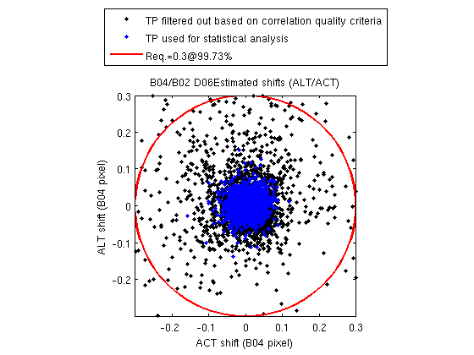
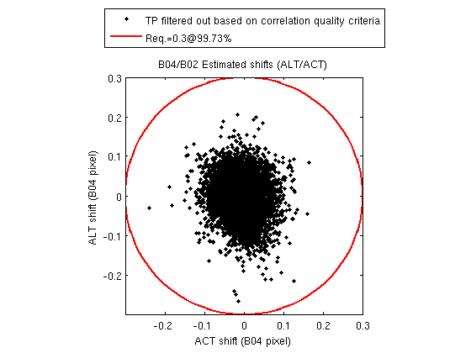
Sentinel 2 Geometric Performances
Sentinel 2 Geometric Performances
Multi-spectral co-registration
Measured worst-cases among band couple: S2A: 0.21 pixels – S2B: 0.18 pixels at 99.7%
Example for visible bands (B02/B04)
S2A
S2B
Notes:
TBW Thales

Slide 21
Sentinel 2 Geometric Calibration
Sentinel 2 Geometric Calibration
How to facilitate the combined use of Sentinel 2 and Landsat ?
Use common conventions to define geometric performance
Use of a common projection system (cf. HLS project)
Use of a common Global Reference Image
Use of a common DEM
Systematic monitoring of co-registration performance
Notes:
To be reviewed by Airbus

