Slide 1
S2 Cal/Val Overview
Sentinel-2 Cal/Val Overview
Ferran Gascon on behalf of Sentinel-2 Data Quality Team
Sioux Falls, 13 November 2017

Slide 2
Outline
Sentinel-2 Cal/Val Overview (Ferran Gascon)
Sentinel-2 Radiometry Cal/Val (Bruno Lafrance)
Sentinel-2 Geometry Cal/Val (Sébastien Clerc)
B11
Band 11

Slide 3
Mission Status / Highlights
Both Sentinel-2A and -2B operational.
Systematic coverage of Europe, Greenland and Africa every 5 days, and rest of the World every 10 days.
Surface reflectance product (Level-2A) over Europe distributed since 2nd May 2017.
Completed reprocessing of Sentinel-2A commissioning phase products.
All products available through Copernicus Open Access Hub:
http://scihub.copernicus.eu
B11
Band 11

Slide 4
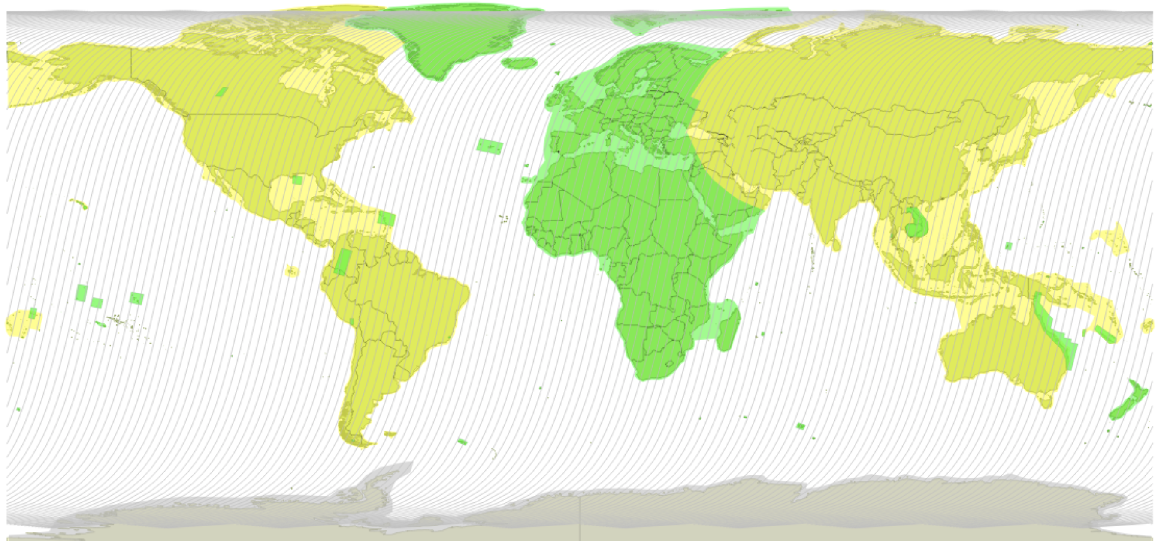
Mission Status / Revisit

Slide 5
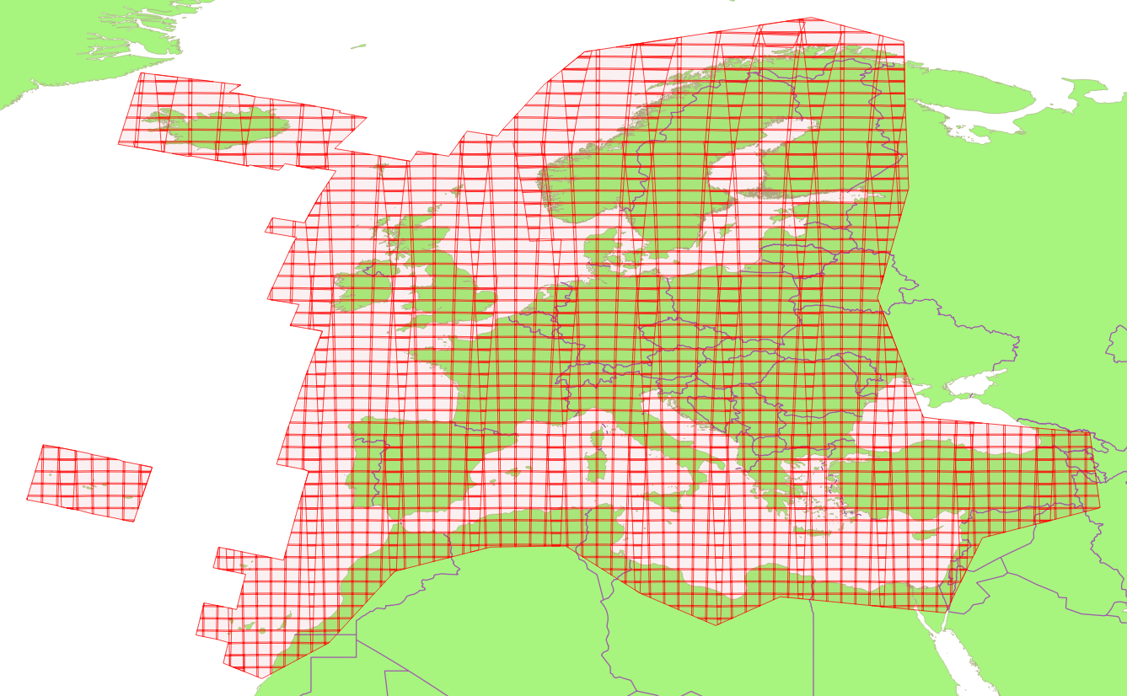
Mission Status / Surface Reflectance
Notes:
The Sen2Cor processor (version 2.4.0) is generating bottom-of-atmosphere (BOA) reflectance products.
It generates daily up to 300GB of L2A products (~600 Tiles per Day).
L2A products are made available as from 02 May 2017 through http://scihub.esa.int
Products granularity of L2A is the same as L1C available on SciHub.

Slide 6
Mission Status / Next Steps
Q4 2017: Global 5-day revisit using 4th ground station (Inuvik, Canada) and/or EDRS (European Data Relay System).
29-31 January 2018: 2nd Sentinel-2 Validation Team Meeting.
2018: Completion of the conversion of Sentinel-2 archive into new tile format.
2018: Operational Level-2A global production.
2019: Start reprocessing of all archived data (~5PB) with geometry-refining (using GRI) and operational L2A processor.
B11
Band 11

Slide 7
Data Quality / Products Evolution
October 2017: New Processing Baseline 02.06 since end of October. Change of naming convention (product discriminator).
2018: Start of the geometry-refined production using GRI (Global Reference Image) to reach multi-temporal registration of 0.3 pixels CE95.
2018: Usage of better DEM to improve geolocation over mountainous regions.
2018: Masks in raster format.
Under assessment: Offset on reflectances.
B11
Band 11

Slide 8
Data Quality / Last Year Events
Decontamination
Jan 2017
Decontamination
Jul 2017
S2A Routine Operations
Decontamination
May 2017
Decontamination
Nov 2017
S2B Commissioning
S2B Routine Ops
S2A 02.04
S2A 02.05
S2A 02.06
S2B 01.01
S2B 02.05
S2B 02.06
6 Dec 16
Compact
naming
7 Mar 17
S2B Launch
19 Apr 17
30 May 17
15 Jun 17
23 Oct 17

Slide 9
Data Quality / L1C Product Performances
Next two presentations...
B11
Band 11

Slide 10
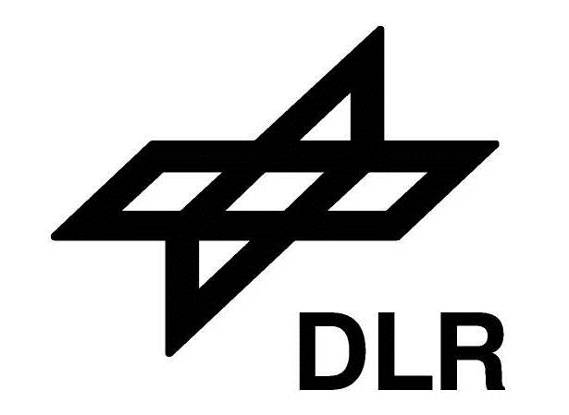
Data Quality / The Team
Team in charge of all aspects related to data quality (including algorihtms and products evolution, cal/val and quality control)
S2 MPC (Mission Performance Centre)
Ferran Gascon (ESA)
Enrico Cadau (ESA)
Roberto De Bonis (ESA)
Laëtitia Pessiot (CSSI)
Sébastien Clerc (ACRI-ST)
Catherine Bouzinac (CSSI)
Dimitra Touli-Lebreton (ADS)
Bruno Lafrance (CSSI)
Stéphane Massera (IGN)
Marion Neveu (TAS)
Aude Espesset (TAS)
Bahjat Alhammoud (ARGANS)
Sébastien Harasse (CSSI)
Jan Jackson (ARGANS)
Dimitra Tzigkari (ARGANS)
Alejandro García-Soto (DEIMOS)
David Ros (ACRI-ST)
Françoise Viallefont (ONERA)
Jérôme Louis (Telespazio)
Vincent Debaecker (Telespazio F)
Bringfried Pflug (DLR)
Magdalena Main-Knorn (DLR)
Uwe Müller-Wilm (Telespazio D)
Vincent Lonjou (CNES)
Florie Languille (CNES)
Angélique Gaudel-Vacaresse (CNES)
Jean-Louis Raynaud (CNES)
Emmanuel Lourme (CNES)

Slide 11
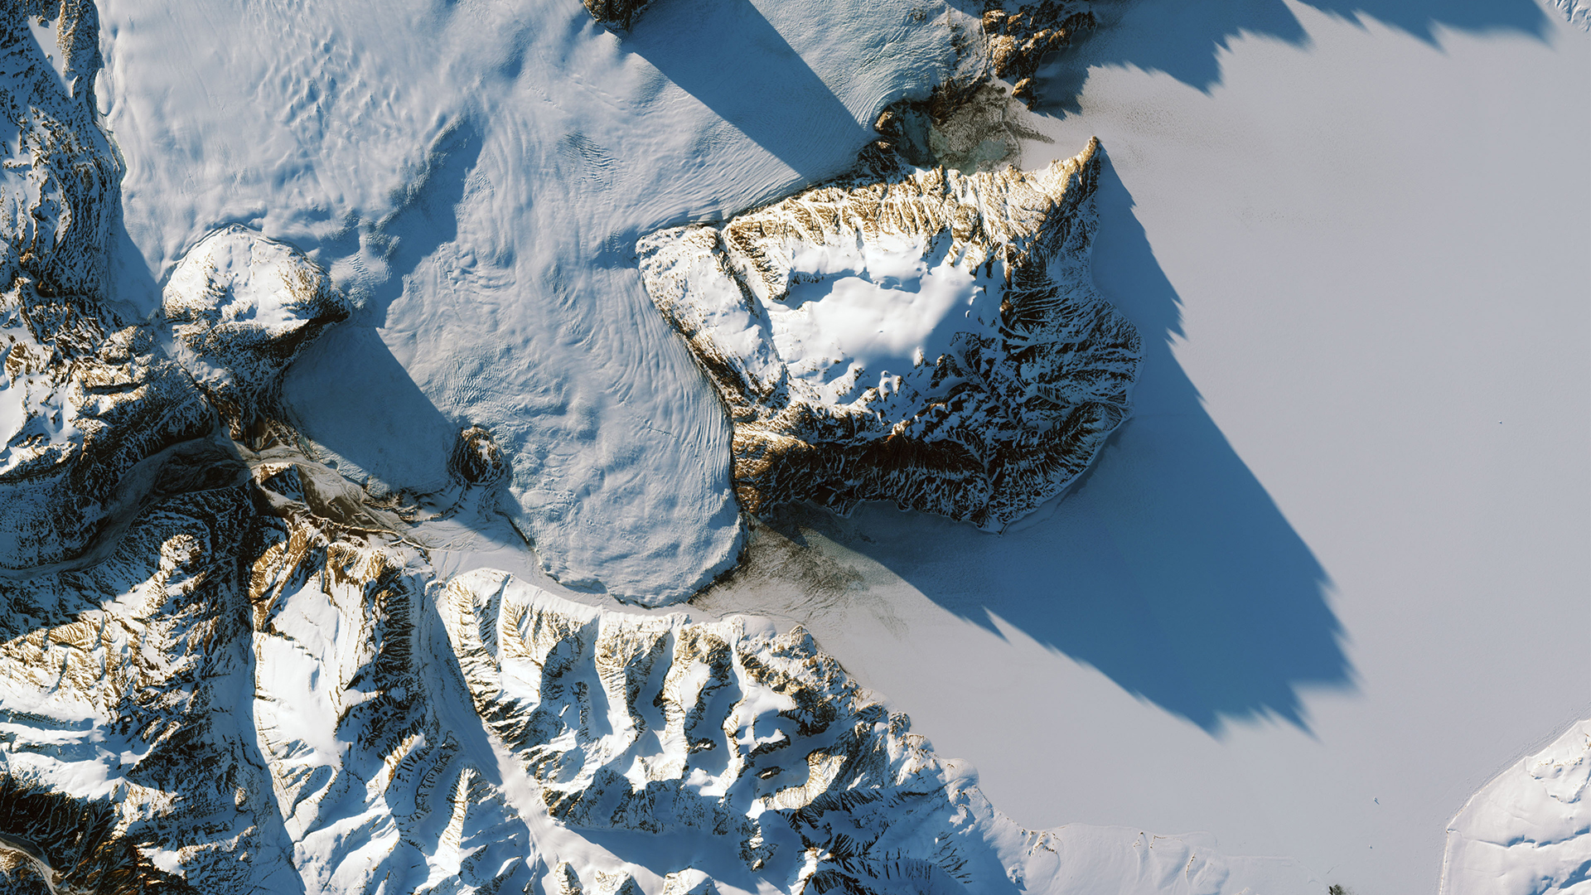
S2 image of a glacier
http://sentinels.copernicus.eu

