Slide 1
ECCOE workshop
Date
Presented By:
Name
Position, Organization
Email, Phone #
What is this all about?

Slide 2
ECCOE Workshop

Slide 3
ECCOE Vision
The EROS Calibration Center of Excellence (ECCOE) is recognized nationally and internationally as a leading organization for effectively improving the accuracy, precision, and efficiency of radiometric, geometric, and spatial characterization, calibration, and cross-calibration of optical remote sensing systems to achieve the highest degree of interoperability of remote sensing data products."

Slide 4
ECCOE Mission
Develop advanced methods to perform radiometric/geometric/spatial characterization and calibration of optical remote sensing systems to improve the accuracy and precision of all derived data products.
Develop new and improved methods for the cross-calibration of optical remote sensing systems for continuous improvement of the interoperability of remote sensing data products.
Provide the expertise and advocacy necessary for the acquisition of new measurements that continue to improve optical remote sensing data quality, coverage, and expanded usefulness for science applications.
Develop mutually beneficial partnerships within USGS/DOI, across other government agencies, and throughout the industry.

Slide 5
Generic ECCOE Structure

Slide 6
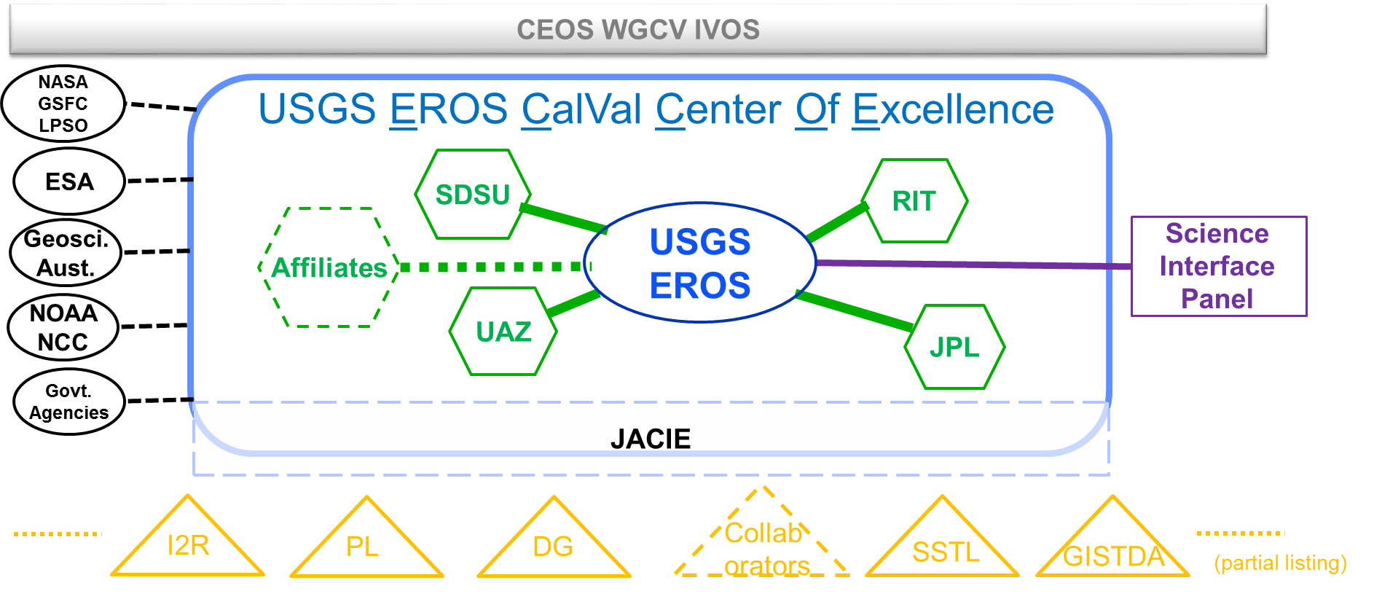
ECCOE Structure – Current

Slide 7
ECCOE Structure & Personnel – USGS EROS
Director – Dennis Helder
Subject Matter Experts
Cody Anderson
Mike Choate
Jon Christopherson
Obaidul Haque
Minsu Kim
Mark Lubke
Esad Micijevic
Tom Stone, USGS Flagstaff
Web/PR/Admin. Support
Anya Hartpence
Ron Morfitt
Rajagopalan Rengarajan
Aparajithan Sampath
Pat Scaramuzza
Greg Stensaas
Jim Storey
Chris Crawford, Science liaison

Slide 8
ECCOE Structure & Personnel – Affiliates
University of Arizona
Nik Anderson
Stu Biggar
Jeff Czapla-Myers
Students
South Dakota State University
Larry Leigh
Morakot Kaewmanee
Cibele Teixeira Pinto
students
Rochester Institute of Technology
Aaron Gerace
Matt Montanero
John Schott
Nina Requeno
Emmett Ientilucci
students
Jet Propulsion Laboratory
Simon Hook

Slide 9
ECCOE Events
ECCOE supports calibration conferences
Sessions at CALCON, IGARSS, JACIE, Pecora, SPIE
ECCOE Workshop
Annual event
Topical focus
Develops recommended practices
Publishes proceedings
Conducts CalVal Future Directions session each year
Venue: JACIE or Pecora

Slide 10
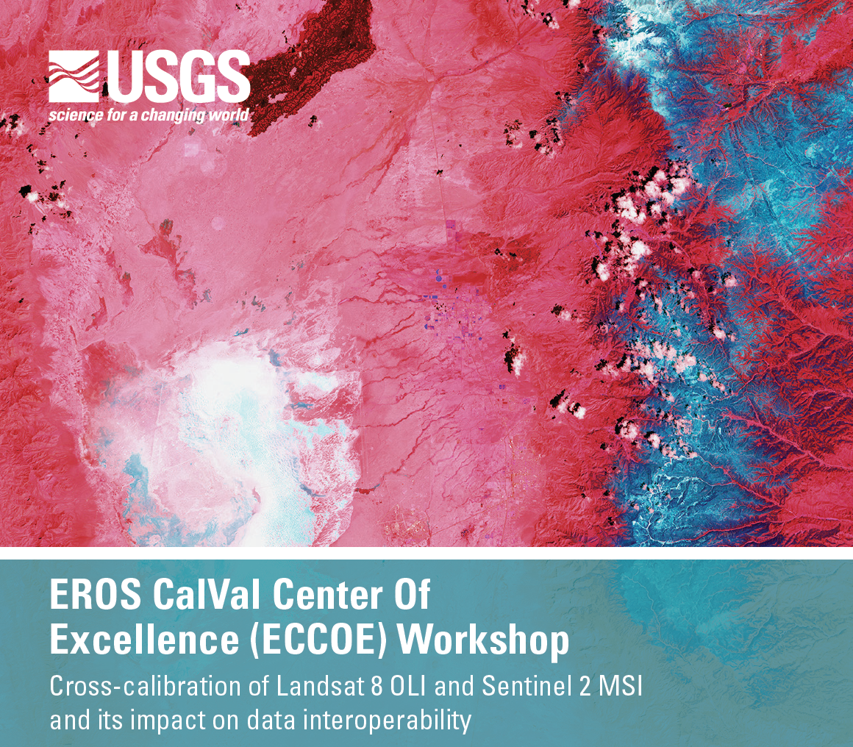
ECCOE Workshop

Slide 11
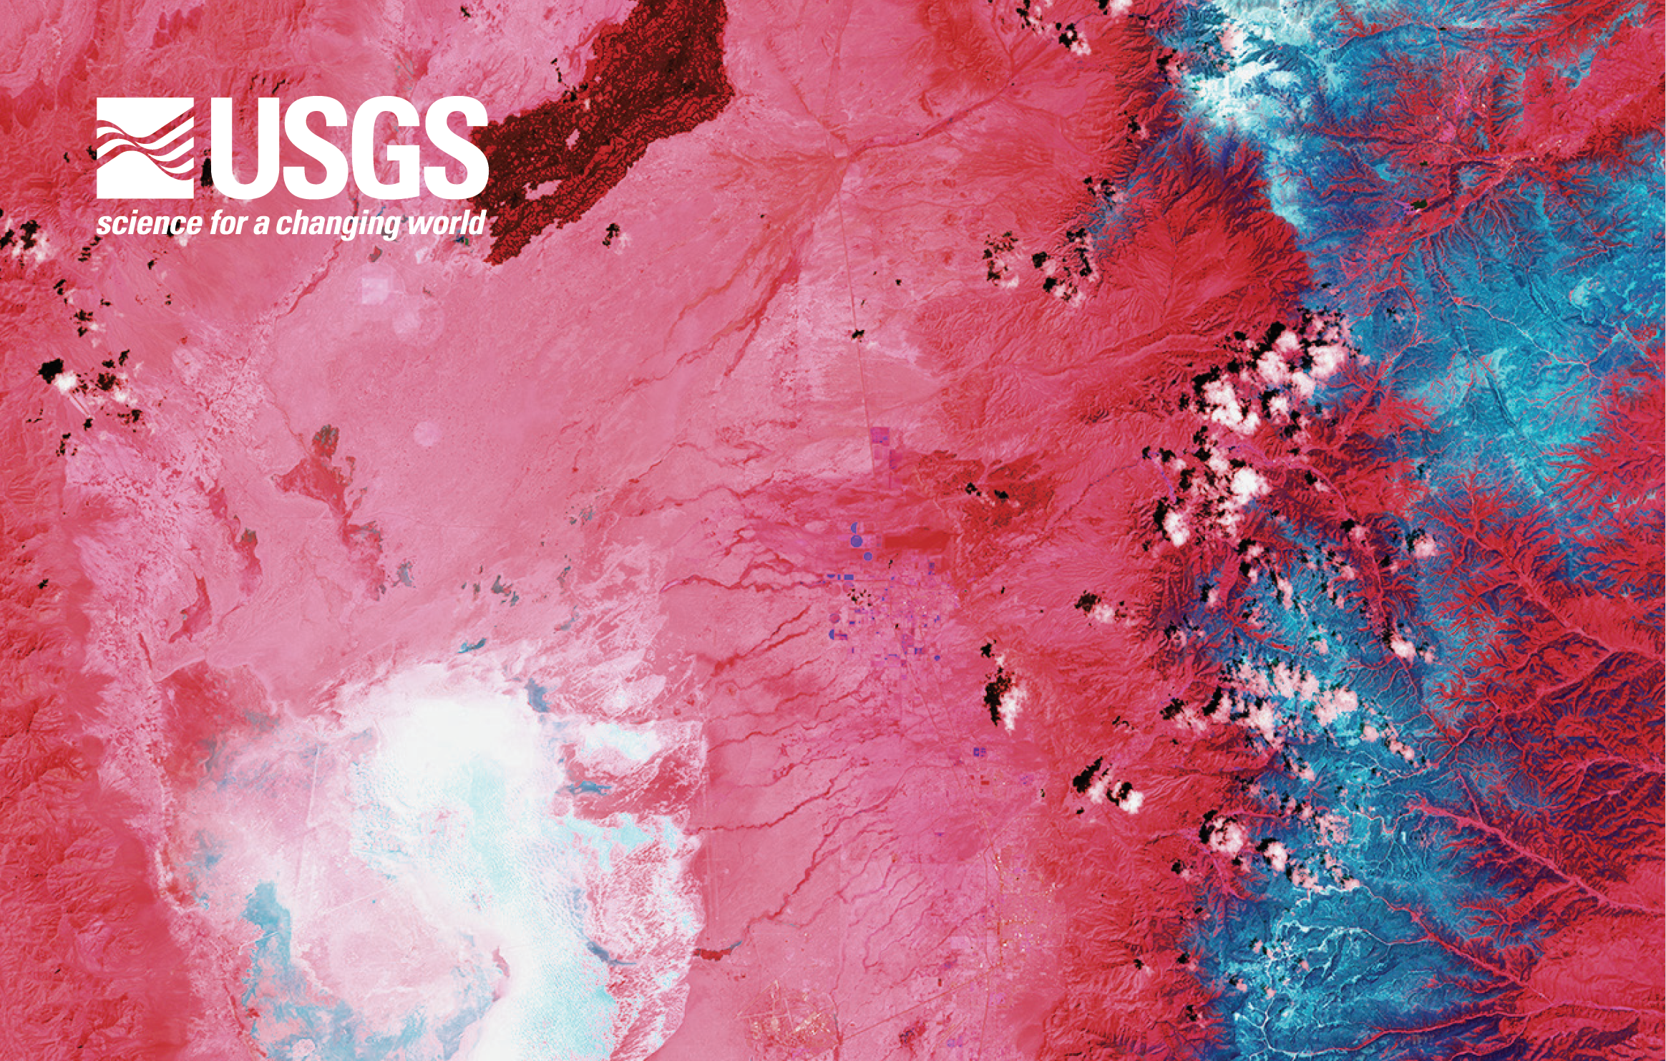
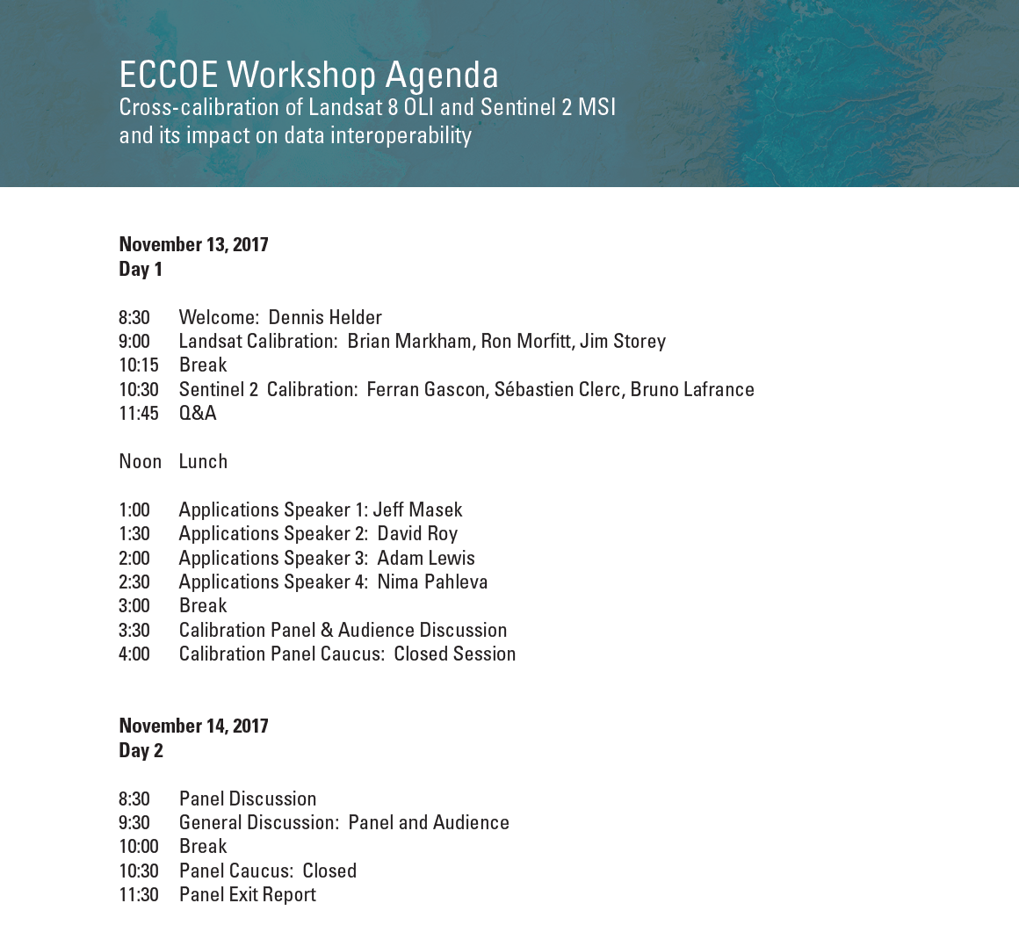
ECCOE Workshop

Slide 12
ECCOE Workshop

Slide 13
ECCOE Workshop
Key Questions:
How well do we know the radiometric and geometric calibration of Landsat 8 OLI and Sentinel 2ab?
How well do we know the cross-calibration between these sensors?
How does the cross-calibration of these sensors affect interoperability of the data products derived from them?
What are our recommendations for future calibration efforts to improve the interoperability of data and data products?

Slide 14
ECCOE Workshop
Charge to the Panel Members:
Please carefully review the Concept, Key Questions, Agenda, and Outcomes for the workshop.
Prepare a 25 minute presentation that addresses your specific area of expertise and addresses the key questions of the workshop.
Be ready to discuss key aspects of cross-calibration of Landsat and Sentinel 2 as they relate to data interoperability.
Prior to the meeting, consider specific recommendations that you'd like to see come out of this workshop.

Slide 15
ECCOE Workshop
Who are the Panel Members?
Landsat Calibration Team
Brian Markham
Ron Morfitt
Jim Storey
Sentinel 2 Calibration Team
Sebastien Clerc
Ferran Gascon
Bruno LaFrance
Applications Scientists
Adam Lewis
Jeff Masek
Nima Pahlevan
David Roy

Slide 16
ECCOE Workshop
Outcomes:
Better understanding of the cross-calibration of Landsat and Sentinel 2.
Recommendations for further cross-calibration of these sensors to improve data interoperability.
Recommendations for cross-calibration of other optical remote sensors to improve data interoperability.
Publication of workshop results.

Slide 17
ECCOE Workshop
LET’S BEGIN!

