Slide 1
Sentinel-2 Radiometry Cal/Val
Sentinel-2 Radiometry Cal/Val
Bruno Lafrance with contributions from MPC Team
Bahjat Alhammoud
Dimitra Touli Lebreton
and from Vincent Lonjou (CNES)
ECCOE, Sioux Falls, 2017 Nov. 13th & 14th

Slide 2
S2 Radiometric calibration
How is performed the radiometric calibration of S2 MSI
Nominal calibration performed by using the on-board sun-diffuser ➔ Absolute gain monitoring per band ➔ Relative gains monitoring (inter-detector pixel variations per detector module and band)
A validation is performed using vicarious methods
Mission requirements: the absolute radiometric uncertainty shall be better than 5% (target 3%)

Slide 3
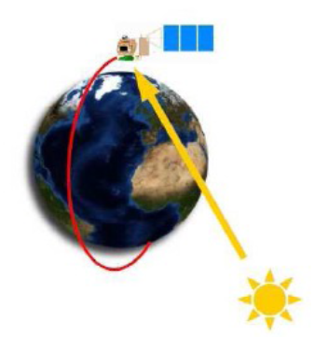
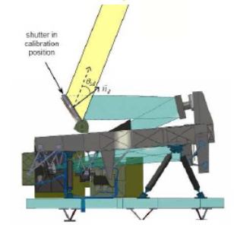
S2 Radiometric calibration
Nominal estimate of absolute gains based on sun-diffuser acquisitions
Measurements corrected with:
Dark correction + relative gain correction
(non-linearity and non-uniformity corrections)
Average ratio of detector pixel measurements over simulations
$$A\left(b\right)={\left\langle \frac{Z\left(p,ℓ,b,d\right)}{Z_{simu}\left(p,ℓ,b,d\right)}\right\rangle }_{}$$
Average over valid detector pixels
for each band b
Simulation
$$Z_{simu}\left(p,ℓ,b,d\right)={K_{slt}\left(b\right)×ρ_{BRDF}\left(p,θ_{S},φ_{S},b,d\right)×\frac{E_{sun}\left(b\right)×cos\left(θ_{S}\right)}{{{π×d}_{sun}\left(ℓ\right)}^{2} }}_{}$$
Stray-light perturbation
Sun-diffuser BRDF
Solar irradiance

Slide 4
S2 Radiometric calibration
Sun-diffuser Bidirectional Reflection Distribution Function characterization
On-ground test bench measurements ➔ sun-diffusers’ reflectance for each detector pixel (per band and detector module) for a set of different illumination angles and different viewing angles
First version of the BRDF characterization
Interpolations to define the BRDF per detector pixel
Fixed viewing angle per detector pixel
Nodes of illumination angles (SZA, SAA)
Refined version of the BRDF
Fitting a BRDF Rahman angular model
SZA (°): 59.5 61.0 62.5
SAA (°): 15 20 25 30 35

Slide 5
S2 Radiometric calibration
S2B absolute calibration : use of the initial sun-diffuser BRDF
VNIR absolute gains stable since Mid-April in a range of ±0.2%
B01 and B08 bands: variations up to 0.75% since first calibration
Not a real change of the sensor sensitivity
Variations due to a limitation of the sun-diffuser BRDF accuracy
Time variation of the SWIR band sensitivity is properly monitored
Decontamination allows retrieving the initial sensitivity level of SWIR bands and reduces the slopes of decrease with time
Decontamination
(May 3rd 2017)
Date

Slide 6
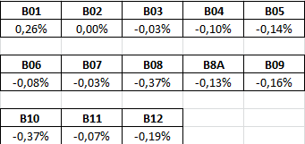
S2 Radiometric calibration
S2B absolute calibration : improvements by using a refined sun-diffuser BRDF model
Great improvement of the stability for the absolute gains estimate
A very good stability
Operationally applied since 2017 October 23rd
(older products will be reprocessed)
Temporal evolution of absolute gains for SWIR bands becomes smoother
Changes for the first acquisition (ref)
Decontamination
(May 3rd 2017)
Date

Slide 7
S2 Radiometric calibration
S2A absolute calibration : use of the initial sun-diffuser BRDF
A trend of sensitivity loss seems to be engaged for VNIR band
-0.6% to -0.9% depending on the band
Change of Earth-Sun distance calculation

Slide 8
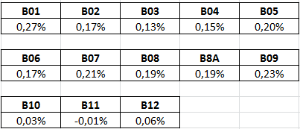
S2 Radiometric calibration
Operationally applied since 2017 October 23rd
(older products will be reprocessed)
S2A absolute calibration : use of the refined sun-diffuser BRDF
Trends of time evolution are much more similar for the different bands
Slight oscillations (low frequency) but a more apparent sensitivity loss with time for VNIR bands
Temporal evolution of absolute gains for SWIR bands becomes smoother
Changes for the first acquisition (ref)

Slide 9
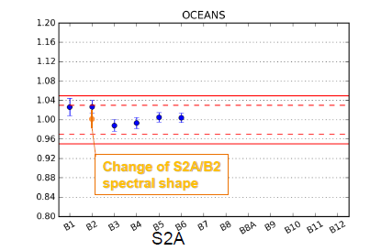
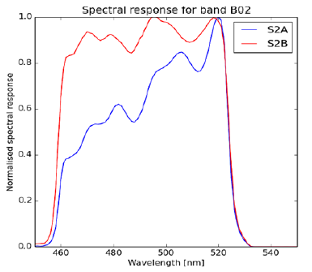
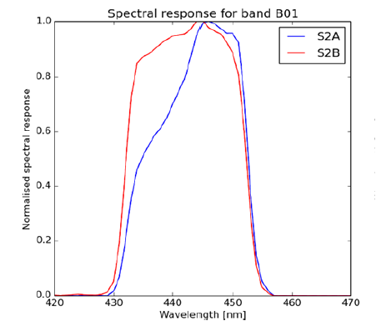
S2A spectral bands
Errors during the on-ground characterization for S2A spectral bands :
Spectral responses are being recalculated
B02 and B01 bands mainly impacted
Spectral response for band B02 (490 nm)
Spectral response for band B01 (443 nm)
CNES courtesy
CNES results:
Conversion of the Rayleigh method result for the B02 band by using the S2B spectral band definition rather than the S2A
Single test not significative to conclude the S2A band shape must be replaced by the S2B
Cross-check with other vicarious methods is necessary

Slide 10
S2 Radiometric validation
Validation by vicarious calibration methods
Absolute calibration method: Rayleigh signal over ocean / simulation
Interband calibration method: Sun-glint signal over ocean (not applied) ➔ geometric design avoid the sun-glint
Desert (PICS) calibration: Comparison TOA reflectance / simulation
Inter-sensor calibration method: Comparison TOA reflectance of sensors

Slide 11
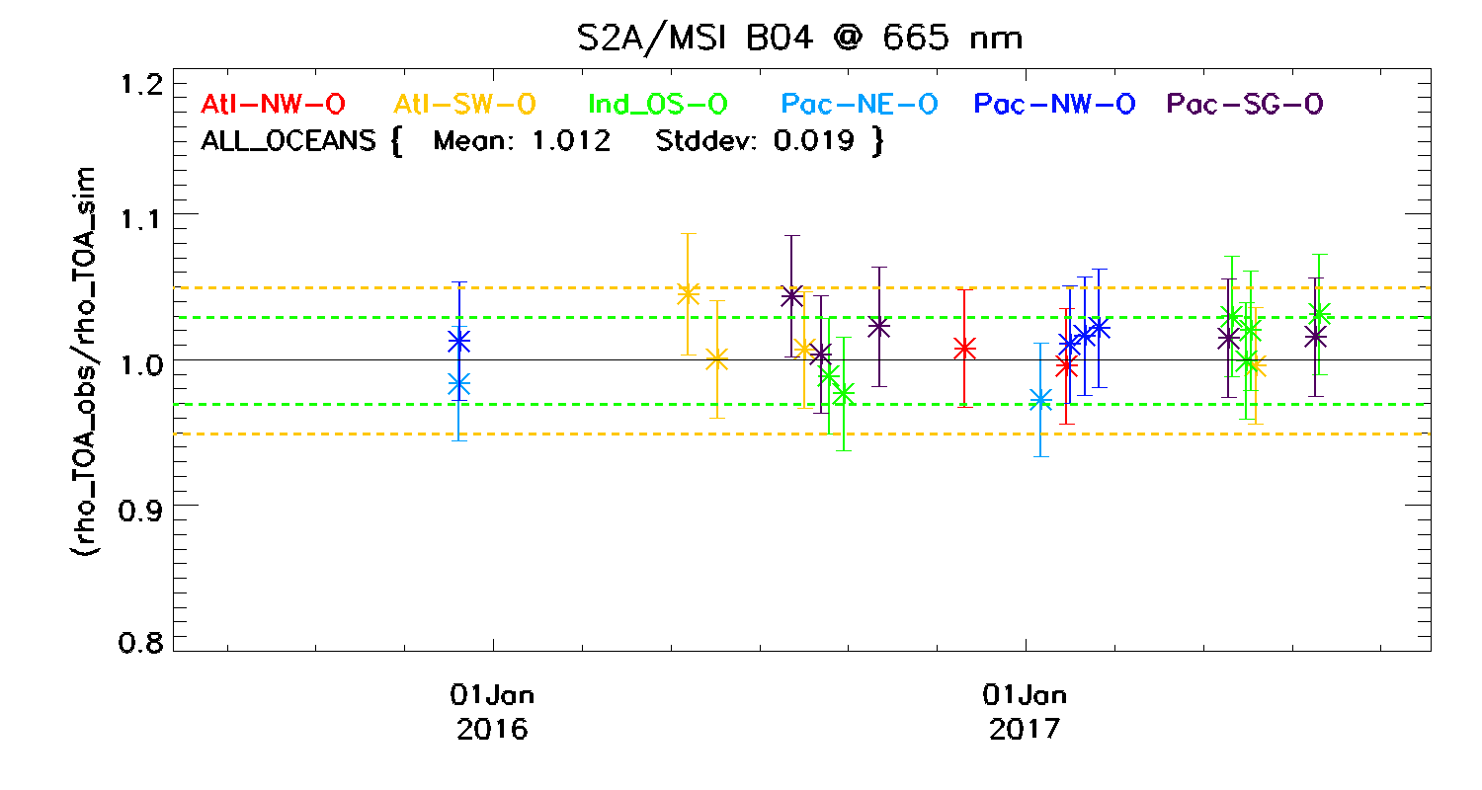
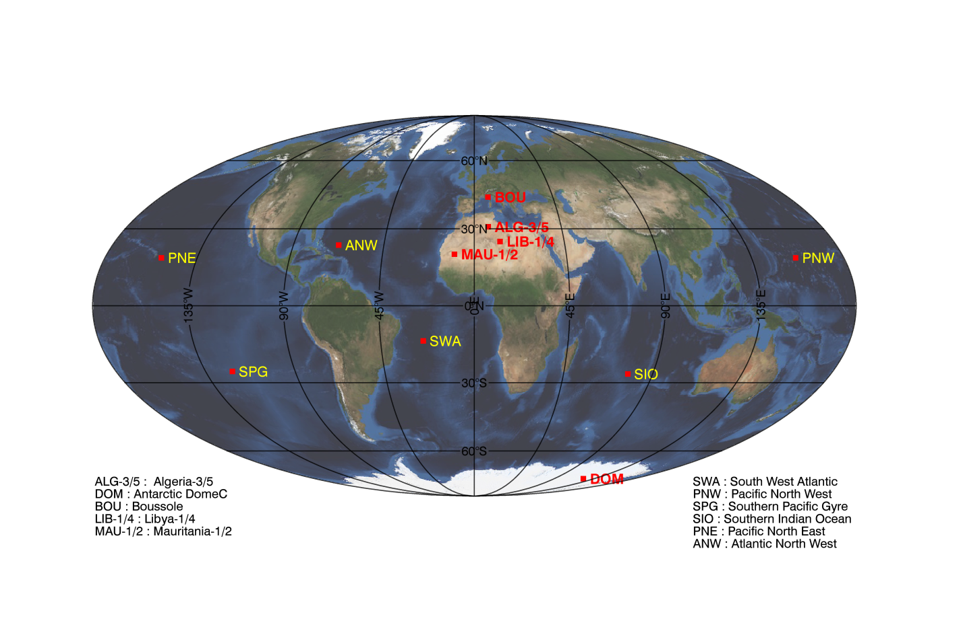
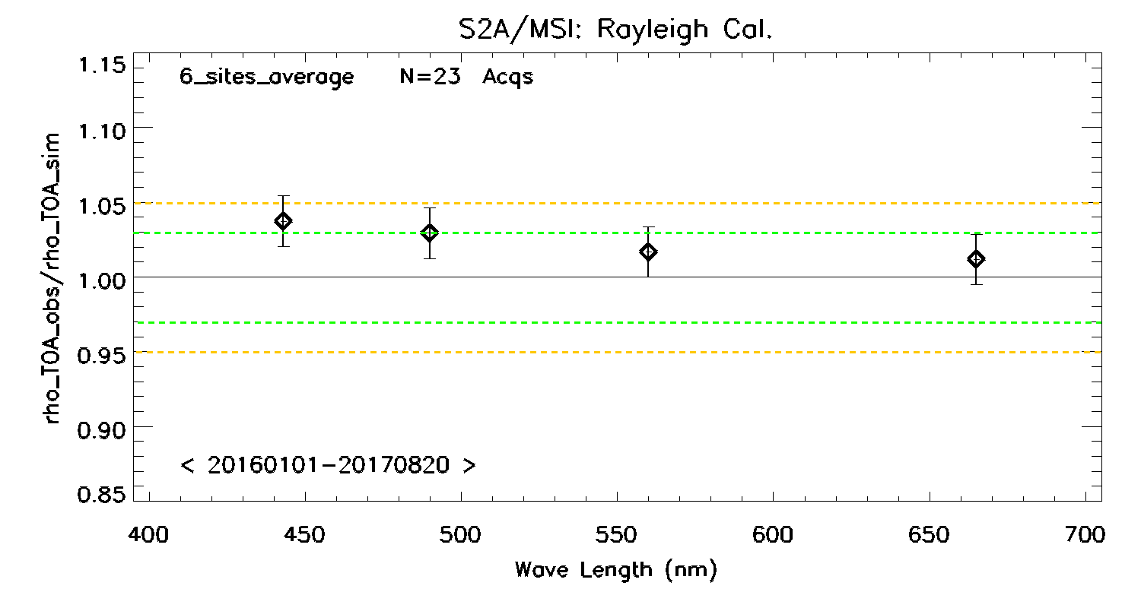
S2 Radiometric validation
Focus on Rayleigh calibration results over S2A
TOA observation
Average value : 0.1° x 0.1°
Aerosol filtering (NIR threshold)
Vicarious CalVal Ocean sites (yellow)
Simulation
Solar irradiance : Thuiller 2003
Water leaving radiance : Morel and Maritorena (2001)
LibRadtran code
$${ρ_{}^{TOA}}_{obs}$$
$${ρ_{}^{TOA}}_{sim}$$

Slide 12
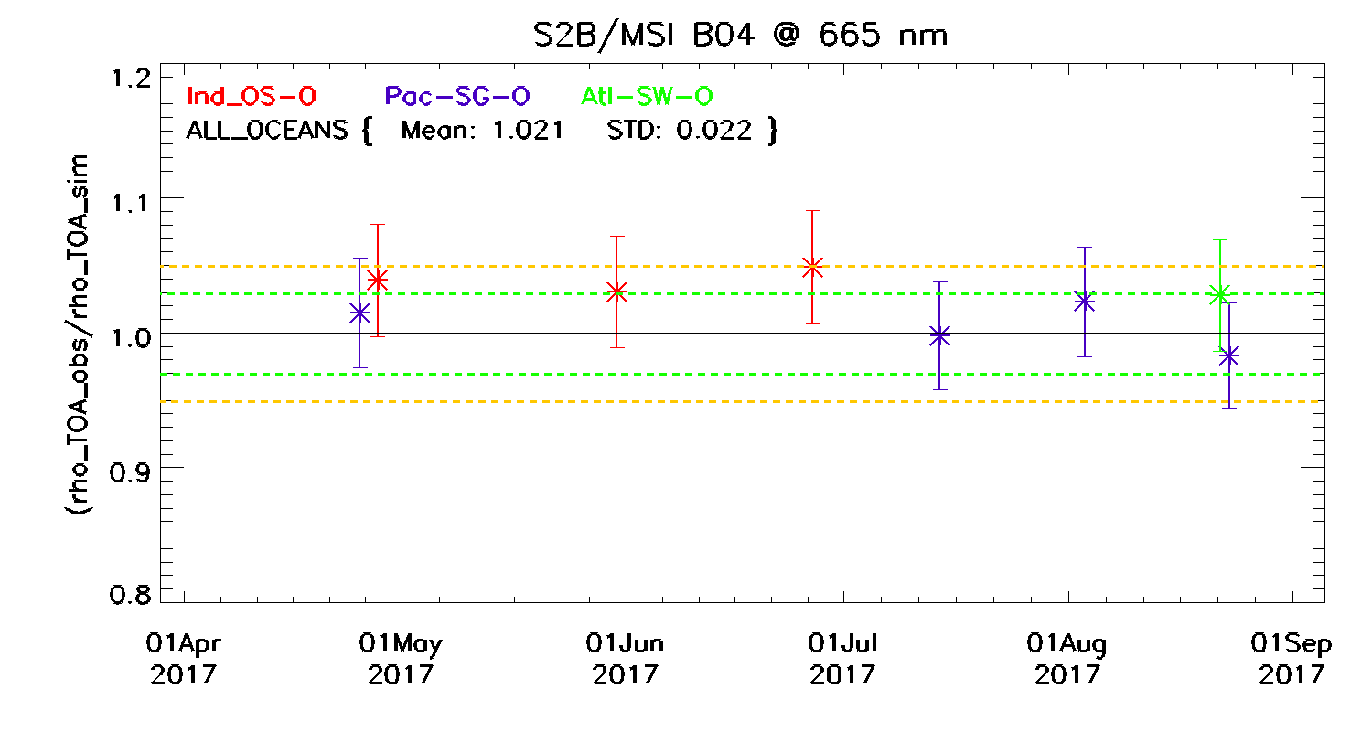
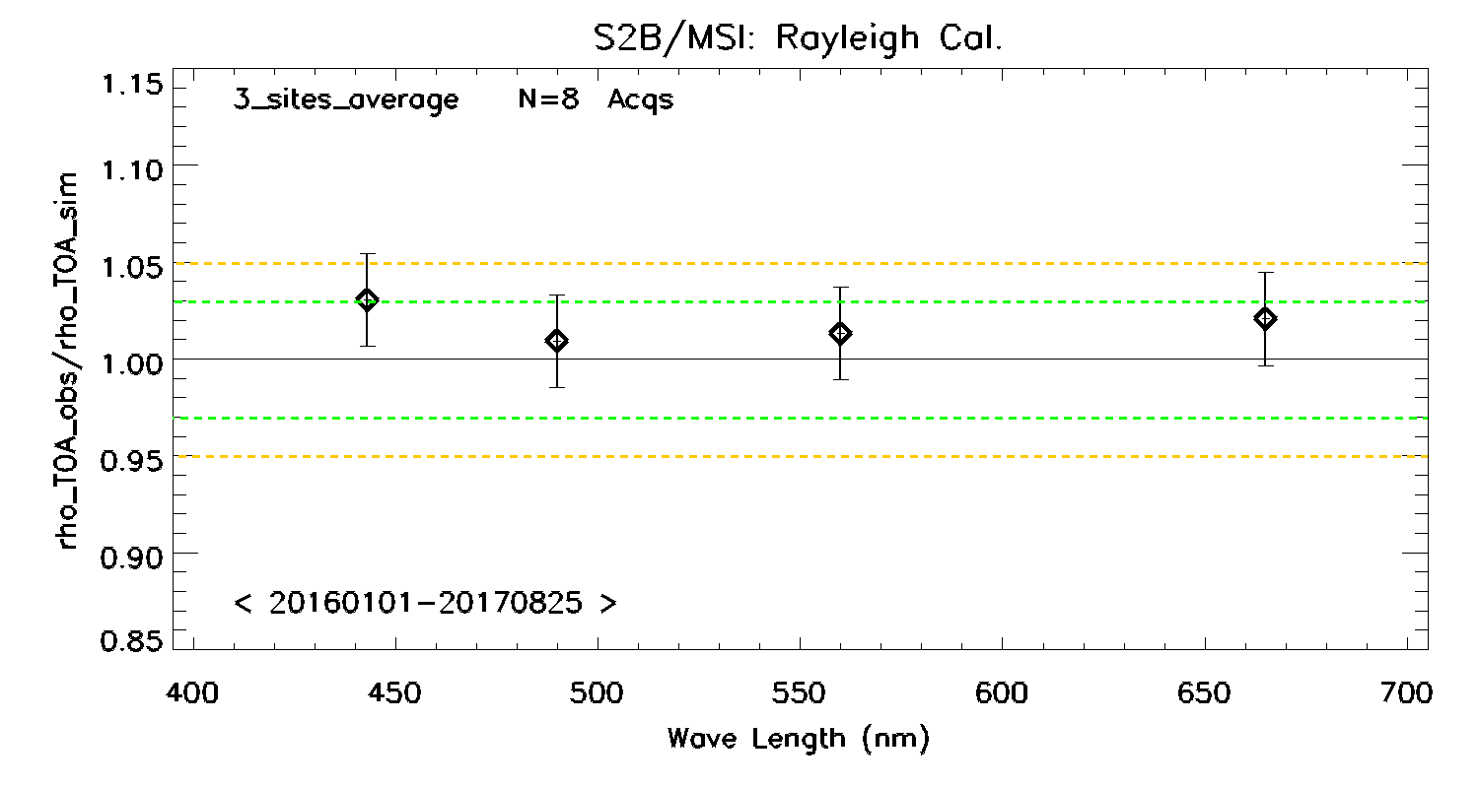
S2 Radiometric validation
Focus on Rayleigh calibration results over S2B
Preliminary results
over 4 months
8 acquisitions
Vicarious CalVal Ocean sites (yellow)

Slide 13
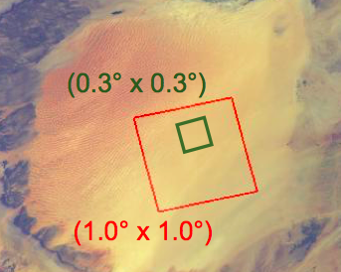
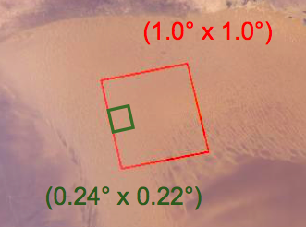
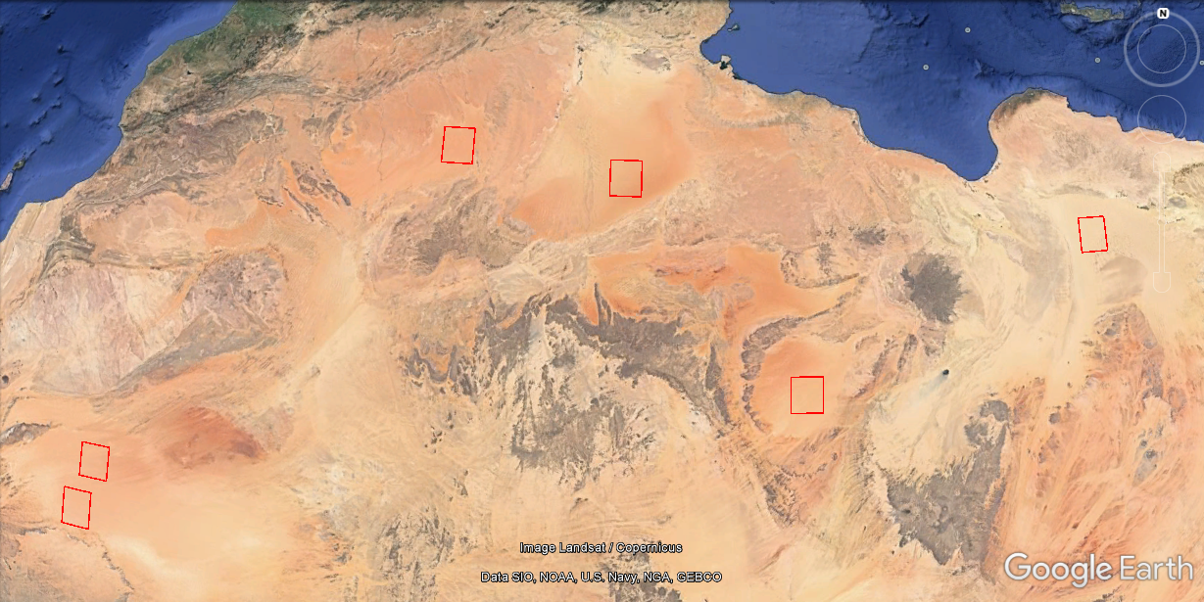
S2 Radiometric validation
Desert sites calibration over 6 CEOS-PICS: Sub-region used for S2A, S2B and LANDSAT
Algeria-5
Algeria-3
Libya-4
Mauritania-2
Libya-1
Mauritania-1

Slide 14
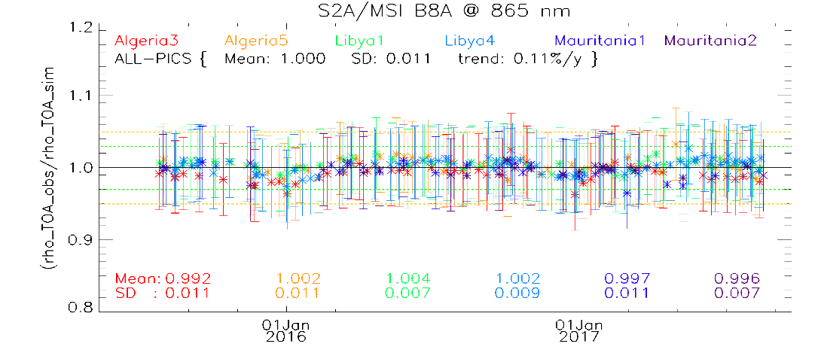
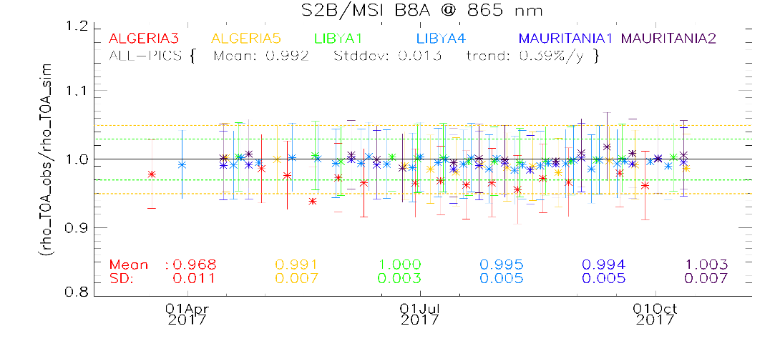
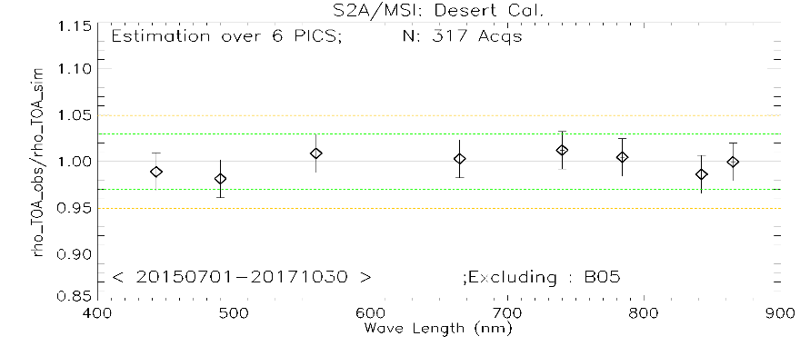
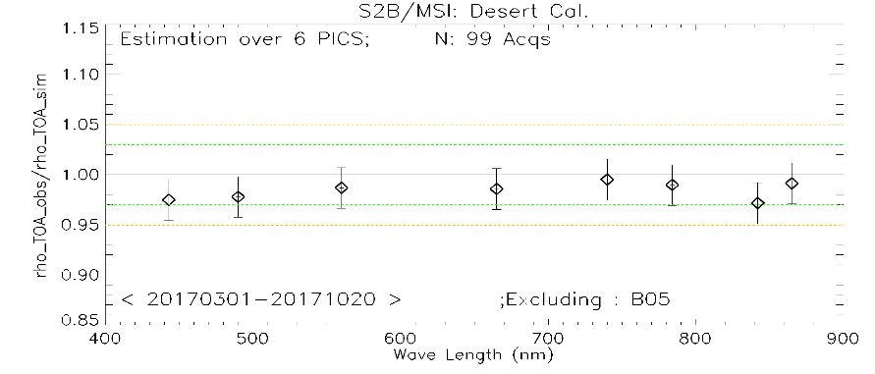
S2 Radiometric validation
Bouvet 2014 method:
BOA BRDF built from MERIS data
Simulation of the TOA observation for
- MSI acquisition geometry
- Ozone and WV content from ECMWF
- Constant AOT
Focus on desert sites calibration over S2A & S2B

Slide 15
S2 Radiometric validation
Focus on Sensor-to-Sensor TOA reflectance comparison over S2A & S2B & LS8
Results without any processing (only selection criteria)
S2A/LS8 N#: 63
S2B/S2A N#: 43
Consistency in a range of 5% depending on the site
MSI-A reflectance > OLI reflectance
Consistency in a range of 2% depending on the site
MSI-A reflectance > MSI-B reflectance by ~ 1%

Slide 16
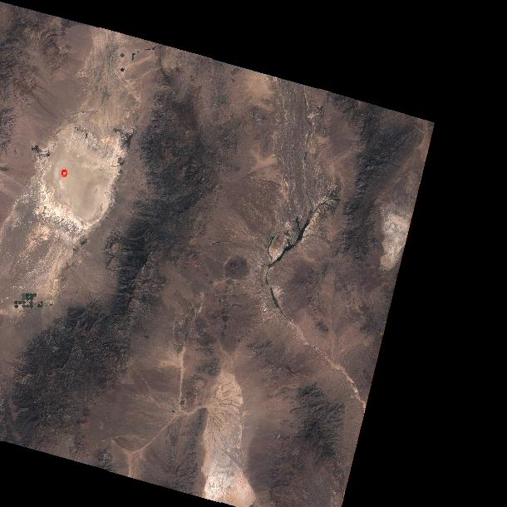
S2 Radiometric validation
Focus on In-situ measurements: 23 overpasses are provided by NASA via ESA
23/08/2015
Average value 1 x 1 km²
Simulation from University of Arizona
${ρ_{}^{TOA}}_{obs}$ / ${ρ_{}^{TOA}}_{sim}$
RRV site: S2A/MSI-L1C (Tile : T11SPC)
945 nm
(water vapor)

Slide 17
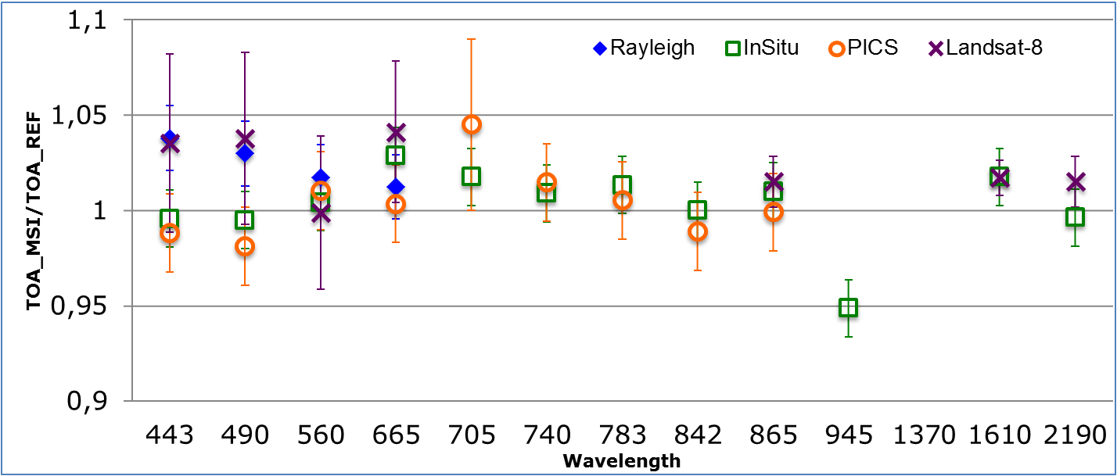
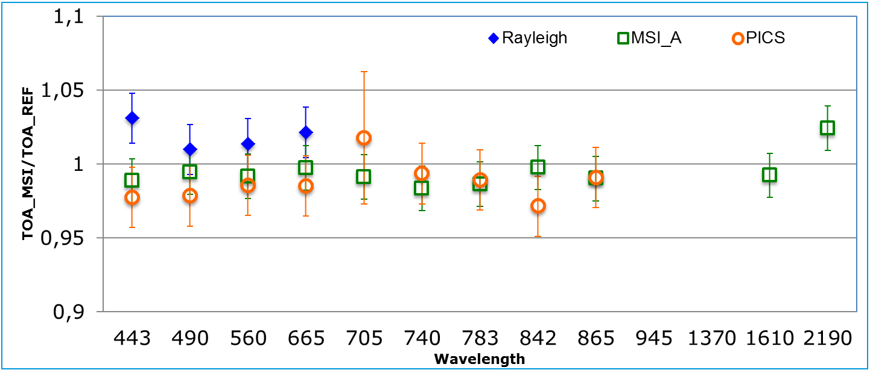
S2 Radiometric validation
S2A
Overall methods results
Discrepancies between methods < 5%
MSI reflectance > OLI reflectance
MSI-B reflectance < MSI-A reflectance (~1%)
S2B

Slide 18
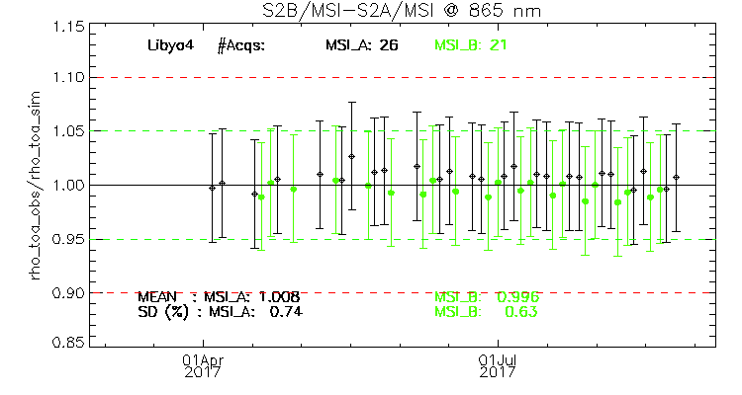
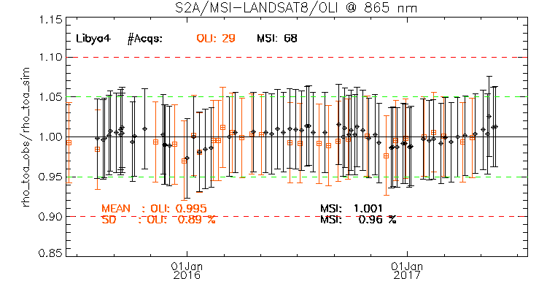
S2 inter-sensors comparison
Focus on PICS method: S2A, S2B, LS8 inter-comparison
MSI-A reflectance > MSI-B reflectance
Some coincident validation points match quite well between MSI-A & OLI at 865 nm

Slide 19
S2 inter-sensors comparison
Focus on PICS method: S2A, S2B, LS8 inter-comparison
Same spectral shapes of calibration results for MSI-A & MSI-B (except B02 band : Spectral response impact is under investigation)
Good consistency in a range of 1-2% between OLI & MSI (except for B01 band)

Slide 20
To conclude
Summary
Absolute gains are stable (VNIR bands) and properly monitored by sun-diffuser acquisitions
Validation activities check operational calibrations
A shift by about 1% is measured between most of S2A / S2B bands
A good calibration agreement of TOA reflectance between S2 & L8 (1-2%)
A refinement of S2A spectral characterization is in progress
How to improve calibration approaches for a better data interoperability of S2 & L8 ?
Confirm we compute calibrations with the same solar irradiance model and Earth-Sun distance
Perform vicarious calibrations over same sites, using same spectral characterization of the targets, same atmospherical parameters (same RT code), quasi-simultaneous observations
Thank you for your attention!

