Slide 1
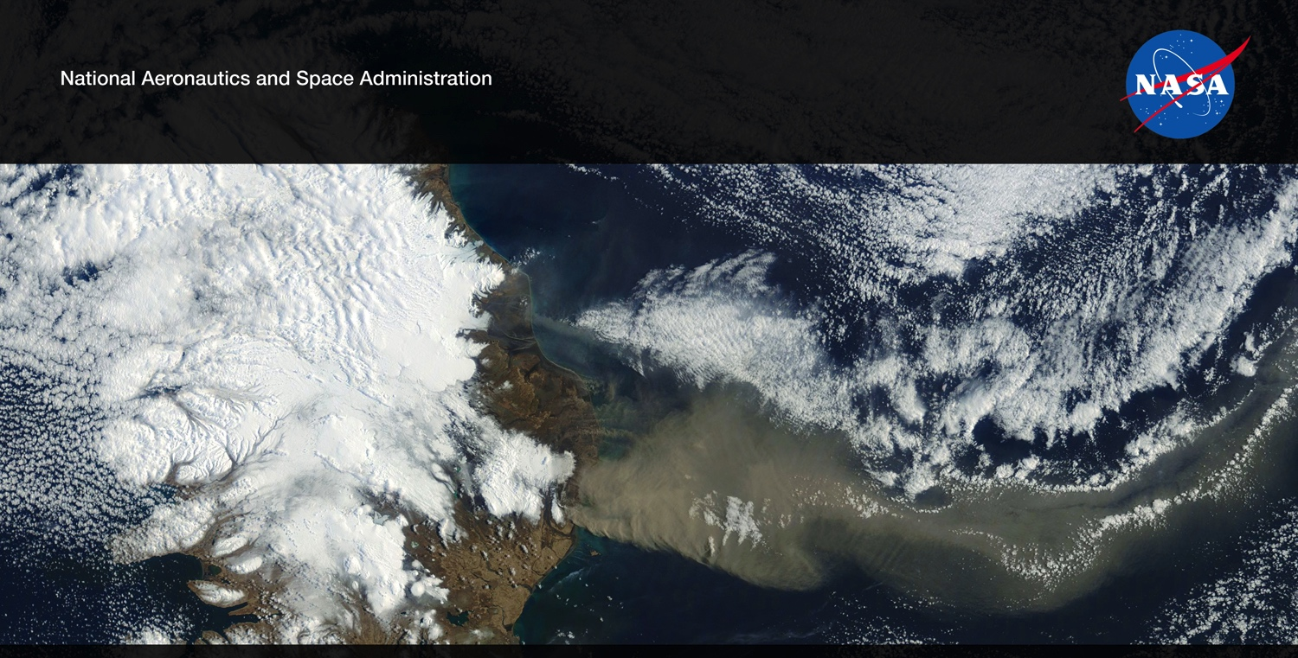
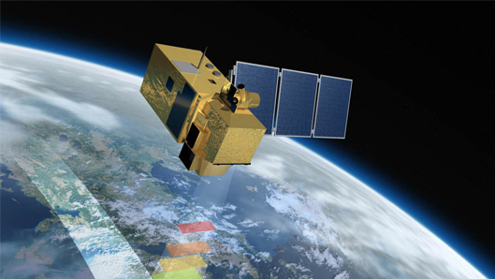
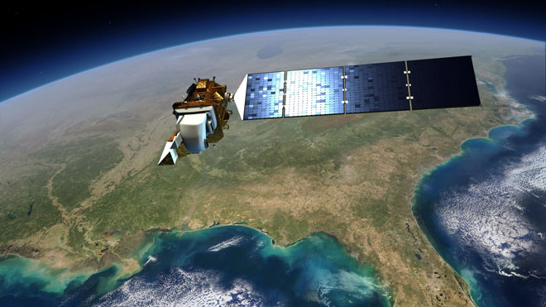
Harmonized Landsat 8 and Sentinel 2 (HLS)
Future US Land Imaging
Jeffrey Masek, NASA GSFC
Experiences with Harmonization of Landsat & Sentinel-2 Data
Jeff Masek, Junchang Ju, Eric Vermote, NASA GSFC
Martin Claverie, Jean-Claude Roger, Sergii Skakun, Chris Justice, University of Maryland
Jennifer Dungan, NASA ARC
Pecora Cross Calibration Workshop
Presentation contains modified Copernicus Sentinel data (2015-17) processed by ESA
NASA Agency Update – CEOS LSI-VC-2
July 20-22, 2016
Dave Jarrett, NASA HQ
Jeff Masek, NASA GSFC

Slide 2
Multi-source Data for Land Science
  Time series observations increasingly central to land monitoring
  Inter-annual disturbance, land use change
  Intra-annual phenology, vegetation condition, agriculture
  Desire for a “Daily 30m” capability
Harnessing the diversity of international remote sensing systems can provide this capability, at a fraction of the cost of a new mission
Courtesy C. Woodcock/USGS

Slide 3
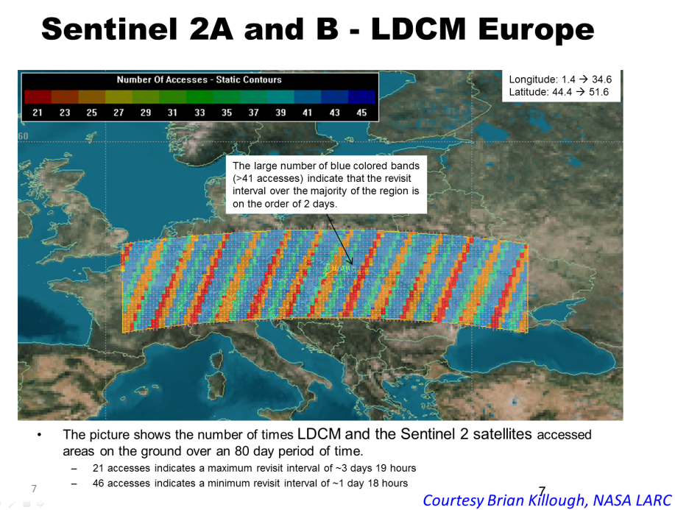
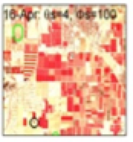
Harmonized Landsat Sentinel-2 (HLS) Project
Merging Sentinel-2 and Landsat data streams can provide 2-3 day global coverage
Goal is “seamless” near-daily 30m surface reflectance record including atmospheric corrections, spectral and BRDF adjustments, regridding
Project initiated as collaboration among GSFC, UMD, NASA Ames

Slide 4
What does “Harmonizing’ Mean?
What Does “Harmonizing” Mean?
Radiometry
  Sensors are fundamentally similar in terms measurement & resolution
  (example: Sentinel-2 & Landsat-8)
Physical Variables (LAI, Land Cover, Biomass, etc…)
  Sensors must be able to produce the same geophysical measurement
  (e.g. LAI from lidar, LAI from Landsat)
“Orthogonal” Measurements (non-harmonizing)
- Sensors with differing modalities, allowing unique information from each
(e.g. Biomass from integrating SAR backscatter & Sentinel-2 reflectance)

Slide 5
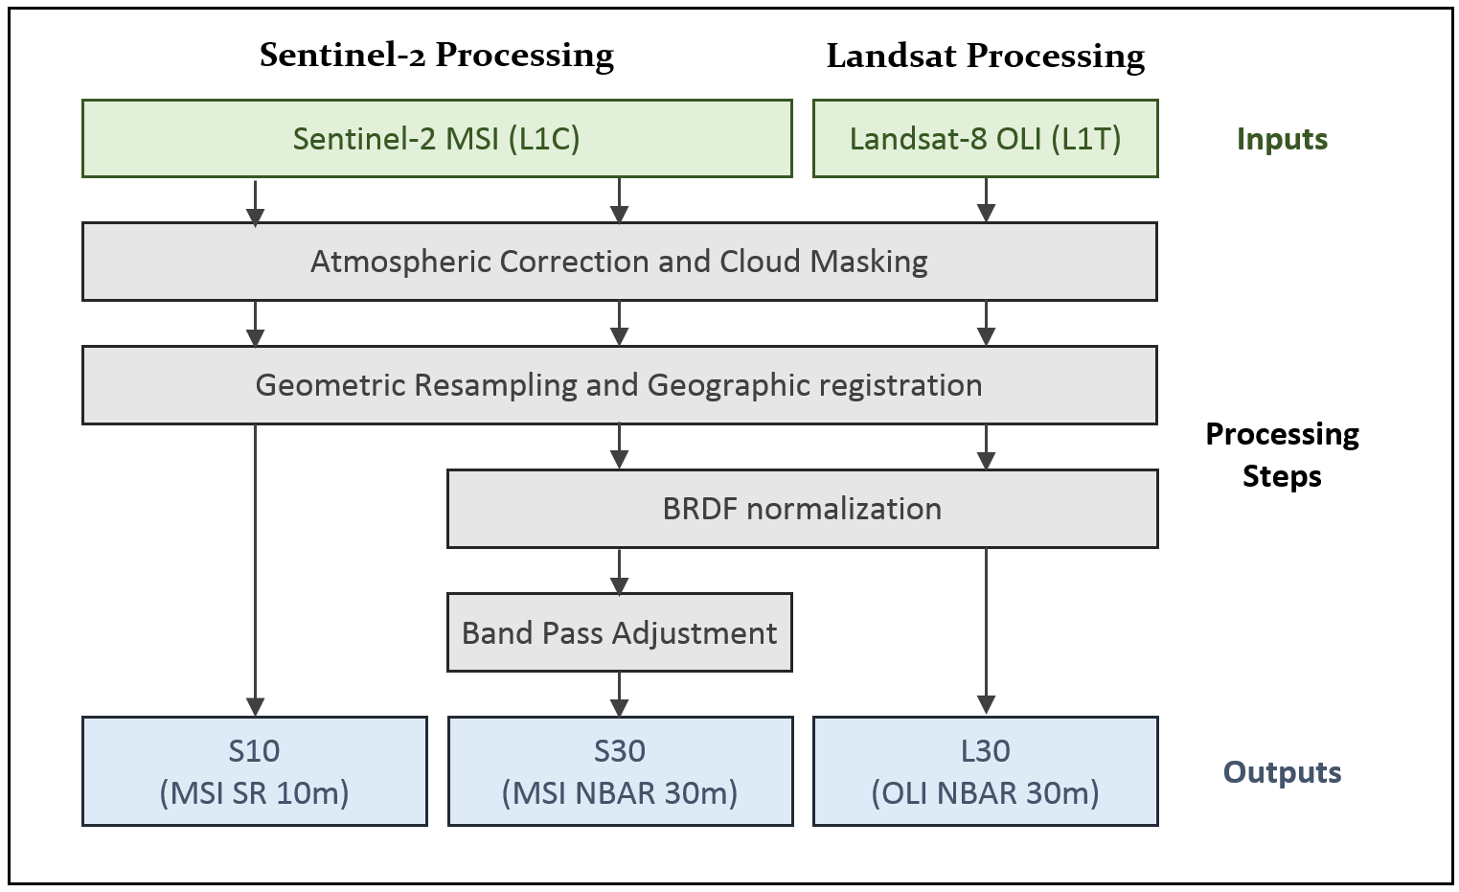
HLS Algorithm Flow
Atmospheric Correction | LaSRC/6S approach (image-based aerosol) | Vermote et al. (2016)
BRDF | corrected to nadir view / latitude-dependent solar angles using fixed coefficients | Roy et al. (2016)
Spectral bandpass | Linear regression using global training set from EO-1 Hyperion | Claverie et al., (in review)
Cloud/shadow mask | Landsat: output from LaSRC; S2: Boston University Fmask algorithm | Zhu et al. (2015)

Slide 6
HLS Algorithms
Atmospheric Correction
  Uses operational Landsat LaSRC approach (Vermote et al., 2016)
  Based on 6S radiative transfer model w/image-based aerosol retrieval
BRDF (view/solar angle) adjustment
  Uses Roy et al (2016) fixed BRDF shape
  Adjusted to nadir view and fixed, latitude-dependent solar angle (aka NBAR)
Spectral adjustment uses linear regression based on Hyperion hyperspectral images
Cloud mask
  Landsat: output from LaSRC atmospheric correction
  Sentinel-2: Boston University Fmask (non-TIR)

Slide 7
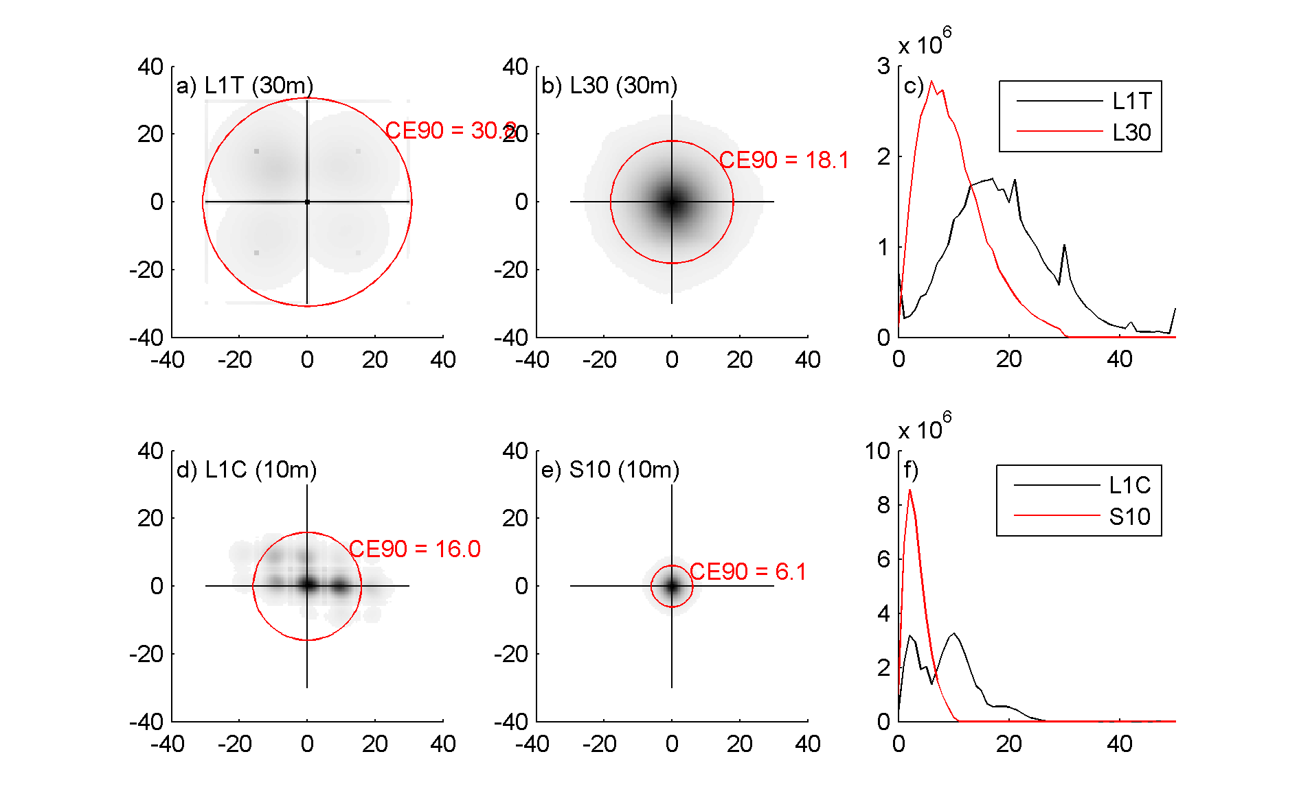
S2/ L8 Registration Issues
S2 / L8 Registration Issues
Mis-registration between Landsat and Sentinel-2
  Up to 35m mismatch due to some areas of relatively poor Landsat ground control (Storey et al, 2016, RSE)
  USGS will improve Landsat ground control in ~2018-19
  For now, users can use automated cross-correlation algorithms to co-register and/or resample L8 to S2.
Mis-registration among early Sentinel-2
  S2a data (processed before June 2016) showed relative misregistration between adjacent orbits due to error in yaw processing
  Corrected with Sentinel-2 v2.04 processing
HLS uses a single Sentinel-2 image as reference for each time series & AROP to co-register
Improvement in Landsat L30 registration after referencing to MSI

Slide 8
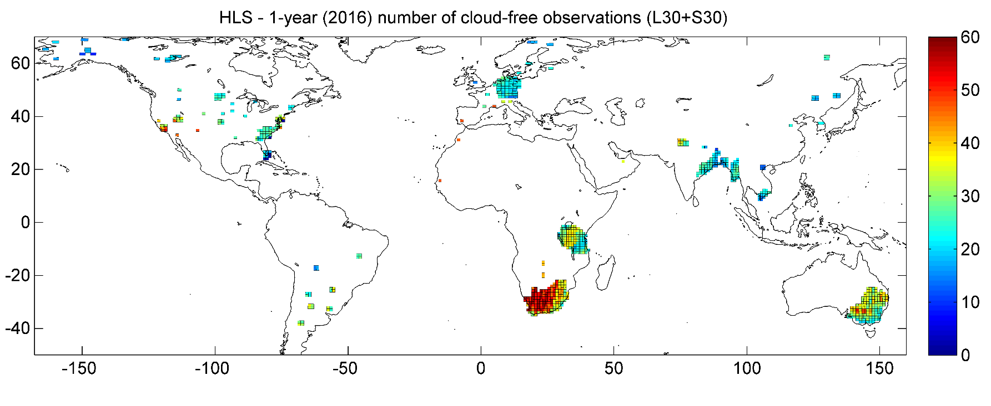
HLS Test Sites
69 Test sites (45 from NASA MuSLI team)
783 MGRS tiles
>7.5 million sq. km2
Landsat-8 data set: 147k products From Mar-2013 to Dec-2016
Sentinel-2 data set: 47k products From Jun-2015 to Dec-2016
Alaska / NW Canada: 16
NE Asia: 11
Europe: 15
(w/o Germ.)
Germany: 62
S Asia: 122
Africa: 6
(w/o SA and TZ)
North America: 95
Tanzania: 121
South America: 28
South-Africa: 166
SE Australia: 141

Slide 9
Results

Slide 10
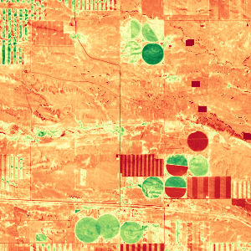
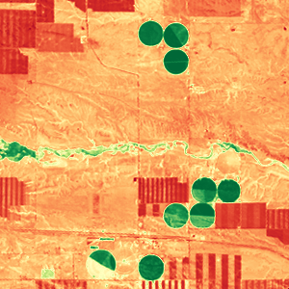
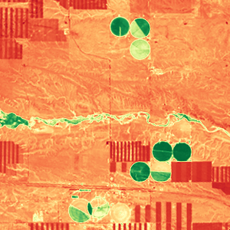
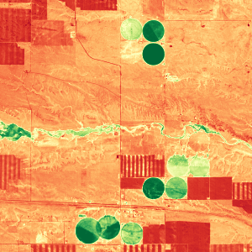
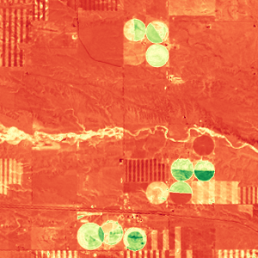

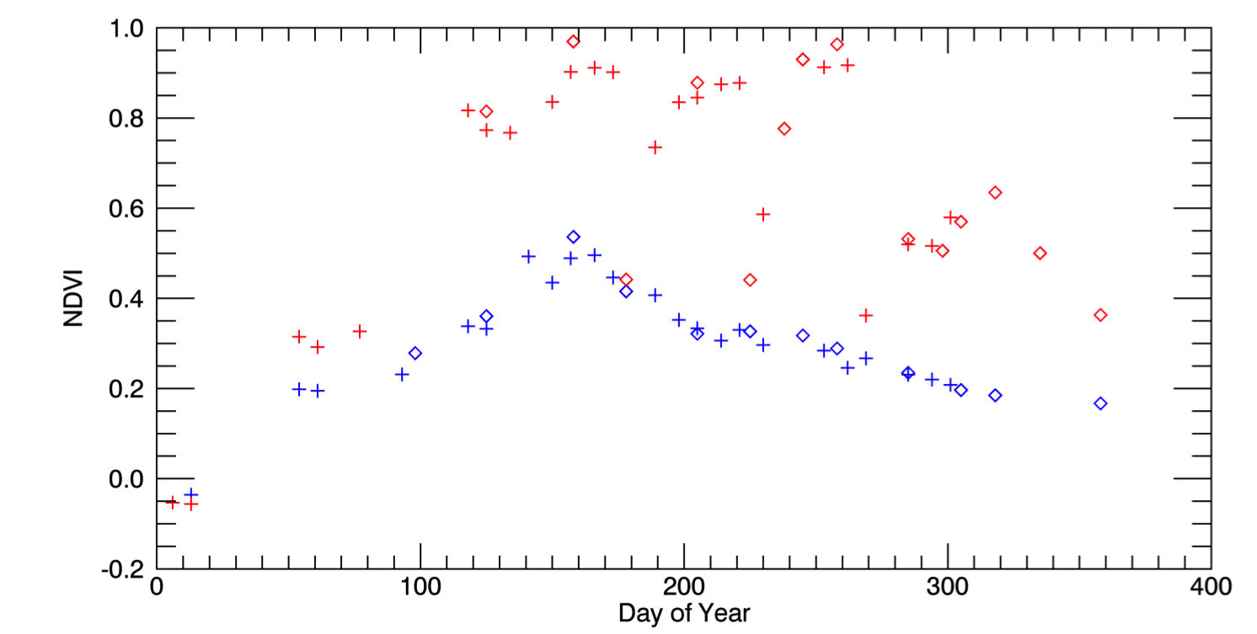
Harmonized Landast / Sentinel-2 Products
Harmonized Landsat / Sentinel-2 Products
Laramie County, WY
May 4, 2016 (S2)
Aug 8 (L8)
Aug 17 (L8)
Sep 1 (S2)
Oct 20 (L8)
3km
0.1 NDVI 0.9
Seasonal phenology (greening) for natural grassland (blue line) and irrigated alfalfa fields (red line) near Cheyenne Wyoming observed from Harmonized Landsat/Sentinel-2 data products. The high temporal density of observations allows individual mowing events to be detected within alfalfa fields. HLS Products available from https://hls.gsfc.nasa.gov
Sentinel-2
Landsat-8
+
Alfalfa
NDVI
mowing
Grassland
Day of Year

Slide 11
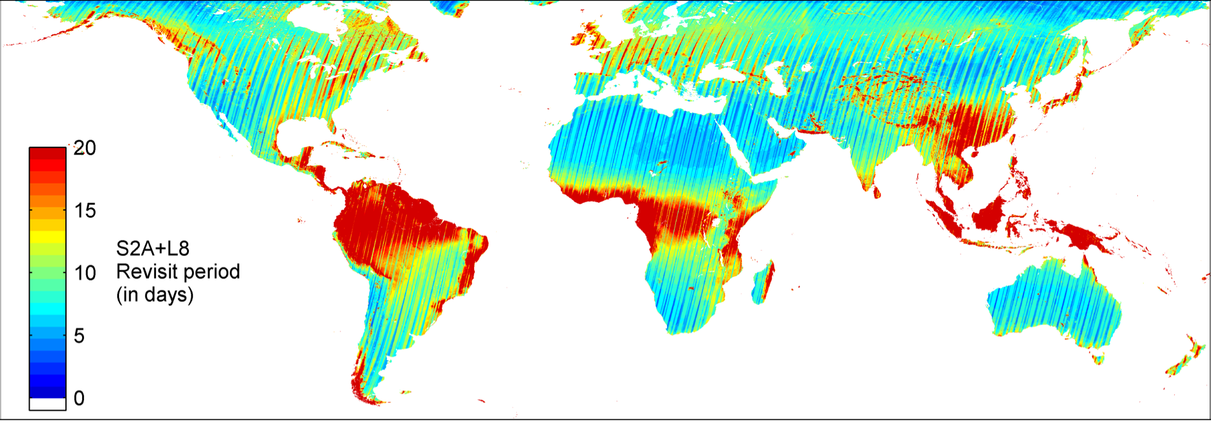
Expected Cloud-Free Observations
Combining Sentinel-2a,b and Landsat-8 can provide
2-3 day global coverage
~weekly cloud-free views over many biomes
18
36
Observations/yr
72
Sentinel-2a + Landsat-8 revisit w/ cloud cover from MODIS CMG

Slide 12
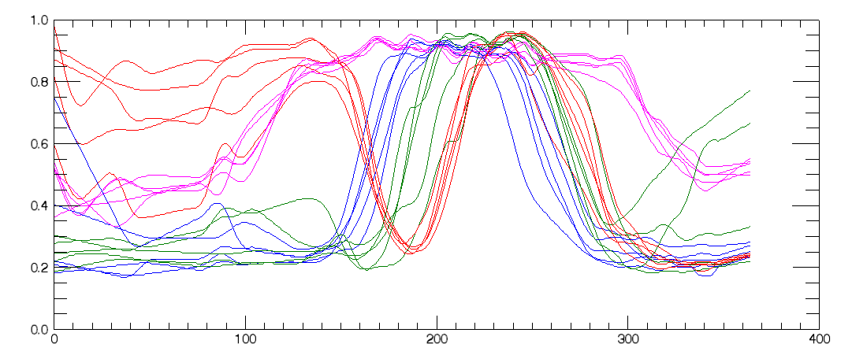
Crop NDVI Phenology
Crop NDVI Phenology
Delaware, USA - crop type examples from USDA Cropland Data Layer (CDL)
HLS data interpolated and smoothed (10-day window)
NDVI
DOY (2016)
Corn
Soybean
Double (Wheat/Soy)
Deciduous Forest

Slide 13
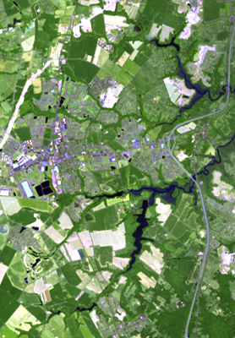
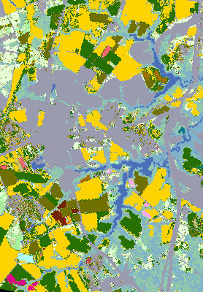
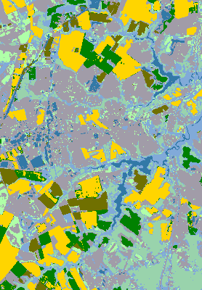
Crop Classification
Crop Classification
Supervised classification (SVM) of HLS NDVI trajectories in Delaware, using USDA CDL as training
RGB image
USDA CDL
HLS Classification
4km
water
soybean
wetland
developed
corn
wheat/soy
forest

Slide 14
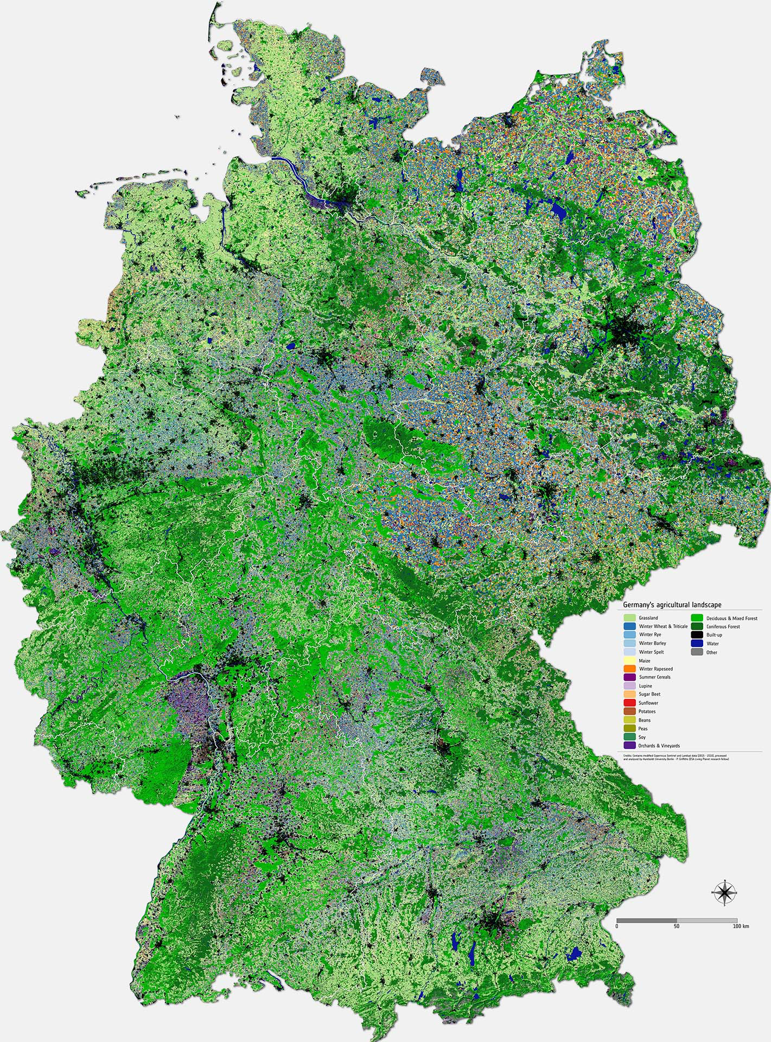
Crop Type Map for Germany
Crop type map derived from analysis of HLS imagery by Humboldt University/P. Griffiths (ESA Living Planet Research Fellow)
Based on data from Oct 2015-Dec 2016
21 land cover classes, 15 crop types
Overall accuracy 76%, several crop types >90% accuracy
http://www.esa.int/spaceinimages/Images/2017/08/Mapping_Germany_s_agricultural_landscape

Slide 15
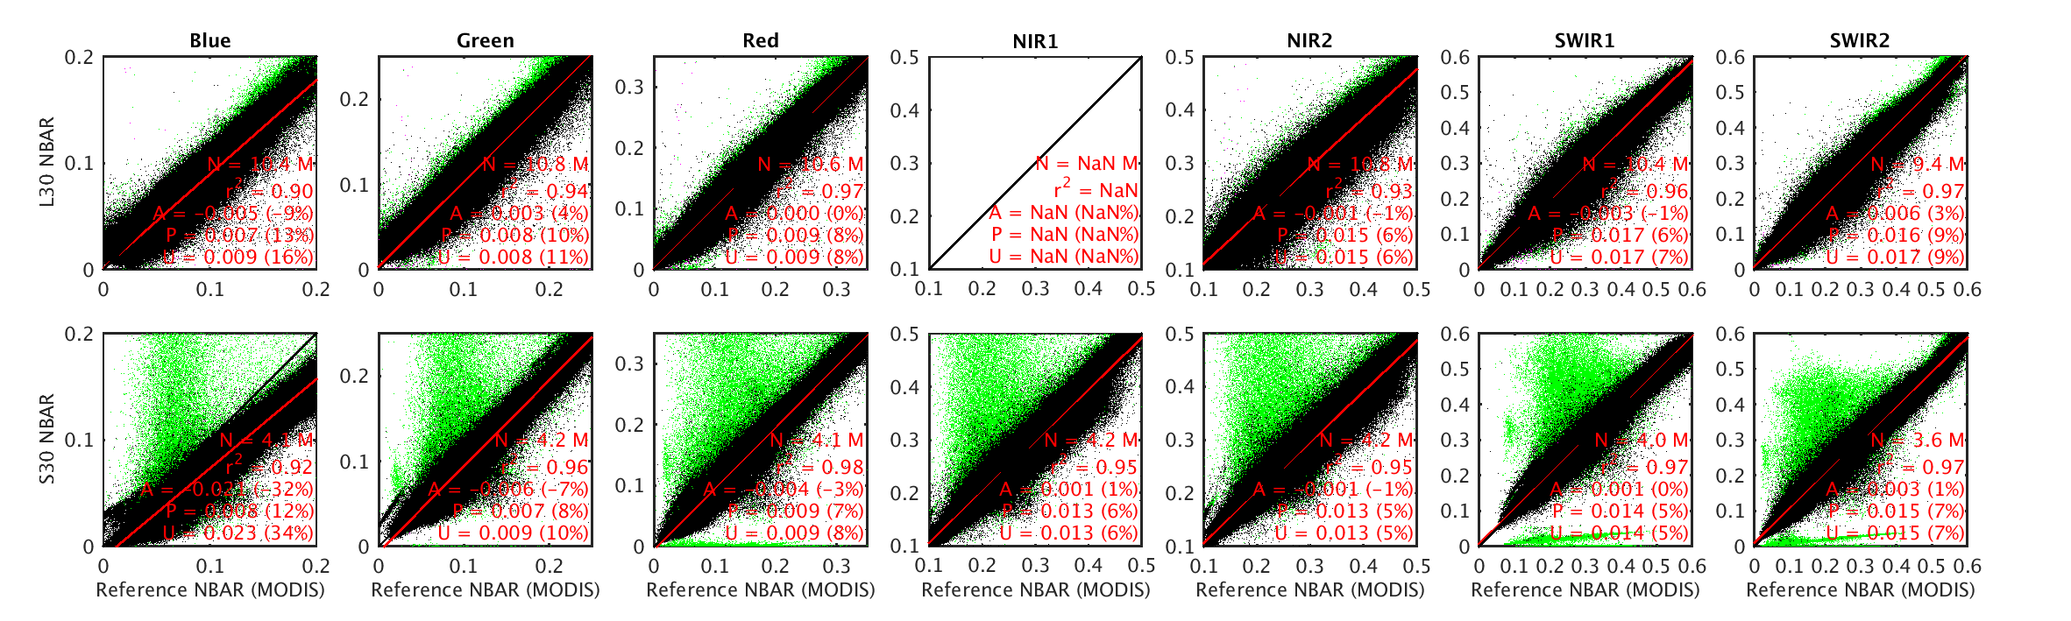
HLS QA & Validation
Product Quality Assurance (QA) - Should the user avoid this particular granule or pixel?
  Per-pixel cloud, shadow, high aerosol bits
  Per-tile & per-granule comparison with contemporary MODIS NBAR
Product Validation – what is the uncertainty (bias, precision) associated with any given observation compared to the true value?
  “Bottom-up” error budget based on algorithm validation
  Comparison with SURFAD albedometer measurements
  Stability of PICS sites
Comparison between MODIS NBAR and L30 (top) and S30 (bottom) SR. Green indicates discarded granules.

Slide 16
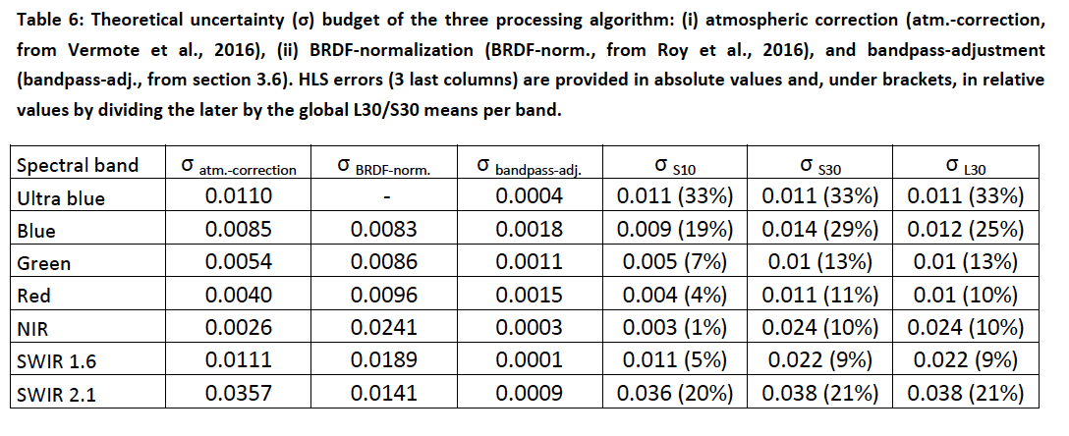
HLS Uncertainty Estimation
Validation or Uncertainty Estimation – what is the uncertainty (bias, precision) of any observation relative to a standard?
Note: BRDF uncertainty includes errors due to atmospheric correction as well, and thus could be overestimated.

Slide 17
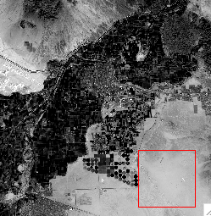
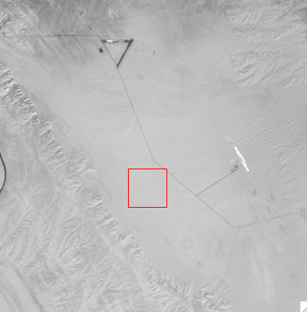
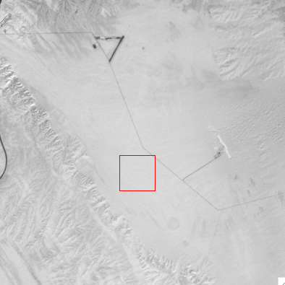
HLS Temporal Variability (Precision)
HLS Temporal Variability (Precision)
SE of Yuma, AZ
Sentinel-2 (HLS S30)
Calendar Year 2016
N = 112 total observations
77 non-null, non-cloud
January 17, 2016
Red
NIR

Slide 18
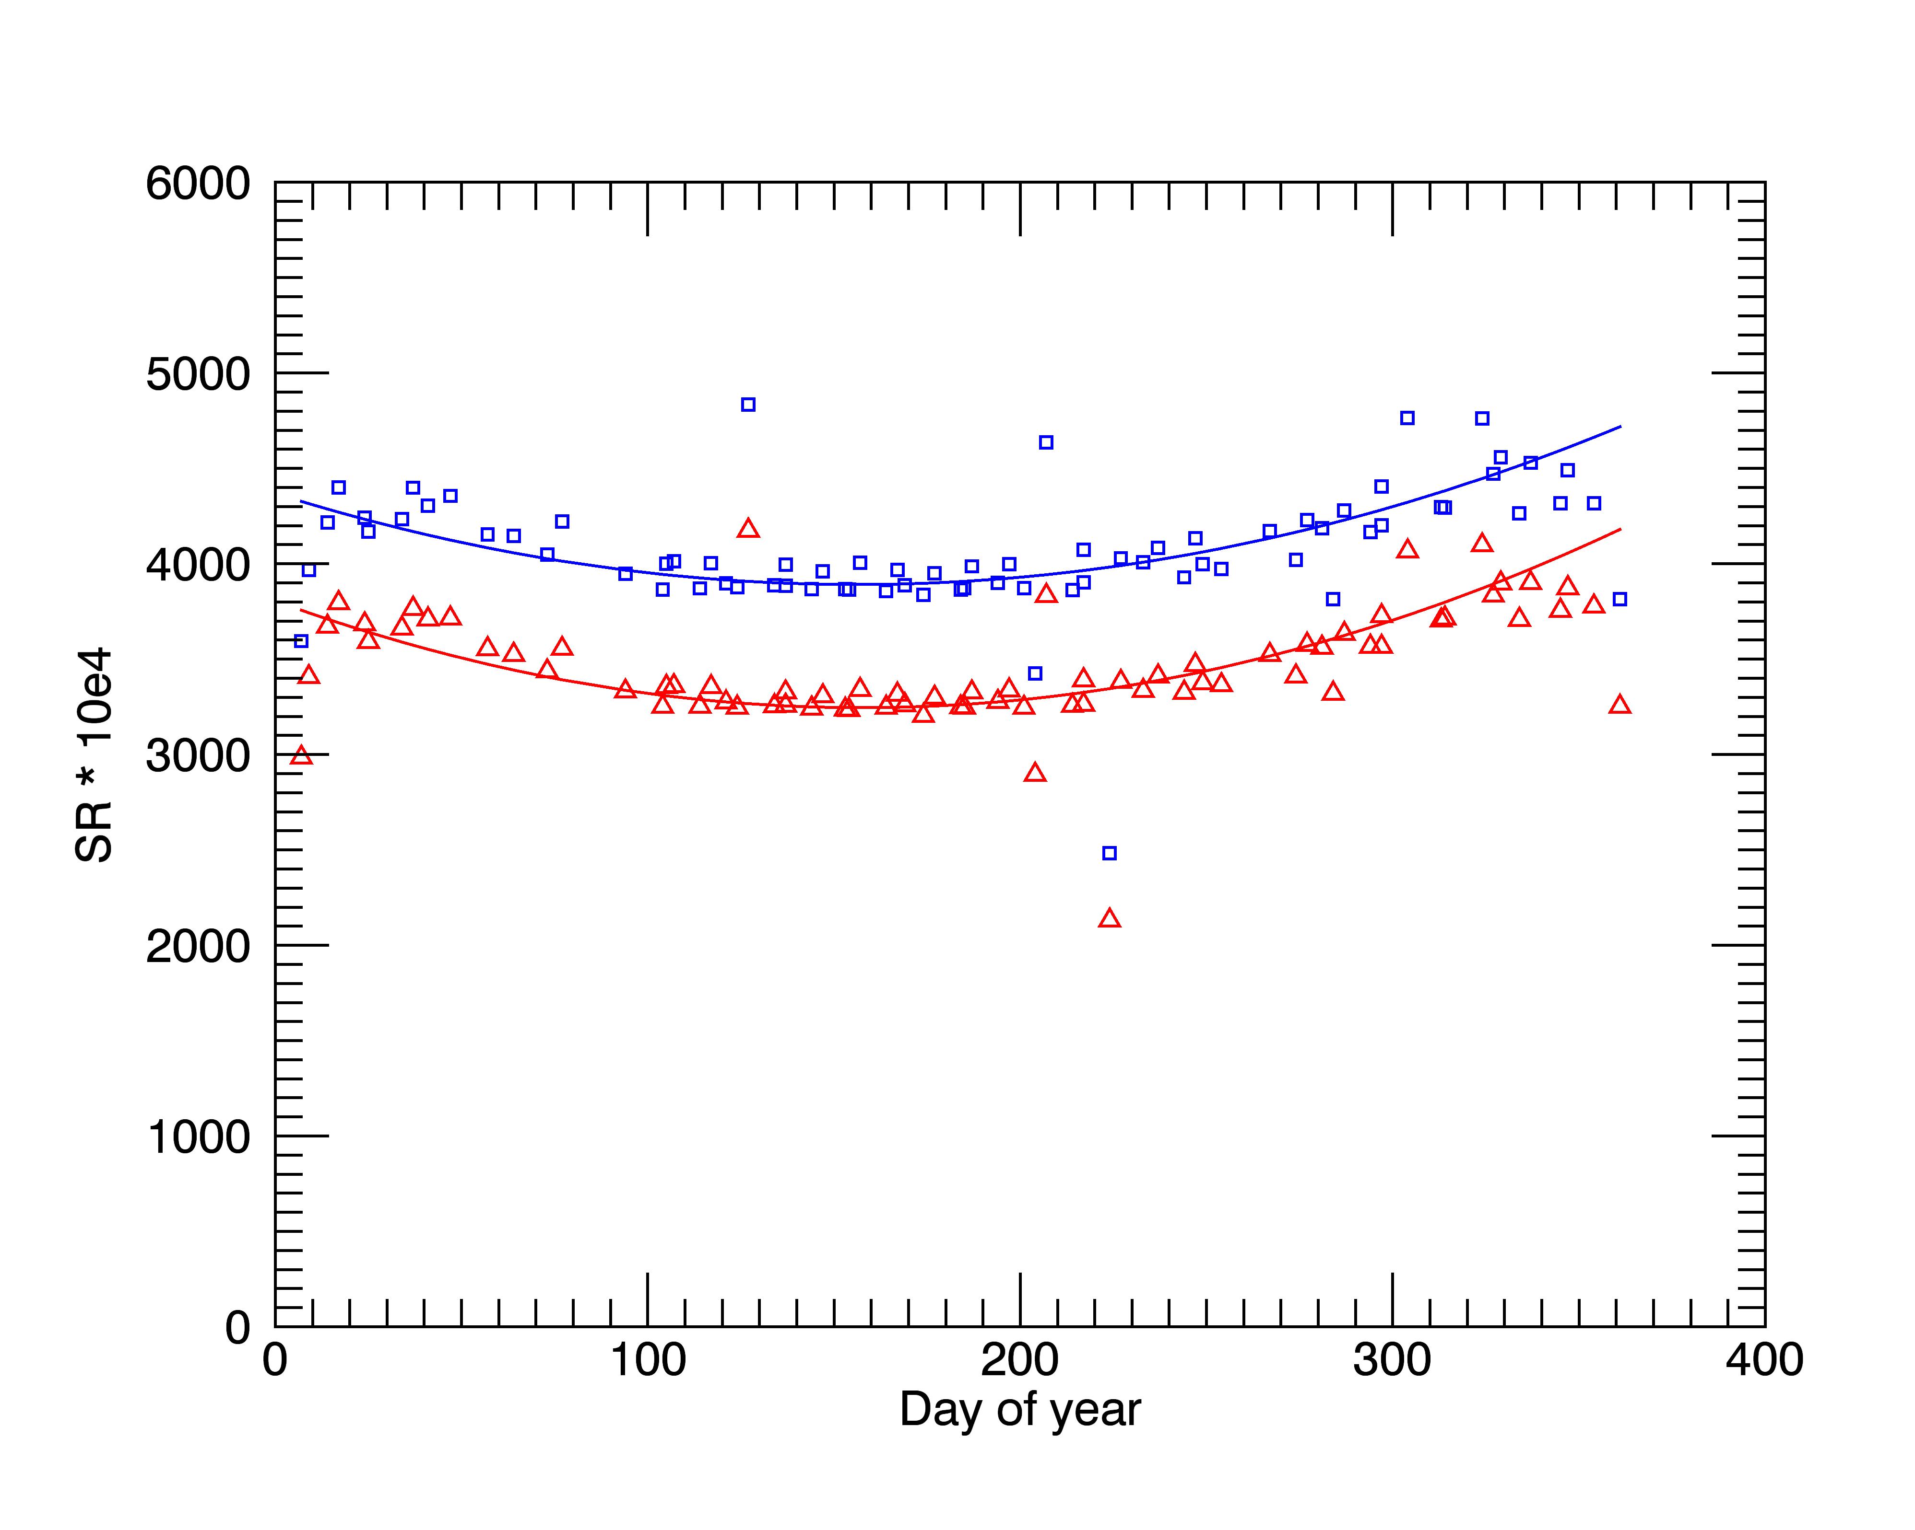
HLS Temporal Variability (Precision)
HLS Temporal Variability (Precision)
Mean StdDev
Raw SR (no detrending, no filtering, N=77)
RED : 3498 466 (13% relative)
NIR : 4113 441 (11% relative)
Detrended, filtered for outliers (N=71)
RED : N/A 126 (3.6% relative)
NIR : N/A 149 (3.6% relative)
nir
red

Slide 19
Harmonization Challenges
Landsat/Sentinel-2 cross calibration has not been an issue
  We assume that both sensors record the true signal with zero bias
  Radiometric bandpass for S2a blue & CA uncertain
S2/Landsat registration issues
  Documenting the problem (Storey et al., RSE, 2016)
  Landsat reprocessing using S2 GRI (Collection 2 - 2018?)
Mixed processing baselines
  L1T -> Collection 1
  Multiple S2 processing baselines
S2 data acquisition limitations
  Systematic global acquisitions still not achieved by S2a,b
Spectral bandpass adjustment (SBAF)
  Maybe not a dominant error term, but no algorithm is ideal
Cloud masking
  BU algorithm intercomparison & upgrade (Woodcock)
  CEOS ACIX v2

Slide 20
Status and Future Directions
Version 1.3 released July 2017
  Paper submitted to RSE special issue on Sentinel-2 Applications (Claverie et al, in review)
Version 1.4 to be released early-2018
  Wall-to-Wall North America + global test sites
  Incorporates Collection 1 Landsat and S2b data
  < 7 day latency
  Processing & data access via Amazon Web Services (AWS)
HLS-like products for coastal/inland water? (Pahlevan)

Slide 21
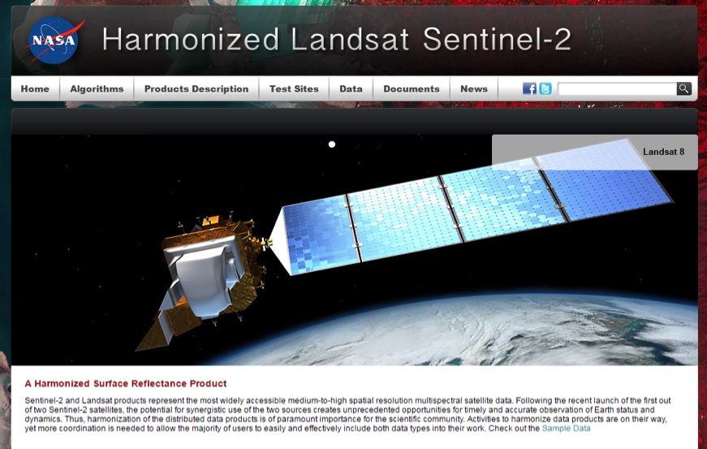
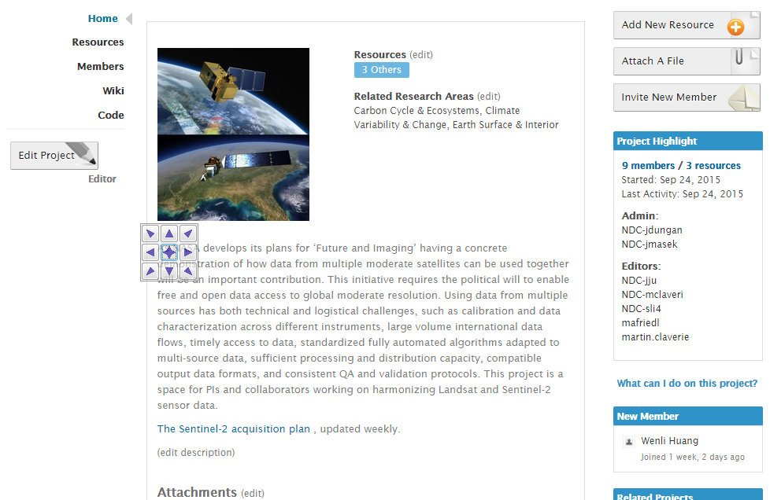
Websites and Public Interface
HLS website
NEX project page
https://hls.gsfc.nasa.gov
Public access
Sample data available (via FTP)
Algorithm & Product descriptions
Request new sites
https://nex.nasa.gov/nex/projects/1371
Registered user access
All HLS data available
Documents (slides, user guides)

Slide 22
Crochety
Rambling

Slide 23
Thoughts on Characterizing L2 Products
Instrument-level characterization is foundational – you can’t build a long-term geophysical record on noise
But Level-2 Products & ARD change the playing field
  Surface reflectance and (soon) temperature as default products
  Harmonized SR data sets with other sensors
As a user, I want to know:
  What is absolute error (1σ) associated with any single SR observation (ie. precision + bias)?
  What is the relative error associated with a set of SR observations through time? (temporal precision or variability)
    How likely is it that any long-term trend is meaningful?
  What is the relative error associated with a set of SR observations in space? (spatial precision or uniformity)
The Problem: We don’t have a clear consensus on these values, nor a framework for obtaining them

Slide 24
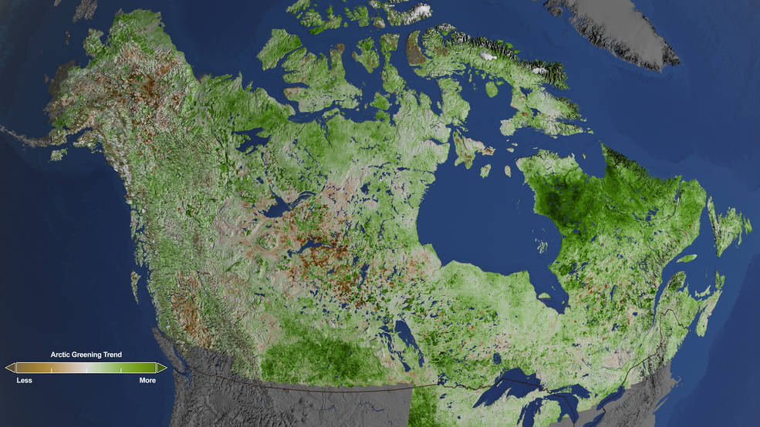
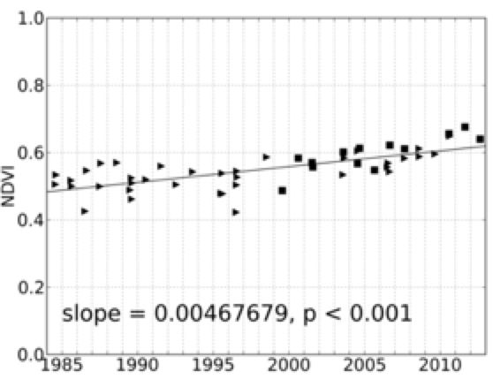
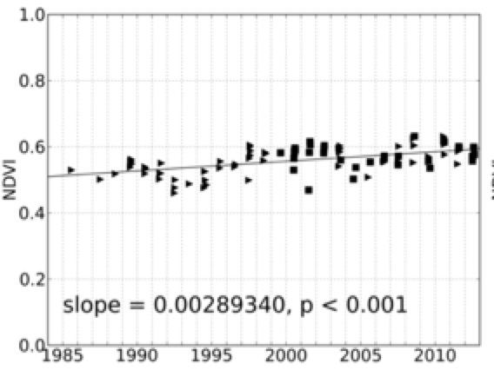
Arctic Greening from Landsat
Ju and Masek, RSE, 2016

Slide 25
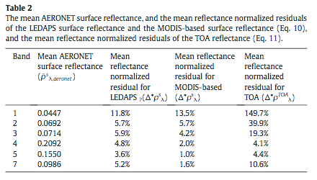
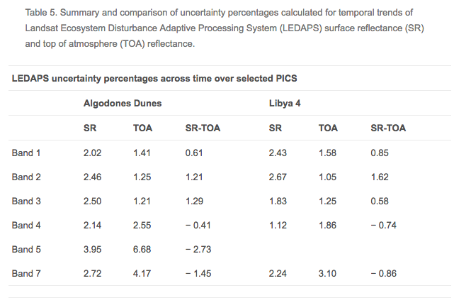
References
Ju et al., 2012
Relative residuals of AERONET-based correction vs. LEDAPS SR: 4-12%; and vs. MODIS-based SR: 1-14%
Maiersperger et al., 2013
Relative uncertainty (temporal variability/mean) of LEDAPS for PICS sites: 2-4%

Slide 26
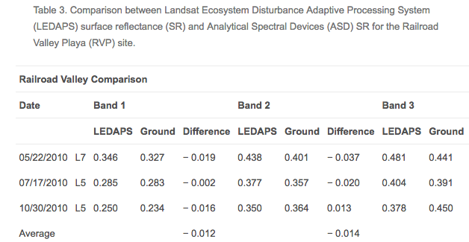
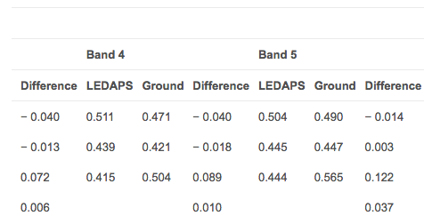
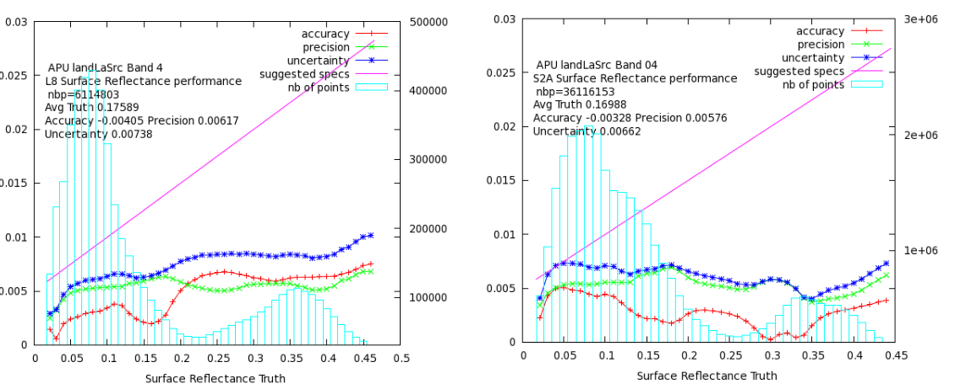
References 2
Maiersperger et al., 2013
Average difference between field spectrometer & LEDAPS SR: 2-7% relative to field data
Vermote, 2017 LST
LaSRC versus 6S processed with Aeronet
~2-6% relative uncertainty

Slide 27
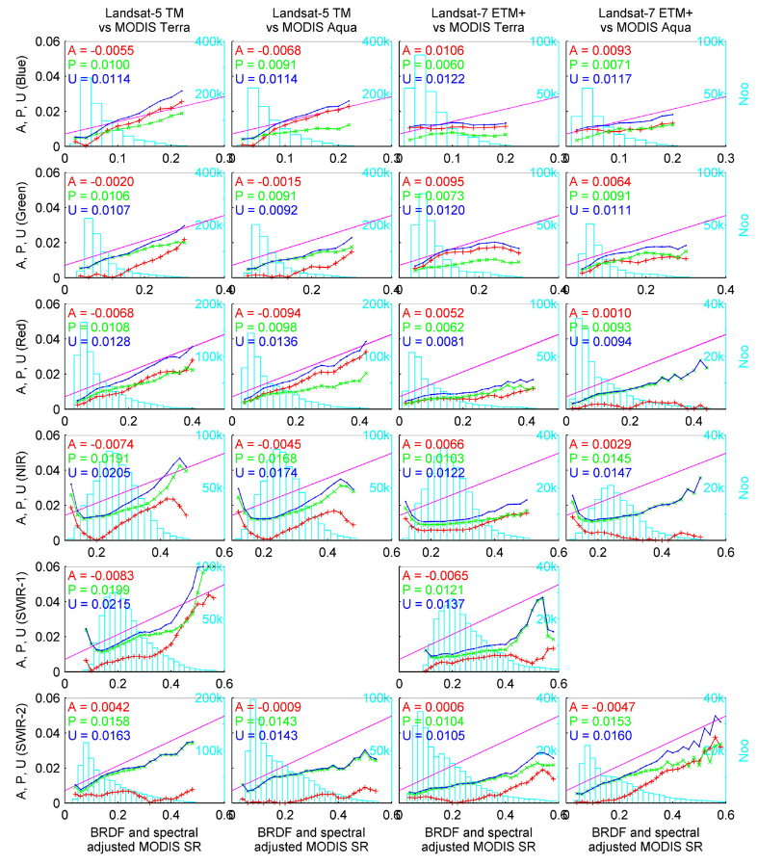
References 3
Claverie et al., 2015
Comparison of LEDAPS SR vs. MODIS CMG
- aggregated Landsat to CMG
- applied BRDF & bandpass corrections
4-15% relative uncertainty

Slide 28
Approaches to Estimate L2 Uncertainty
Comparison with MODIS (MOD09, NBAR)
  Assumes that MODIS is “truth”
  Scale mismatch (500m or 0.05deg versus 30m)
  Bandpass mismatches, angular mismatches…
Comparison of image-based AOT correction with AERONET-based AOT correction (e.g. ACIX)
  Assumes that AOT dominates error budget
  Does not test radiative transfer model itself
Component error budget
  Difficult to quantify component errors
Direct comparison of SR with ground observations
  Logistically difficult to generate statistically meaningful sample
  Assumes ground radiometer data is accurate
  Little used – perhaps new technology (drones) could help with this!
What’s needed: A framework that uses multiple, convering lines of evidence to provide absolute and relative (temporal) uncertainty in surface reflectance (and temperature)

Slide 29
Sources of Uncertainty
Level 1
  Instrument (SNR) ~ 0.3% relative at Ltyp
  Transfer to absolute TOA reflectance (<3% abs)
    Uncertainty in NIST, transfer radiometers, etc
  Stability (ie. temporal variability) (0.5-2% relative)
Level 2
  Atmospheric correction
    Per-pixel aerosol and water vapor
    RT model
    Inconsistent Algorithms
  BRDF model (30m resolution)
  Surface measured reference (reflectance,
  Residual cloud, cirrus, adjacent scattered light…
Harmonized
  Relative bandpass & SBAF

Slide 30
Inter-Sensor Harmonization Within Landsat
The post-1982 archive uses two approaches to atmospheric correction
  LEDAPS for L4-7 TM & ETM+
  LaSRC for L8 OLI
The consistency of these records has not been established
  Some studies (e.g. Holden and Woodcock, 2016) suggest systematic differences in visible band reflectance
LaSRC could be applied consistently back to 1982 but the effect of large-scale land cover change on the key “blue/red” ratio has not been evaluated
What about MSS?

Slide 31
Conclusions
HLS is generating “harmonized” products of Landsat-8 and Sentinel-2 surface reflectance
  Initial results look promising
  We believe the largest error sources are the atmospheric correction & BRDF adjustment
  Focusing on more rigorous characterization of absolute error (SURFRAD) and precision (PICS)
Radiometric calibration differences could (& should) be incorporated in HLS-like processing chains
In general, the community will be looking for clear, concise estimates of uncertainty (bias, precision) associated with Level 2 products and ARD

Slide 32
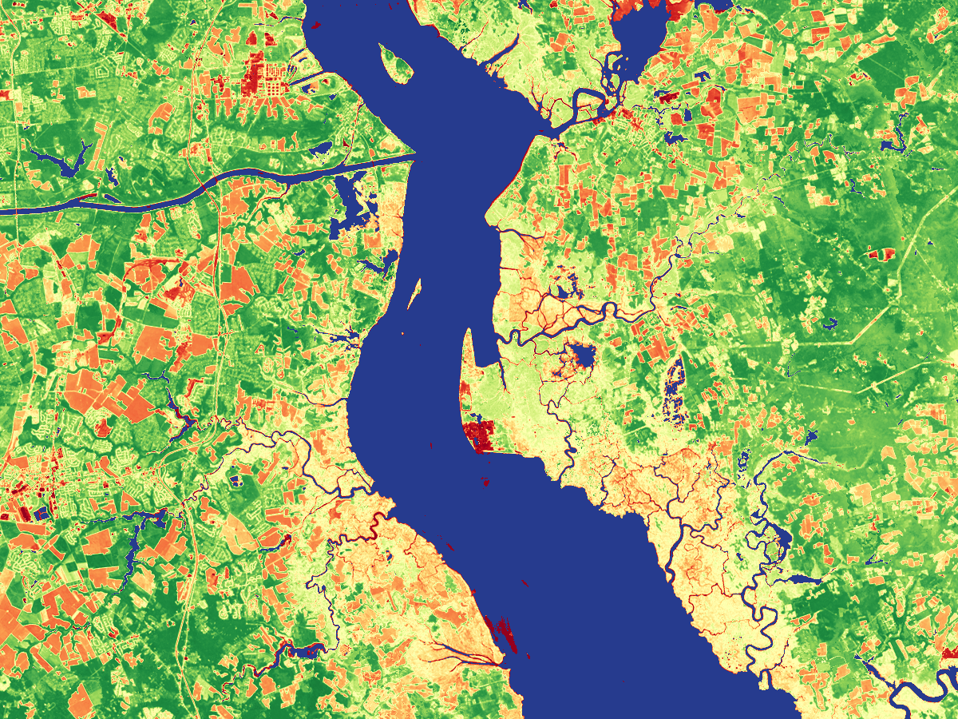
Thank you
Thank You
Delaware / New Jersey

Slide 33
Backup
Backup

Slide 34
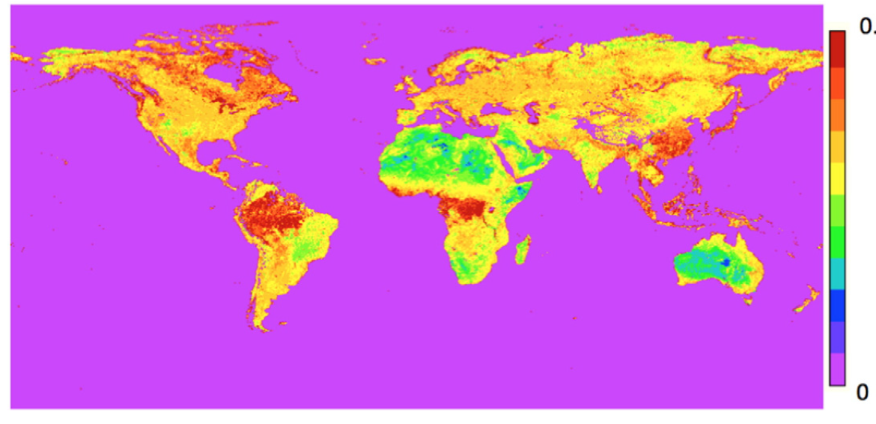
LaSRC Atmospheric Correction
LaSRC Atmospheric Correction
Similar to MODIS Collection 6 approach & previous LEDAPS
Uses 6S radiative transfer model to correct for scattering (Rayleigh, Mie) and gaseous absorption
  MODIS water vapor
  NCEP GDAS ozone and surface pressure
  Aerosol optical thickness derived via fixed red/blue ratio observed in MODIS SR for every land location
Red/Blue ratio derived from MODIS (Vermote et al., 2016, RSE)

Slide 35
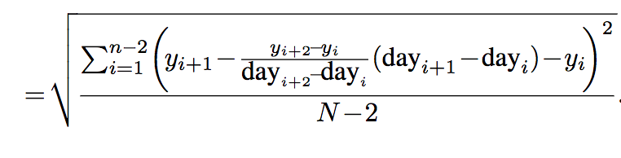
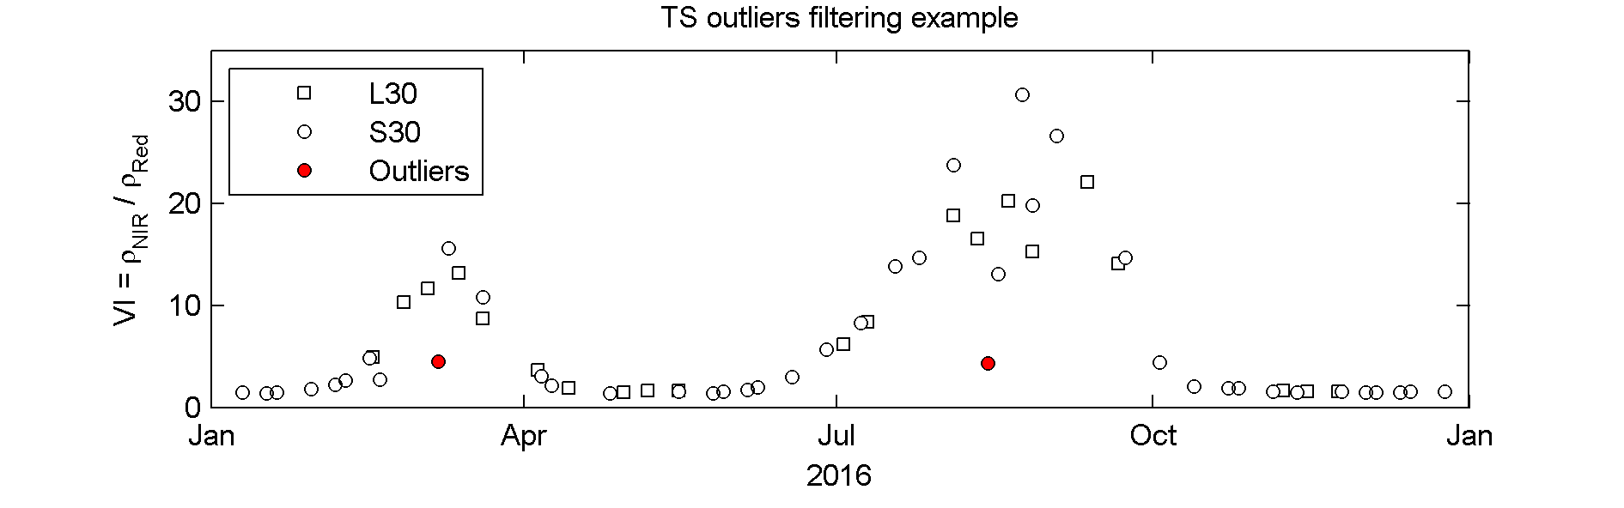
HLS QC: Temporal Smoothness
Approach based on variance among cloud-free VI triplets (Vermote et al., 2009)
Per-pixel metric calculated from median of all triplets (N>6) in time series
VI (y)
Noise
day

Slide 36
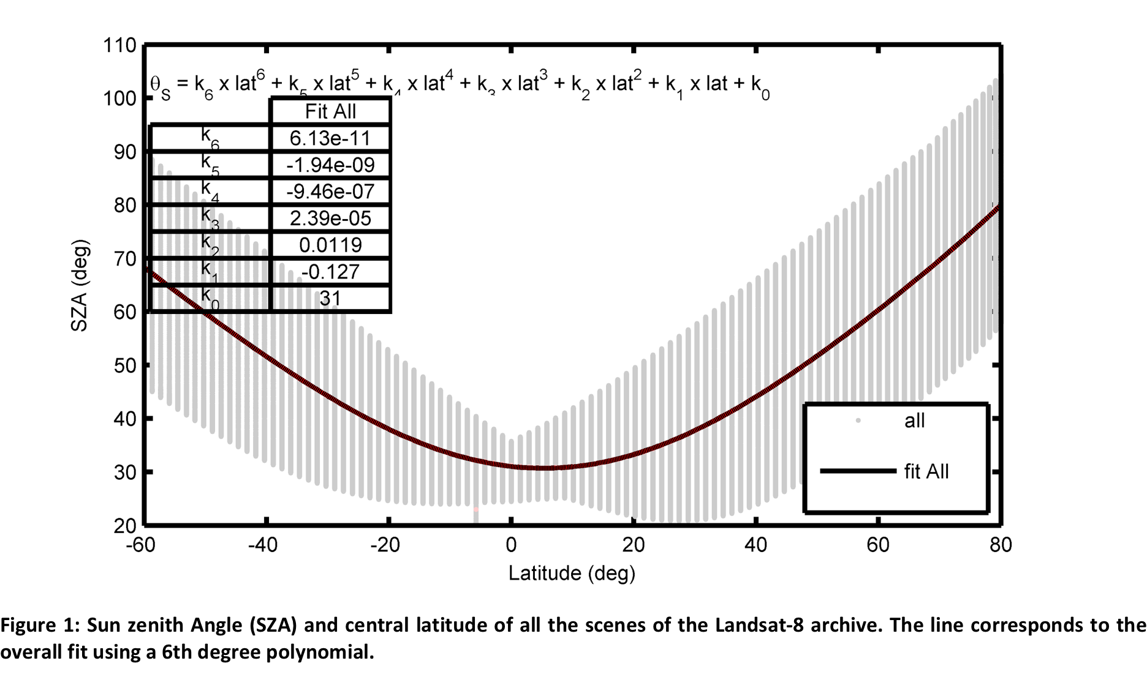
BRDF Correction
Uses “fixed” coefficients of Roy et al (2016)
  Over narrow view angles, little improvement with using local or landcover-dependent kernel
Corrects to a fixed view (nadir) and solar (latitude-dependent) solar elevation
  Similar to MODIS NBAR but variable solar elevation

Slide 37
Effect of Mixed Resolution on Change
Sensor “A”
Sensor “B”
Sensor “A”
2
1
2
Reflectance
1
Time ->

Slide 38
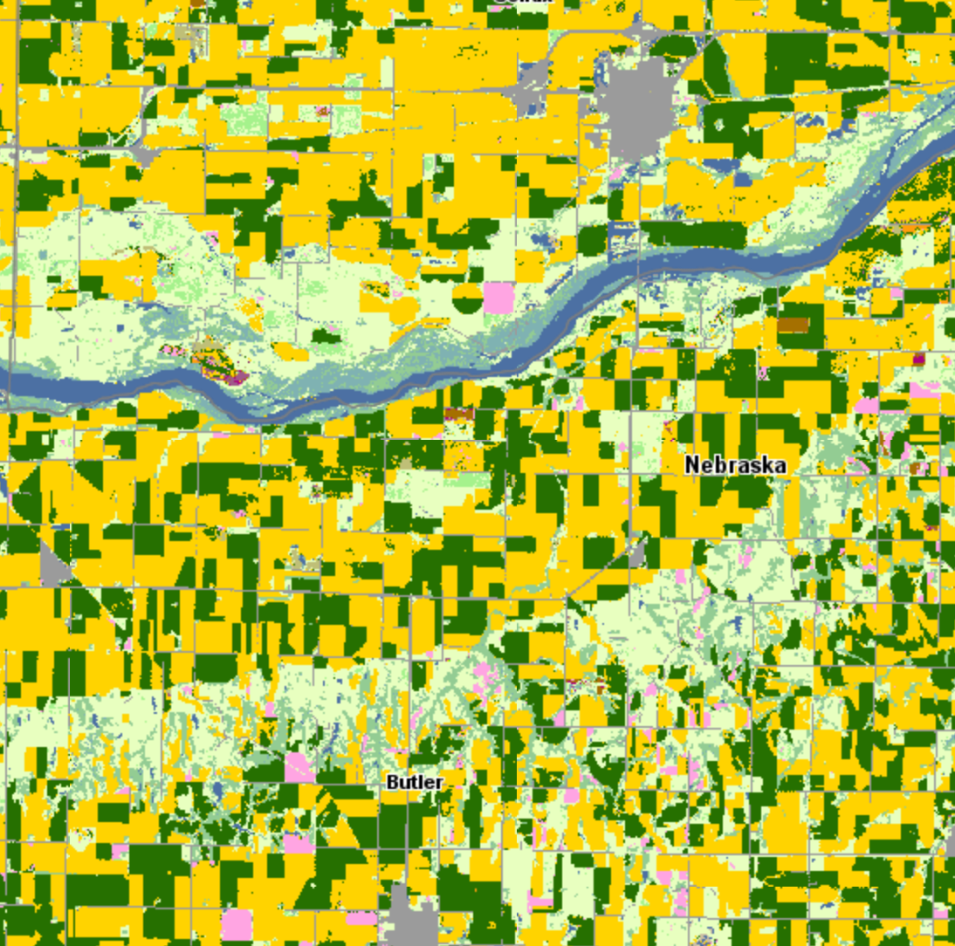
USDA 2016 Cropscape
55
Schuyler,
Nebraska
USDA 2016 Cropscape
5km

Slide 39
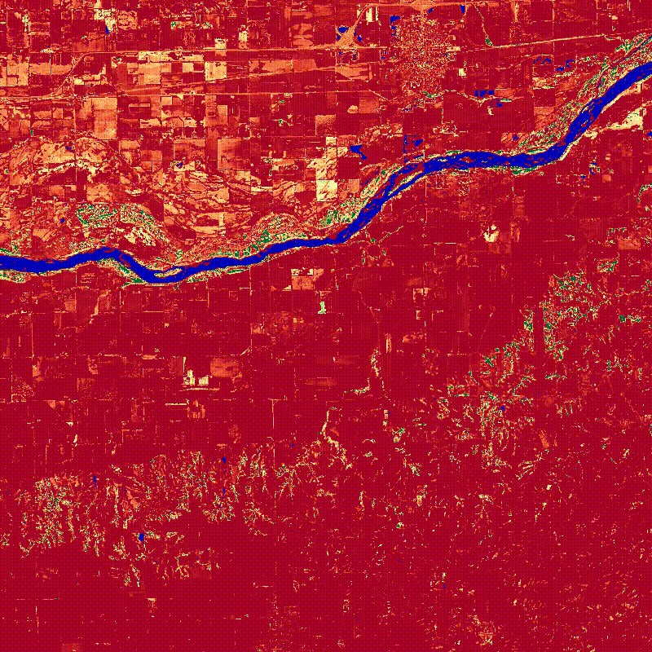
HLS 2016 NDVI
Schuyler,
Nebraska
HLS 2016 NDVI
Filtered, interpolated to daily time step
1.0
0.0

Slide 40
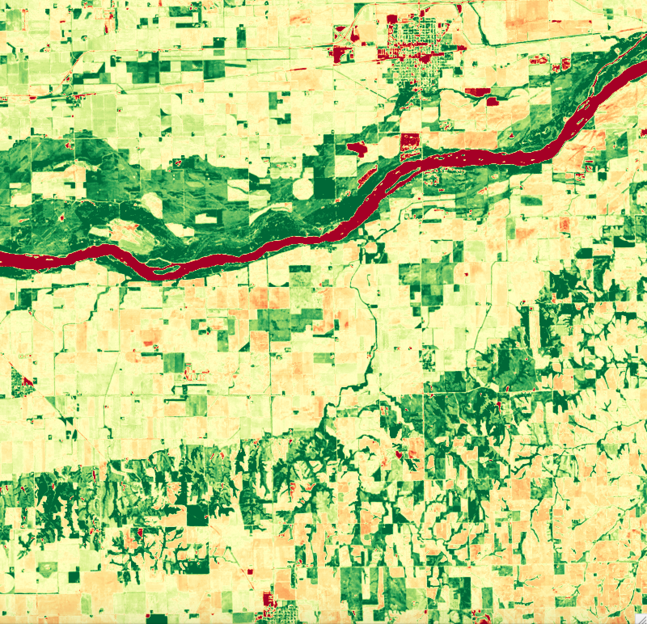
Cumulative 2016 NDVI
Wetland
Schuyler,
Nebraska
Cumulative 2016 NDVI
Corn
250
Soybean
NDVI Days
0.0

