Slide 1
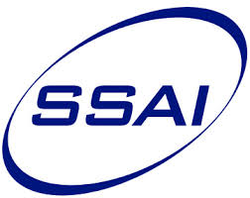

Landsat-Sentinel-2A product consistency and implications for monitoring aquatic systems
Nima Pahlevan, Sudipta Sarkar, Sandeep Chittimalli,
Sundarabalan Balasubramanian, Brandon Smith
NASA Goddard Space Flight Center
Science Systems and Applications Inc.
ECCOE CalVal Workshop
Pecora 2017
Sioux Falls SD

Slide 2
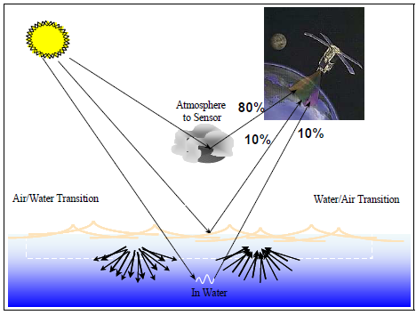
Why is there a stringent calibration requirement for aquatic remote sensing?

Slide 3
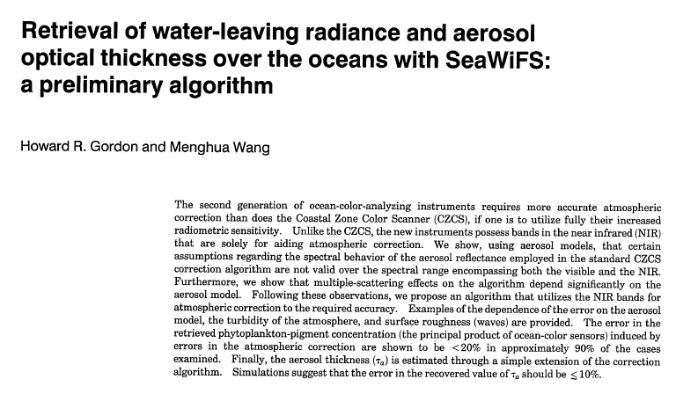
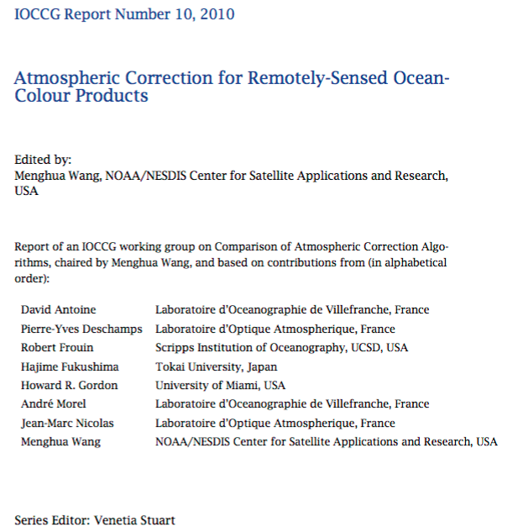
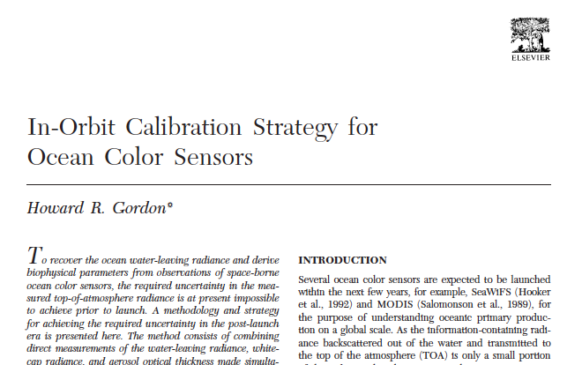
Ocean color and the lesson learned
1% error in TOA observations in the blue bands over blue waters yields ~10% error in water-leaving radiance

Slide 4
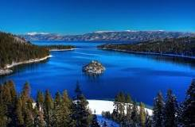
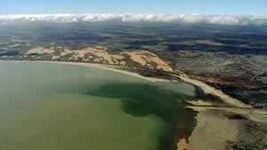
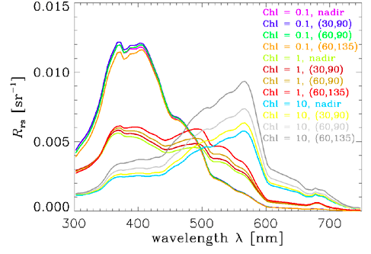
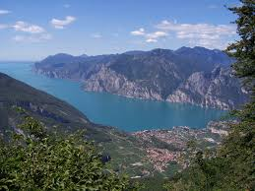
Coastal/inland waters are not necessarily blue!
Coastal/inland waters are not necessarily blue!
4.5
3.0
Reflected light (%)
1.5
0.0

Slide 5
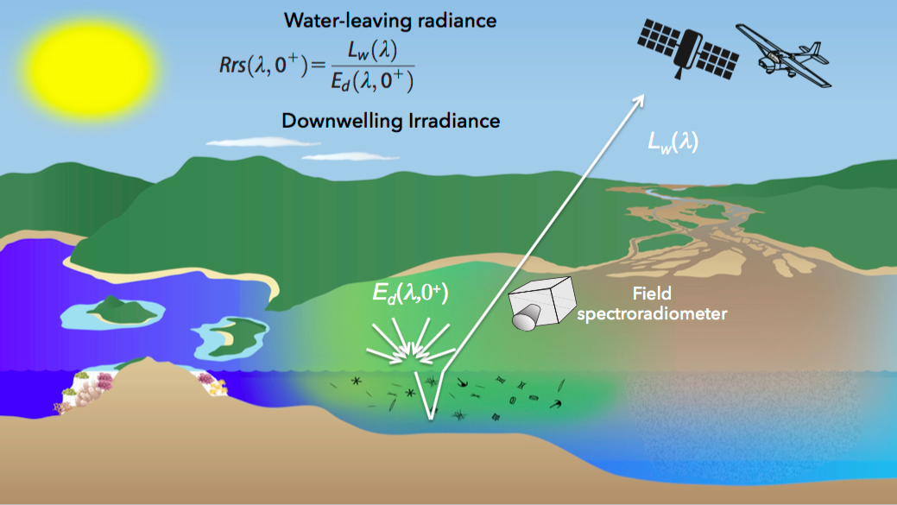
FYI…
[1/sr]
Remote sensing reflectance (R_{rs}) is the key quantity
Credit: https://arset.gsfc.nasa.gov

Slide 6
Landsat-Sentinle-2 constellation:
A game-changer for monitoring water quality

Slide 7

Landsat-Sentinle-2 constellation:
A game-changer for monitoring water quality
Enhanced frequency of revisit
2010
2015
2020
2025
Landsat-7
Sentinel-3A
Landsat-9
Sentinel-2D
Sentinel-2A
Sentinel-2B
Sentinel-2C
Sentinel-3D
Landsat-8
Sentinel-3B
Sentinel-3C
Landsat-5
Constellations of satellites until ~2028
2-3 day revisit time
20 to 300m resolution

Slide 8
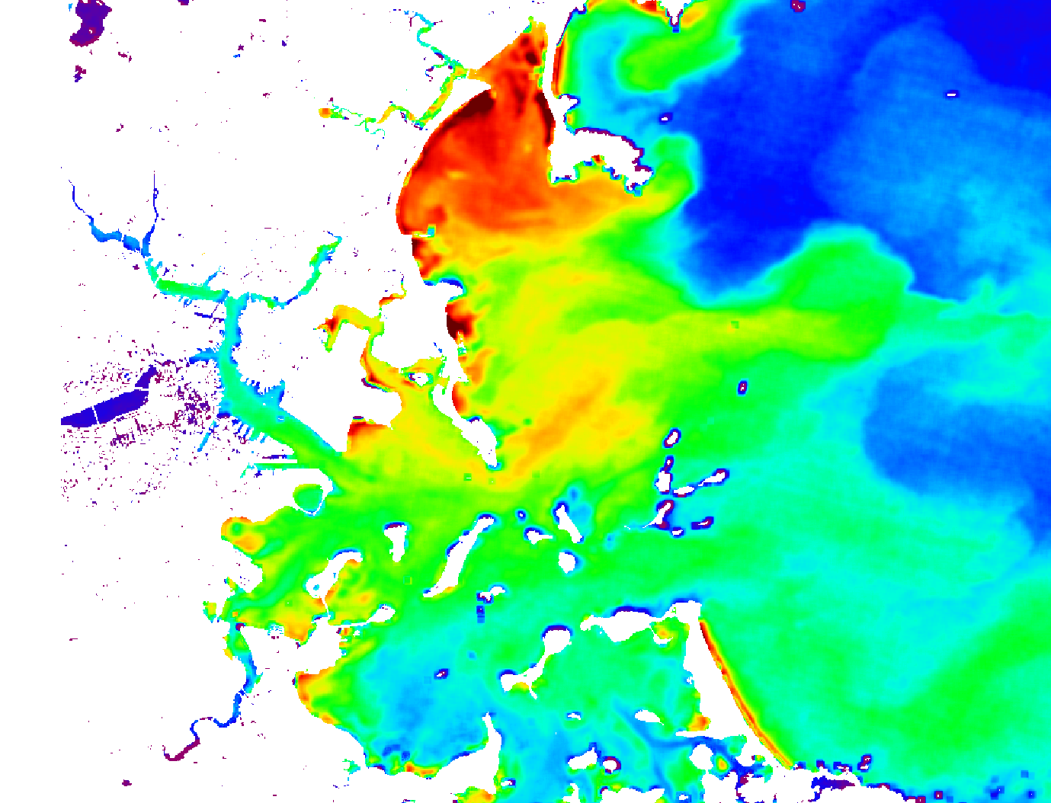
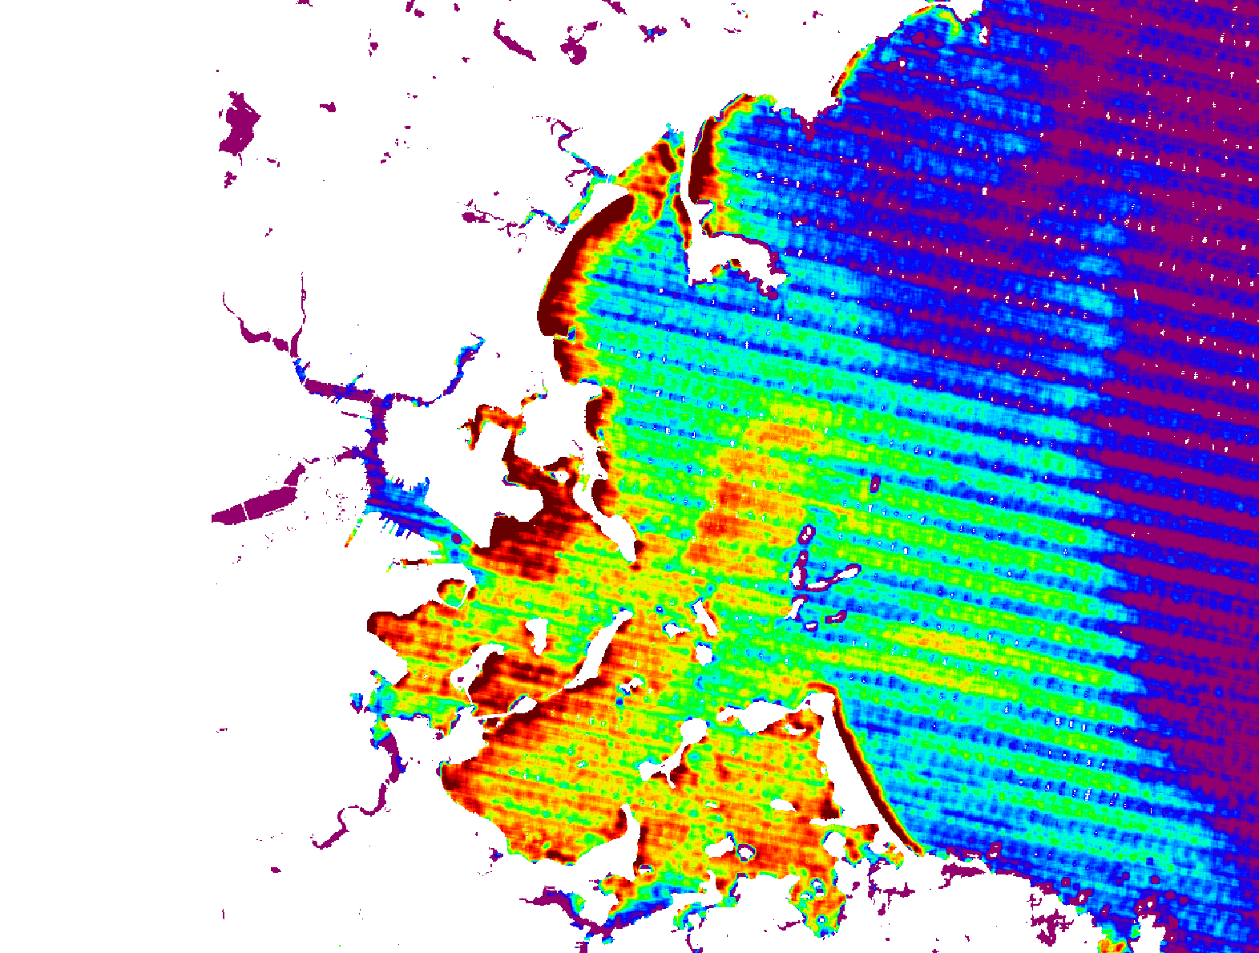
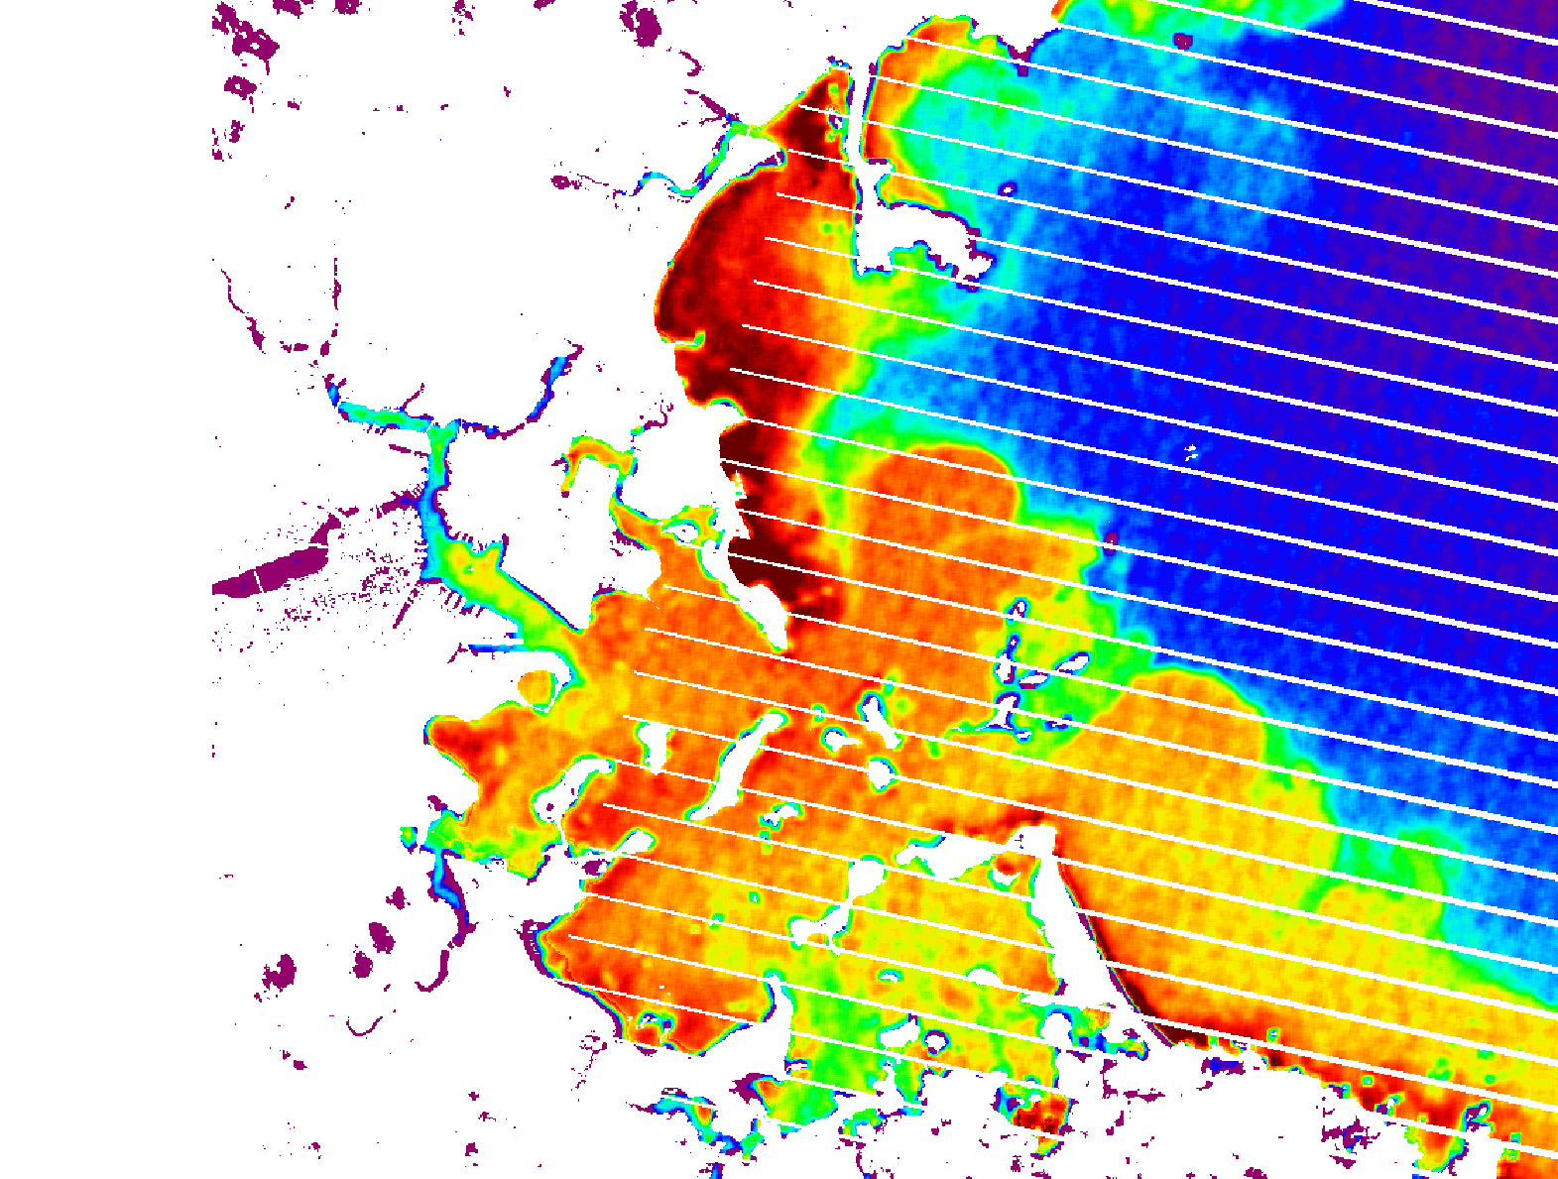
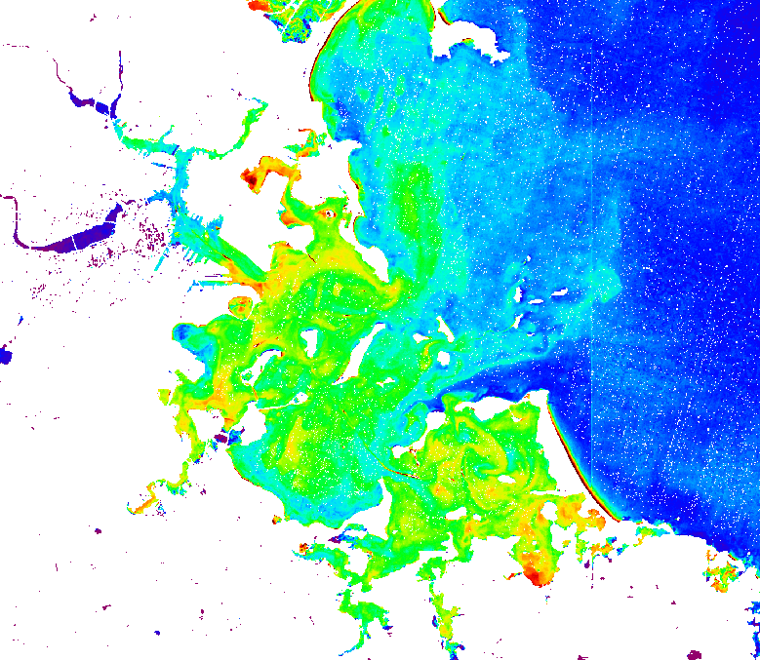
Landsat-Sentinle-2 constellation:
A game-changer for monitoring water quality
Enhanced radiometric capability
Landsat-7
Sentinel-2A
Landsat-8
Landsat-5
Boston Harbor

Slide 9
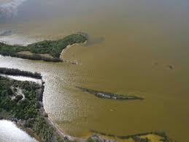
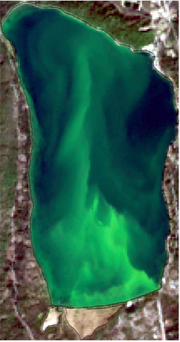
Landsat-Sentinle-2 constellation:
A game-changer for monitoring water quality
Pressing need for expedited monitoring of water quality
Diamond Lake
US Algal Bloom Map – 2016

Slide 10
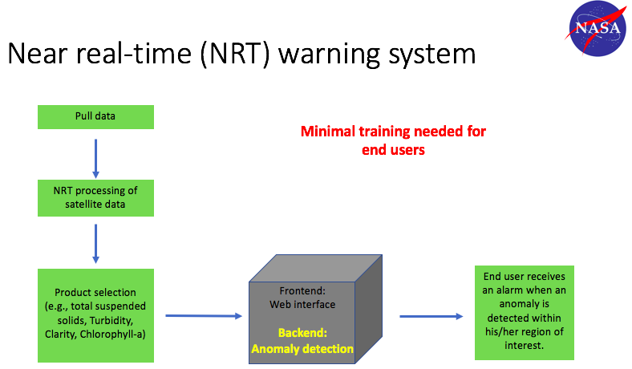
Landsat-Sentinle-2 constellation:
A game-changer for monitoring water quality
End-users’ enthusiasm and support
  A water quality workshop hosted by NASA GSFC Applied Sciences
  340 registered – 140 physically attended
    EPA, USGS, States, Army Corps, private sector, major cities

Slide 11
Evaluate Landsat-Sentinel-2A radiometric consistency
Methods
  Image pairs at near simultaneous nadir overpasses (n-SNOs)
    TOA reflectance AND
    Remote sensing reflectance (R_{rs})
  R_{rs} products at AERONET-OC sites
  Time-series applications
Consistency in calibration (Level-1; TOA) Consistency in products (Level-2 ;R_{rs})

Slide 12
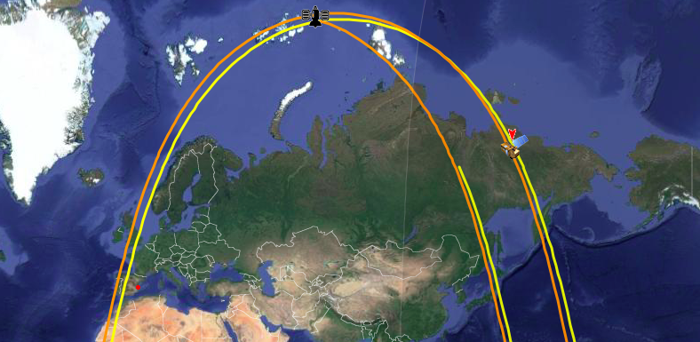
Intercomparisons at n-SNOs
Landsat-8 and Sentinel-2A overpass certain areas of the globe on a regular basis
60 scene pairs
Landsat-8
Greenland
n-SNO
Sentinel-2A
Notes:
TOA comparisons. OLI-MODISA meet always at +72.2deg (with 8min time difference)

Slide 13

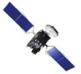

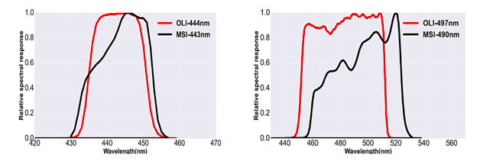
Intercomparisons at n-SNOs
Sun @t1
Considerations
    overpass times (t1-t2 < 30min)
    imaging geometry ( α < 7.5º)
    spatial sampling
    spectral responses
MSI@ t1
Sun @ t2
OLI @ t2
N. Pahlevan, J. R. Schott, B. A. Franz, G. Zibordi, B. Markham, S. Bailey, C. B. Schaaf, M. Ondrusek, S. Greb, and C. M. Strait, "Landsat 8 remote sensing reflectance (R rs) products: Evaluations, intercomparisons, and enhancements," Remote Sensing of Environment 190, 289-301 (2017).
N. Pahlevan, Z. Lee, J. Wei, C. Schaff, J. Schott, and A. Berk, "On-orbit radiometric characterization of OLI (Landsat-8) for applications in aquatic remote sensing," Remote Sensing of Environment 154, 272–284 (2014).
Notes:
TOA comparisons. OLI-MODISA meet always at +72.2deg (with 8min time difference)

Slide 14
Atmospheric Correction (Gordon & Wang 1994) to generate R_{rs}

Slide 15
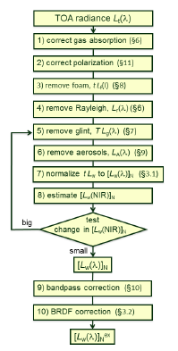

Atmospheric Correction (Gordon & Wang 1994)
Since late 90’s
Aerosol removal using band ratios of
  NIR + SWIR bands, or
  Two SWIR bands
R_{rs} [1/sr]: the ratio of water-leaving radiance to total downwelling irradiance just above the water surface
Implemented in NASA’s software suite (SeaDAS)
Gordon, H.R., & Wang, M. (1994). Retrieval of water-leaving radiance and aerosol optical thickness over the oceans with SeaWiFS: a preliminary algorithm. Appl. Opt., 33, 443-452
C. D. Mobley, J. Werdell, B. Franz, Z. Ahmad, and S. Bailey, "Atmospheric Correction for Satellite Ocean Color Radiometry," NASA/TM-2016-217551, GSFC-E-DAA-TN35509 (2016).

Slide 16
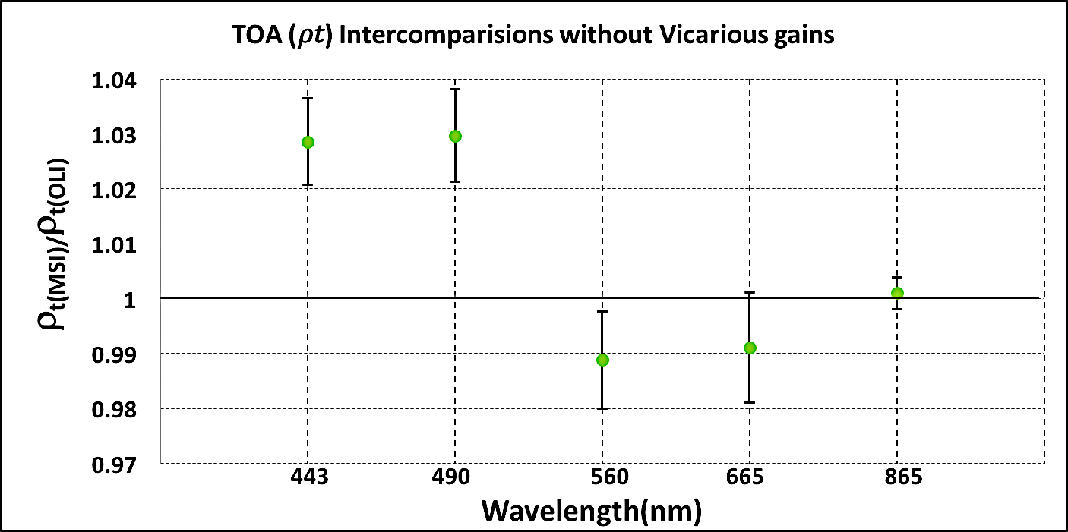
Intercomparisons at n-SNOs: Top-of-atmosphere (TOA)
Visible and near infrared (VNIR) bands. Error bars represent one standard deviation.

Slide 17
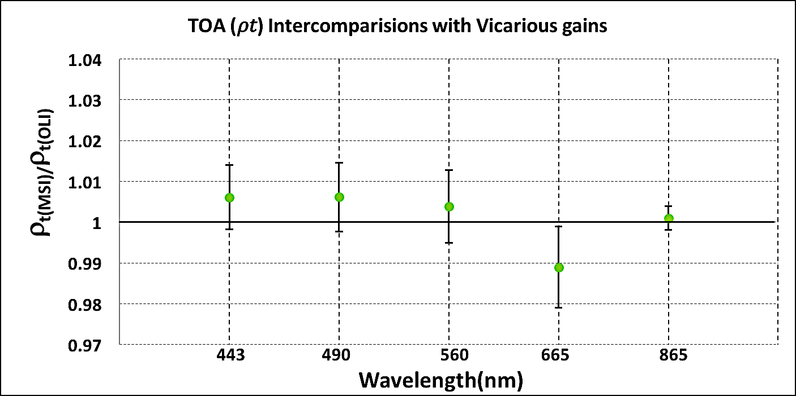
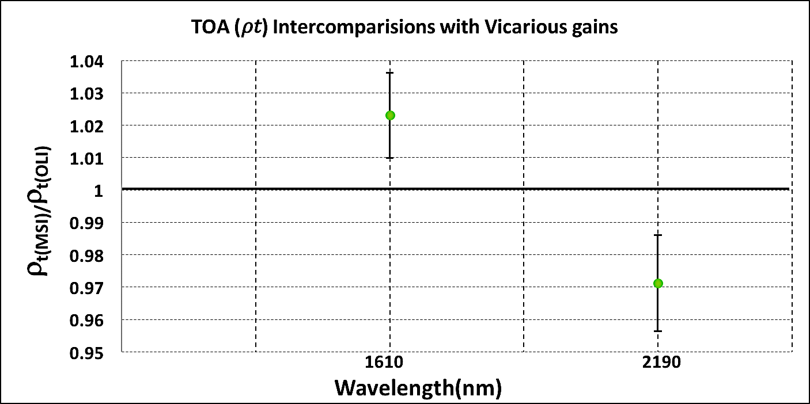
Intercomparisons at n-SNOs: Top-of-atmosphere (TOA)
Short-wave infrared (SWIR) bands. Error bars represent one standard deviation.

Slide 18
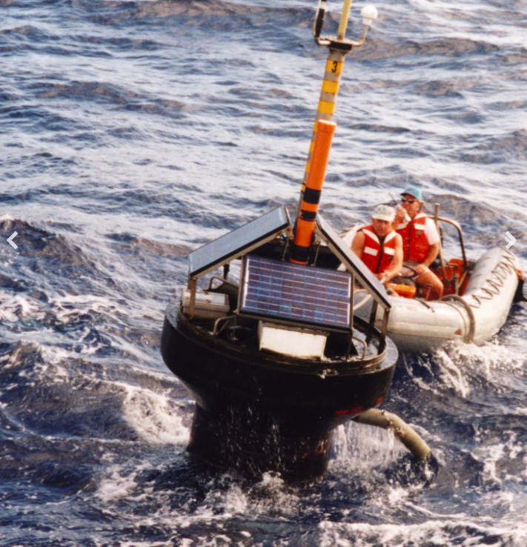
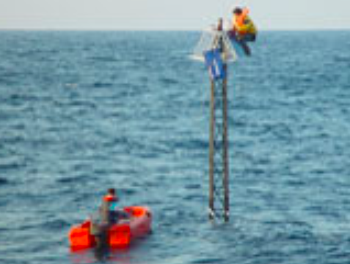


Vicarious calibration
MOBY (Lanai, Hawaii)
BOUSSOLE (Mediterranean Sea)
B. A. Franz, S. W. Bailey, P. J. Werdell, and C. R. McClain, "Sensor-independent approach to the vicarious calibration of satellite ocean color radiometry," Appl. Optics 46, 5068-5082 (2007).
N. Pahlevan, J. R. Schott, B. A. Franz, G. Zibordi, B. Markham, S. Bailey, C. B. Schaaf, M. Ondrusek, S. Greb, and C. M. Strait, "Landsat 8 remote sensing reflectance (R rs) products: Evaluations, intercomparisons, and enhancements," Remote Sensing of Environment 190, 289-301 (2017).
N. Pahlevan, S. Sarkar, B. A. Franz, S. V. Balasubramanian, and J. He, "Sentinel-2 MultiSpectral Instrument (MSI) data processing for aquatic science applications: Demonstrations and validations," Remote Sensing of Environment 201, 47-56 (2017).

Slide 19
Intercomparisons at n-SNOs: Top-of-atmosphere (TOA) - after vicarious calibration
Visible and near infrared (VNIR) bands. Error bars represent one standard deviation.

Slide 20
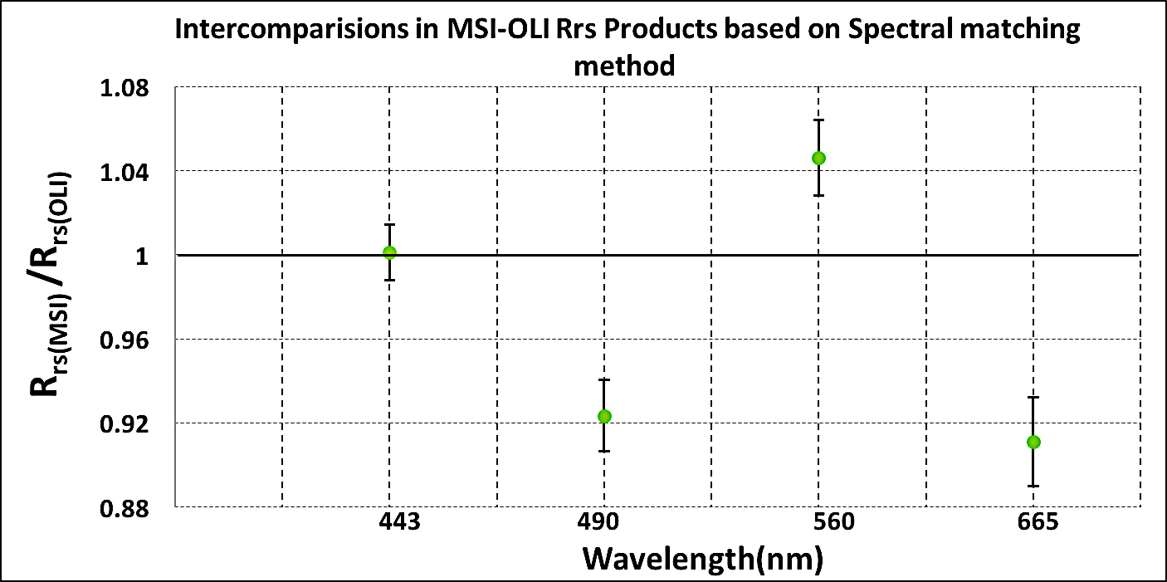
Intercomparisons at n-SNOs: R_{rs} – after vicarious calibration
Trained a deep neural network to do the spectral band adjustments
N. Pahlevan, B. Smith, C. Binding, and D. M. O’Donnell, "Spectral band adjustments for remote sensing reflectance spectra in coastal/inland waters," Optics Express 25, 28650-28667 (2017).

Slide 21
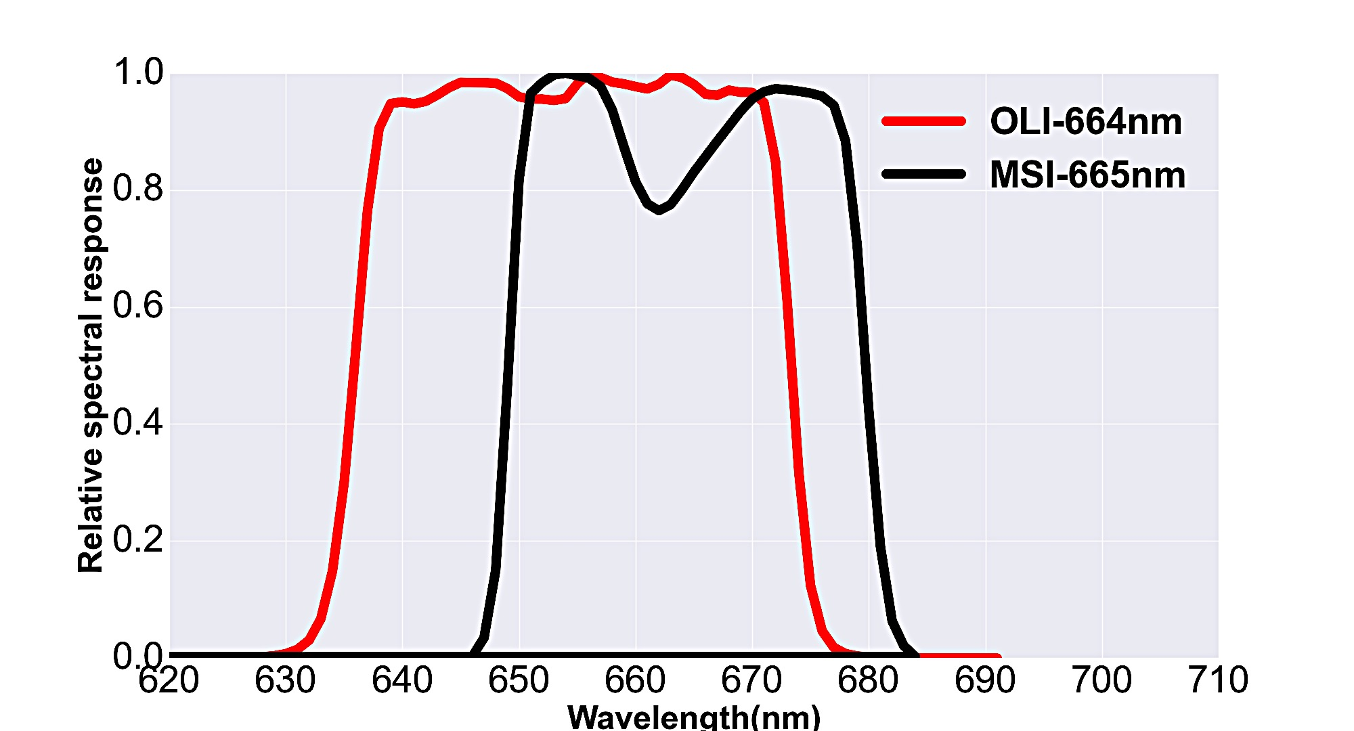
Intercomparisons at n-SNOs: R_{rs} – after vicarious calibration
N. Pahlevan, B. Smith, C. Binding, and D. M. O’Donnell, "Spectral band adjustments for remote sensing reflectance spectra in coastal/inland waters," Optics Express 25, 28650-28667 (2017).

Slide 22
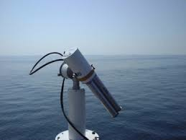
Analyze R_{rs} products at AERONET-OC sites
Ocean color component of AERONET

Slide 23
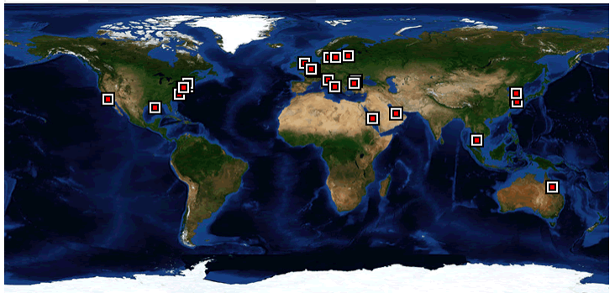
Analyze R_{rs} products at AERONET-OC sites
BOUSSOLE
MOBY

Slide 24
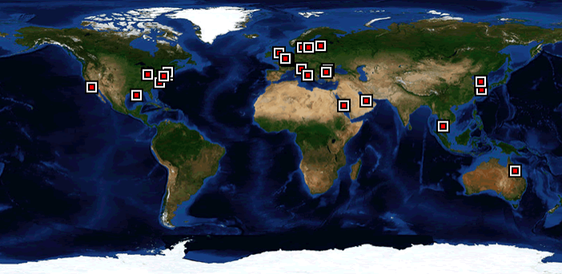
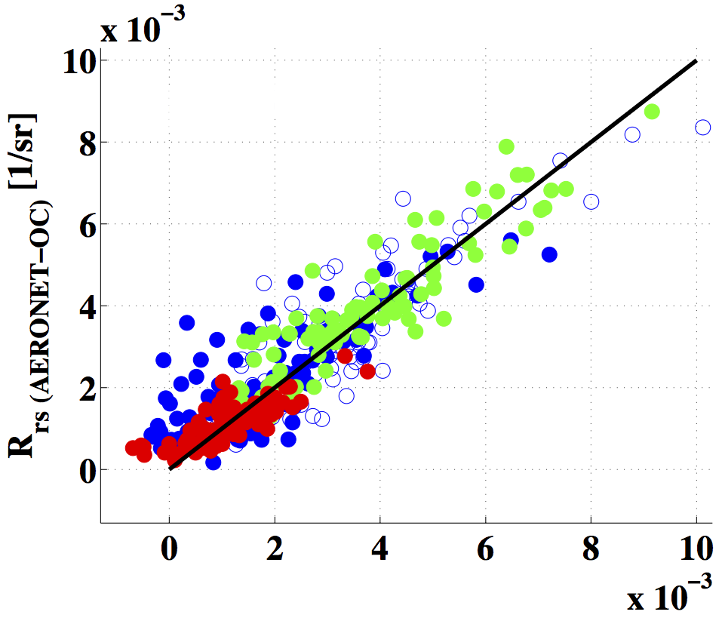
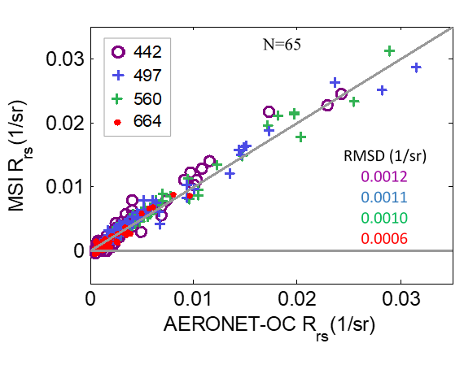
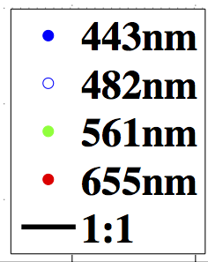
Analyze R_{rs} products at AERONET-OC sites
Landsat-8 /OLI
Sentinel-2A /MSI
RMSD (1/sr)
0.0009
0.0008
0.0007
0.0004
N=90
N=65
R_{rs} (Landsat-8) [1/sr]
N. Pahlevan, J. R. Schott, B. A. Franz, G. Zibordi, B. Markham, S. Bailey, C. B. Schaaf, M. Ondrusek, S. Greb, and C. M. Strait, "Landsat 8 remote sensing reflectance (R rs) products: Evaluations, intercomparisons, and enhancements," Remote Sensing of Environment 190, 289-301 (2017).
N. Pahlevan, S. Sarkar, B. A. Franz, S. V. Balasubramanian, and J. He, "Sentinel-2 MultiSpectral Instrument (MSI) data processing for aquatic science applications: Demonstrations and validations," Remote Sensing of Environment 201, 47-56 (2017).

Slide 25
Time-series applications

Slide 26
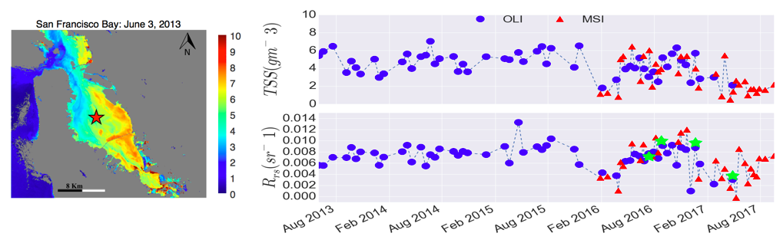
Time-series applications
443nm
N. Pahlevan, S. Chittimalli (2018) Landsat-8-Sentinel-2 product consistency and implications for monitoring aquatic systems. Submitted to Remote Sensing of Environment – Special issue on Sentinel-2 science results

Slide 27
How about image artifacts and noise?
After dealing with overall absolute calibration…

Slide 28
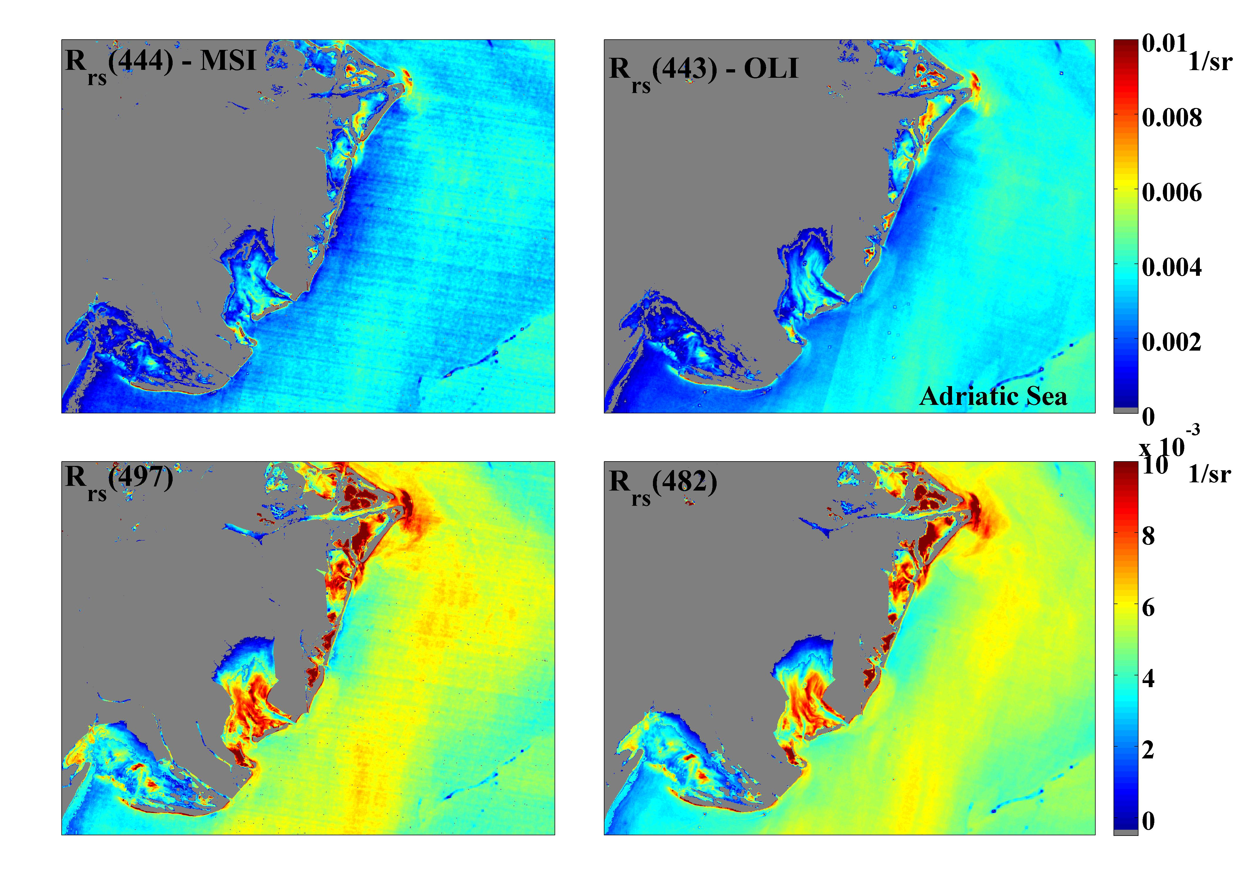
n-SNO event over Adriatic Sea (R_{rs} products)
N. Pahlevan, S. Sarkar, B. A. Franz, S. V. Balasubramanian, and J. He, "Sentinel-2 MultiSpectral Instrument (MSI) data processing for aquatic science applications: Demonstrations and validations," Remote Sensing of Environment 201, 47-56 (2017).

Slide 29
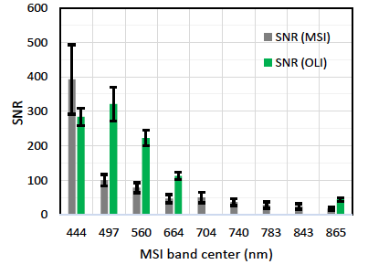
Signal-to-noise ratios (SNR)
N. Pahlevan, S. Sarkar, B. A. Franz, S. V. Balasubramanian, and J. He, "Sentinel-2 MultiSpectral Instrument (MSI) data processing for aquatic science applications: Demonstrations and validations," Remote Sensing of Environment 201, 47-56 (2017).

Slide 30
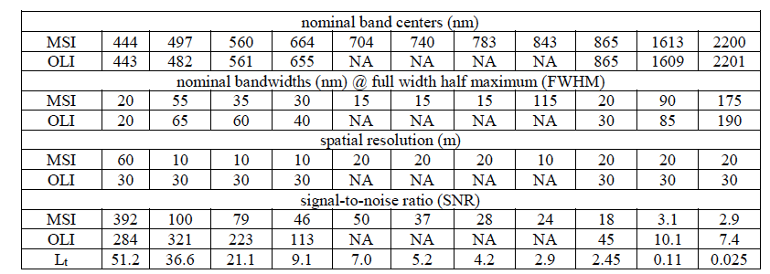
Signal-to-noise ratios (SNR)
N. Pahlevan, S. Sarkar, B. A. Franz, S. V. Balasubramanian, and J. He, "Sentinel-2 MultiSpectral Instrument (MSI) data processing for aquatic science applications: Demonstrations and validations," Remote Sensing of Environment 201, 47-56 (2017).

Slide 31
How about impact of calibration uncertainties in NIR & SWIR?

Slide 32
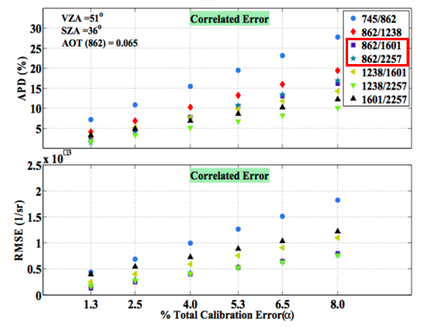
Impact of calibration uncertainties in NIR & SWIR:
Error in R_{rs}(443)
N. Pahlevan, J.-C. Roger, and Z. Ahmad, "Revisiting short-wave-infrared (SWIR) bands for atmospheric correction in coastal waters," Optics Express 25, 6015-6035 (2017).

Slide 33
Summary
Overall, OLI and MSI products are expected to be consistent after vicarious calibration
  Agree within +/- 1% at top-of-atmosphere reflectance domain (Visible + NIR bands)
  Agree within +/- 10% in remote sensing reflectance (R_{rs}) products (Visible)
  Agree within +/-5% in SWIR bands
  More image artifacts are expected in Sentinel-2 data
  The consistency can be improved as more data become available over cal sites

Slide 34
Recommendations
  Cal/Val teams should consider open ocean calibration sites and examine how changes in calibration impacts L2 products. Western Australia, San Miguel Island, MOBY, and BOUSSOLE are potential good sites.
  Calibration and Validation should go together, i.e., changes in calibration should be examined at Level-2.
  The calibration/validation should be routinely performed for both very dark and very bright targets. Cross-track uniformity should also be looked into over dark targets.
  The vicarious gain calculations over-water should follow heritage ocean color methodology
  Coordinated efforts between NASA-USGS/ESA Cal/Val teams

Slide 35
Acknowledgments
Funding
  NASA’s Landsat project science office

Slide 36
Backup: Differences in Spectral Samplings
Forward RT simulations
  Imaging geometries
    Orbit Altitude
    Relative azimuth angle
  NCEP Data
    Water vapor
    O3
    Wind speed (Cox-Monk BRDF)
  Input water-leaving radiance (modeled)
    Find the best fit by “spectral” matching
  Vary aerosol ( +/- 20% of retrieved values)
    Find the best fit by “spectral” matching
  Convolve with RSRs at 0.001nm
NCEP
Geometry
Varying aerosol
Modeled spectral
water-leaving radiance
MODTRAN
Multiple TOA Radiances
Optimize against OC TOA
radiance

Slide 37
Backup: TOA Ratios (averaged for four years)

Slide 38
Backup: R_{rs} Ratios (averaged for four years)

