Slide 1
Geometric and Spatial Aspects of Data Interoperability
13 November 2017
James Storey
Landsat Geometric Calibration Team, USGS/EROS/SGT
Contractor to the USGS under contract #G15PC00012
Contact: James.C.Storey@nasa.gov, (301) 614-6683
Notes:
Update title slide with subtitle, date, presenter(s), title, organization, email address, and phone number

Slide 2
Overview
Geometric Calibration
  Geolocation accuracy and internal geometric accuracy
Reference Data Sets
  Ground control (L8) and reference images (S2)
  Digital elevation models
  Consistency vs. accuracy
Image registration accuracy
  Landsat-8 / Sentinel-2 predicted and measured
  Steps to improve interoperability
  Other aspects of registration
Spatial Performance
  Spatial response and sampling
  Spatial normalization
Notes:
Start with a brief review of Landsat 8 geometric performance highlights with a reference to the separate handout.
Review the results of the completed phase 1, 2, 3 GCP improvement activities and note that all of those improvements were included in Collection-1.
Show an estimate of the current accuracy of the GLS across the world, based upon Landsat 8 measurements (the average observed offset at each path/row).
Provide a status update on the Sentinel-2 harmonization phase 4 activity including:
Predicted and measured L8/S2 registration accuracy.
Phase 4 approach for improving registration.
Status of Phase 4 GCP extraction and triangulation.
Plans for integrating S2 MSI tie points.

Slide 3
Geometric Calibration
What is geometric calibration?
  Measuring key elements of the sensor line-of-sight model to improve pointing knowledge accuracy.
  This may be internal to the sensor, e.g., relative band alignment, sensor chip placement; or external to the sensor, e.g. sensor to attitude control system alignment.
Geometric calibration parameters are typically measured during prelaunch integration and test.
  Some parameters can change from ground test to on-orbit operations due to launch shift and zero-G release.
  Angular parameters can often be measured more accurately on-orbit due to the long lever arm to the Earth.
Geometric calibration is part of commissioning.
  So is spacecraft attitude control system calibration.

Slide 4
L8 Geometric Calibration Operations
Operation | Parameter | Purpose | Frequency
OLI Sensor Alignment | OLI to ACS alignment matrix | Estimate OLI orientation relative to attitude control system to improve absolute pointing knowledge / geolocation. | During commissioning and quarterly as needed.
OLI Focal Plane Alignment | Pan band sensor chip lines-of-sight | Estimate corrections to pan band line-of-sight model for each sensor chip assembly to improve internal alignment of sensor modules. | During commissioning. Monitor and update if needed.
OLI Band Alignment | MS band sensor chip lines-of-sight | Estimate corrections to MS band line-of-sight models to improve band-to-band alignment, holding pan band fixed. | During commissioning. Monitor and update if needed.
TIRS Alignment - External | TIRS to OLI alignment matrix | Estimate corrections to TIRS-to-OLI alignment and to TIRS 10.8 micron band line-of-sight model for each sensor chip assembly. TIRS-to-OLI and SCA-to-SCA alignments can be estimated simultaneously or separately. | During commissioning and quarterly as needed.
TIRS Alignment - Internal | 10.8 band sensor chip lines-of-sight |  | During commissioning. Monitor and update if needed.
TIRS Band Alignment | 12.0 band sensor chip lines-of-sight | Estimate corrections to 12.0 micron band line-of-sight models to improve band-to-band alignment, holding 10.8 micron band fixed. | During commissioning. Monitor and update if needed.
TIRS Scene Select Mechanism | SSM rotational position | Estimate SSM pointing model using TIRS-to-OLI registration measurements. Added post-launch due to failure in SSM encoder electronics. | Biweekly with daily updates.

Slide 5
Calibration Objectives – Internal Geometry
Accurate internal image geometry is a prerequisite for accurate sensor-to-sensor registration.
Sensor chip to sensor chip alignment
  OLI focal plane calibration
  TIRS internal alignment calibration
Band to band alignment
  OLI band alignment calibration
  TIRS band alignment calibration
  TIRS external alignment calibration (emissive to reflective)
  TIRS SSM calibration (emissive to reflective)
Details will vary with sensor architecture
Internal accuracy also depends upon accurate short-term attitude, position, and timing knowledge

Slide 6
Calibration Objectives – External Geometry
Calibration is required to maintain geolocation accuracy for products that are not referenced to ground control points.
  This is the role of OLI to ACS alignment calibration.
  Accurate absolute geolocation knowledge is important for scenes for which ground control does not exist or cannot be matched (e.g., due to clouds).
  Accurate absolute geolocation also assists in control point location and correlation reliability.
For products that use ground control, the control point accuracy will drive product accuracy.
  Fitting to ground control can be thought of as a per-scene calibration that ensures product-to-product consistency.
  The ground control points also provide the reference for OLI to ACS alignment calibration.

Slide 7
Landsat Geometric Correction
Landsat products are registered to control points derived from the Global Land Survey (GLS) data.
  This is done to ensure multi-temporal registration across the entire Landsat archive.
L8 absolute geolocation is slightly more accurate than the GLS.
  L8 was used to improve the GLS control in a few areas prior to the Collection-1 reprocessing.
Repeated L8 measurements can be used to estimate the accuracy of the GLS control at each WRS-2 path/row location.
  Compute the averaged measured offset between each L8 scene acquired and the GLS ground control.
  These offsets are routinely measured as part of the product generation process.
Notes:
Phases 1, 2, and 3 updated 2269 path/row locations (of ~9500) including all of Australia.
The affected path/rows are listed on the Landsat web site.
These updates have been incorporated in the Landsat GCP database and were used in Collection-1 processing.

Slide 8
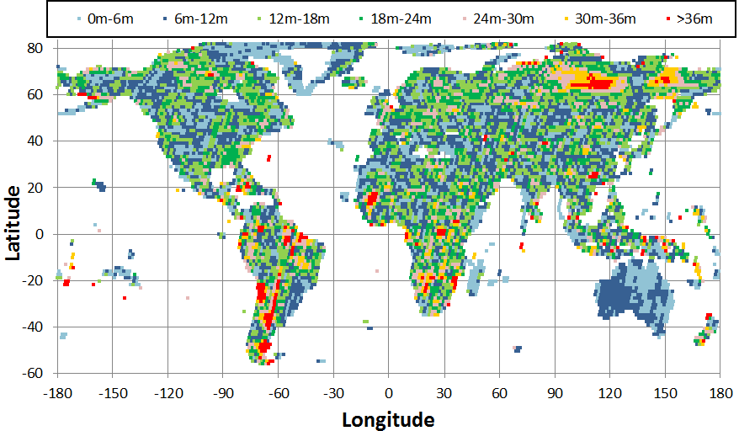
L8 Estimate of Collection-1 Horizontal Error
Notes:
This plot, derived from Collection-1 data, shows the mean (pre-correction) offset between the L8 images and the GLS control. This provides an estimate of the remaining errors in the GLS framework.
This plot can be toggled/flickered with the previous plot to show that the phase 1/2/3 update areas are now in the good blue/green regions.

Slide 9
S2 GRI Development (as we understand it)
Current Sentinel-2 products are generated without the use of ground control.
  S2 absolute geolocation accuracy is excellent, but better multi-temporal registration is desired.
Sentinel-2 is constructing a set of global reference images (GRI) to ensure multi-temporal registration.
  This reference is being established through a series of continental-scale triangulation blocks of Multi-Spectral Instrument (MSI) data.
  High resolution images are being used to control the blocks.
Once complete, the Sentinel-2 products will be reprocessed using the GRI as a control reference.
Notes:
Sentinel-2 is establishing their own global geometric framework by triangulating large blocks of MSI data. The result will be a set of global reference images (GRI) to which all MSI data will be registered to ensure consistency.
The discrepancies between this GRI framework and the GLS are likely to be larger than the science community will find acceptable.
This gives us “permission” to update the entire GLS to enhance accuracy globally while improving consistency with MSI data.
The referenced paper describes this situation in somewhat more detail.
Direct measurements of L8 OLI to S2 MSI registration (see next chart) have shown registration accuracy that is close to, but slightly better than the prediction.

Slide 10
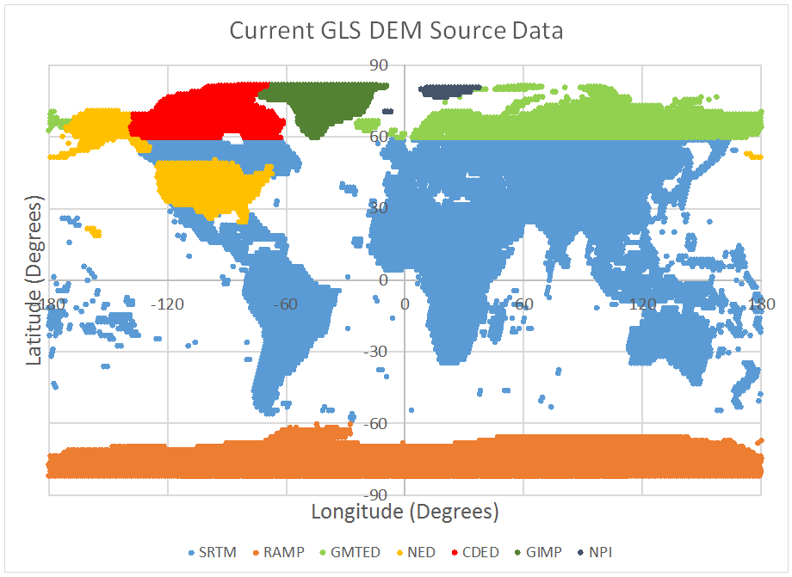
Digital Elevation Data
The final accuracy of terrain corrected image products also depends upon the accuracy of the digital elevation model (DEM) used in processing.
  The sensitivity is a function of sensor viewing geometry.
Absolute DEM accuracy is required since the effects are sensor dependent.
The plot shows the current GLS DEM sources.
Seek better sources for GMTED areas.

Slide 11
Impact on Interoperability
The primary objective of geometric calibration and correction for sensor interoperability is ensuring sensor-to-sensor registration accuracy.
This requires using common or at least consistent ground control/reference image data.
  Consistency is more important for registration than absolute accuracy.
  High frequency errors are still problematic as they create internal inconsistency in the control framework.
Elevation-induced errors depend upon the sensor viewing geometry, and so are sensor specific.
  Accuracy is thus more important for registration than consistency when it comes to elevation data.

Slide 12
Predicted Landsat – Sentinel-2 Registration
Given the estimated accuracies of the GLS (17m RMSEr) and MSI data (10m 2σ), L8-to-S2 misregistration of up to ~26m 2σ can be expected.
  Better registration is required by the user community.
  Provides motivation to improve the GLS while making it consistent with the Sentinel-2 GRI framework.
  Reference: “A note on the temporary misregistration of Landsat-8 Operational Land Imager (OLI) and Sentinel-2 Multi Spectral Instrument (MSI) imagery”, J. Storey, D.P. Roy, J. Masek, F. Gascon, J. Dwyer, and M. Choate, Remote Sensing of Environment 186 (2016) pp. 121-122.
Direct registration measurement results are slightly better than predicted.
Notes:
Sentinel-2 is establishing their own global geometric framework by triangulating large blocks of MSI data. The result will be a set of global reference images (GRI) to which all MSI data will be registered to ensure consistency.
The discrepancies between this GRI framework and the GLS are likely to be larger than the science community will find acceptable.
This gives us “permission” to update the entire GLS to enhance accuracy globally while improving consistency with MSI data.
The referenced paper describes this situation in somewhat more detail.
Direct measurements of L8 OLI to S2 MSI registration (see next chart) have shown registration accuracy that is close to, but slightly better than the prediction.

Slide 13
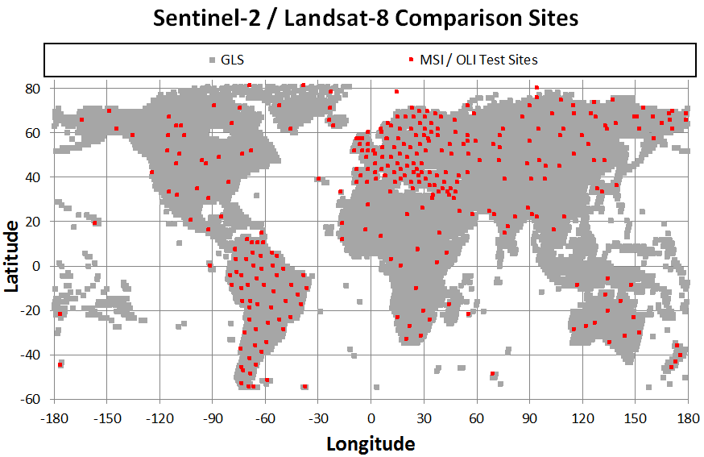
Measured L8 / S2 Misregistration
L8/S2 registration accuracy was measured at 317 sites at the locations shown in the plot.
Summary results:
Test site distribution:
Notes:
L8/S2 registration was measured at 257 sites distributed globally. Recall that this registration uses S2 data that has not yet been aligned to the Geographic Reference Image (GRI) which is still under construction.
These results are based on the current GLS ground control.
The overall L8/S2 registration accuracy was around 22 meters 2-sigma versus a prediction of 26 meters 2-sigma, but there is some regional variation.
A few “interesting” notes:
The test sites are dense over Europe because that area was used to prototype and test the methods that will be used to incorporate S2 tie points in the final Phase 4 triangulation.
Even though Australia was the most accurate region, the performance there was slightly disappointing given that the GLS in Australia has been registered to the AGRI data.

Slide 14
L8/S2 Registration Improvement Plan
Perform global readjustment of the GLS control using L8 data with sparse ties to Sentinel-2 GRI.
  Six triangulation blocks have been identified to perform this global readjustment (see next chart).
L8-only triangulations are complete for all blocks.
  New OLI GCPs were also extracted for all blocks.
  The adjusted control is available for testing but is not yet being used for product generation.
When the S2 GRI data become available, we will re-run the triangulation solution with MSI control added to a subset of scenes.
  Some MSI control will be withheld to test the triangulation.
  Validate using OLI-MSI image registration measurements.
Notes:
As a first step, we have identified 13 triangulation blocks (really 12 plus islands) covering all GLS path/rows. These are shown on the next chart.
Australia is one of these blocks. We have extracted new OLI GCPs over Australia, including in some island/reef areas not previously covered by GLS control. We did not initially plan to readjust Australia since it is already registered to the Geoscience Australia AGRI framework, but re-triangulation (with AGRI control) proved to be necessary to include the new areas.
GCP extraction and L8-only triangulation has been performed for 12 blocks with the Island block now in work. The South America block, which was the first block processed, is now being reworked to include some more recent imagery that is more cloud-free than what had previously been available.
As the GRI framework becomes operational we will extract MSI GCPs and use them to constrain a second adjustment. The 13 blocks will be consolidated into 6 blocks for this final triangulation to reduce the risk of discontinuities at block boundaries.

Slide 15
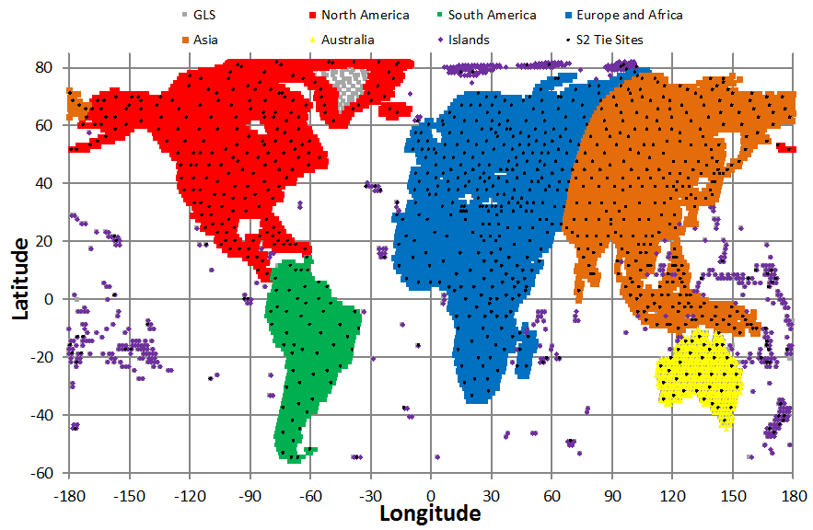
L8 Triangulation Blocks with S2 Tie Sites
Notes:
Efficiency improvements in the triangulation algorithm has made it practical to process large blocks. This has the advantage of reducing block-to-block seams where special measures must be taken to enforce continuity across blocks.
The locations of the planned S2 tie point sites are shown as black dots.

Slide 16
Other Aspects of Registration
Geometric registration, as used thus far, refers to the degree to which two image products report the same positions for common features.
A stricter definition would be the degree to which corresponding image pixels report the reflectance (or radiance) of the same ground area.
  This brings in the additional elements of sampling pattern, pixel alignment, and sensor spatial response.
Even if two sensors use the same map projection, sample spacing, sampling grid definition, and pixel alignment reference (corner vs. center), differences in spatial response will prevent the data from being seamlessly interoperable.

Slide 17
MSI and OLI Spatial Response
The sensor point spread function (PSF) describes the target area that the sensor integrates to yield one pixel (sample) value.
  The PSF is often assumed to be rectangular but this is only an approximation.
Product generation image resampling effects also impact the final product spatial response.
  The resampling kernel should also be considered in determining a product spatial response.
  This is complicated by the fact that the response of many resampling functions varies with phase.
  Convolving the sensor PSF with an average resampling kernel response can provide a reasonable product PSF.

Slide 18
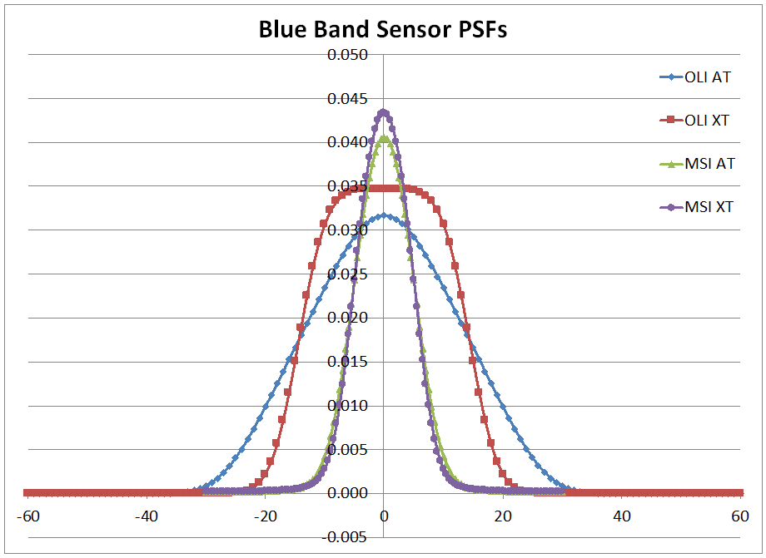
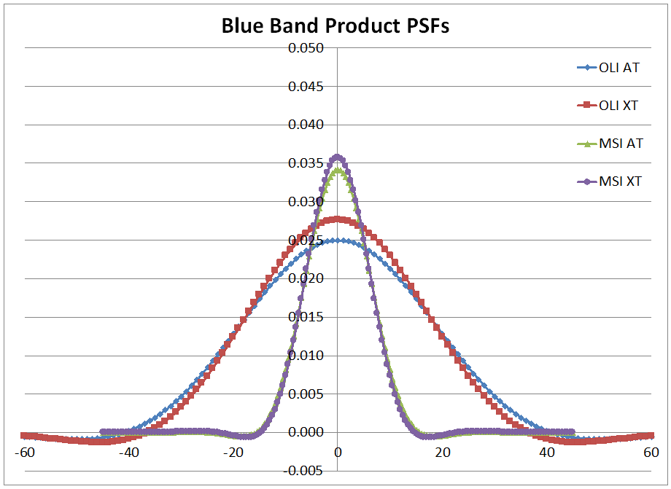
MSI and OLI Sensor and Product PSFs
The plots below compare the sensor PSFs (left) and product PSFs (right) for the (10m) MSI blue band and the (30m) OLI blue band.
  Along- and across-track PSFs are plotted for each.

Slide 19
L8 and S2 Sampling Patterns
L8 and S2 both use the UTM projection but the sampling patterns are different:
The difference in sample spacing reflects the difference in sensor detector dimension.
Some form of pixel aggregation is required to normalize spatial response.
Seek to avoid introducing unwanted phase shifts in the aggregation procedure.
 | Landsat 8 | Sentinel 2
Pixel spacing | 30m/15m | 60m/20m/10m
Pixel reference | Pixel center | Pixel corner
Grid alignment | Pixel centers at whole multiples of pixel spacing | Pixel corners at whole multiple of pixel spacing

Slide 20
MSI 20m vs. OLI 30m Sampling
There are four cases of 20m MSI and 30m OLI pixel alignment.
These four cases result in 2x2, 3x3, 3x2, and 2x3 pixel aggregation to synthesize OLI samples from MSI samples.
MSI Pixels
OLI Pixel

Slide 21
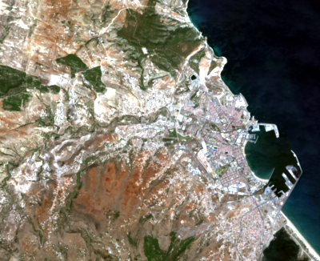
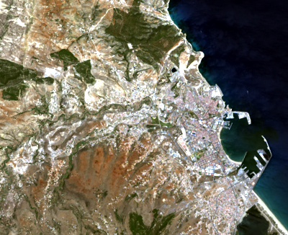
Spatial Normalization
Can derive pixel aggregation weights that best fit the sum of the MSI PSFs to the OLI PSF.
  Need to derive weights for each aggregation case.
  Aggregation also has radiometric impacts.
MSI 4:3:2 @ 30m for R051_199/036
OLI 4:3:2 @ 30m for 199/036

Slide 22
Summary
Accurate geometric calibration is necessary.
  For internal geometric accuracy including band-to-band.
  Geolocation accuracy is beneficial but secondary.
Supporting data must be accurate and consistent.
  Ground control / reference image frameworks must be consistent (more important than accuracy).
  Elevation models must be accurate (more important than consistency unless viewing geometry is the same).
Direct product-by-product registration is possible but it is better to build in geometric consistency.
Differences in spatial response will affect cross-comparison results.
  Response can be normalized, but usually only “downward” (toward the lower resolution sensor).
  Impacts on radiometry (e.g., SNR) must be considered.
Notes:
Landsat 8 geometric performance continues to be stable.
The original three phases of planned GCP improvement are complete and were part of Collection-1.
Phase 4 of GCP improvement for Sentinel-2 harmonization is in progress.
The objective is to improve the current 22m (measured) to 26m (predicted) 2-sigma L8/S2 registration error.
New OLI GCP extraction and L8-only triangulation are complete for 11 of 13 blocks.
Final triangulation with S2 tie points will be performed using 5 or 6 blocks to minimize block-to-block seams.
Phase 4 completion will lag the availability of Sentinel-2 GRI by 3-6 months (late 2017/early 2018).
Phase 4 will require a complete archive reprocessing (collection #2).

