Slide 1
Lessons Learned with VIIRS On-orbit Radiometric Calibration in Reflective Solar Bands (RSBs)
Taeyoung Choi^{1,2}, Sirish Uprety^{2,3} , Slawomir Blonski^{1,2}, Xi Shao^{2,3}, Wenhui Wang^{1,2} Changyong Cao²
¹Global Science & Technology (GST), Inc.,
7855 Walker Dr., Suite 200, Greenbelt, MD 20770, U.S.A
²NOAA Center for Satellite Applications and Research (STAR)
5830 University Research Ct. College Park MD 20740-3818, U.S.A.
³University of Maryland, College Park, MD 20740, U.S.A.
September 23, 2018 ECCOE meeting

Slide 2
Outline
Introduction
  About VIIRS and Prelaunch Calibration
Primary RSB Calibration
  Primary Solar Diffuser (SD) and Solar Diffuser Stability Monitor (SDSM) calibration
Alternative RSB Calibration using the Moon
Lessons Learned
  SD/F-factor related issues
  SD vs. Lunar F-factors
  Operational F-factor LUT (for production)
  Deep Convective Cloud (DCC)
  Simultaneous Nadir Observations (SNO)
Summary

Slide 3
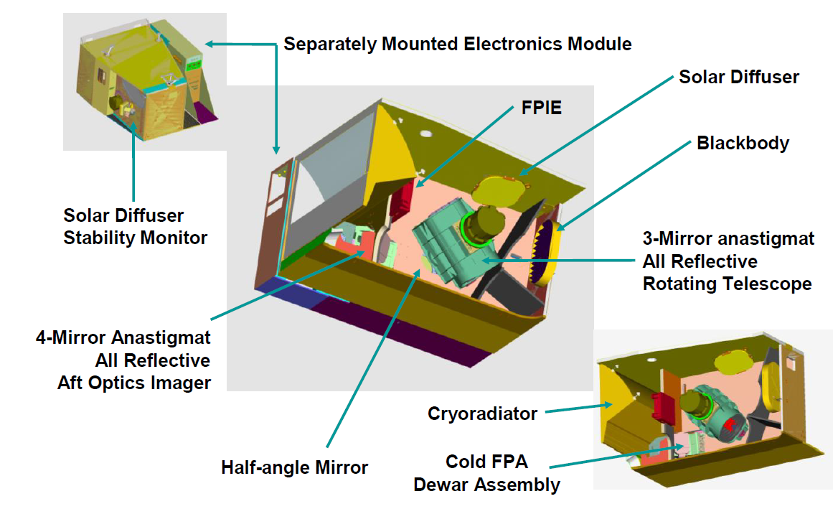
Introduction
Visible Infrared Imaging Radiometer Suite (VIIRS) is a scanning radiometer on Suomi-NPP and NOAA 20 satellites at ~829 km altitudes.
  NOAA 20 local time of equator crossings is ~1:25 pm. NOAA 20 is ~30 sec later than SNPP.
It produces radiometric measurements with moderate spatial resolutions and 22 spectral bands.
Source: VIIRS Radiometric ATBD.

Slide 4
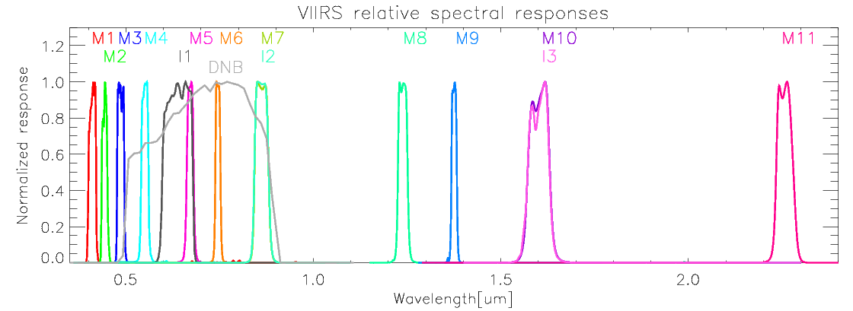
Introduction
Spectral Bands of the VIIRS RSB and Day/Night Band (DNB)
  RSB cover a spectral range from 0.412 μm to 2.25 μm.
  There are 14 RSB with 3 image bands (I1-I3) and 11 moderate bands (M1-M11).
  RSB band calibration is dependent on Solar Diffuser (SD) and Solar Diffuser Stability Monitor (SDSM) observations.
  The required RSB calibration uncertainty is 2 percent.

Slide 5
Introduction
Prelaunch calibration of VIIRS sensors are mostly done by JPSS government team
  Sensor Vendor : Raytheon
  NASA : VIIRS Characterization Support Team (VCST)
  NOAA: VIIRS Science Data Record (SDR) team
  Aerospace Corp.
  University of Wisconsin
Test data sets were independently analyzed and reviewed.
  In the Data Review Board (DRB) team, Data Analysis Working Group (DAWG) team, VIIRS SDR team meeting.
All the prelaunch calibration related parameters were delivered in the binary Look-Up-Table (LUT) form.
Requirement: 2% reflectance uncertainty at Ltyp for all RSB
Prelaunch measurements met the requirements (~1.5~1.6% level except M11 ~ 2.6%).

Slide 6
Introduction
There are 42 LUTs for VIIRS production.
1 | VIIRS-RSBAUTOCAL-BRDF-SCREEN-TRANSMISSION-PRODUCT-RTA-VIEW-LUT
2 | VIIRS-RSBAUTOCAL-BRDF-SCREEN-TRANSMISSION-PRODUCT-SDSM-VIEW-LUT
3 | VIIRS-RSBAUTOCAL-DNB-DARK-SIGNAL-AUTOMATE-LUT
4 | VIIRS-RSBAUTOCAL-DNB-GAIN-RATIOS-AUTOMATE-LUT
5 | VIIRS-RSBAUTOCAL-DNB-LGS-GAIN-AUTOMATE-LUT
6 | VIIRS-RSBAUTOCAL-DNB-MOON-ILLUMINATION-LUT
7 | VIIRS-RSBAUTOCAL-H-AUTOMATE-LUT
8 | VIIRS-RSBAUTOCAL-H-LUT
9 | VIIRS-RSBAUTOCAL-ROT-MATRIX-LUT
10 | VIIRS-RSBAUTOCAL-RSB-F-AUTOMATE-LUT
11 | VIIRS-RSBAUTOCAL-RVF-LUT
12 | VIIRS-RSBAUTOCAL-SDSM-SOLAR-SCREEN-TRANS-LUT
13 | VIIRS-RSBAUTOCAL-SDSM-TIME-LUT
14 | VIIRS-RSBAUTOCAL-VOLT-LUT
15 | VIIRS-SDR-DELTA-C-LUT
16 | VIIRS-SDR-DG-ANOMALY-DN-LIMITS-LUT
17 | VIIRS-SDR-F-PREDICTED-LUT
18 | VIIRS-SDR-OBS-TO-PIXELS-LUT
19 | VIIRS-SDR-QA-V2-LUT
20 | VIIRS-SDR-RADIOMETRIC-PARAM-V4-LUT
21 | VIIRS-SDR-REFLECTIVE-LUT
22 | VIIRS-SDR-RELATIVE-SPECTRAL-RESPONSE-LUT
23 | VIIRS-SDR-RVF-LUT
24 | VIIRS-SDR-SOLAR-IRAD-LUT
25 | VIIRS-SDR-TELE-COEFFS-LUT
26 | VIIRS-SDR-CAL-AUTOMATE-LUT
27 | VIIRS-SDR-DNB-DN0-LUT
28 | VIIRS-SDR-DNB-FRAME-TO-ZONE-LUT
29 | VIIRS-SDR-DNB-GAIN-RATIOS-LUT
30 | VIIRS-SDR-DNB-LGS-GAINS-LUT
31 | VIIRS-SDR-DNB-RVF-LUT
32 | VIIRS-SDR-DNB-STRAY-LIGHT-CORRECTION-LUT
33 | VIIRS-SDR-BB-TEMP-COEFFS-LUT
34 | VIIRS-SDR-EBBT-LUT
35 | VIIRS-SDR-EMISSIVE-V2-LUT
36 | VIIRS-SDR-HAM-ER-LUT
37 | VIIRS-SDR-OBC-ER-LUT
38 | VIIRS-SDR-OBC-RR-LUT
39 | VIIRS-SDR-RTA-ER-LUT
40 | VIIRS-SDR-GEO-DNB-PARAM-V2-LUT
41 | VIIRS-SDR-GEO-IMG-PARAM-V2-LUT
42 | VIIRS-SDR-GEO-MOD-PARAM-V2-LUT

Slide 7
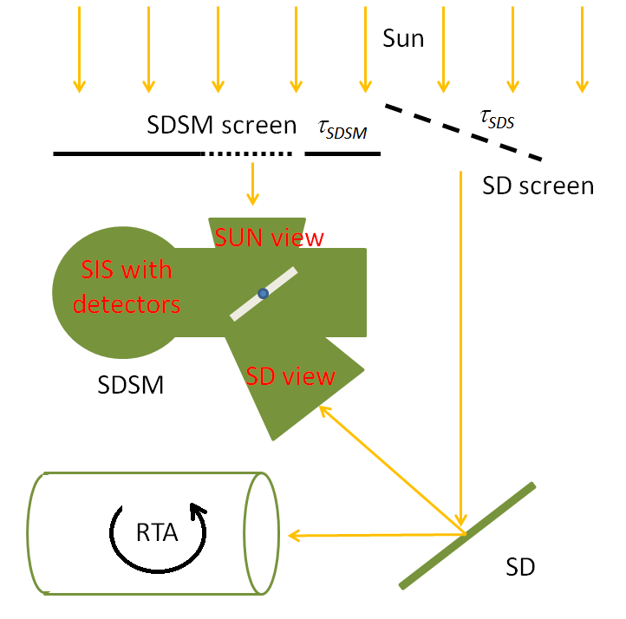
Primary Reflective Solar Band (RSB) Calibration
F: RSB Calibration coefficient.
H: SD degradation factor.
LUT15
LUT12
LUT2
LUT1
dn: VIIRS bias removed response
dc: SDSM bias removed response

Slide 8
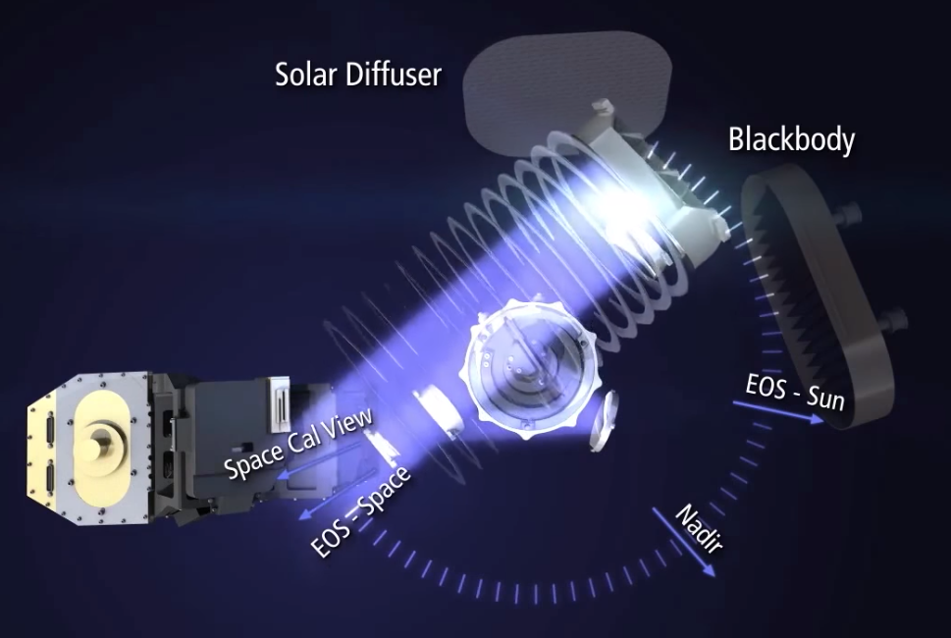
Alternative RSB Calibration
VIIRS monthly lunar observations through SV.

Slide 9
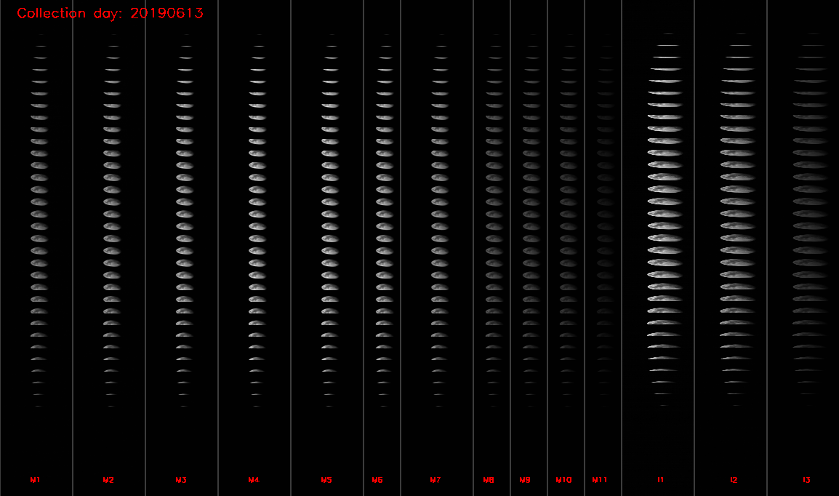
Alternative RSB Calibration
VIIRS monthly lunar observations through SV.

Slide 10
Alternative RSB Calibration
Lunar F-factor: as the secondary calibration coefficient
The lunar F-factor is calculated as a ratio between the theoretical lunar irradiance and observed lunar irradiance.
  I_{GIRO} : band dependent lunar irradiance value from the the Global Space-based Inter-Calibration System (GSICS) Implementation of RObotic lunar observatory (GIRO v1.0.0) model (at https://gsics.nesdis.noaa.gov/wiki/Development/LunarWorkArea ), φ: moon phase angle, L_{Avg}: averaged radiance of the effective lunar pixels, R_{moon}: moon radius, Dist_{Sat_Moon}: distance between satellite and moon

Slide 11
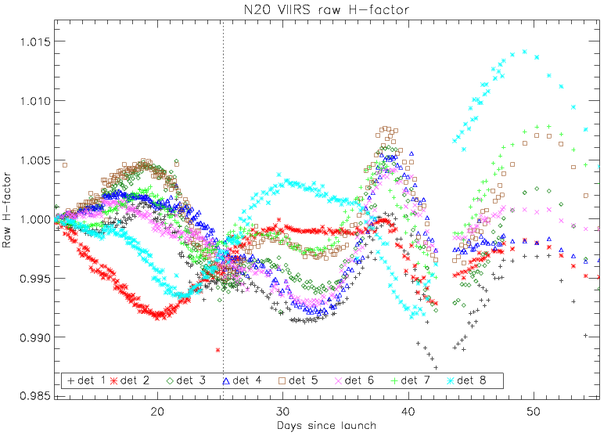
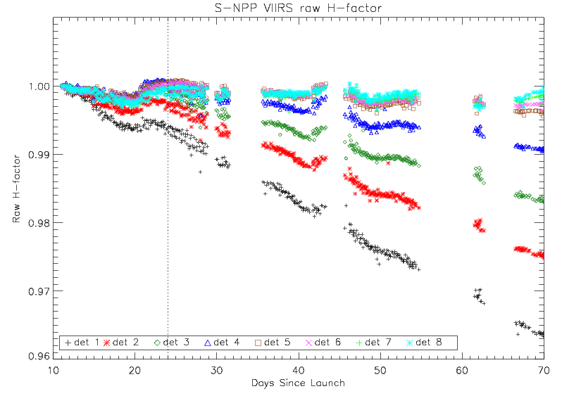
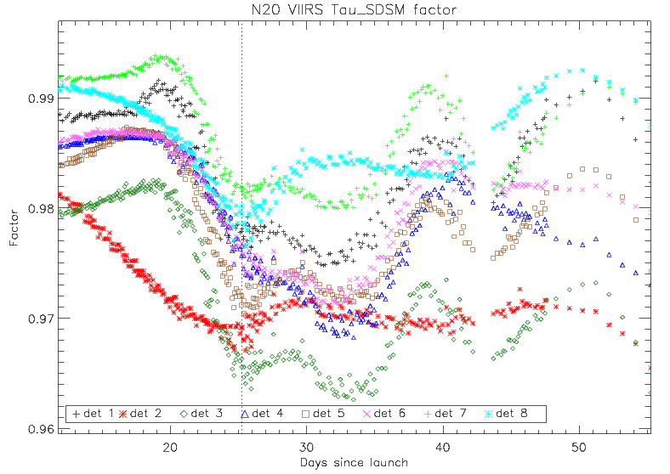
Lessons Learned: SD/F-factor Related Issues
Initial calculations of SD degradations (H-factors) indicated potential problems with prelaunch transmission and BRDF LUTs
The H-factor large oscillations were mainly caused by the τ_{SDSM} LUT as shown in the second plot.
N20 VIIRS SD showed significantly less degradation compared to SNPP VIIRS case.
Nadir door open
Nadir door open
S-NPP VIIRS
Nadir door open
T. Choi, S. Blonski, and C. Cao, “Initial on-orbit radiometric calibration of the NOAA 20 VIIRS reflective solar bands,” in SPIE Optical Engineering and Applications, San Diego, USA, 2018.

Slide 12
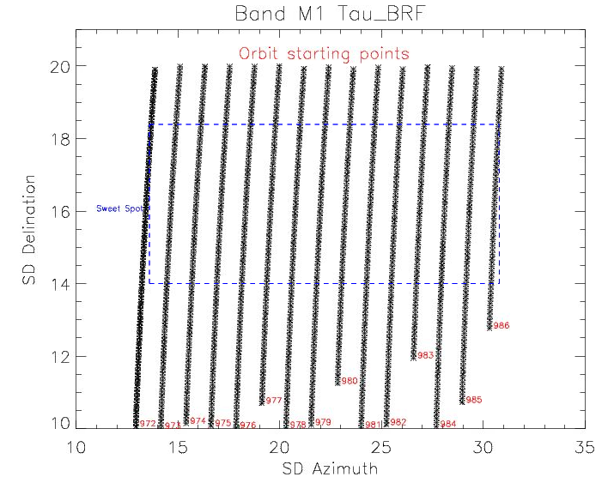
Lessons Learned: SD/F-factor Related Issues
A total of 15 yaw maneuvers were performed on 25~26 of January, 2018.
Recalculated on-orbit τ_{SDS}⋅BRDF_{SD_RTA}, τ_{SDS}⋅BRDF_{SD_SDSM}, and τ_{SDSM} LUTs and compared to prelaunch LUTs.
LUT12
LUT2
LUT1

Slide 13
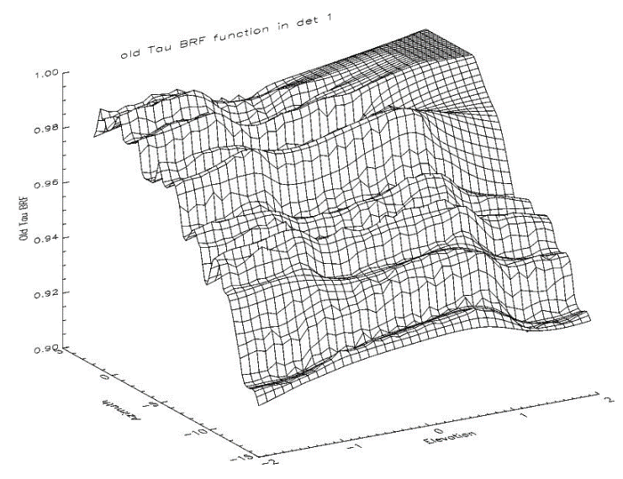
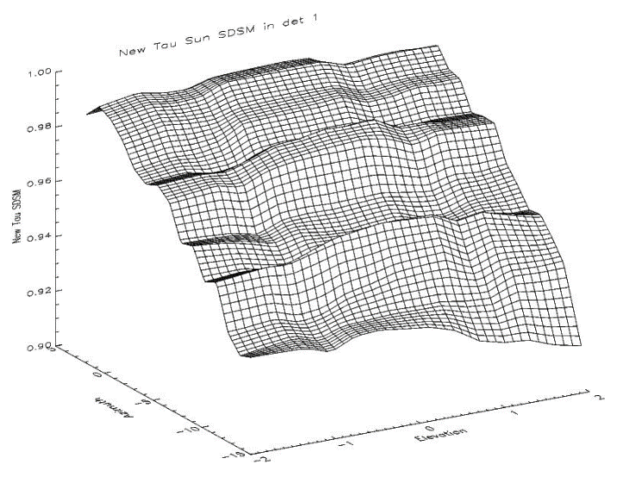
Lessons Learned: SD/F-factor Related Issues
There were noticeable differences between the pre-launch and on-orbit versions of the τ_{SDSM}.
  Pre-launch LUT showed distinctive higher frequency ridge lines along with azimuth direction.
Because of these larger difference in the τ_{SDSM} function than other SDSM and SD BRF results, there were large H-factor oscillations.
To fill up the micro features correctly, the regular on-orbit SDSM data collections were added in the τ_{SDSM} derivation.
Prelaunch
Yaw derived

Slide 14
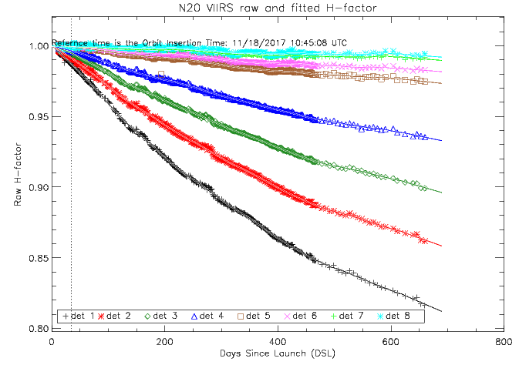
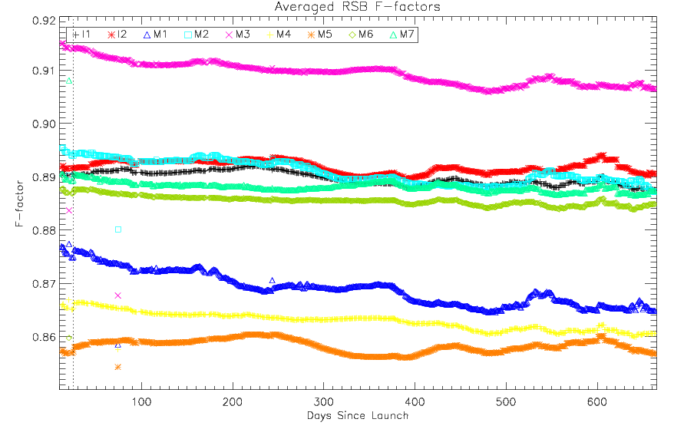
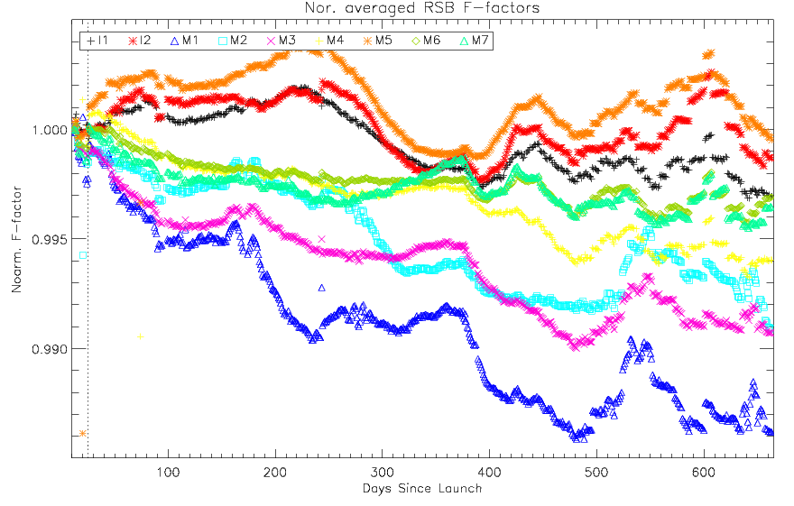
Lessons Learned: SD/F-factor Related Issues
The detector 7 and 8 H-factors were flatted after the SDSM time-dependent gain correction
The H-factors are updated, extrapolated and normalized to the orbit insertion time
After resolving the H-factor issues, it was applied to calculate F-factors
  F-factors are very stable (changes are around 1% or less)
  N20 F-factors are lower than S-NPP cases → Currently under study

Slide 15
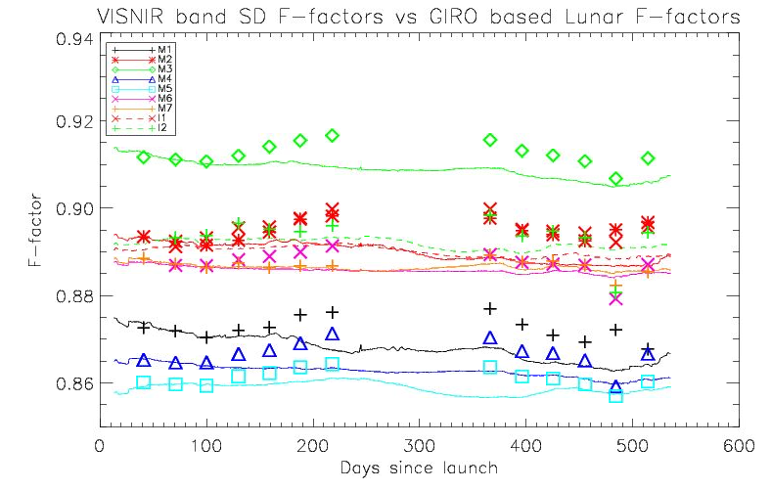
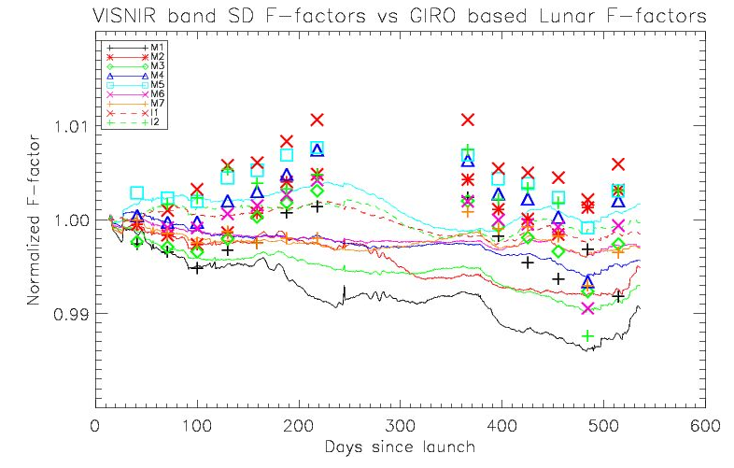
Lessons Learned: SD versus lunar F-factors
To compare the trends between SD and lunar F-factors
  The lunar F-factors are normalized to the SD F-factors in each band.
Normalization is needed because of absolute calibration issues.
  GIRO (ROLO) has issues on atmospheric correction and large uncertainties with Vega (reference) irradiance → only used for relative analysis.
Need several years lunar collections to resolve relative differences.
  Because of the annual oscillations between the SD and lunar F-factors.
One year

Slide 16
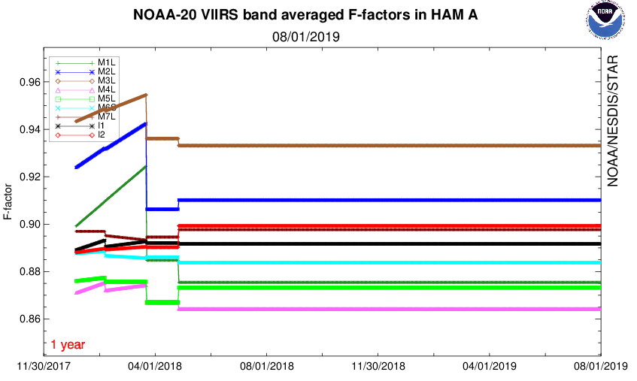
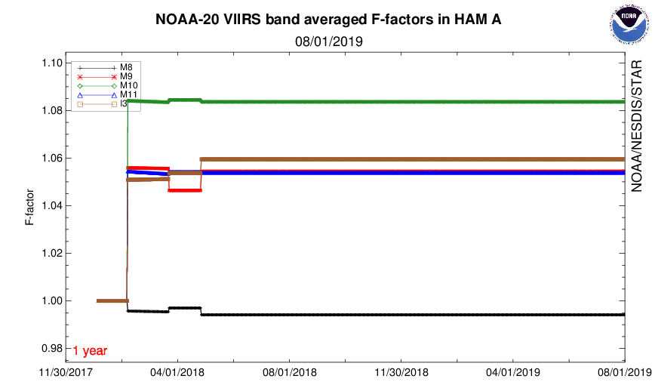
Lessons Learned : Operational F-factor LUT
Because of the initial uncertainties in the SD degradation estimations, the increasing trends are caused by setting no SD degradation (H=1) until March of 2018.
The operational F-factors calculated in April 2018 have remained stable levels in the NOAA production since then.
  Based on DCC and SNO analyses.
4/27/2018
Trends are set to zero
4/27/2018

Slide 17
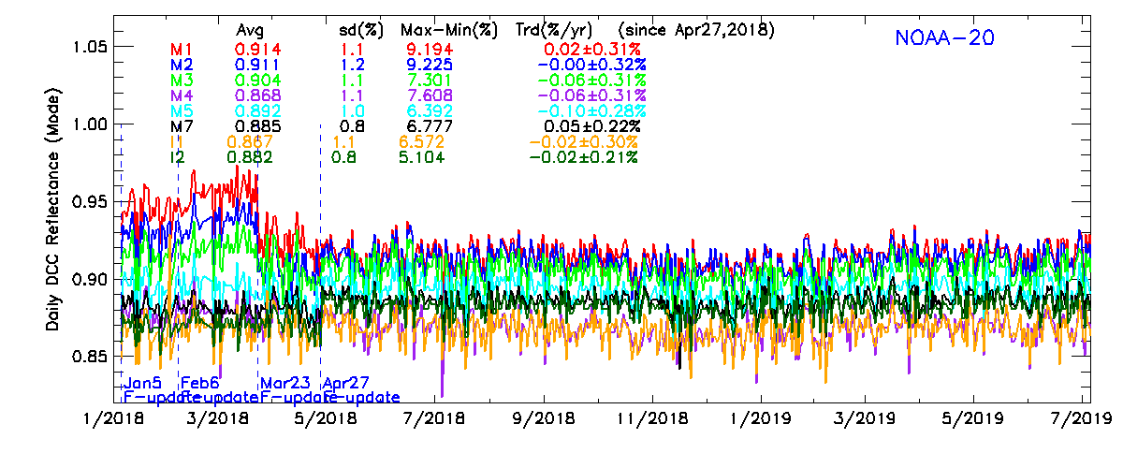
Lessons Learned : Deep Convective Cloud (DCC)
The DCC measurements have been collected daily.
The daily DCC time series are generally stable after 4/27/2018.
The DCC trends indicate that the NOAA 20 VIIRS gains are stable after the latest F-factor LUT update on 4/17/2018.

Slide 18
Lessons Learned : Simultaneous Nadir Observations (SNO)
SNOs with MODIS are conducted over polar, desert and ocean regions.
MODIS sensor is used as a transfer radiometer.
SNO trends show more variability than DCC but NOAA-20 radiometric responses are rather stable.
S-NPP
N20
S-NPP
N20
S-NPP
N20
S-NPP
N20

Slide 19
Summary
VIIRS RSB radiometric calibration is based on Solar Diffuser measurements.
Prelaunch SD/SDSM related LUTs were updated by the yaw maneuver derived LUTs.
  Especially for the SDSM Sun screen transmittance function (τ_{SDSM )}
Lunar based calibration results are consistent around 1% of the SD calibration trends.
  However the SD F-factors are lower to 0.5% in the short wavelength bands (M1~M3).
  Lunar calibration points can be used relative comparisons.
  Need multi-years of response to be able to make corrections because of annual oscillations in the Lunar and SD F-factors.
The operational F-factor LUT in the NOAA production remains unchanged because of the stable DCC and SNO results.
Additional DCC, SNO and lunar results are needed before correcting the F-factors.
NOAA VIIRS team is closely monitoring DCC, SNO, SD and lunar trends for the best quality of VIIRS SDR product.

Slide 20
Backup Slides

Slide 21
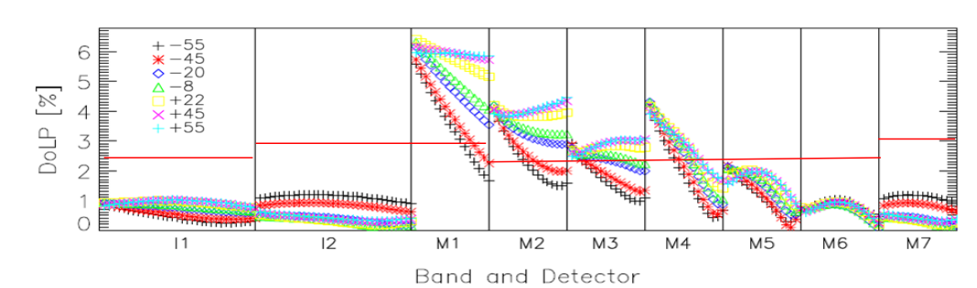
Polarization Issues
NOAA-20 VIIRS polarization issues.
  Bands M1~M4 were non-compliant with the polarization sensitivity requirements.
  Concerns were raised from Ocean Color group.
This chart is taken from Hassan Oudrari’s talk “Summary of JPSS-1 VIIRS Pre-Launch Radiometric Performance” for NOAA-STAR Annual Science Team Meeting on August 9, 2016.

Slide 22
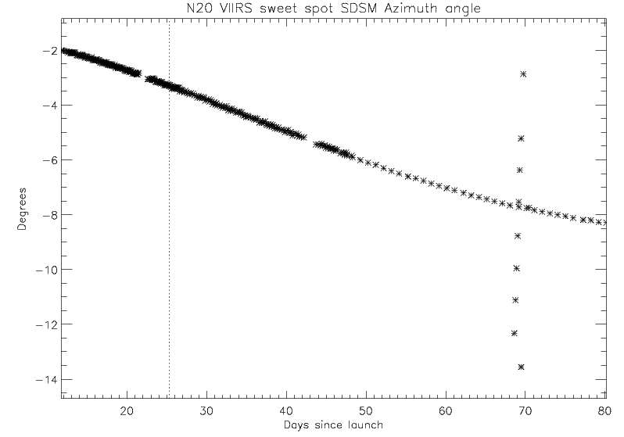
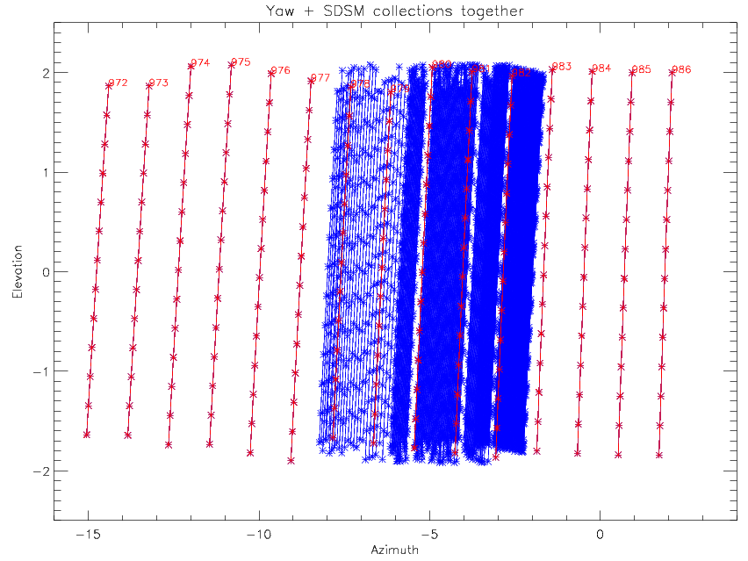
H-factor update with on-orbit SDSM data
To fill up the micro features correctly, the regular on-orbit SDSM data collections were added in the τ_{SDSM} derivation.
Plots below show yaw maneuver data and on-orbit SDSM data.
The on-orbit SDSM data will fill up the operational range within one year.
Only τ_{SDSM} was derived and reprocessed the H-factor.

Slide 23
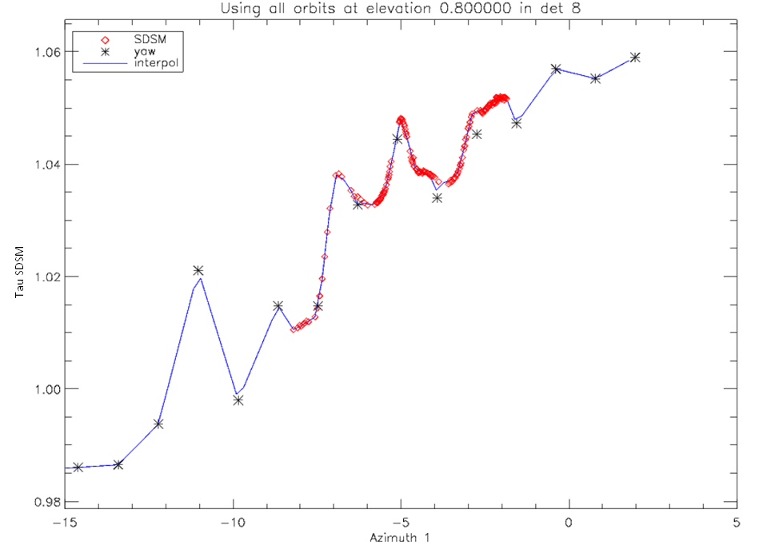
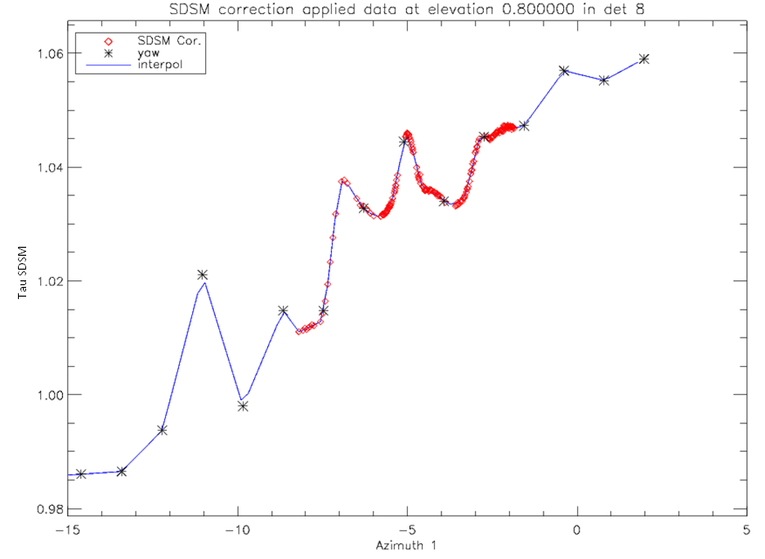
Results: H-factor update with SDSM gain correction
To check any discrepancies, the yaw maneuver and on-orbit SDSM data values were visualized at the solar elevation angle of 0.8 degrees with the SDSM detector 8.
The on-orbit SDSM data points (red diamonds) provided fine structures in between the yaw data points (black asterisk) successfully.
The differences between the yaw and on-orbit SDSM data were increased from the solar azimuth angles from -7 to -2 degrees.
  Because of the SDSM time-dependent gain change → linearly corrected.

Slide 24
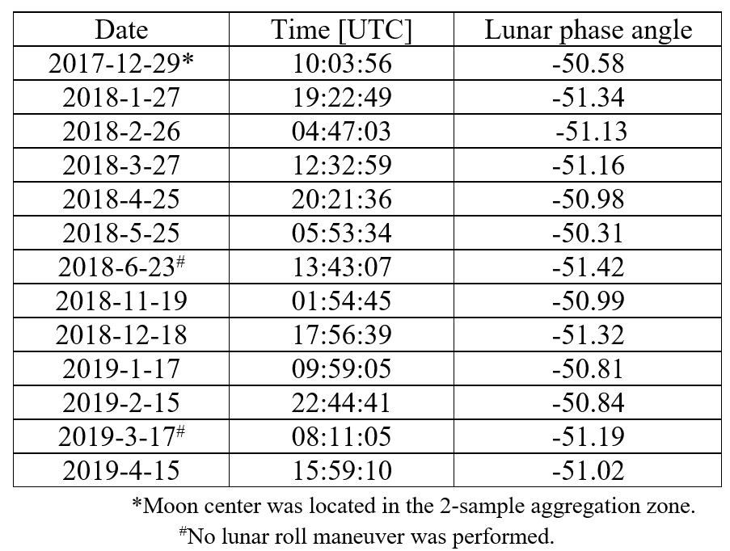
Scheduled Lunar Collections
Negative phase angle indicates waxing lunar phase.
The moon image is in the no-aggregation zone of the EV scan

Slide 25
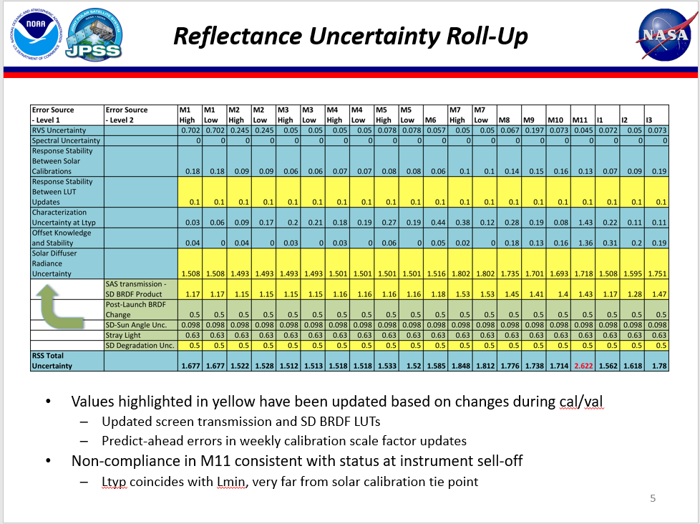
Reflectance Uncertainty Roll-up
From Frank DeLuccia’s talk on “VIIRS Reflective Solar Band (RSB) Performance and Uncertainty Estimates” at Suomi NPP SDR Product Review December 18-20, 2013.

