Slide 1
CERES Strategy for Calibrating GEO/LEO imagers: GEO/LEO ray-matching (SNO) inter-calibration Spectral Band Adjustment Factors (SBAF)
Raj David Doelling, Rajendra Bhatt, Conor Haney, Arun Gopalan
CERES Imager and Geostationary Calibration Group
NASA Langley Research Center, Hampton, Virginia
3rd Annual ECCOE Workshop at USGS, Reston, VA, Sept. 23, 2019

Slide 2
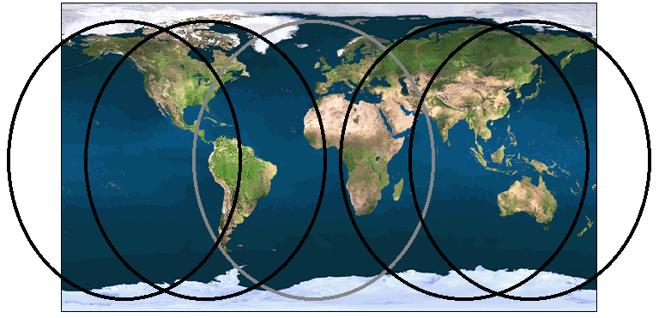
GOESTATIONARY imager coverage
Geo 135ºW
(GOES-10, -11, -15, -17)
Geo 75ºW
(GOES-8, -12, -13, -14, -16)
Geo 0º
(Met 7-11)
Geo 63ºE
(Met 5-8)
Geo 140ºE (GMS-5; GOES-9;
MSAT-1R, -2; Himawari-8, -9)

Slide 3
Geostationary imager characteristics
GEO Imager Class | Satellites | Pixel Resolution | Visible Channels | IR Channels | Full Disc Scan Frequency
1st generation | GMS 5 | 1.25-km visible 5-km IR | 0.55-0.9µm | 6.5-7.0 µm 10.5-11.5µm 11.5-12.5µm | 30 minutes
 | Met 5,7 | 2.5-km visible 5-km IR | 0.5-0.9µm | 5.7-7.1 µm 10.5-12.5µm | 30 minutes
2nd generation | GOES 8-15 MTSAT 1-2 | 1-km visible 4-km IR | 0.65 µm | 3.9 µm, 6.8 µm, 10.7 µm, MTSAT1-2, 12 µm GOES8-11, 12 µm GOES12-15, 13.4 µm | 30 minutes
3rd generation | Met 8-11 | 3-km visible 3-km IR | 0.65 µm, 0.86 µm, 1.6 µm 0.6-0.9µm 1-km | 3.9 µm, 6.2 µm, 7.3 µm, 8.7 µm, 9.7 µm, 11 µm, 12 µm, 13.4 µm | 15 minutes
4th generation | Himawari 8-9 GOES 16-17 | 0.5-km 0.65 µm 1-km visible 2-km IR | 0.47 µm, 0.65 µm, 0.86 µm, 1.6 µm, 2.3 µm GOES 16-17 1.4 µm Himawari 8-9 0.51 µm | 3.9µm, 6.2µm, 7.0µm, 7.4µm, 8.5µm, 9.7µm, 10.3µm, 11.2µm, 12.3 µm, 13.3µm | 10 minutes

Slide 4
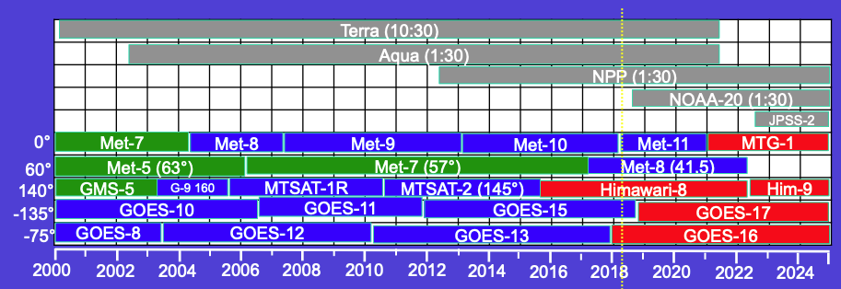
GEOSTATIONARY imagers
Geostationary (GEO) imagers have been in operation since the late 1970’s
The constellation of GEO imagers maintain their equatorial location and scanning schedules
The Earth is scanned horizontally with a set number of inline detectors/channel and incremented vertically to map a full disc.
For a given Earth location, the daily view and solar geometry of the GEO observation is repeated annually.
The number of spectral bands are increasing and spectral widths are decreasing

Slide 5
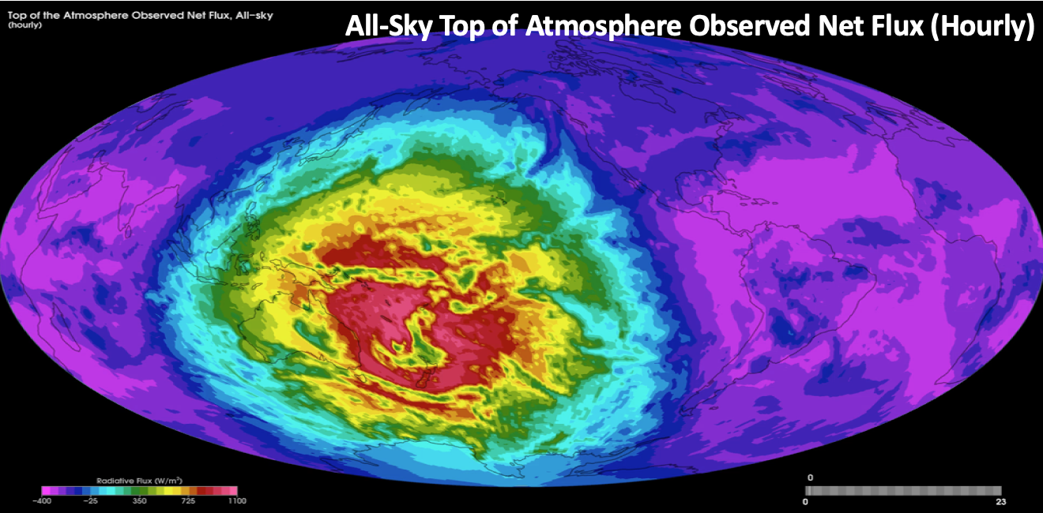
CERES GEOSTATIONARY imager calibration requirements
CERES uses GEO imager derived broadband fluxes to estimate the diurnal flux variation between the Terra-CERES (10:30 LT) and Aqua-CERES (1:30 LT) flux observations
The CERES project retrieves cloud properties to identify scene types needed to convert GEO NB radiances into fluxes
For CERES Ed4 all the GEO imager channels must be inter-calibrated to the same Aqua-MODIS C6.1 calibration reference
All-Sky Top of Atmosphere Observed Net Flux (Hourly)
• The 5 GEO domain boundaries must not show discontinuities due to spectral band differences and calibration differences
• There can be no temporal calibration drifts, which could be falsely interpreted as climate variability

Slide 6
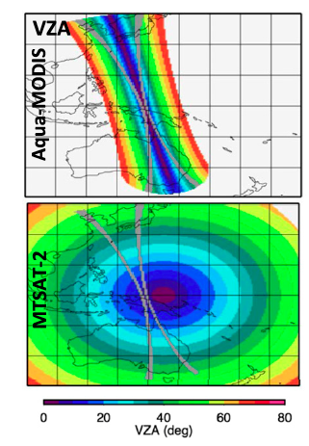
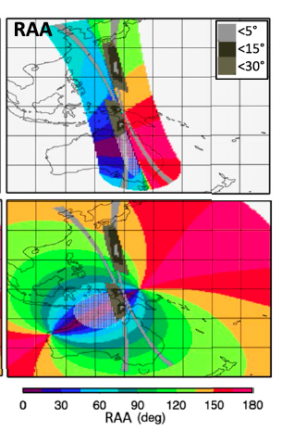
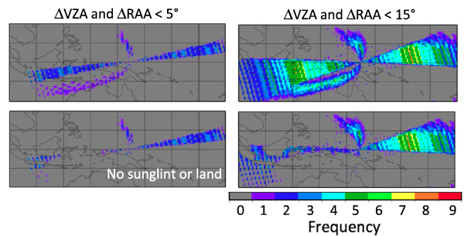
GEO/LEO ray-matching
Find within 15 minute coincident GOES-16 and Aqua-MODIS 50-km ray-matched radiances over all-sky tropical ocean (ATO-RM) of deep convective clouds (DCC-RM)
For clear locations the ray-matching is strict within 5° view and azimuthal
For bright cloud locations the ray-matching is within 15° view and azimuth, since the target is more Lambertian
There are many more clear locations than bright cloud locations
Doelling, D.R.; Haney, C.O.; Scarino, B.R.; Gopalan, A.; Bhatt, R. Improvements to the geostationary visible
imager ray-matching calibration algorithm for CERES Edition 4. J. Atmos. Ocean. Technol. 2016, 33, 2679–2698.

Slide 7
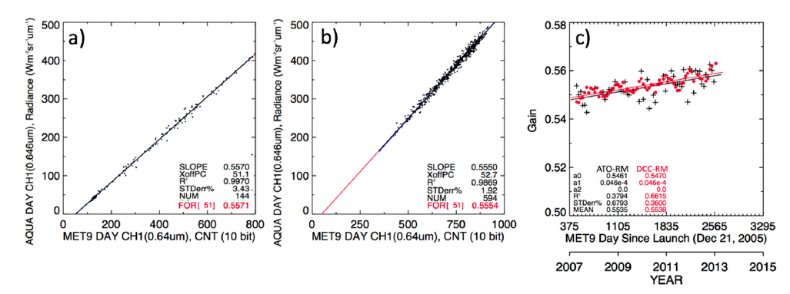
GEO/LEO ATO-RM and DCC-RM calibration
MODIS/Met-9 all-sky tropical ocean ATO-RM
MODIS/Met-9 deep convective cloud DCC-RM
MODIS/Met-9 ATO/DCC-RM
50-km grid
30-km cells
Linearly regress through the space count the GEO/LEO ray-matched radiance pairs to obtain the monthly gain factor. Apply SBAF to LEO radiances
Linearly regress the monthly gain factors to obtain the GEO calibration coefficients over time.
Doelling, D.R.; Haney, C.O.; Bhatt, R.; Scarino, B.R.; Gopalan, A. Geostationary Visible Imager Calibration for the CERES SYN1deg Edition 4 Product, Remote Sens. 2018, 10, 288

Slide 8
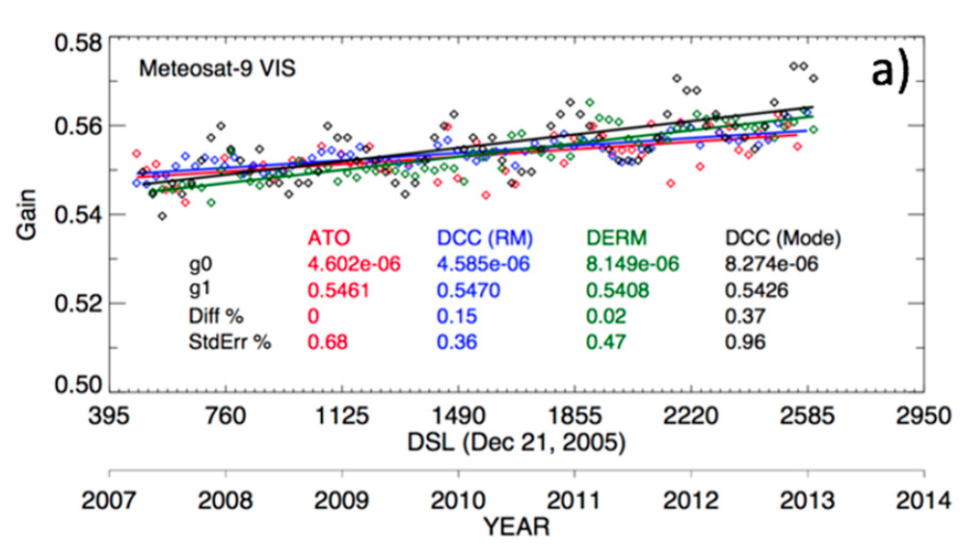
MET-9 calibration gains
• Meteosat-9 0.65µm calibration gains using multiple methods are consistent within 0.4%
• All methods independently transfer the Aqua-MODIS C6.1 reference calibration
CERES Edition 4 calibration website:
https://satcorps.larc.nasa.gov/cgibin/site/showdoc?mnemonic=CALIB-ED4
Realtime GEO calibration web site:
https://satcorps.larc.nasa.gov/cgibin/site/showdoc?mnemonic=CALIB-UPRT

Slide 9
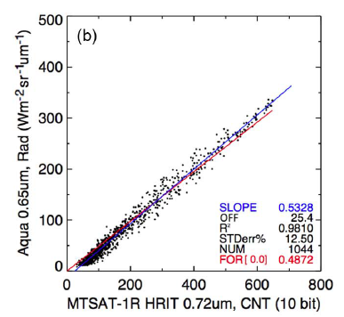
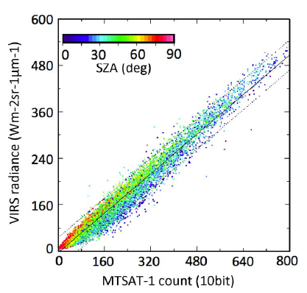
MTSAT-1R ATO-RM reveals a nonlinear response
Aqua-MODIS/MTSAT-1R
• TRMM satellite is in a precessionary cycle, observing all SZA every 23 days
• The MTSAT-1R sensor response was ruled out when the scatter was found to be a function of solar zenith angle
TRMM-VIRS/MTSAT-1R
ATO-RM can evaluate the linearity of the sensor response, since the ATO ray-matching domain, where the radiances can vary from dark clear-sky ocean targets to bright deep convective targets under near overhead sun conditions

Slide 10
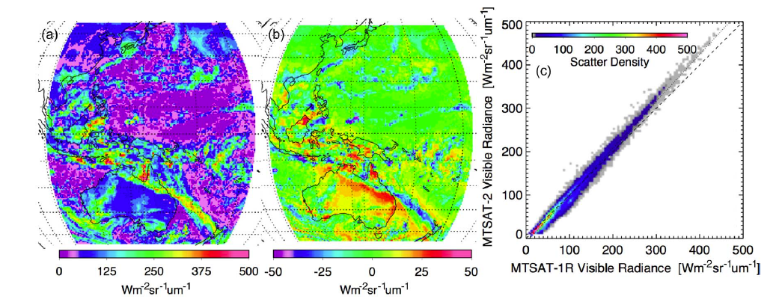
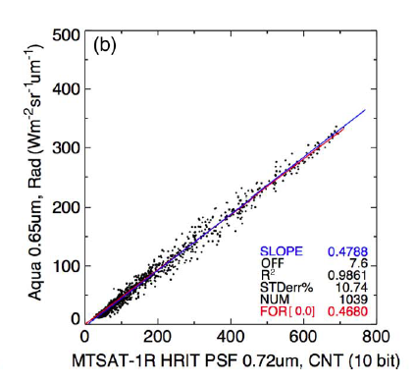
MTSAT-1R Point Spread Function was redefined
MTSAT2 0.65µm
MTSAT1R – MTSAT2
MODIS/MTSAT-1R PSF
• Coincident MTSAT-1R and MTSAT-2 were taken for 5 days during MTSAT-2 commissioning period.
• The 1-sigma 4-km pixel width was found to be ∼120, indicating that 95% of the PSF radiance contribution for a single pixel extends over 900 km.
The force fit and the linear regression slopes are now consistent after applying the redefined PSF
Doelling, D.R.; Khlopenkov, K.V.; Okuyama, A.; Haney, C.O.; Gopalan, A.; Scarino, B.R.; Nordeen, M.;
Bhatt, R.; Avey, L. MTSAT-1R visible imager point spread function correction, Part I: The need for,
validation of, and calibration with. IEEE Trans. Geosci. Remote Sens. 2015, 53, 1513–1526

Slide 11
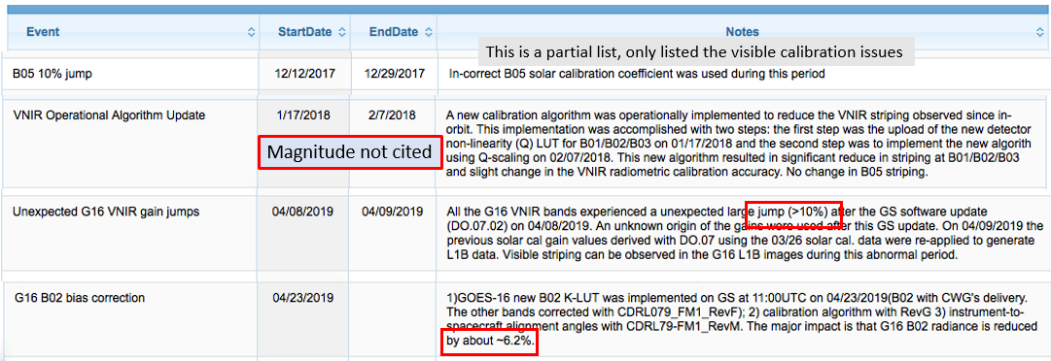
NOAA GOES-16 ABI Calibration Events Log
• GEO L1B data I usually not reprocessed
• must account for these changes during production
https://www.star.nesdis.noaa.gov/GOESCal/goes_SatelliteAnomalies.php

Slide 12
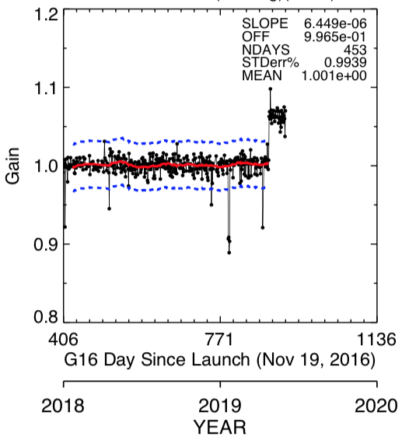
GOES-16 daily ATO-RM gain monitoring
DCC-RM 3-sigma blue dots are ±3%, red line is a 30 day previous mean
DCC-RM was able to detect Jan 18-22, 2019, & April 8-9 GOES-16 L1B calibration anomalies
DCC-RM was able to determine that the GOES-16 B2 radiance was reduced by ~6.2%
Only two false positives exceeded ±3%
A stable GEO can determine daily variations in the LEO L1B radiances

Slide 13
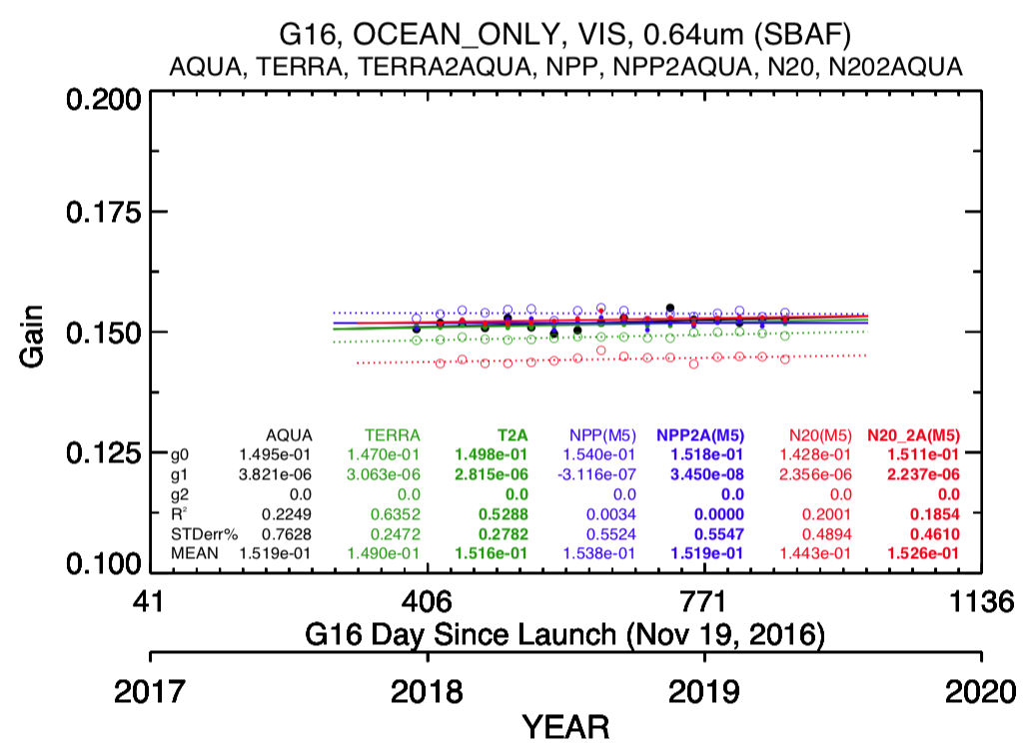
Determine LEO calibration differences using GOES-16
CERES uses the MODIS C6.1 and NPP-VIIRS land SIPS V2, NOAA-20-VIIRS land SIPS V1
Compare the MODIS and VIIRS L1b radiance difference using LEO/GOES-16 ATO-RM
Radiometrically scale the MODIS and VIIRS L1b radiance using LEO/LEO ATO-RM to Aqua-MODIS C6.1 calibration and verify using LEO/GOES-16 ATO-RM
 | Terra/Aqua | NPP/Aqua | NOAA-20/Aqua
L1b | -2.0% | +1.3% | -3.2%
L1b scaled | -0.2% | 0.0% | +0.5%

Slide 14
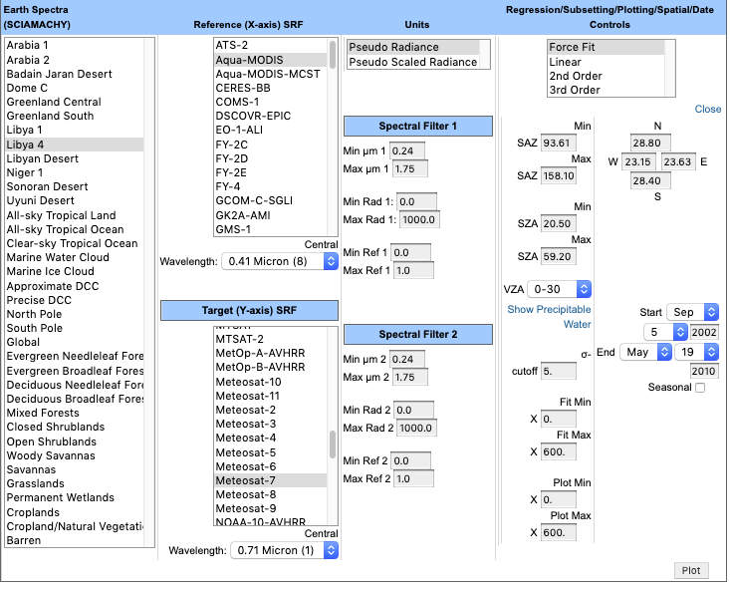
Spectral Band Adjustment Factors (SBAF)
SBAF mitigate the non-overlapping part of the spectral band induced sensor observed radiance differences
SBAF is a function of surface type, atmospheric and cloud conditions or scene types
Use the same angular, time of year conditions as your calibration event
Use SCIAMACHY, Hyperion, or GOME-2 footprint hyper-spectral radiances convolved with the spectral response function pseudo radiance pairs to derive SBAF
NASA Inter-consistency proposal sponsored SBAF web site
https://satcorps.larc.nasa.gov/cgi-bin/site/showdoc?mnemonic=SBAF

Slide 15
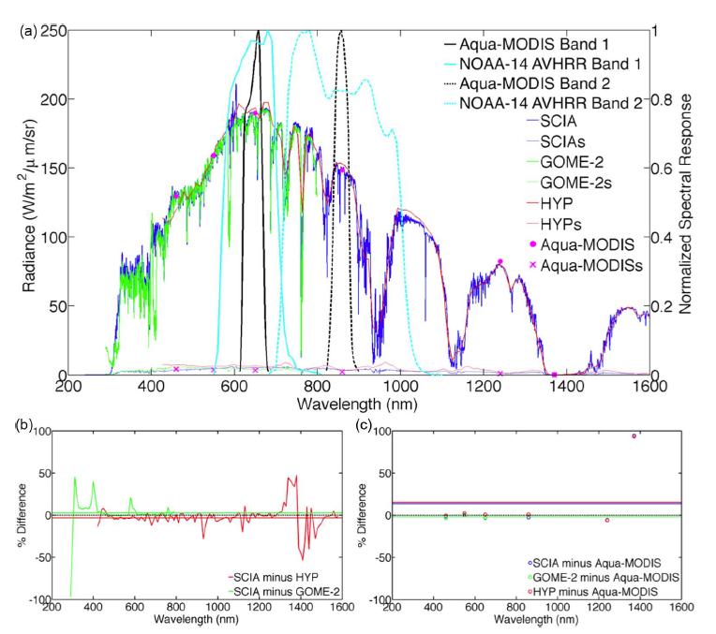
Comparison of the SCIAMACHY, Hyperion and GOME-2 Libya-4 spectra
MODIS/AVHRR 0.65µm SCIAMACHY, GOME-2, Hyperion based SBAF are within 0.3%
SBAFs are not dependent on the absolute calibration of the hyper-spectra radiances but the spectral consistency

Slide 16
Aqua-MODIS and N14 0.65µm Libya-4 SBAF
PW bin g cm−3 | SBAF
0 to 3 | 0.858
0.0–0.75 | 0.885
0.75–1.5 | 0.862
1.5–2.0 | 0.846
2.0–3.0 | 0.835
• There is a 6% SBAF difference between the driest (winter) and humid (summer) atmospheric conditions

Slide 17
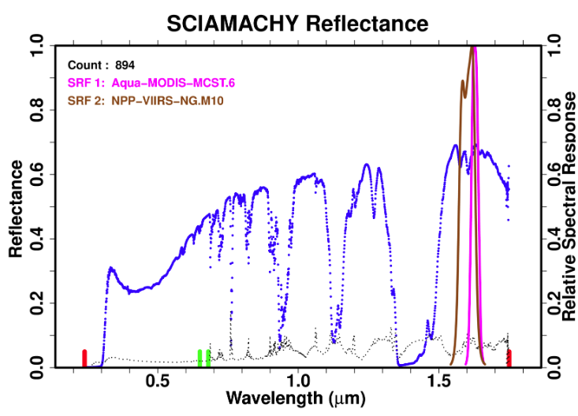
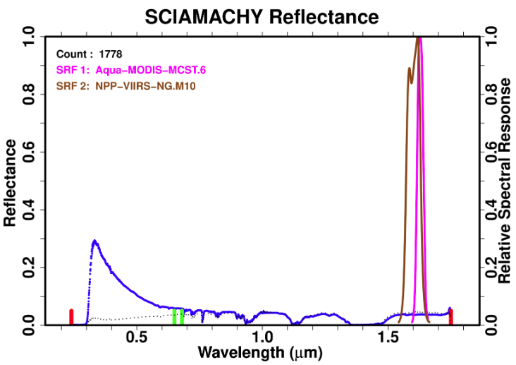
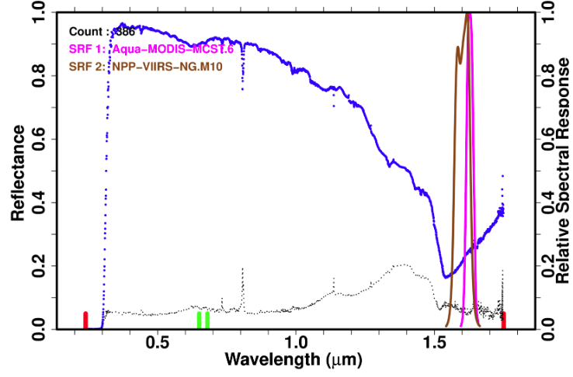
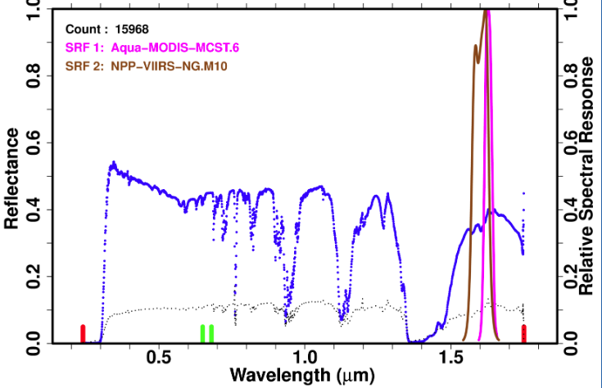
SCIMACHY Reflectance
Aqua-MODIS B6 /NPP-VIIRS M10 1.6µm SBAF
Libya-4
 | SBAF
Libya-4 | 3.5%
DCC | 14.2%
Clear Ocean | 1.3%
Water Cloud | 7.8%
Clear Ocean
SBAF is a function of scene type
Verify SBAF by using multiple scene type calibrations
DCC
Water cloud

Slide 18
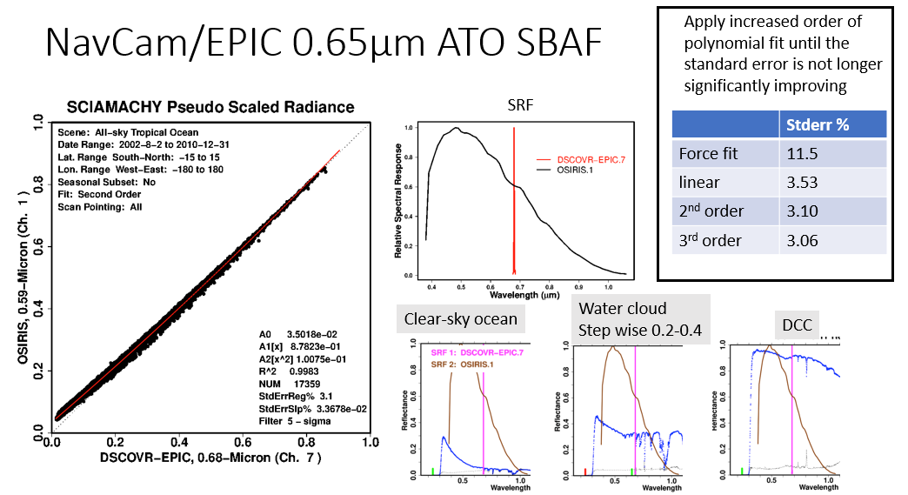
NavCam/EPIC 0.65µm ATO SBAF

Slide 19
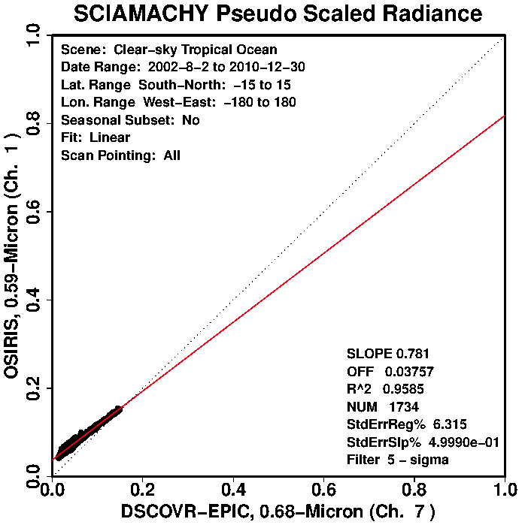
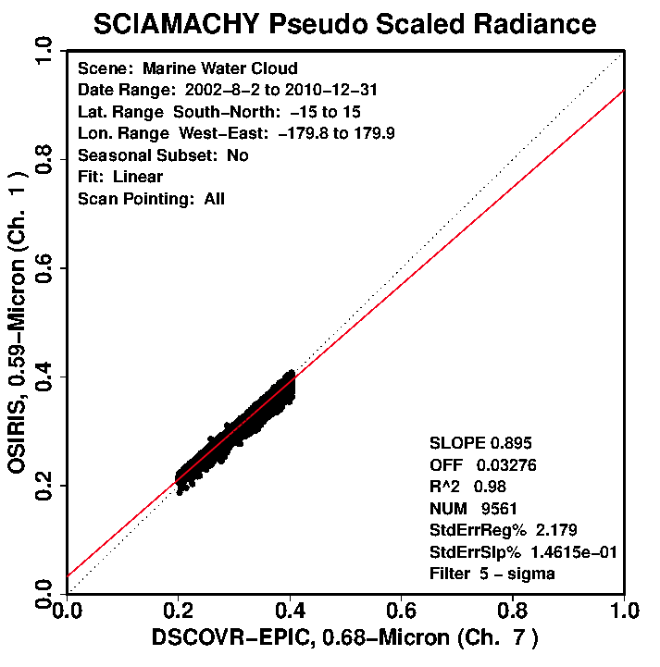
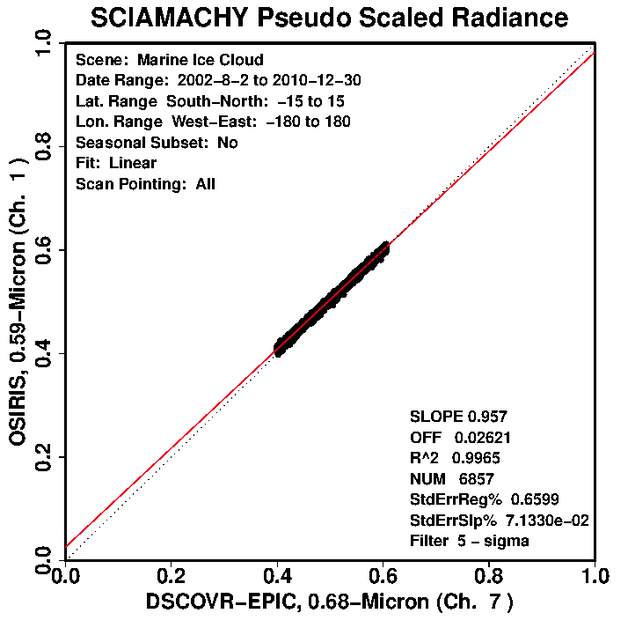
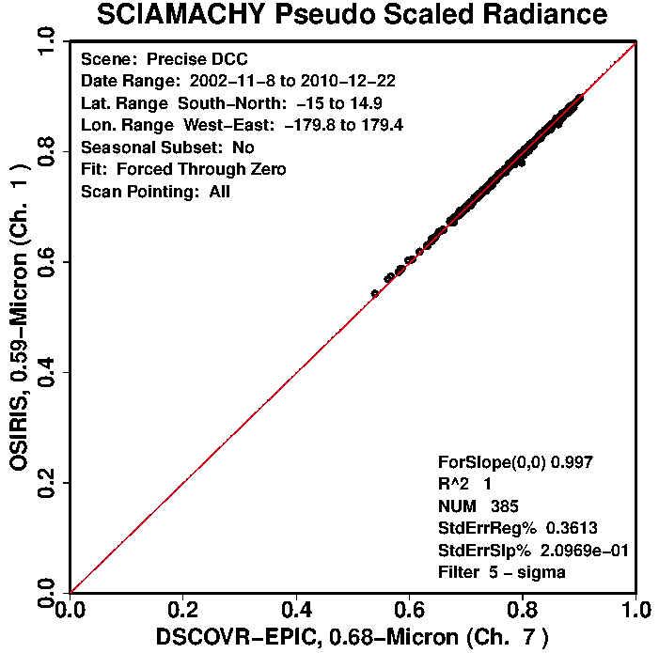
NavCam/EPIC 0.65µm ATO SBAF
Clear-sky ocean
Water cloud
Step wise 0.2-0.4
ATO SBAF 2nd order fits transitions between clear-sky ocean, partly cloud, and DCC and nearly provides the same SBAFs as scene type specific
Scene type | reflectance | ATO-RM (2nd order) | Scene type (linear) | Scene - ATO | sigma
CLR OCN | 0.1 | 0.124 | 0.116 | 0.008 | 6.32%
Water cloud | 0.3 | 0.308 | 0.301 | 0.007 | 2.18%
Ice cloud | 0.5 | 0499 | 0.504 | 0.006 | 0.66%
DCC | 0.8 | 0.803 | 0.802 | 0.001 | 0.36%
Ice cloud
Step wise 0.4-0.6
DCC

Slide 20
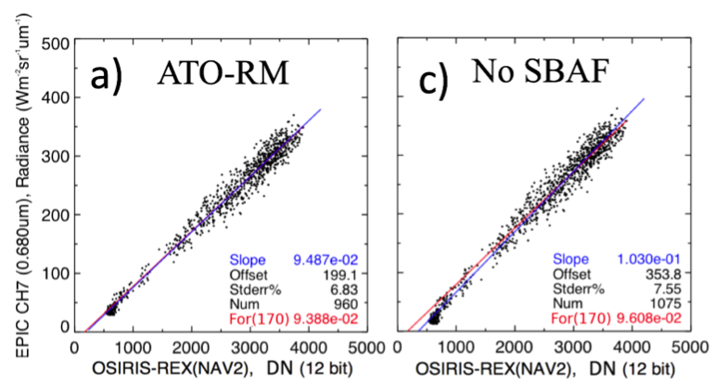
OSIRIS REX NavCam and EPIC B7 (0.65µm)
• Without SBAF the offset is 354 counts, with SBAF the count 199 and much closer to the true NavCam space count of 170
• With SBAF the linear regression slope and the force fit through the space count of 170 are within 1.0%, without SBAF the slopes differ by 7.2%
• The NavCam in orbit calibration was found to be within 3% of ground characterization

Slide 21
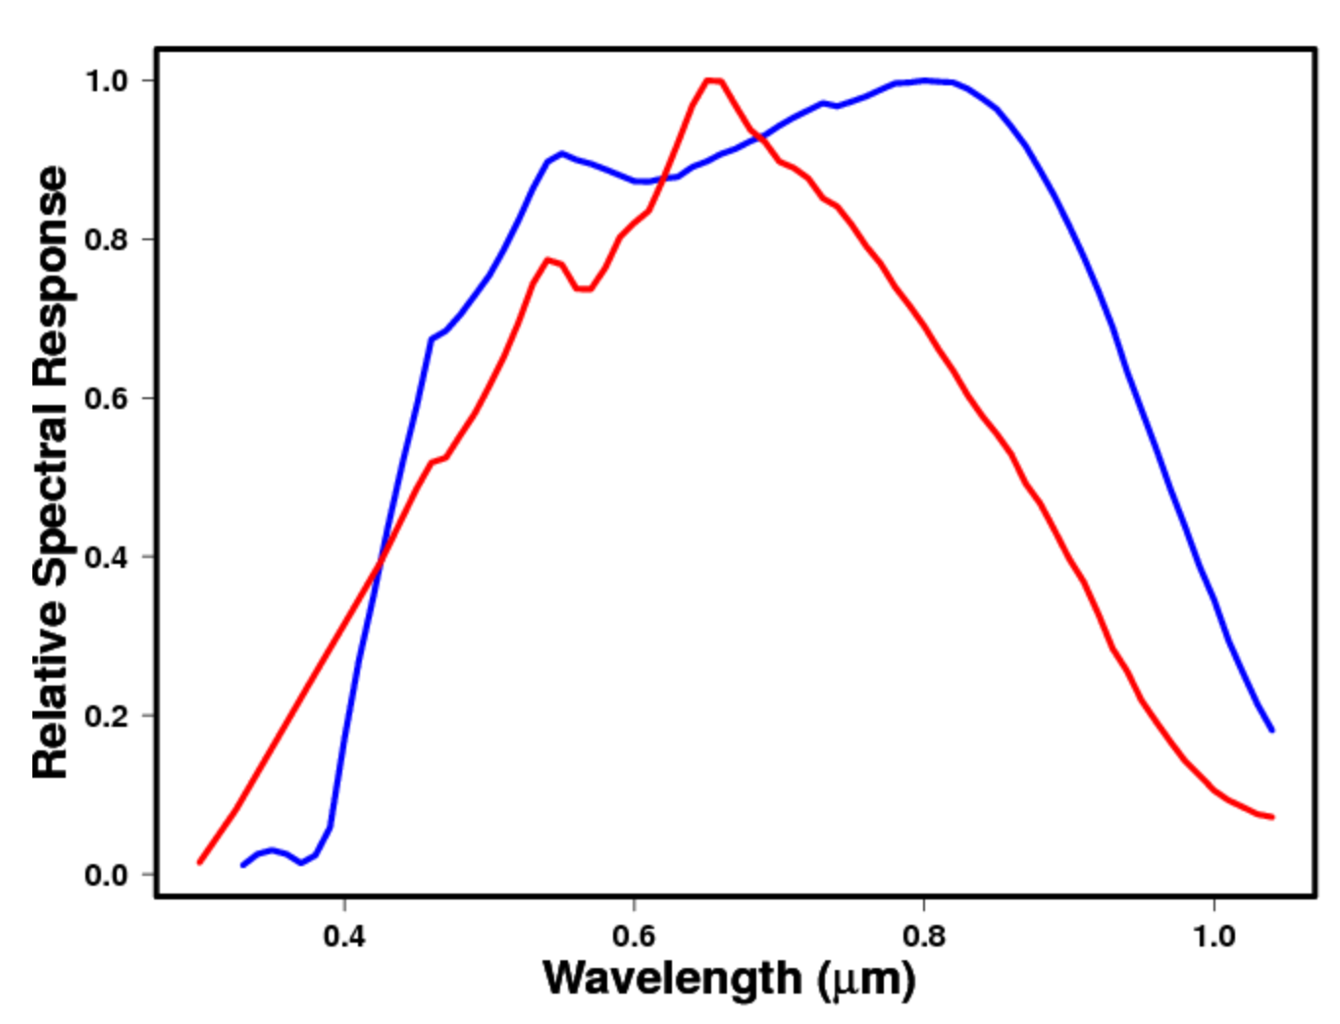
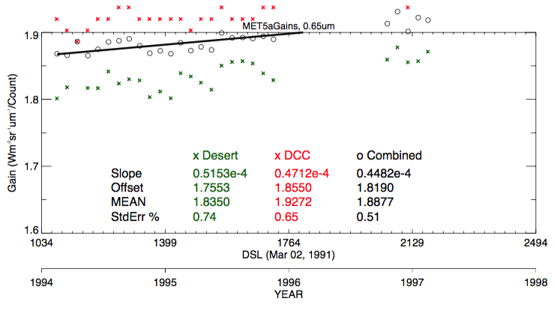
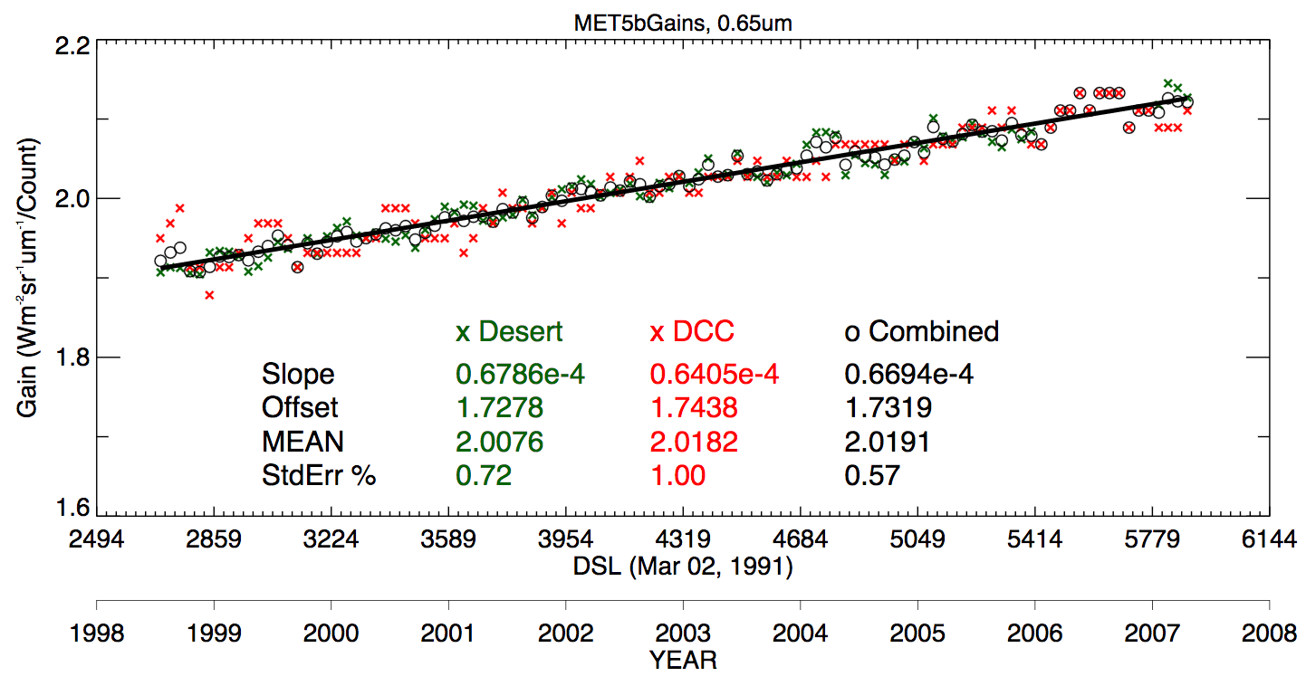
Test the MET-5 SRF with spectra-based calibration
With Met-5 SRF
4.8% desert and DCC gain difference
• The Met-5 SRF may not be accurate
• Met-5,6,7 were all made at the same time
• Met-7 SRF was characterized later with better equipment
• Apply the Met-7 SRF to the MET-5 radiances to test if the desert and DCC calibration gains are more consistent
With Met-7 SRF
0.5% desert and DCC gain difference

Slide 22
Conclusions
GEO/LEO ray-matched radiance pair inter-calibration over all-sky tropical oceans and deep convective clouds can easily radiometrically all GEOs to the same Aqua-MODIS reference calibration
ATO-RM can validate the sensor linear response and the PSF
The ray-matching methods can track up to daily calibration anomalies
The GEOs can be used as transfer radiometers to radiometrically scale LEO sensors such as MODIS or VIIRS, even if they are in different sun synch orbits
Spectral Band Adjustment Factors are necessary to remove the unshared band radiance response during calibration events
Use SCIAMACHY, GOME-2, Hyperion spectra with similar angular and atmospheric conditions as the calibration events to compute the SBAFs
Calibration consistency from several surface and cloud types can verify the robustness of the SBAF

