Slide 1
DESIS Level 1 Product Evaluation Using RalCalNet Measurements
Joint Agency Commercial Imagery Evaluation (JACIE) Workshop
November 18, 2020
Mahesh Shrestha, Dennis Helder, Jon Christopherson
KBR, Inc. Contractor to USGS EROS

Slide 2
Motivation and Goal
Motivation
  Limited hyperspectral instrument on space
    Measures energy from relatively narrow and continuous spectral band
  Understanding radiometric quality helps broader scientific community
    Vegetation characterization
    Coastal and inland water
    Soil science
Goal
  Radiometric evaluation of Level 1 DESIS product
    Cross comparison with DESIS and RadCalNet

Slide 3
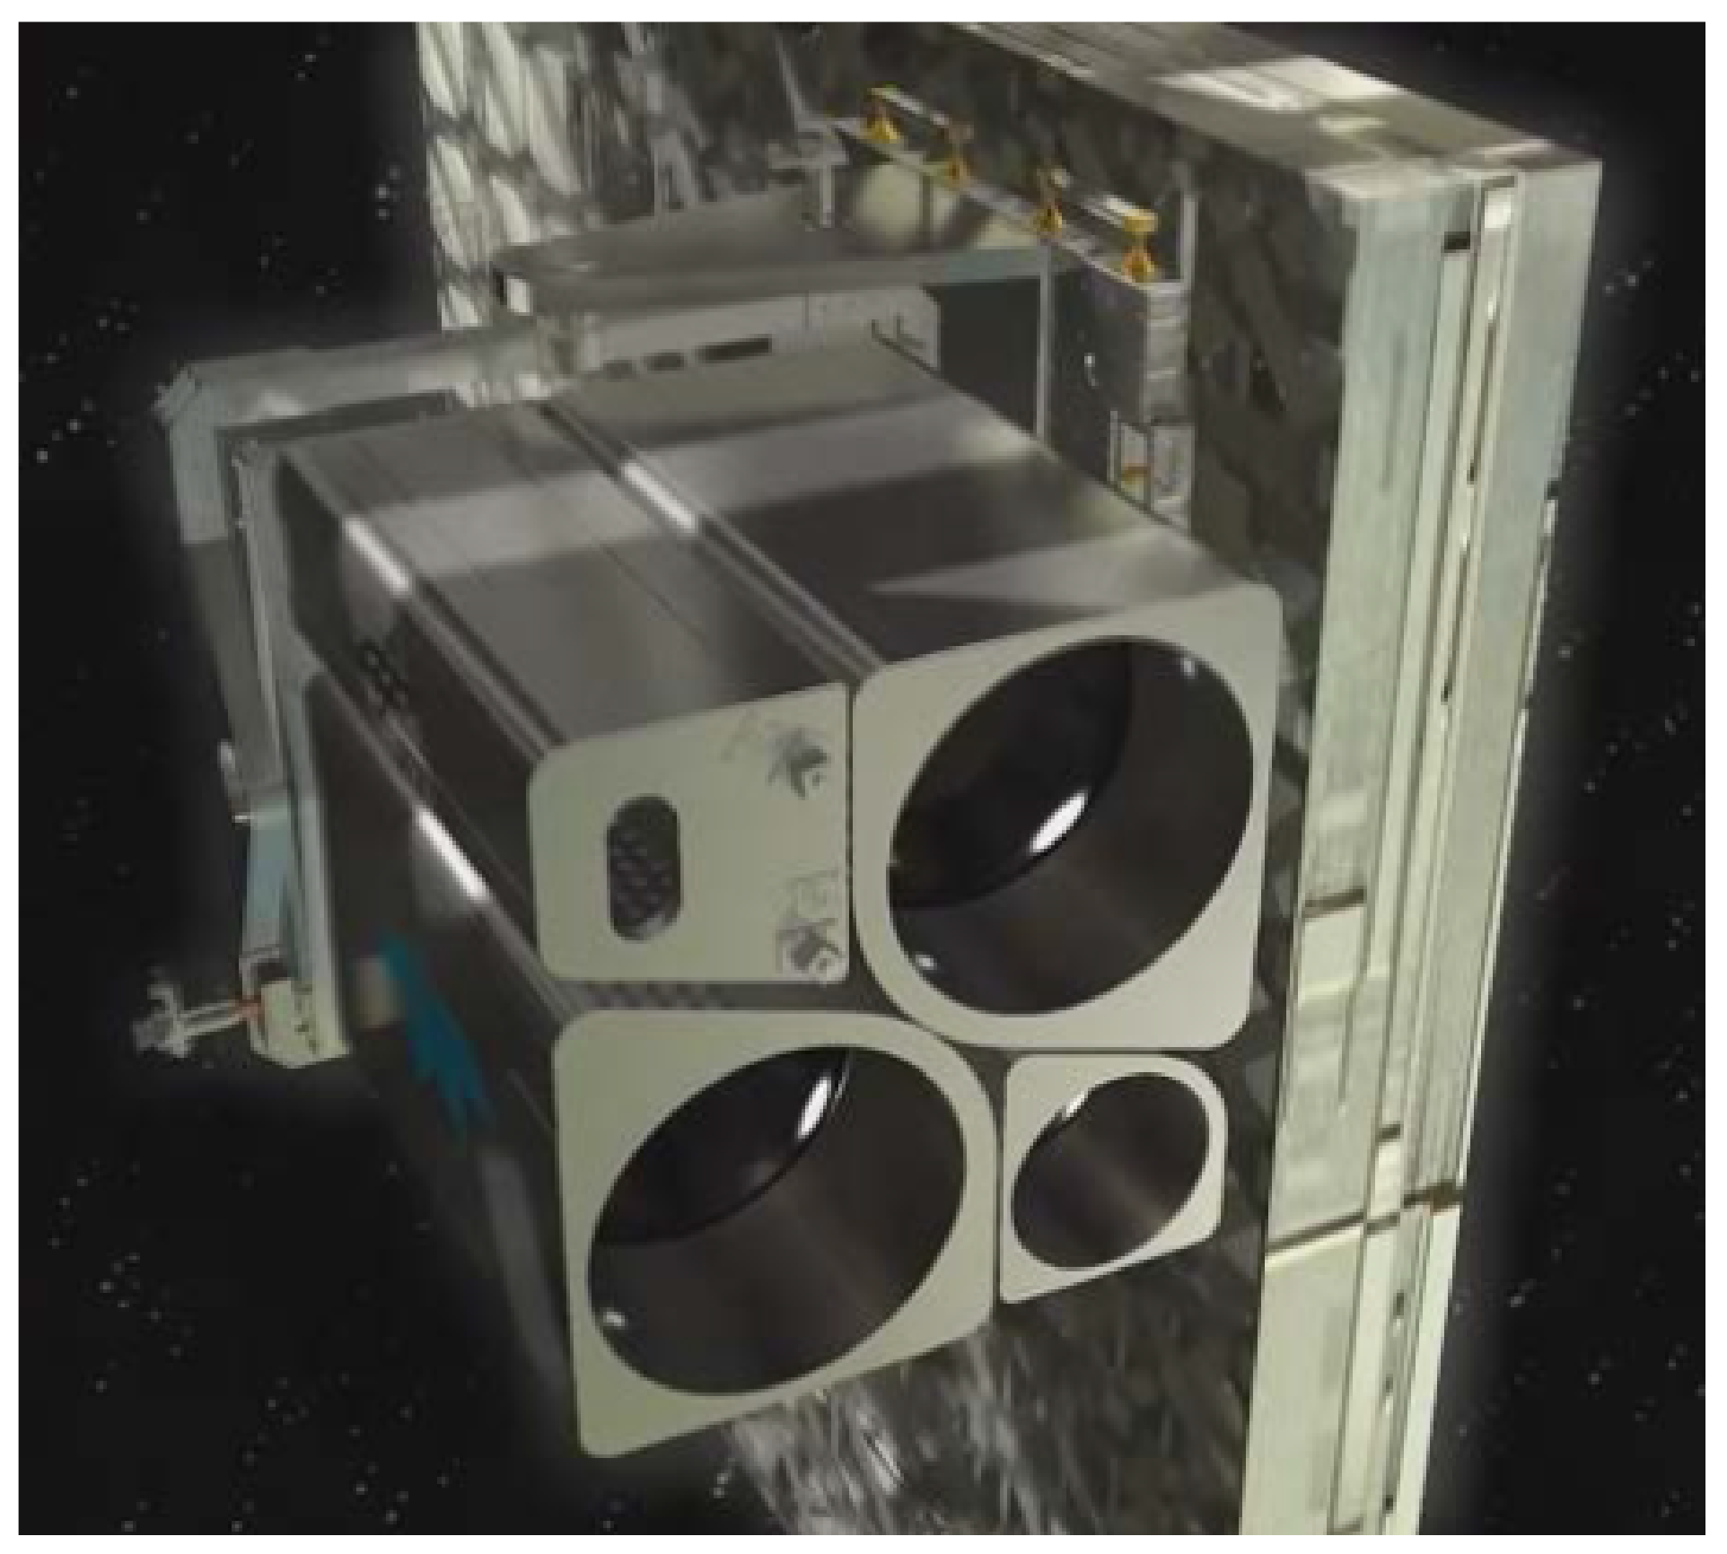
DLR Earth Sensing Imaging Spectrometer (DESIS) on the ISS
Hyperspectral VNIR Imaging Spectrometer
DLR and Teledyne Partnership
  German Aerospace Center (DLR)
    instrument development
  Teledyne Brown Engineering (TBE)
    Installation and operation of Multi-User System for Earth Sensing (MUSES) on the ISS
      MUSES platform with the two small and two large slots for payloads
      DESIS is in one of the large slots
Sebastian, Ilse, et al. "On-ground calibration of DESIS: DLR's Earth Sensing Imaging Spectrometer for the International Space Station (ISS)." Optical Sensing and Detection V. Vol. 10680. International Society for Optics and Photonics, 2018.

Slide 4
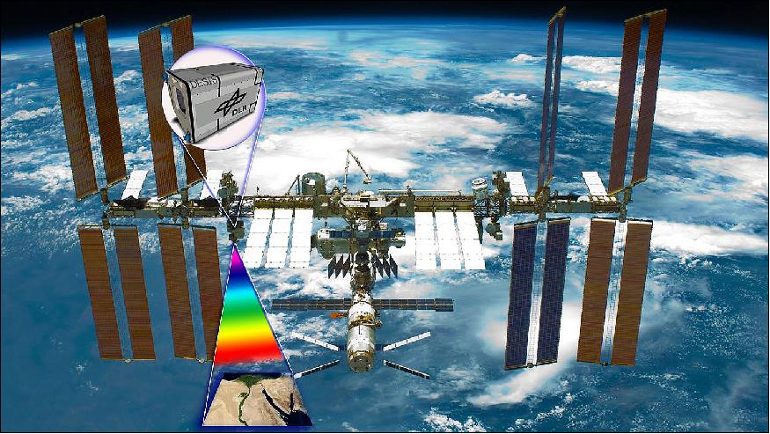
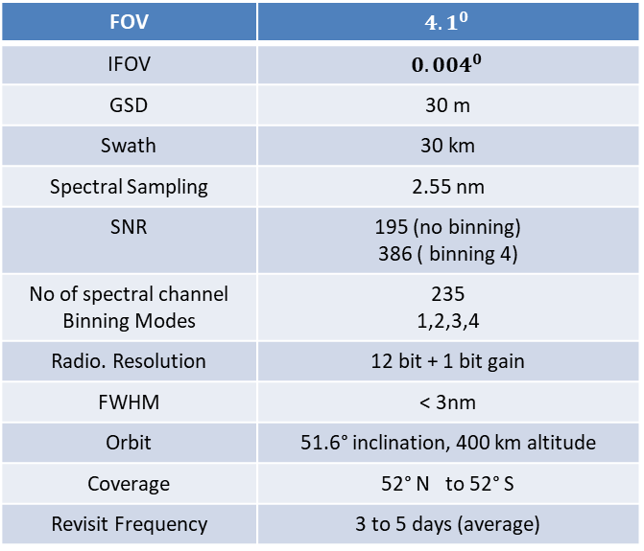
DESIS Hyperspectral VNIR Imaging Spectrometer
FOV | $${4.1}^{0}$$
IFOV | $${0.004}^{0}$$
GSD | 30 m
Swath | 30 km
Spectral Sampling | 2.55 nm
SNR | 195 (no binning) 386 ( binning 4)
No of spectral channel Binning Modes | 235 1,2,3,4
Radio. Resolution | 12 bit + 1 bit gain
FWHM | < 3nm
Orbit | 51.6° inclination, 400 km altitude
Coverage | 52° N to 52° S
Revisit Frequency | 3 to 5 days (average)
Sebastian, Ilse, et al. "On-ground calibration of DESIS: DLR's Earth Sensing Imaging Spectrometer for the International Space Station (ISS)." Optical Sensing and Detection V. Vol. 10680. International Society for Optics and Photonics, 2018.
Eckardt, Andreas, et al. "Desis (dlr earth sensing imaging spectrometer for the iss-muses platform)." 2015 IEEE international geoscience and remote sensing symposium (IGARSS). IEEE, 2015.
Müller, Rupert, et al. "The new hyperspectral sensor DESIS on the multi-payload platform MUSES installed on the ISS." The International Archives of the Photogrammetry, Remote Sensing and Spatial Information Sciences 41 (2016): 461-467.
Alonso, Kevin, et al. "Data Products, Quality and Validation of the DLR Earth Sensing Imaging Spectrometer (DESIS)." Sensors 19.20 (2019): 4471.

Slide 5
Methodology
Data Selection
  Coincident acquisition
Cloud Filtering
Image ROI Data Extraction
Interpolation
  DESIS in resampled at 10nm spectral sampling
Compare with RadCalNet measurements

Slide 6
Coincident Acquisitions Between DESIS and RadCalNet
RVUS, GONA, LCFR, and Baotau Sand have 26,17,12, and 3 coincident collects
Baotou site was not used
  Not large enough(48 m)
Green
  Data available all day
Yellow
  Data available during the day at discrete times
Notes:
Baotou is not large enough to avoid adjancey effect for DESIS having spatial resolution of 30 m

Slide 7
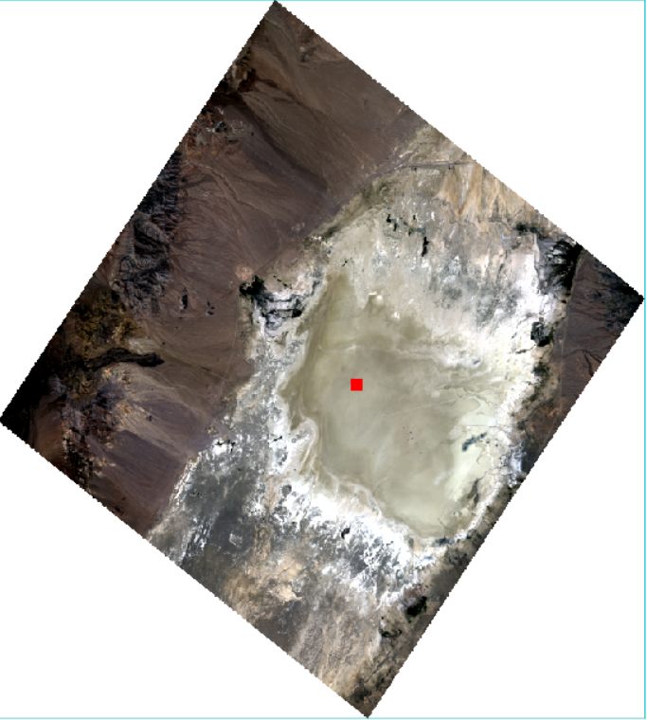
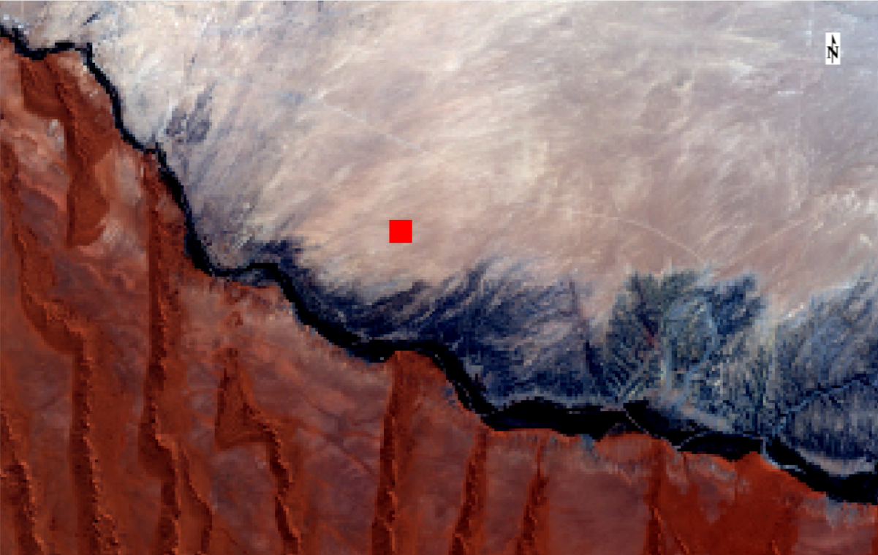
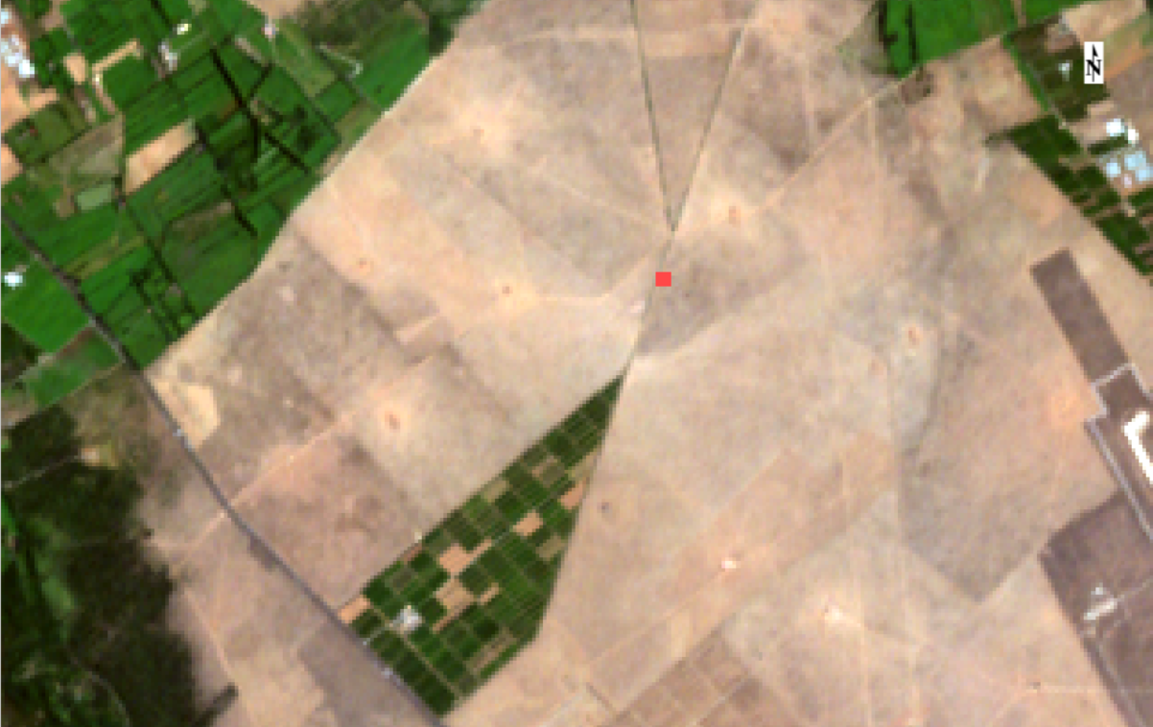
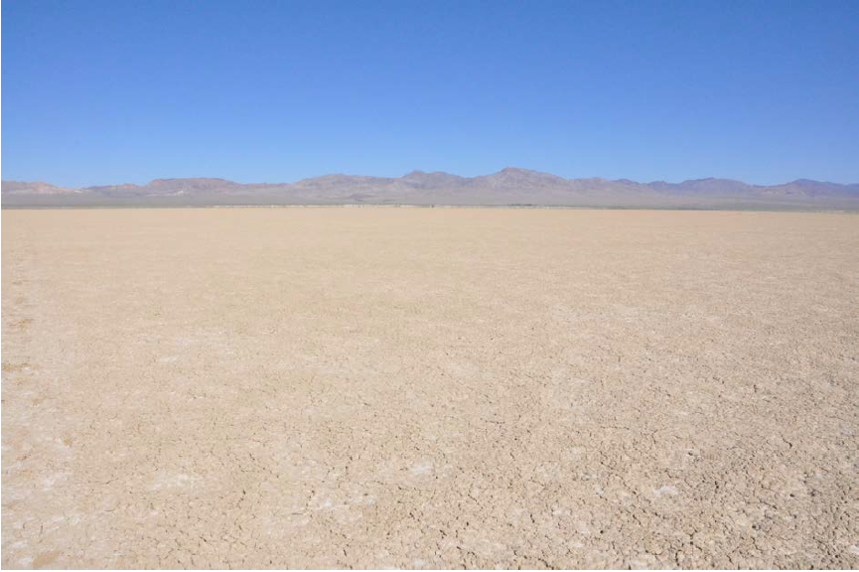
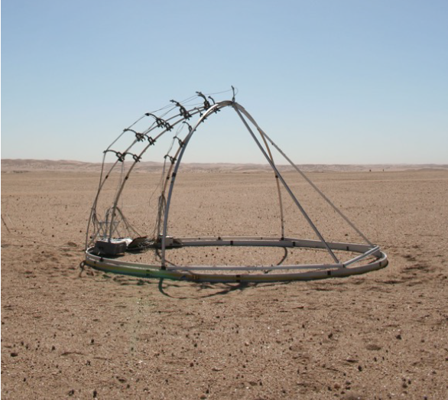
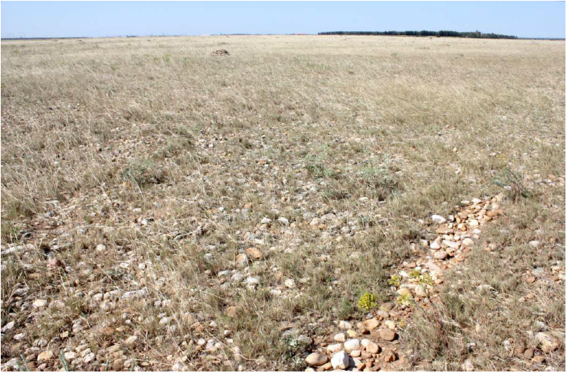
RadCalNet Sites: RVUS, GONA, LCFR
RVUS:23*23
GONA: 15*15
LCFR:4*4
Valid data
  RVUS, GONA, and LCFR

Slide 8
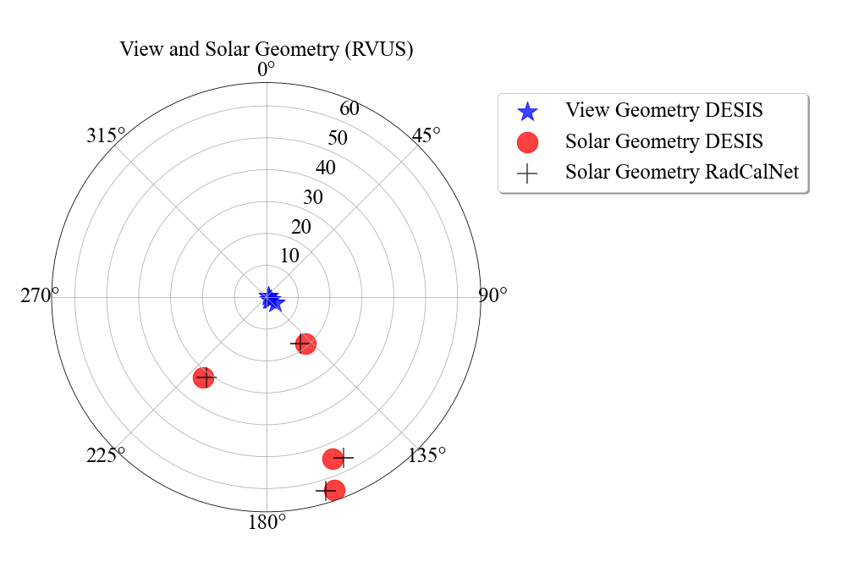
Acquisition Geometry(RVUS)
4 coincident collects
View zenith angle with 4°
View Azimuth: 56° and 123 °

Slide 9
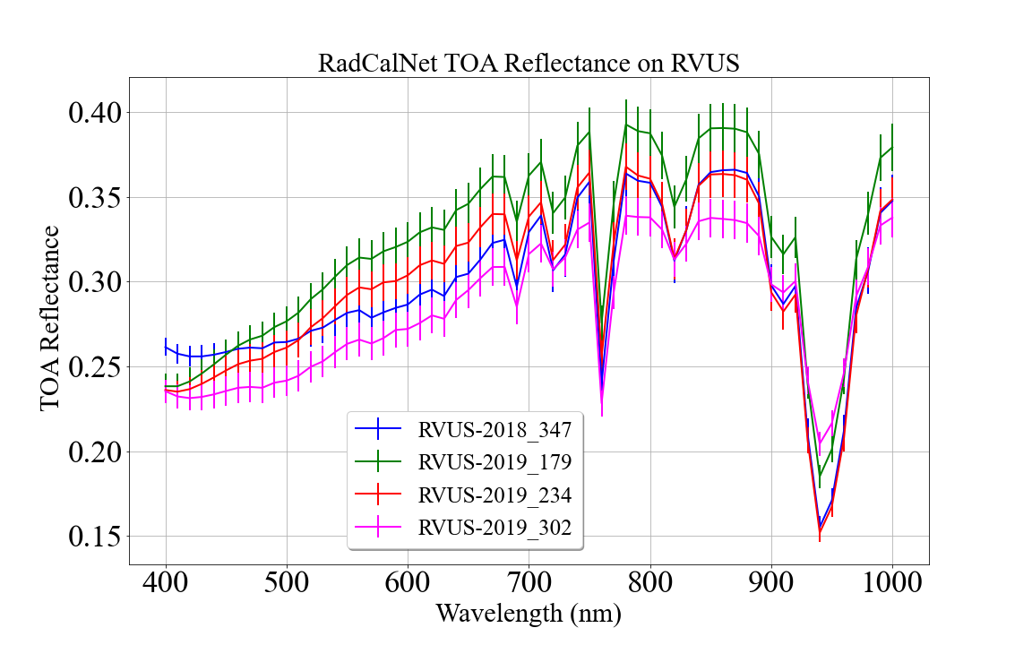
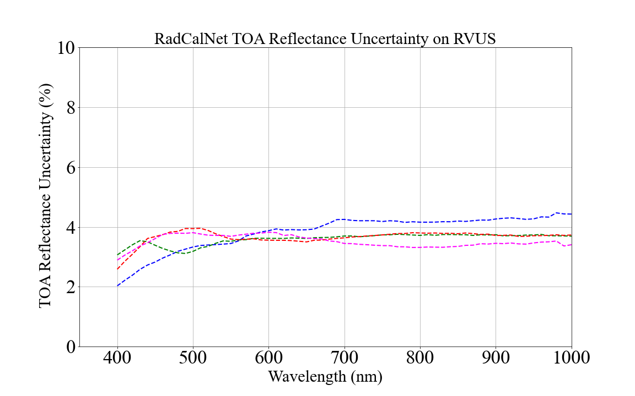
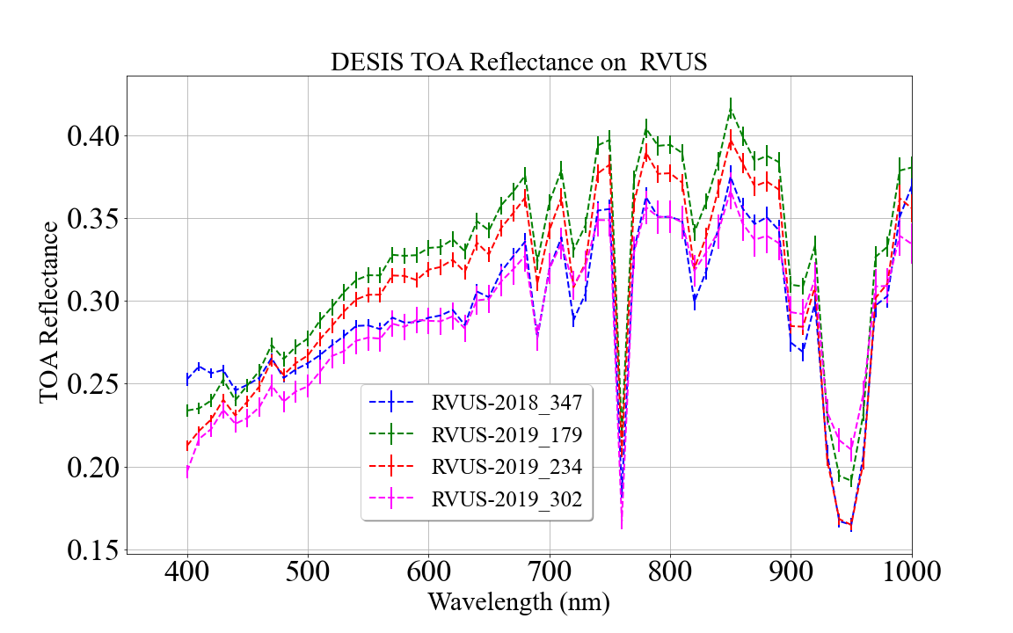
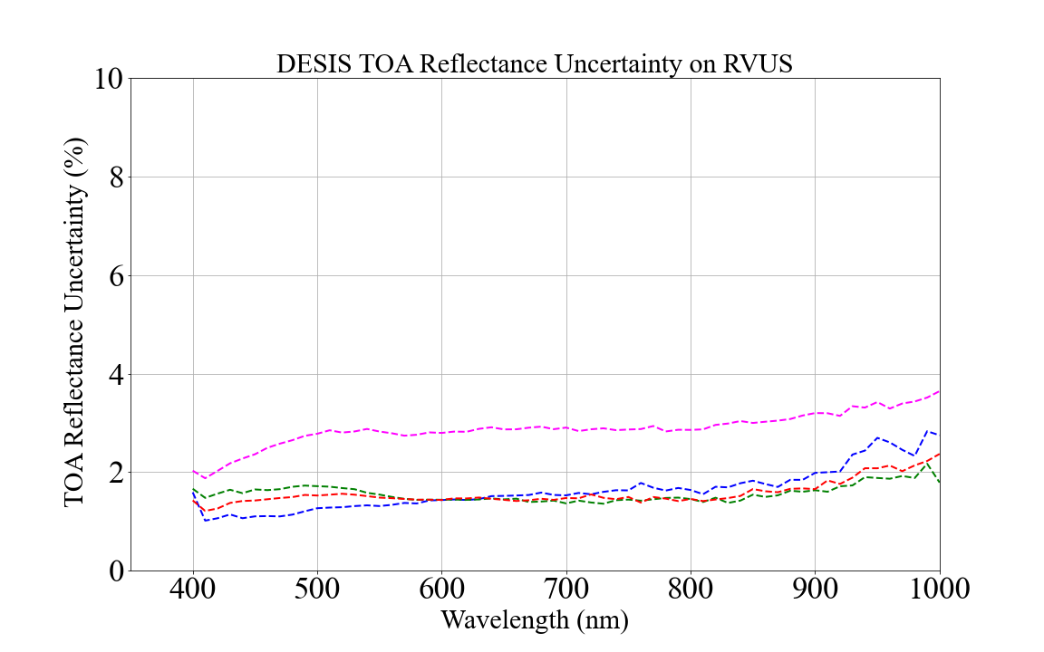
RadCalNet and DESIS TOA Reflectance on RVUS
RVUS RadCalNet data is within 4% uncertainty
DESIS spatial uncertainty is within 2%
DESIS shorter wavelength(<430nm) measurements are not consistent
High variability at 940 nm is due to water vapor

Slide 10
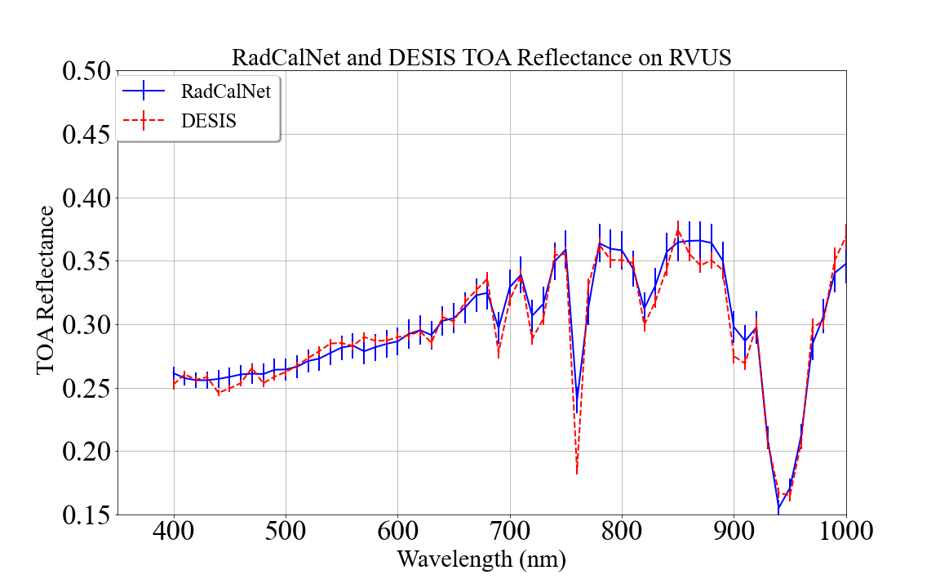
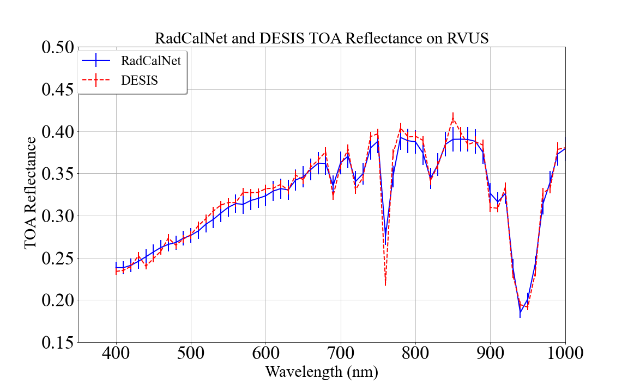
RadCalNet and DESIS TOA Reflectance Comparison
Acquisition Date: 2018_347
Acquisition Date: 2019_179
DESIS measurement lies within RalCalNet uncertainty

Slide 11
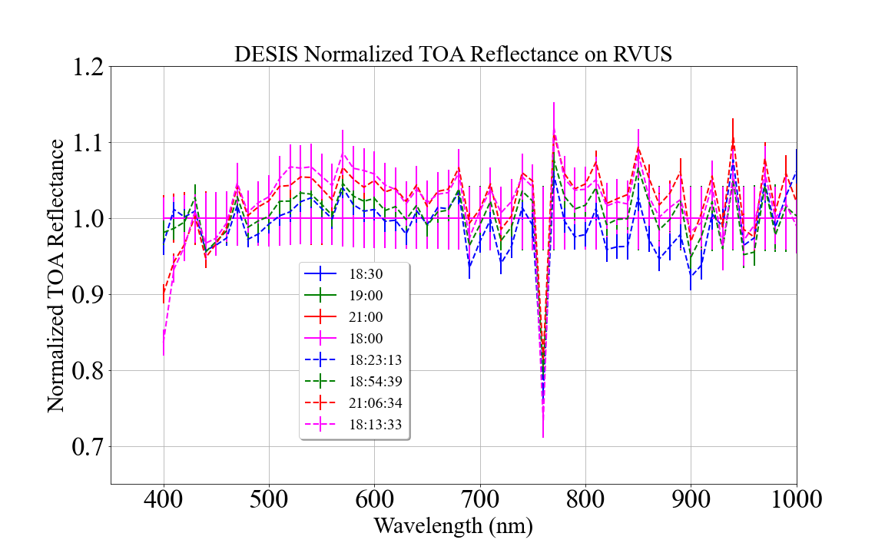
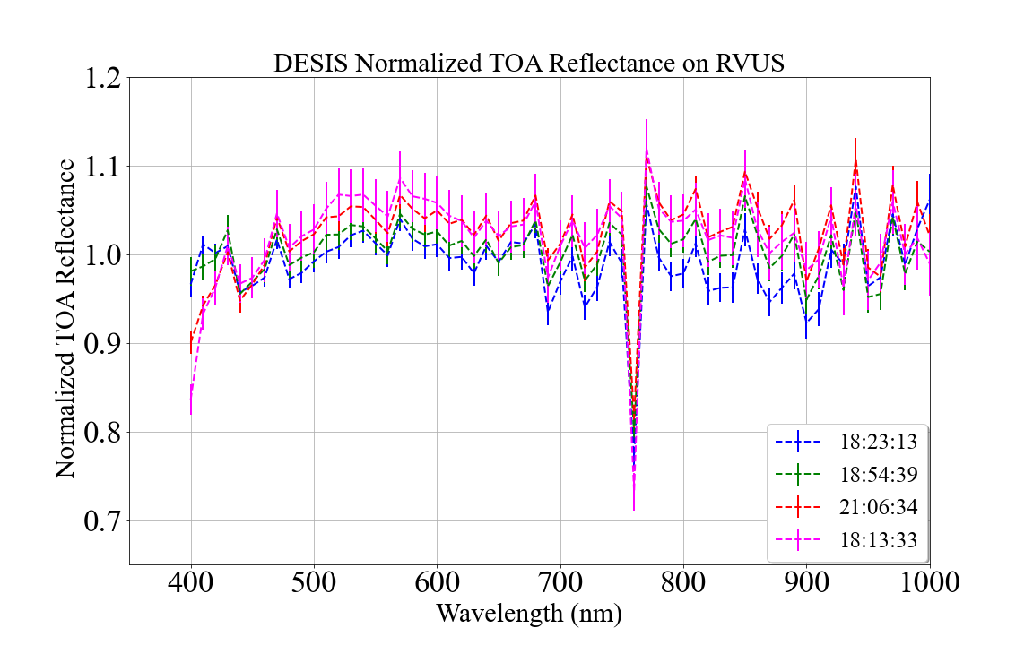
DESIS/RadCalNet TOA Reflectance Ratio
DESIS TOA reflectance is normalized by RadCalNet coincident spectrum
  Solid curves represent RadCalNet measurements
  Dashed curves represent DESIS measurements
Agreement between DESIS and RadCalNet ranges from 2-6%

Slide 12
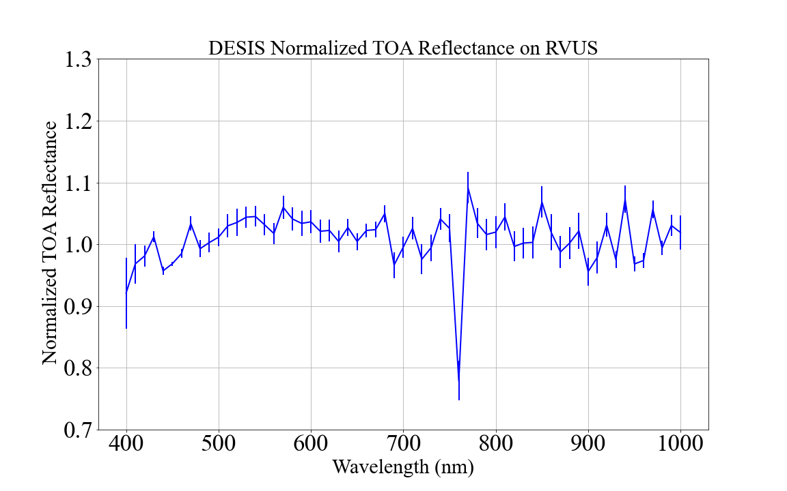
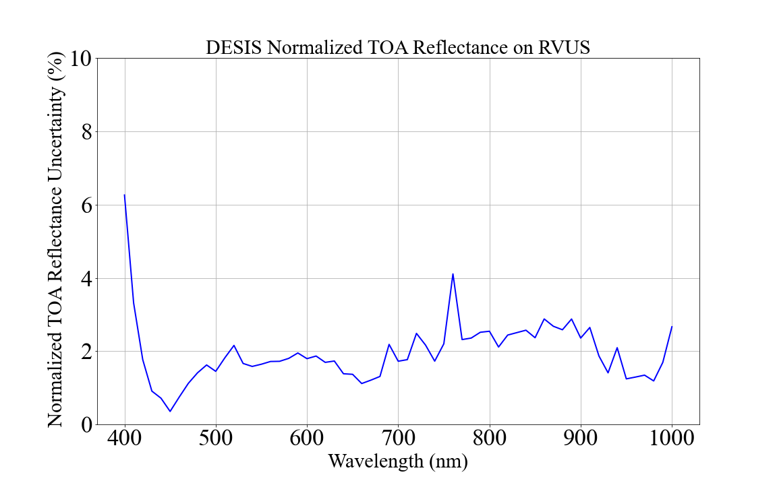
DESIS/RadCalNet TOA Reflectance Ratio
DESIS agrees with 3% for most of the spectral region (i.e.>430 nm)
Variability of TOA reflectance ratio is within 2% for majority of spectral region

Slide 13
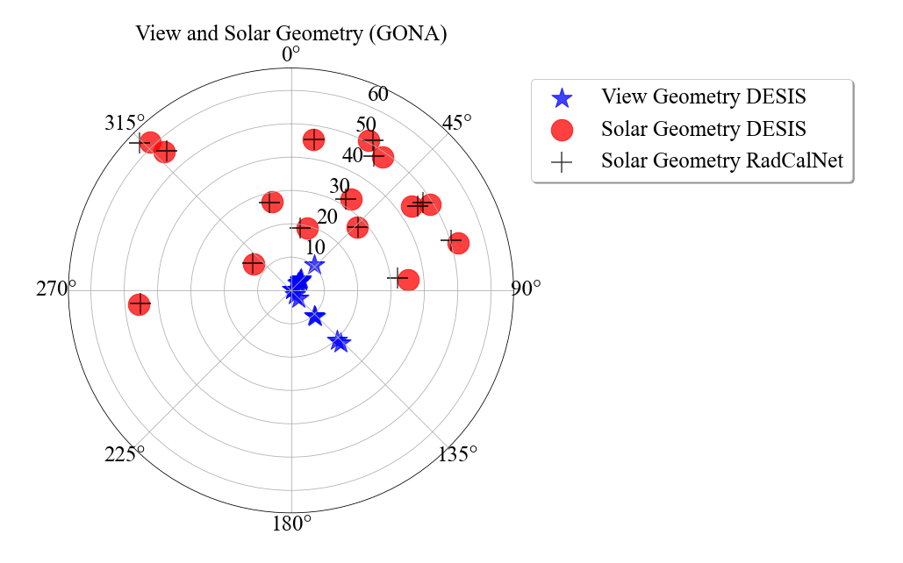
Acquisition Geometry(GONA)
15 coincident collects
View Zenith : 0.43°- 21°
View Azimuth : 42°- 137°

Slide 14
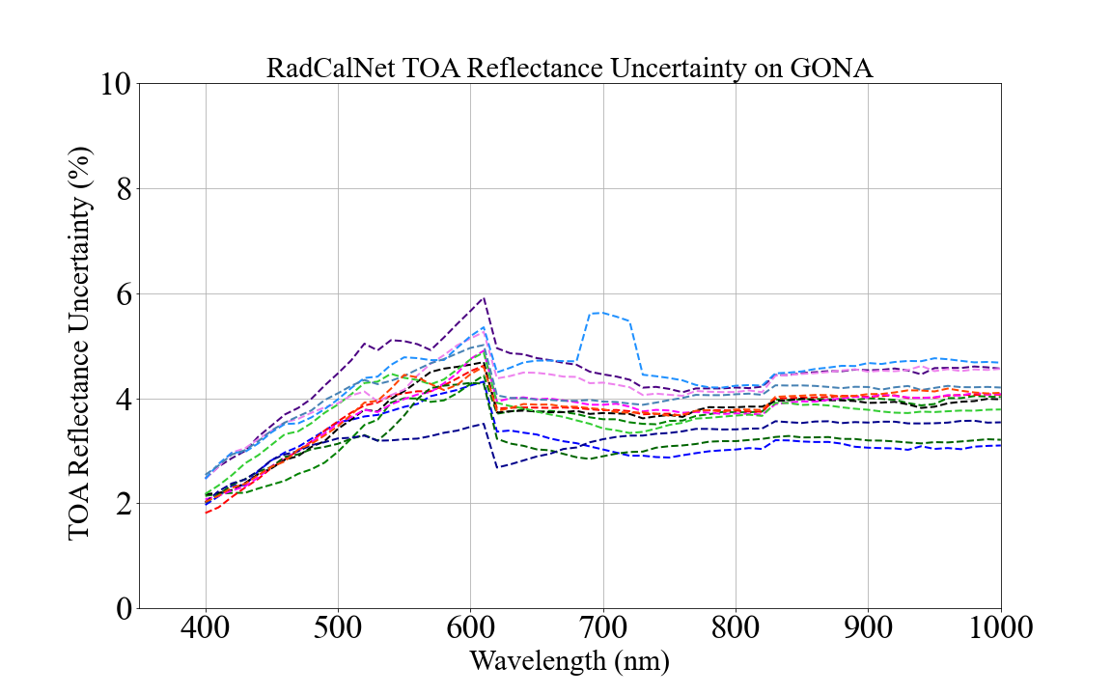
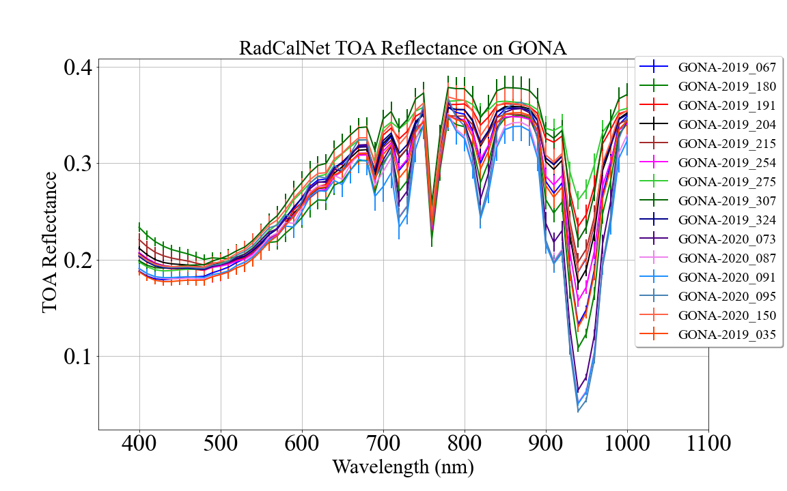
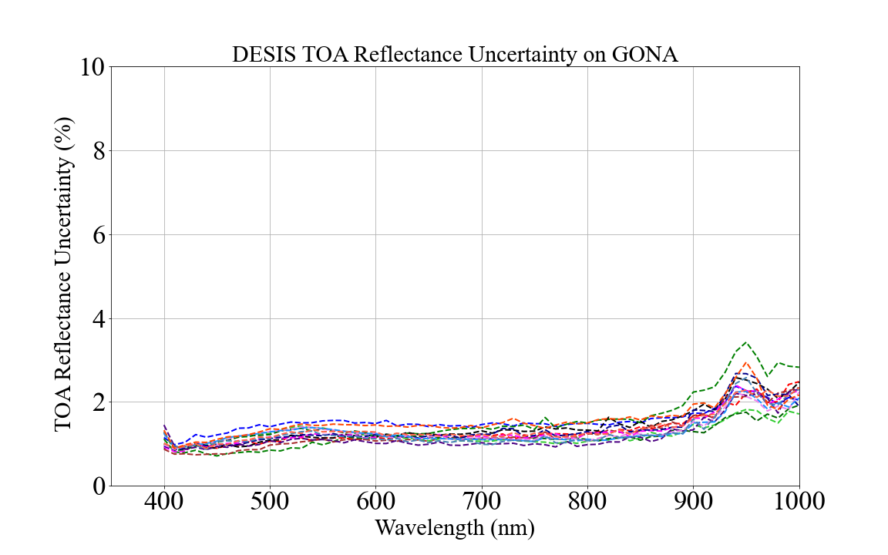
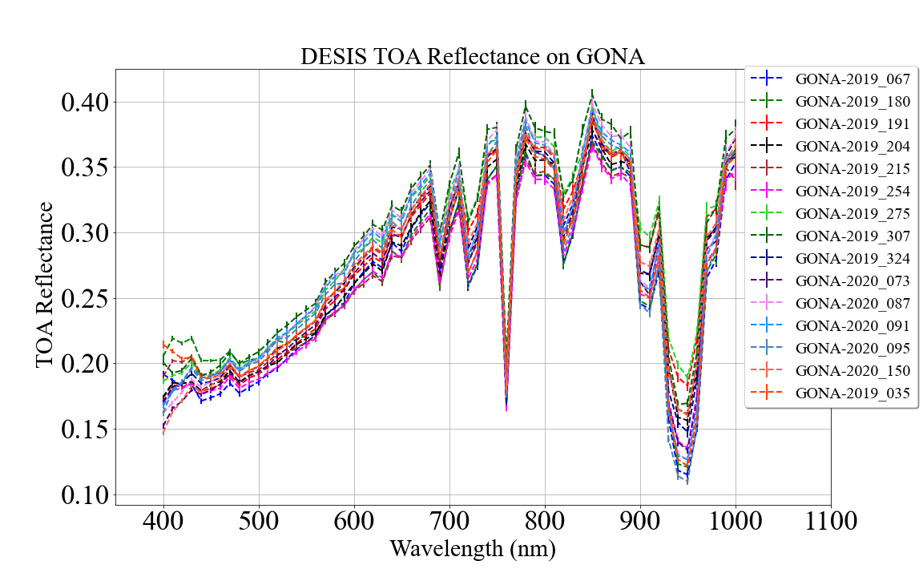
RadCalNet TOA Reflectance on GONA
GONA RadCalNet data is within 4% uncertainty
DESIS spatial uncertainty is within 2%
DESIS shorter wavelength(<430nm) measurements are not consistent
High variability at 940 nm is due to water vapor

Slide 15
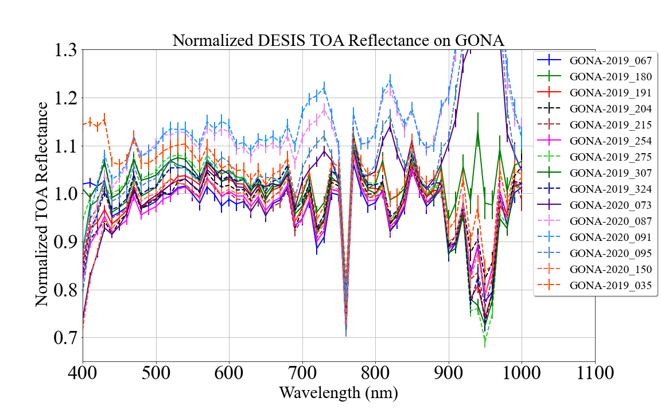
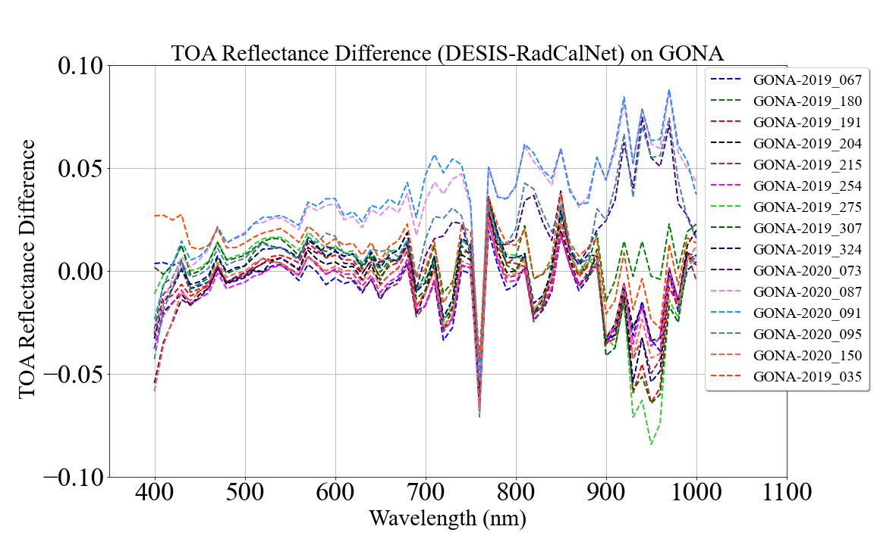
DESIS/RadCalNet TOA Reflectance Ratio
Agreement between DESIS and RadCalNet ranges from 2-10%
Absolute reflectance difference is within 0.02

Slide 16
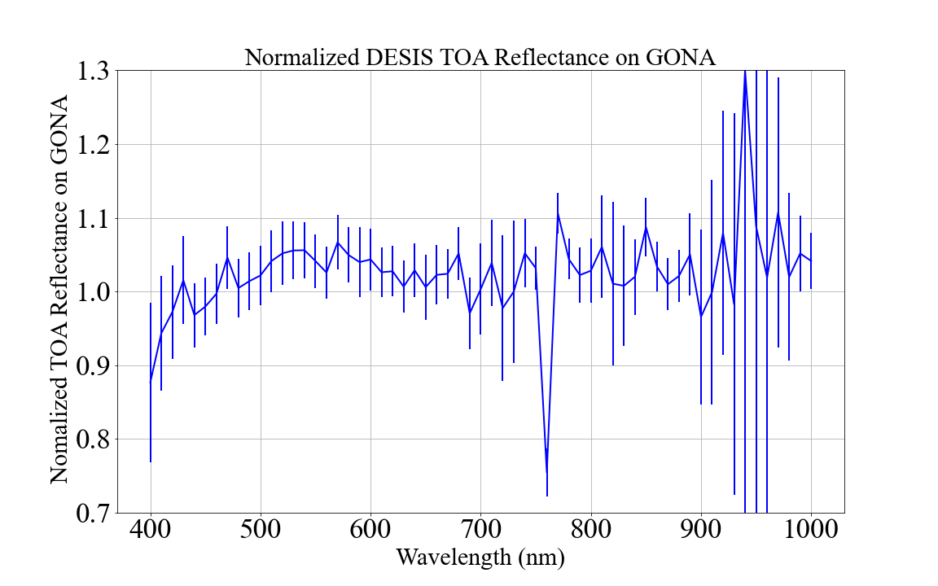
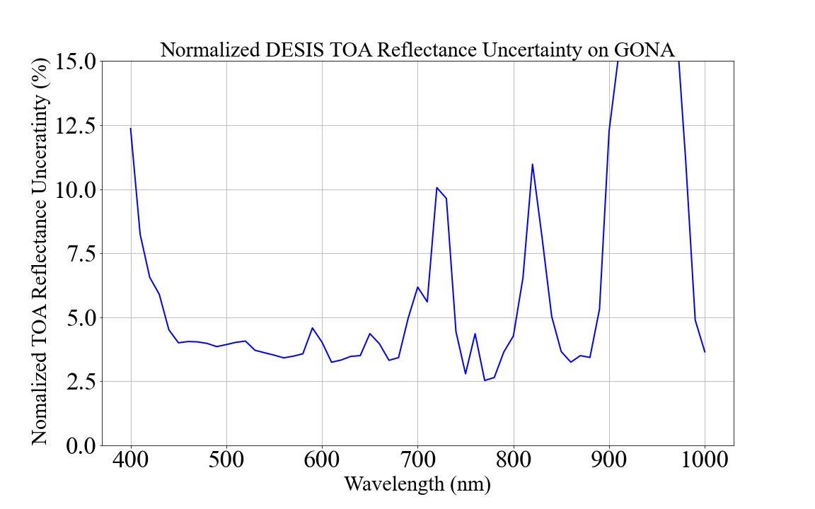
DESIS/RadCalNet TOA Reflectance Ratio
DESIS measurements agrees with RadCalNet within 4% and 10% at shorter wavelengths
Variability of TOA reflectance ratio is within 4% for majority of spectral region

Slide 17
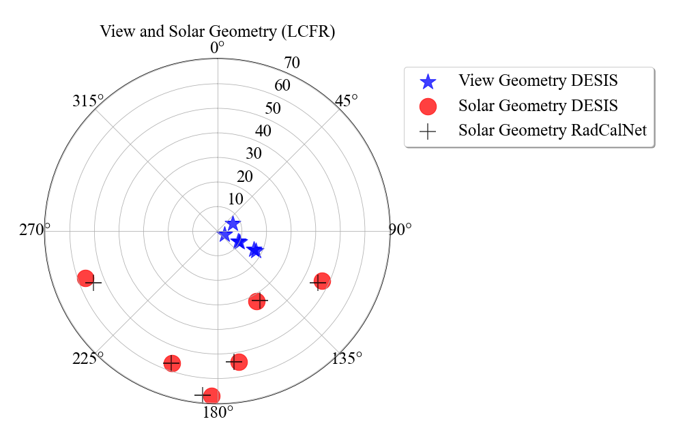
Acquisition Geometry(LCFR)
6 coincident collects
View Zenith : 3.15°- 17.42°
View Azimuth : 64°- 115°

Slide 18
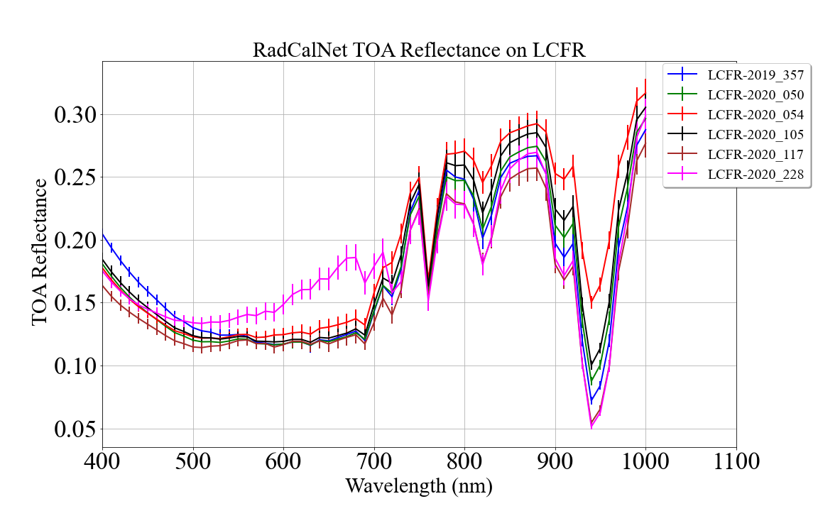
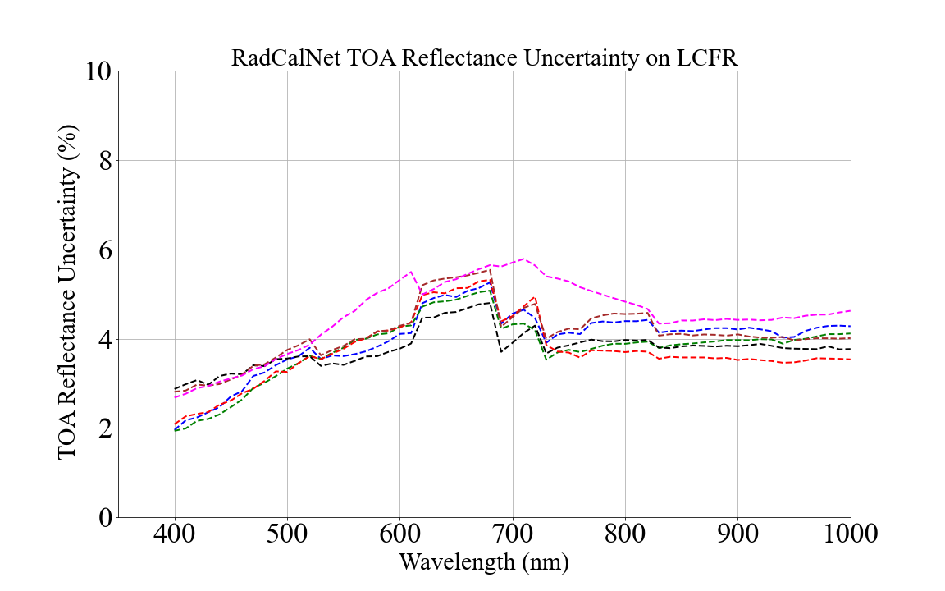
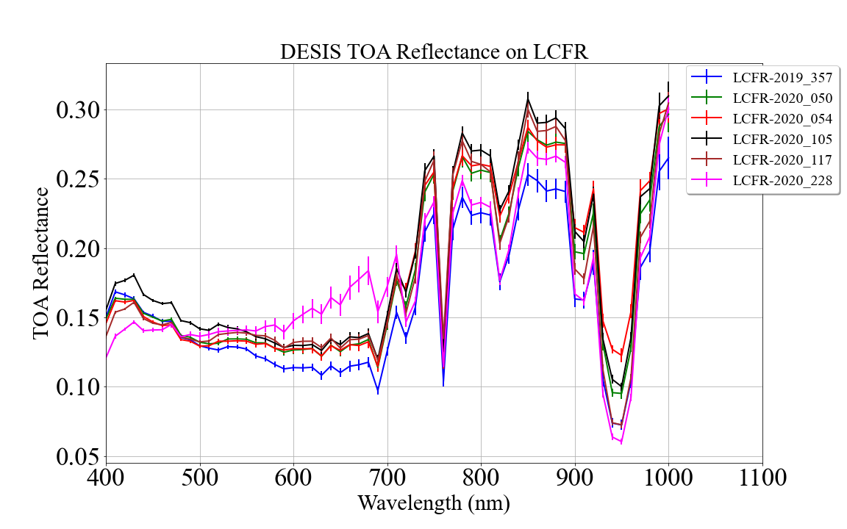
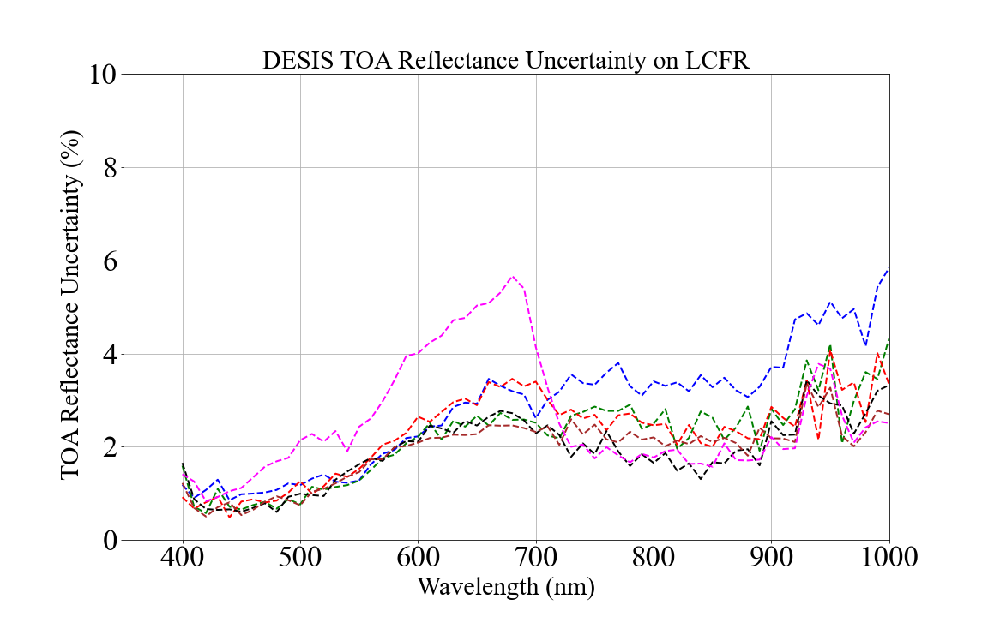
RadCalNet and DESIS TOA Reflectance on GONA
GONA RadCalNet data is within 5% uncertainty
DESIS spatial uncertainty is within 3%

Slide 19
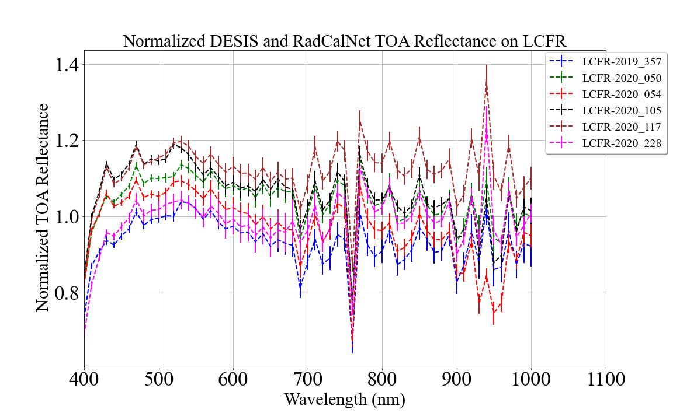
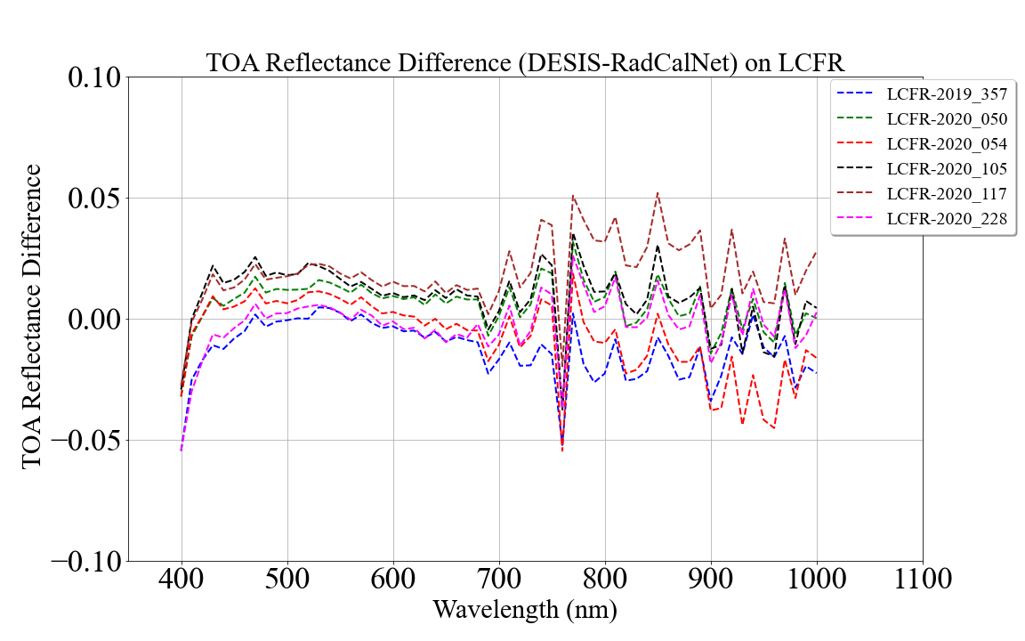
DESIS/RadCalNet TOA Reflectance Ratio (LCFR)
Agreement between DESIS and RadCalNet ranges from 5-10%
Absolute reflectance difference ranges from 0.01-0.03 reflectance unit

Slide 20
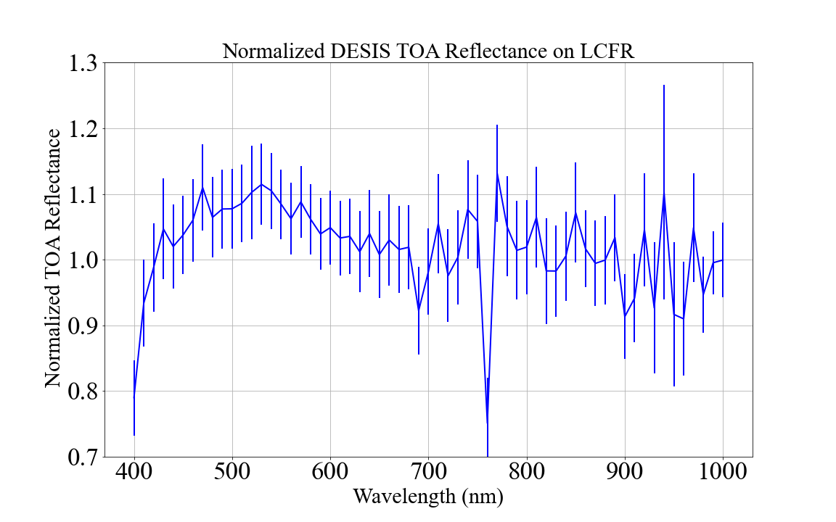
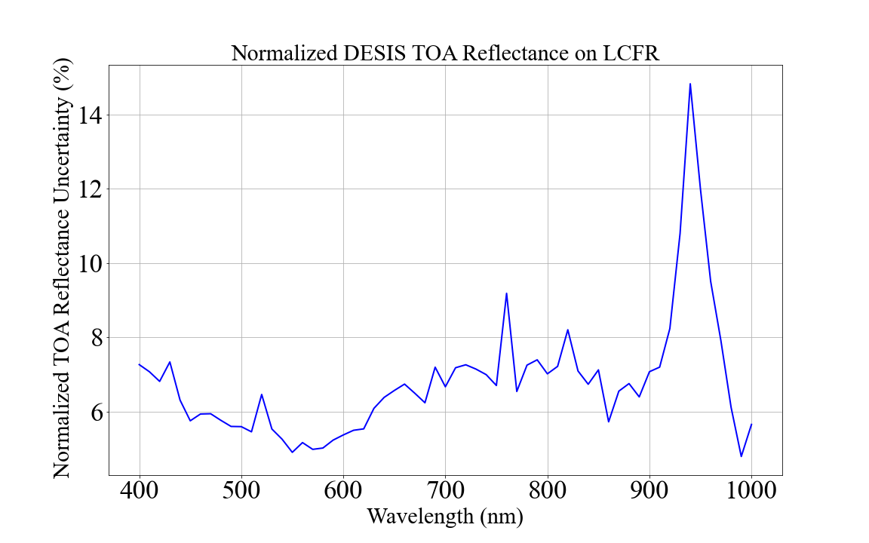
DESIS/RadCalNet TOA Reflectance Ratio (LCFR)
DESIS measurements agrees with RadCalNet within 5% and 10% at shorter wavelengths
Variability of TOA reflectance ratio is within 6-7%

Slide 21
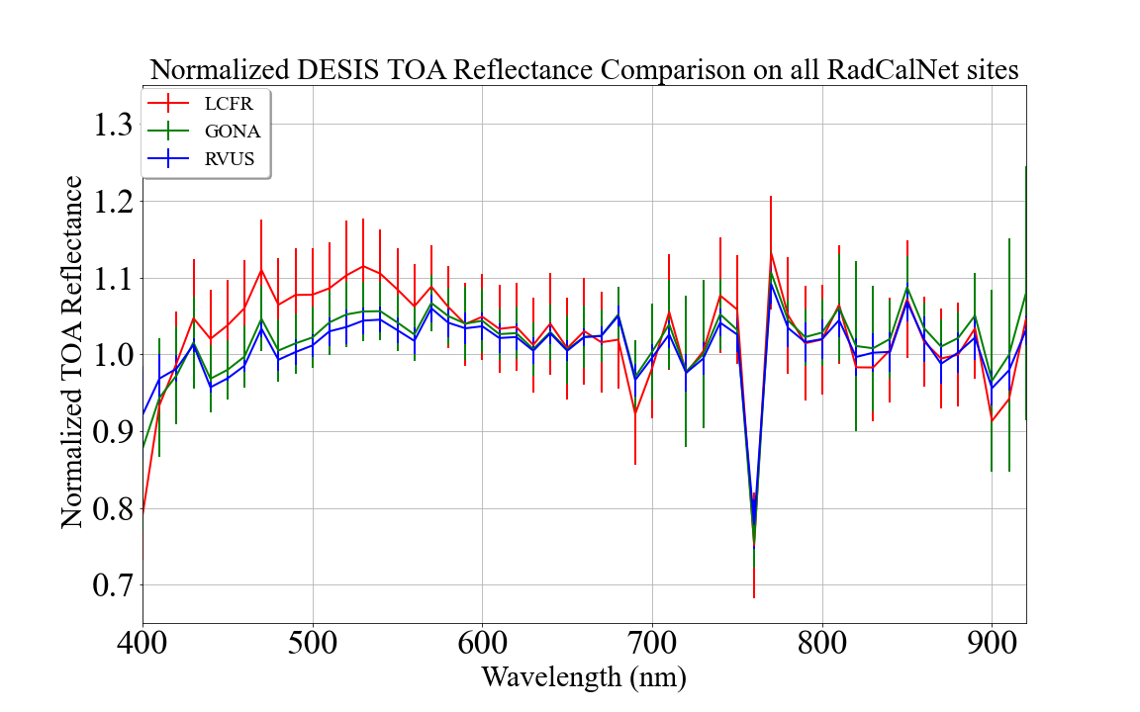
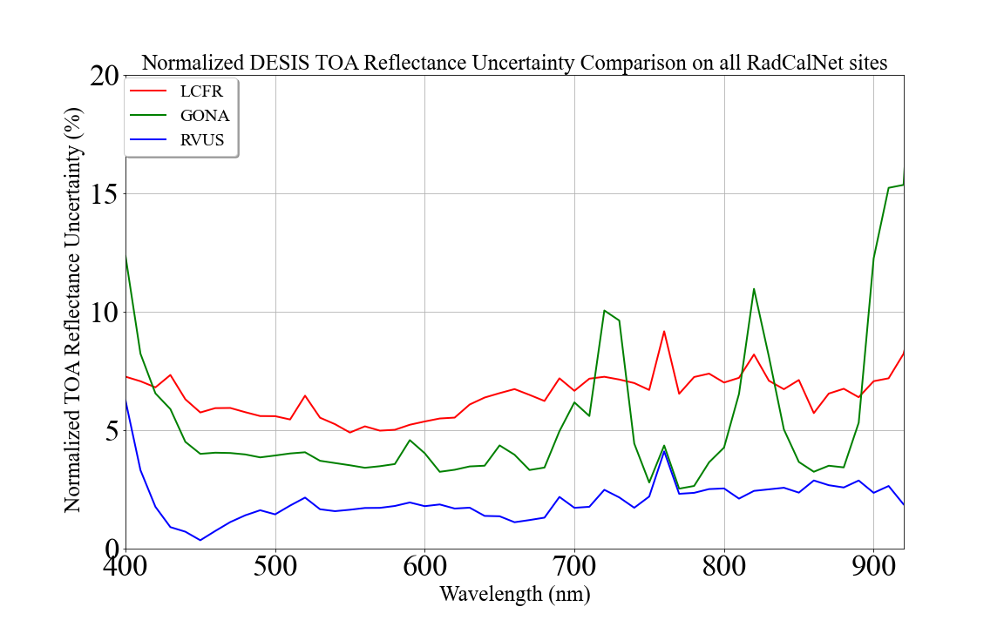
DESIS/RadCalNet TOA Reflectance Ratio Comparison
RVUS and GONA
  Similar accuracy (3% and 4%)
  RVUS shows 2-3% precision whereas GONA shows 4% precision
LCFR
  Similar accuracy like RVUS and GONA for >600 nm
  Less accuracy (5-10%) and precision (6%)

Slide 22
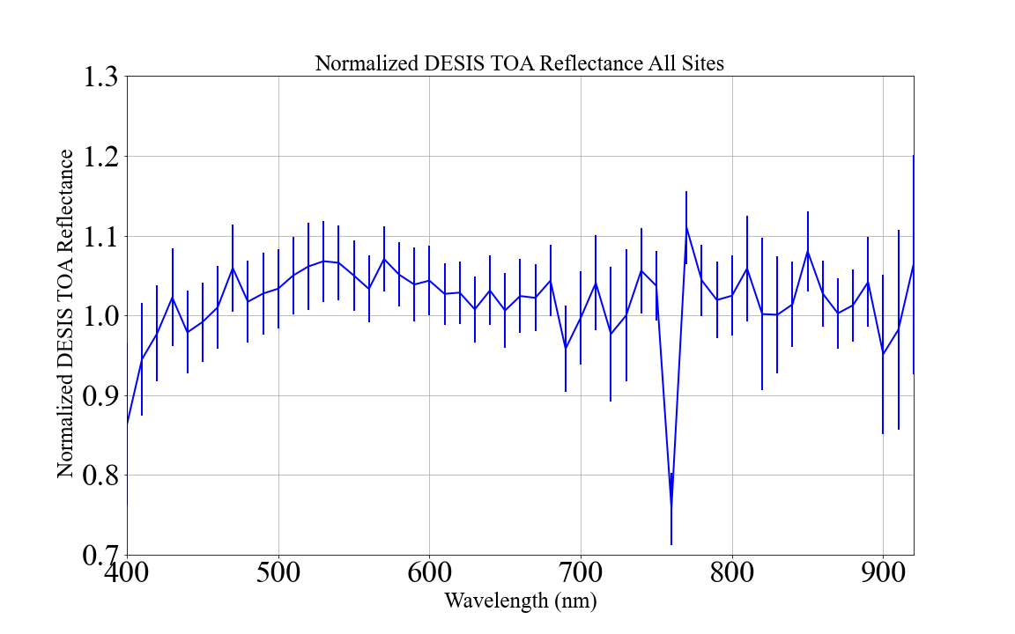
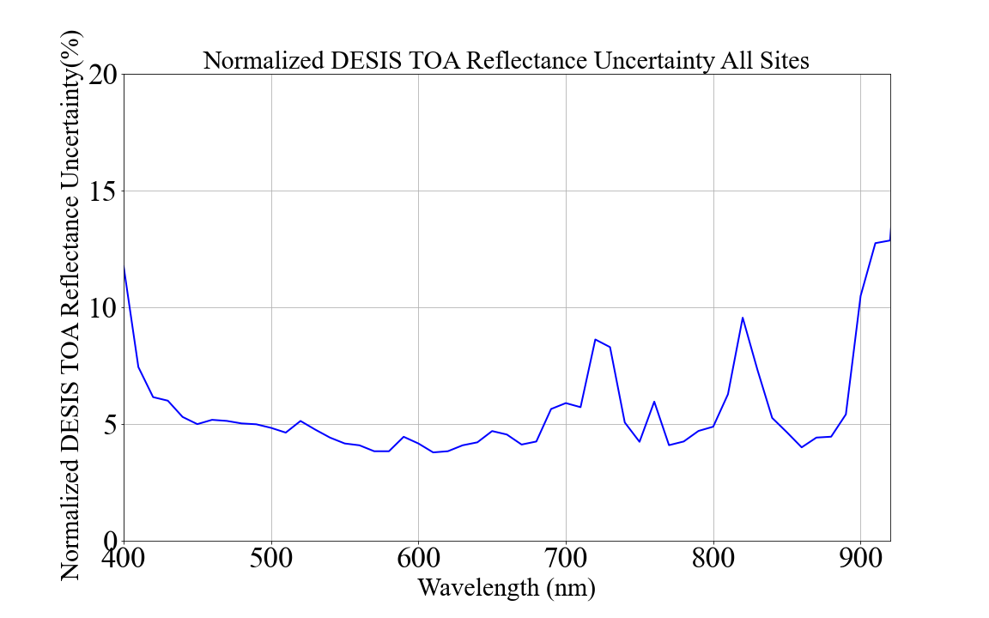
DESIS/RadCalNet TOA Reflectance Ratio (All Sites Combined)
Accuracy and precision are within 5% for most of spectral regions

Slide 23
Conclusions
DESIS is well calibrated within what RadCalNet measures
  radiometric quality is stable
DESIS agrees with RadCalNet within 5-10% depending in spectral region
  Precision is within 5%
RVUS and GONA shows an accuracy within 3% and 4% and precision with 2.5% and 4% respectively
LCFR shows similar accuracy as of RVUS and GONA for the wavelengths >600 nm and 10% for wavelengths less than 600 nm
  Precision is within 6% for most of the spectral region

Slide 24
Thank you
Thank you

