Slide 1
Focusing on Data Quality – and the understanding of quality
January 10, 2022
Cody Anderson, ECCOE PM
USGS EROS
chanderson@usgs.gov
Earth Resources Observation and Science (EROS) Center, Sioux Falls, SD 57198, USA.

Slide 2
Outline
CARD4L
SI-Traceability and Uncertainty
Combining Datasets
Interoperability Metrics
Conclusions

Slide 3
CARD4L

Slide 4
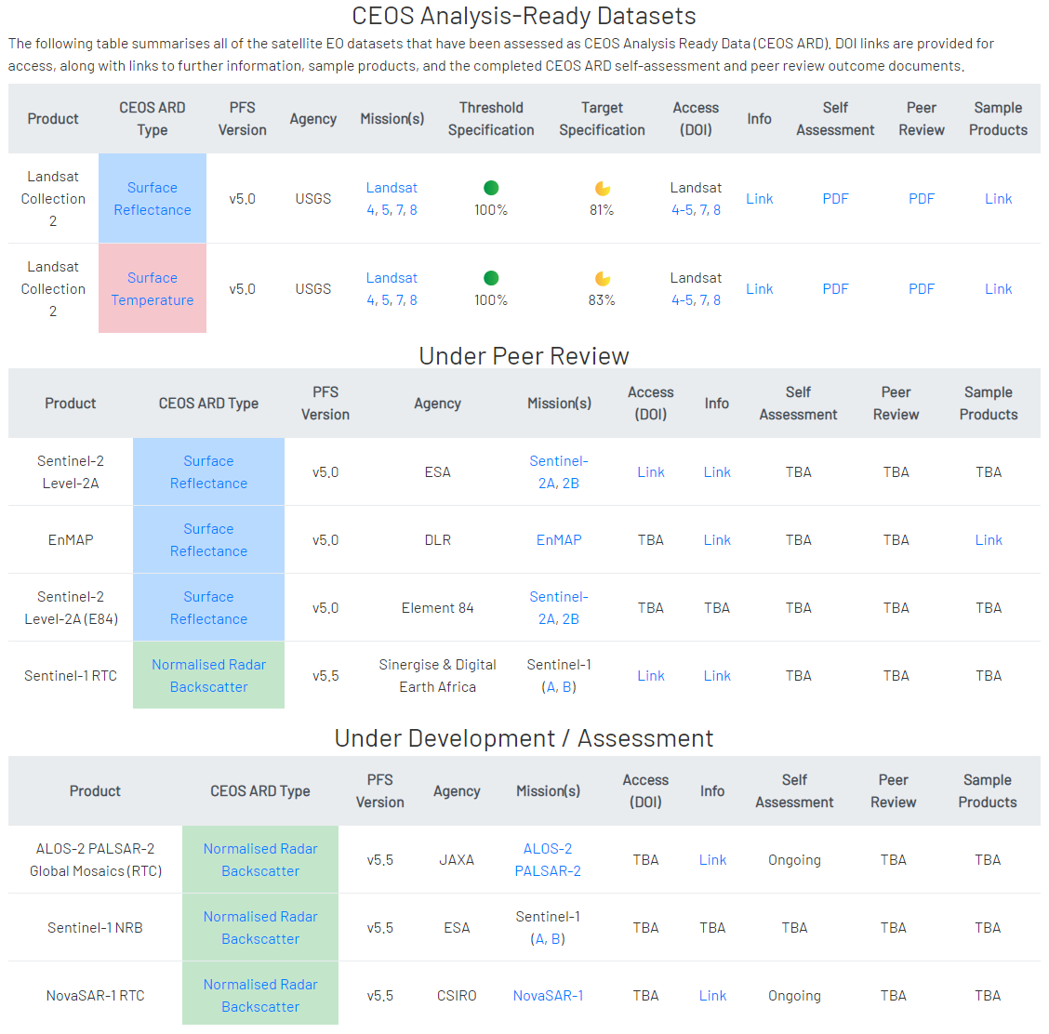
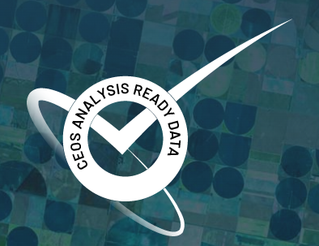
CARD4L Datasets

Slide 5
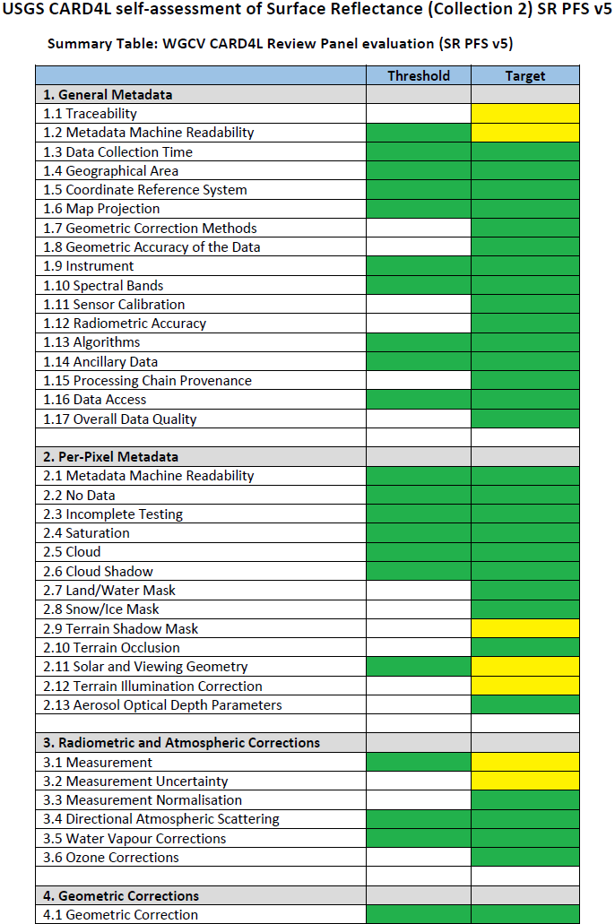
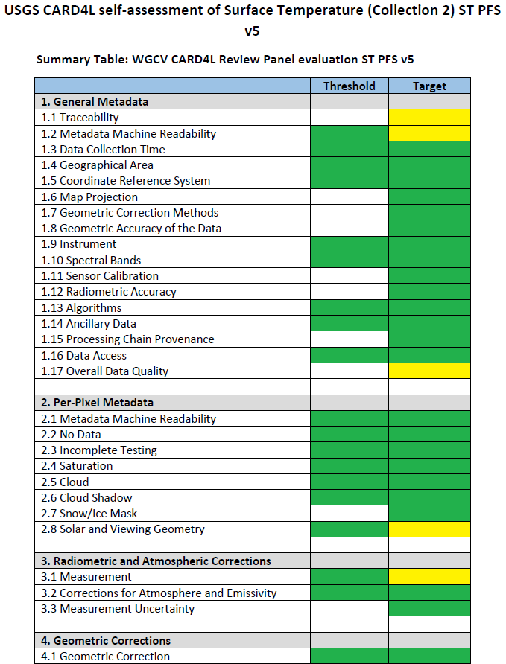
USGS Landsat CARD4L Compliance
Surface Reflectance
Surface Temperature

Slide 6
CARD4L – Surface Reflectance and Temperature Data Quality Specifications
1.1 | Traceability
1.8 | Geometric Accuracy of the Data
1.12 | Radiometric Accuracy
3.1 | Measurement
3.3 | Measurement Uncertainty

Slide 7
SI-Traceability and Uncertainty

Slide 8
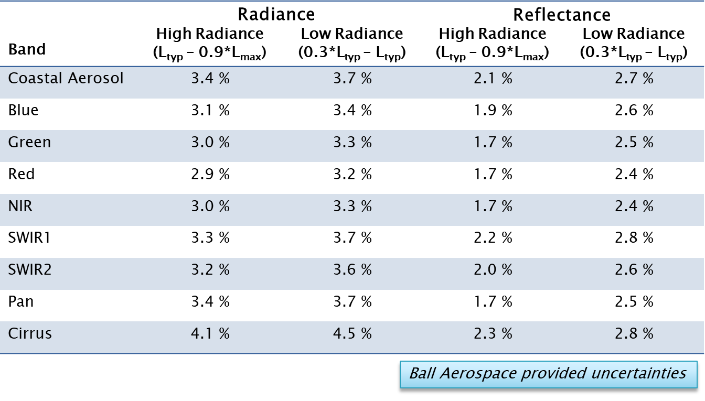
SI – Traceability and Uncertainty
Pre-Launch Measurements

Slide 9
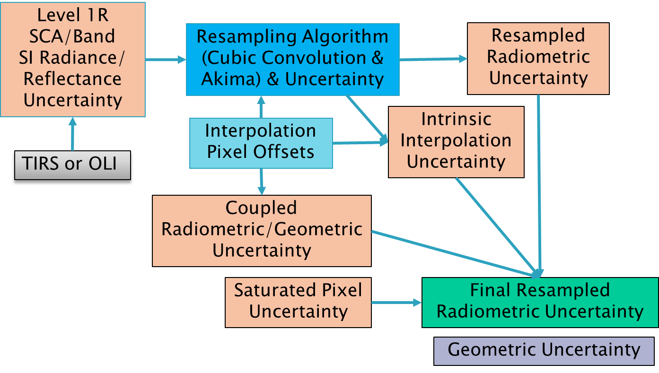
Per-Pixel Uncertainty

Slide 10
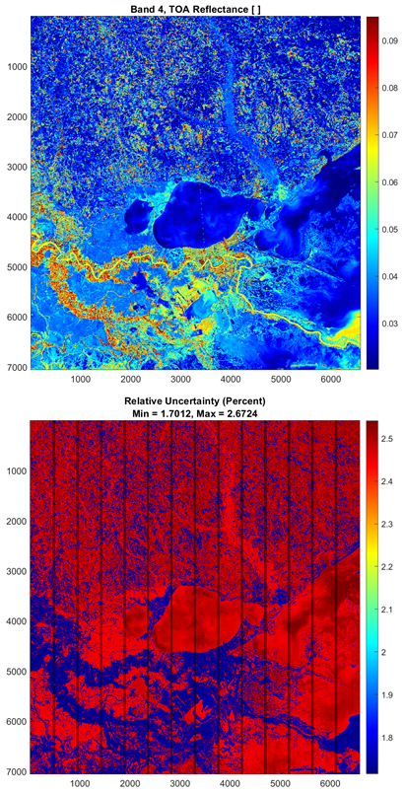
Per-Pixel Uncertainty
Absolute
Relative

Slide 11
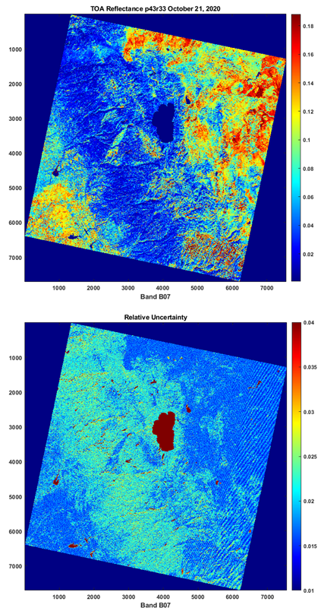
Per-Pixel Uncertainty
Absolute
Relative

Slide 12
Per-Pixel Uncertainty
Absolute
Relative

Slide 13
Per-Pixel Uncertainty
Still Working on this part
And this is for Level 1, not surface reflectance or temperature

Slide 14
Combining Datasets

Slide 15
Sentinel-2A&B
Sentinel-2 Processing Baseline 04.00
Correction of the radiometric bias between Sentinel-2A and Sentinel-2B (keeping Sentinel-2A as reference): Sentinel-2A and Sentinel-2B radiometric cross-calibration results have highlighted a small bias for VNIR bands B01 to B09. This radiometric difference will be mitigated by applying a radiometric bias correction of 1.1% to Sentinel-2B VNIR bands B01 to B09.
News
Copernicus Sentinel-2: Major Products Upgrade Upcoming
29 September 2021
https://sentinel.esa.int/web/sentinel/-/copernicus-sentinel-2-major-products-upgrade-upcoming

Slide 16
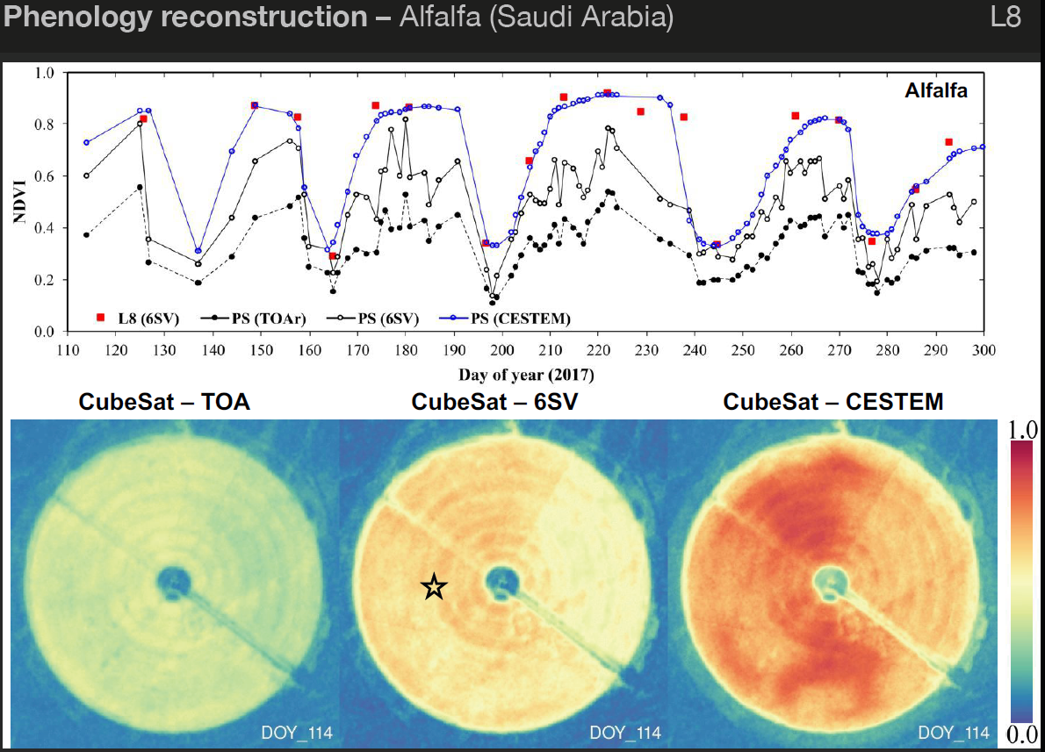
Planet and Landsat 8
Rasmus Houborg
CubeSat, Sentinel-2, Landsat 8, and MODIS data fusion
for enhanced land surface characterization
JACIE 2018

Slide 17
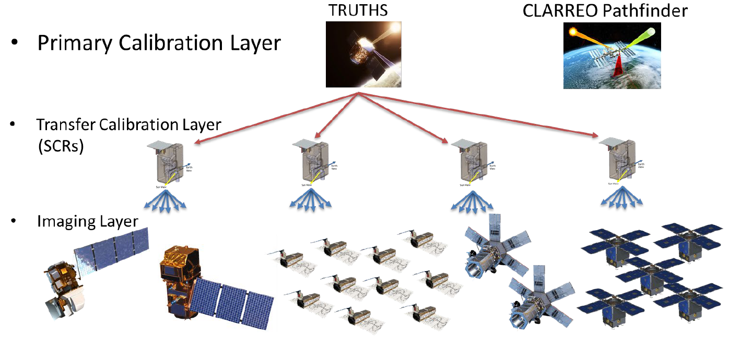
Common References

Slide 18
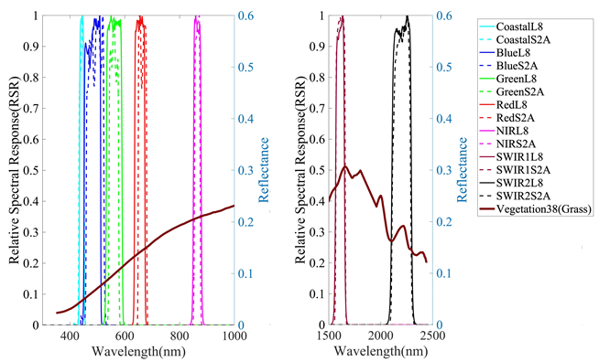
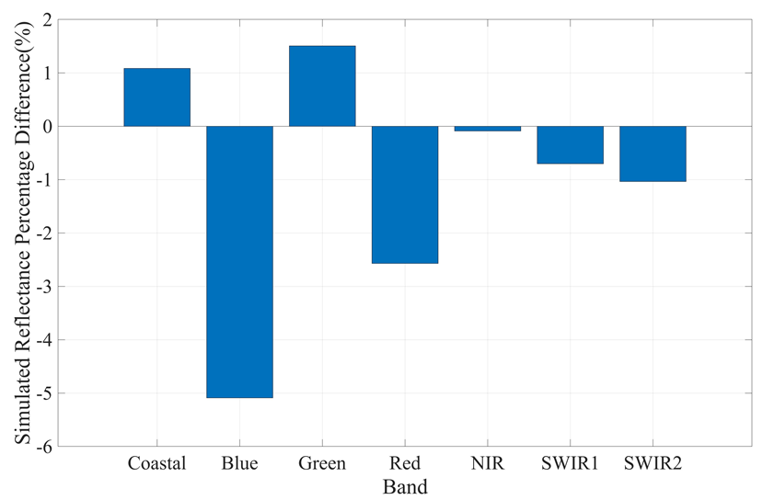
Still Differences – Landsat 8 vs Sentinel 2
Landsat based its Collection 2 georeferencing off the Sentinel-2 Global Reference Image (GRI)
L8 vs S2 (using GRI data) co-registration error is expected to be < 8 m​
Still differences in Spectral Responses
Grass Target Spectra with L8 and S2 RSRs
Percent Diff. between L8 and S2

Slide 19
Interoperability Metrics

Slide 20
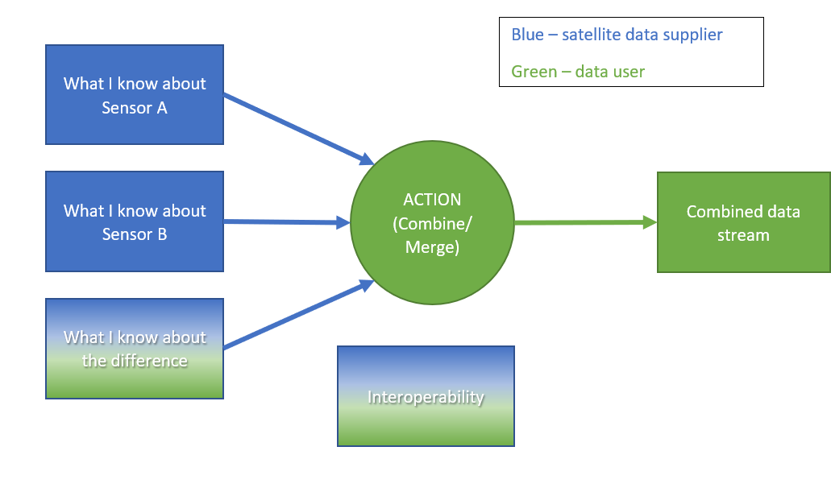
Interoperability Metric Methodology

Slide 21
Spatial dimension
Spatial Dimension
 | Action | Combined Data Stream
What I know about data set A | Provide two data sets in their native resolutions Or Resample higher resolution data to match lower resolution data | Two data streams with the same spatial resolution that can be combined / compared
Pixel size, P_{A} (meters), of a product (not sensor)
What I know about data set B
Pixel size, P_{B} (meters), of a product (not sensor)
What I know about the difference
Pixel alignment
 | Interoperability
 | What is the pixel size on the ground for the combined product? $$I_{S}=max⁡(P_{A},P_{B})$$

Slide 22
Geometric dimension
Geometric Dimension
 | Action | Combined Data Stream
What I know about data set A | Provide data sets with their original datum Or Define a common grid (projection / datum) and correct to it; include any known inter-sensory bias | Two data streams brought onto the same grid
CE-90 (90% Circular Error), CE_{A} (meters)
What I know about data set B
CE-90 (90% Circular Error), CE_{B} (meters)
What I know about the difference
Inter-sensor bias, B
 | Interoperability
 | How close are pixels from one data set to pixels of another data set? Can I stack pixels? $$I_{S}=max⁡(P_{A},P_{B})$$

Slide 23
Temporal dimension
Temporal Dimension
 | Action | Combined Data Stream
What I know about data set A | Find a common overpass time for comparison Or Create a data set that merge the two to get more overpasses | Matchups between two sensors Or Single data set from the two data sets
Time between overpasses, T_{A} (days)
What I know about data set B
Time between overpasses, T_{A} (days)
What I know about the difference
Offset time for a particular location, $∆T$
 | Interoperability
 | How often do I get a match up? $I_{Ta}=LCM⁡(T_{A},T_{B})$ What is the maximum time gap between any two observations? $I_{Tb}=min⁡(T_{A},T_{B})$ What is the observational time difference (within day variability)? $I_{diurnal}=T_{A}^{′ }$-${ T}_{B}^{′}$

Slide 24
Radiometric dimension
Radiometric Dimension
 | Action | Combined Data Stream
What I know about data set A | Provide both sensor data sets with information about biases Or Bias correction or harmonization | Data set from both sensors (may have jumps) Or Data sets from both sensors (jumps removed)
Radiometric uncertainty, u_{A}
What I know about data set B
Radiometric uncertainty, u_{B}
What I know about the difference
Inter-sensor bias, B Match up uncertainty, u_{M} | Interoperability
 | How What is the worst-case radiometric uncertainty for a combined data set over an ROI? $I_{u}=max⁡(u_{A},u_{B})$ What is the bias between data sets? B How well can I correct the data sets to a common reference?$I_{\text{R}}=\sqrt{u_{\text{A}}^{2}+u_{\text{ref}}^{2}+u_{\text{m}}^{2}}$
Notes:
Radiometric uncertainty per-mission, per-pixel, with or without error correlation information. Baseline is to consider the TOA data product with uncertainty expressed in absolute units (radiance/reflectance) for the worst case pixel.

Slide 25
Spectral dimension
Spectral Dimension
 | Action | Combined Data Stream
What I know about data set A | SBAF calculation (effect on radiance of that difference); based on typical RSR for common surfaces – vegetation, sand, water, snow, ice, and soil Or Homogenization (correct for spectral and radiometric differences to make the data sets equivalent) | Provide a combined data stream (with SRF information) – user corrects for SRF over their own scene Or Provide a corrected data stream as though both data sets are from the same sensor, correction over typical scenes
Relative spectral response function (RSR or SRF), $ξ_{A}$
What I know about data set B
Relative spectral response function (RSR or SRF), $ξ_{B}$
What I know about the difference
Ground spectral reflectance, $ρ_{gnd}(λ)$

Slide 26
Continued from previous slide
Spectral Dimension Continued
 | Interoperability
 | How much variability might I get for my scene type (e.g. vegetation) between data sets? Or specifically, how much variability might I get over my scene? Spectral interoperability is equal to the SBAF over a range of typical sites (or the site of interest) where spectra are available $$I_{S}= \frac{\int_{λ}{ρ_{λ}RSR1dλ \int_{λ}{RSR2dλ}}}{\int_{λ}{ρ_{λ}RSR2dλ} \int_{λ}{RSR1dλ}}$$ How well can I correct for differences over my scene using a correction over a typical scene? Uncertainty on the SBAF – looking at the variability in SBAF between individual scenes and typical scenes Spectral library – standard deviation of SBAF calculations for a group of possible typical scenes

Slide 27
Angular dimension
Angular Dimension
 | Action | Combined Data Stream
What I know about data set A | Provide data at raw viewing angles with information about those angles Or Normalize to a consistent viewing angle (often nadir)
Range of viewing zenith angles for A, $θ_{A, min}, θ_{A,max}$
What I know about data set B
Range of viewing zenith angles for B, $θ_{AB min}, θ_{B,max}$
 | Interoperability
What I know about the difference | How different could the observed reflectance / radiance be for my scenes of interest because of the different viewing angles, typical for particular types of scenes (vegetation, now, ice, concrete, etc.) How wrong could my correction be?
BRDF of the scene(s), $ρ(θ,φ)$
Notes:
Range of viewing zenith angles:
globally – swath limited range, or
locally – set of viewing angles for different overpasses,
very maneuverable sensors, …

Slide 28
Conclusions
Individual dataset quality needs to be understood
Standard reporting of quality needs to be adopted
Individual datasets need to be improved
Standard references need to be adopted
Differences between datasets need to be understood
Impacts of data quality, uncertainty, and differences between datasets needs to advertised

