Slide 1
Deconstructing
Analysis Ready Data
Moving ForewARD with Analysis Ready Metadata
Matthew Hanson
@GeoSkeptic
JACIE 2022 (virtual)
Jan 10, 2022

Slide 2
What does ARD mean ?
Notes:
Sections
Use to break up your presentation into logical parts
Not for images or large amounts of text

Slide 3
Landsat, the Original ARD
“The ARD are available to significantly reduce the burden of pre-processing on users of Landsat data.”
Goal: Treat all Landsat as a “virtual” constellation to enable easy time series analysis across all platforms
Processing
Surface reflectance (Atmospherically corrected)
Georegistered
Metadata
Cloud/QC mask
Formatting
Tiled
Common projection

Slide 4
CARD4L - one ARD specification
2 levels of requirements: threshold and target
Processing (partial)
Atmospherically corrected
Georegistered
BRDF corrected (target)
Sub-pixel relative (threshold) or absolute (target)
Metadata (partial)
Note CARD4L does not specify how metadata is included
cloud mask
Per-pixel sun angles
Provenance
Format
none

Slide 5
Analysis Ready Data Defined
Apr 2018: “ARD Defined”, Chris Holmes
Sep 2018: “State of Satellite Imagery”, SatSummit 3
Processing Requirements
Atmospherically corrected
BRDF corrected
Georegistered
Sensor alignment
Per-pixel metadata requirements
Cloud mask available
Format Requirements
Fixed grid, aligned pixels
Common projection

Slide 6
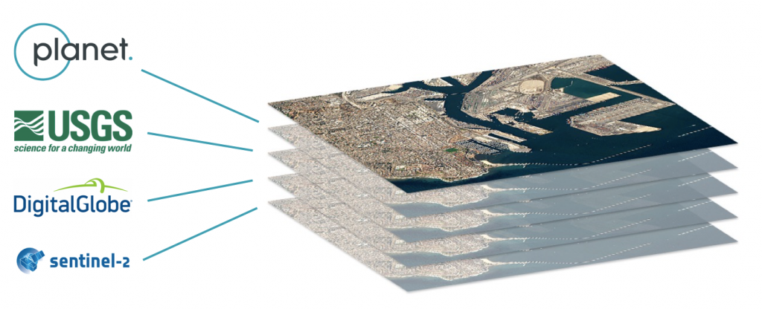
The Satellite Interoperability Workshop
Aug 2018: Satellite Interoperability Workshop
STAC (sprint #3) + ARD (ARD18)
Virtual Constellations
Harmonization
From Top Takeaways From The Satellite Interoperability Workshop by Ignacio Zuleta
“When it comes to ARD and interoperability, in contrast, public missions have an outsize effect on cost and schedule considerations for commercial providers of fusion products. This has traditionally discouraged the commercial sector from leading implementations of standards, which was what partly motivated the workshop discussions: the need for more industry-driven collaboration.”
“There was also consensus that no simple definition of ARD can exist without the definition of standardized families of applications (for eg, analysis-ready data could be ready for a surveyor, but maybe not for a farmer).”

Slide 7
An alternative view of ARD
Notes:
Sections
Use to break up your presentation into logical parts
Not for images or large amounts of text

Slide 8
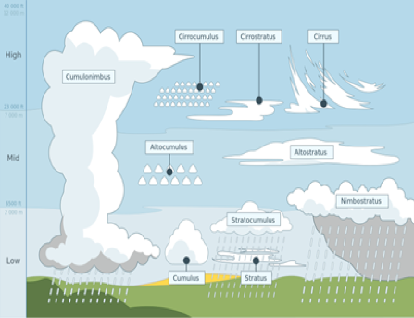
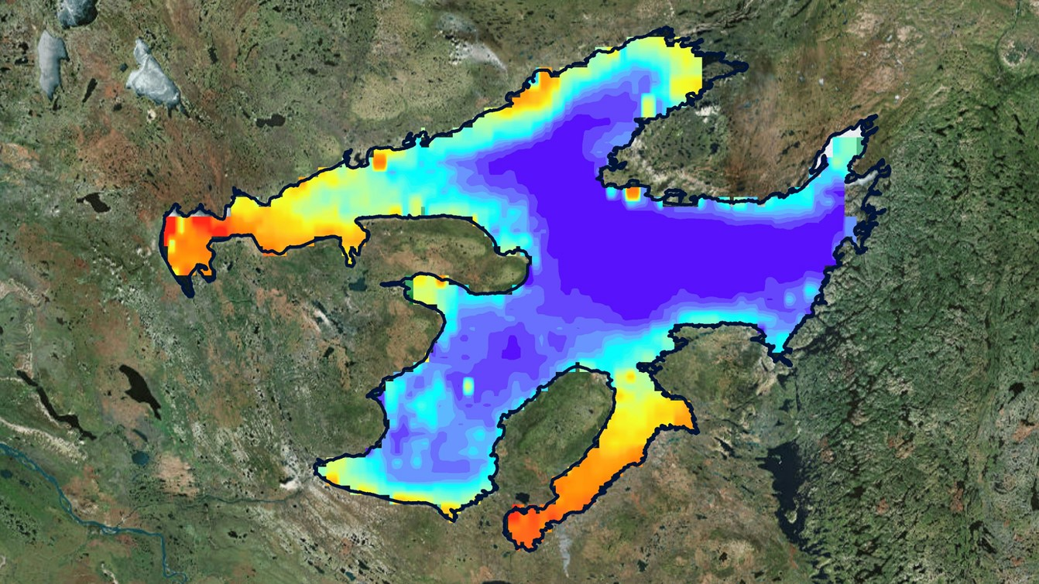
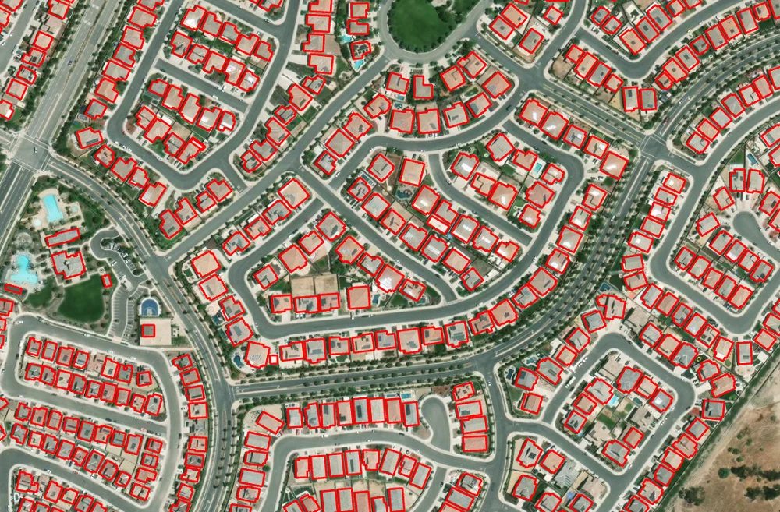
Workflows have different requirements
Processing “level” of inputs
Geolocation and measurement uncertainty
Required metadata

Slide 9
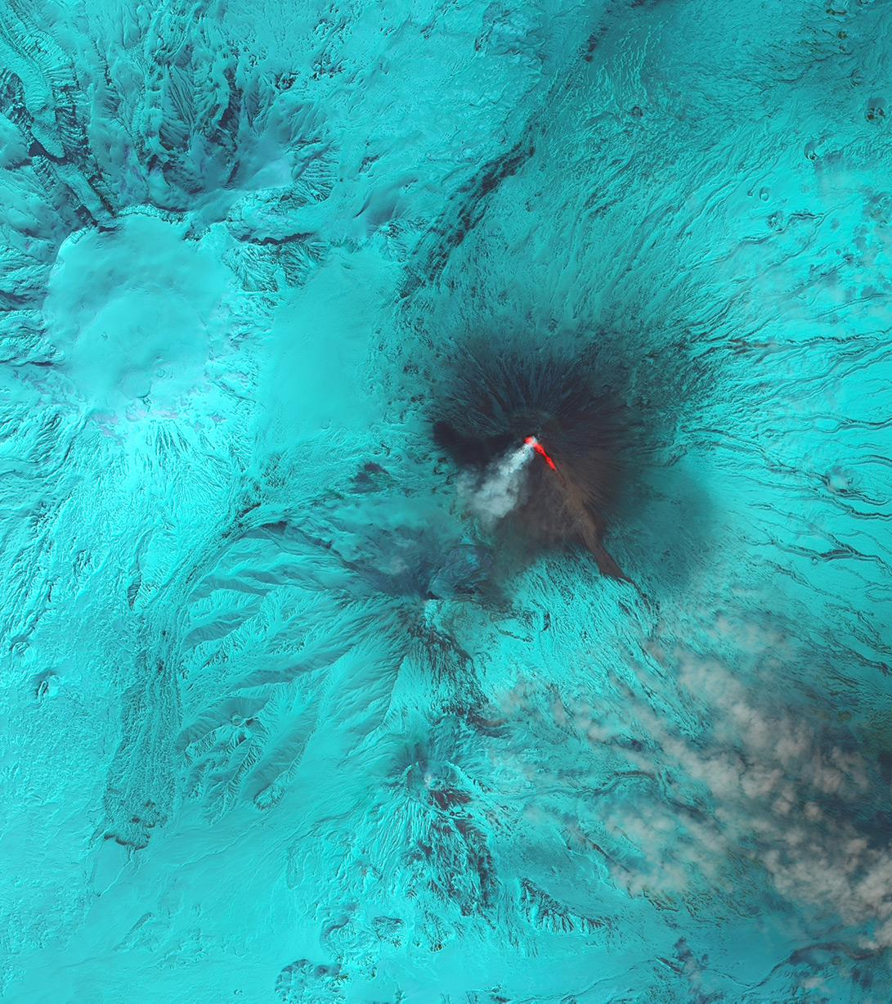
Image of volcano
“The ARD are available to significantly reduce the burden of pre-processing on users of Landsat data.”
Landsat ARD
“CEOS Analysis Ready Data for Land (CARD4L) are satellite data that have been processed to a minimum set of requirements and organized into a form that allows immediate analysis with a minimum of additional user effort and interoperability both through time and with other datasets.”
CEOS ARD

Slide 10
ARD means easy discovery, access, and exploitation of measured geospatial data
Notes:
Quote Slide

Slide 11
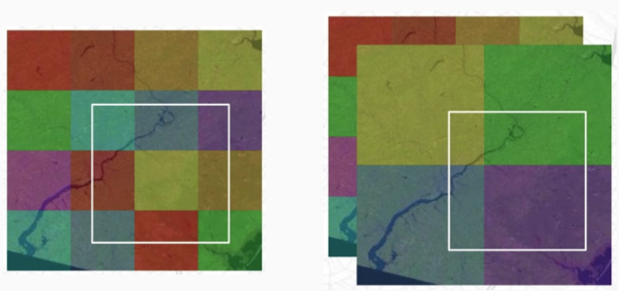
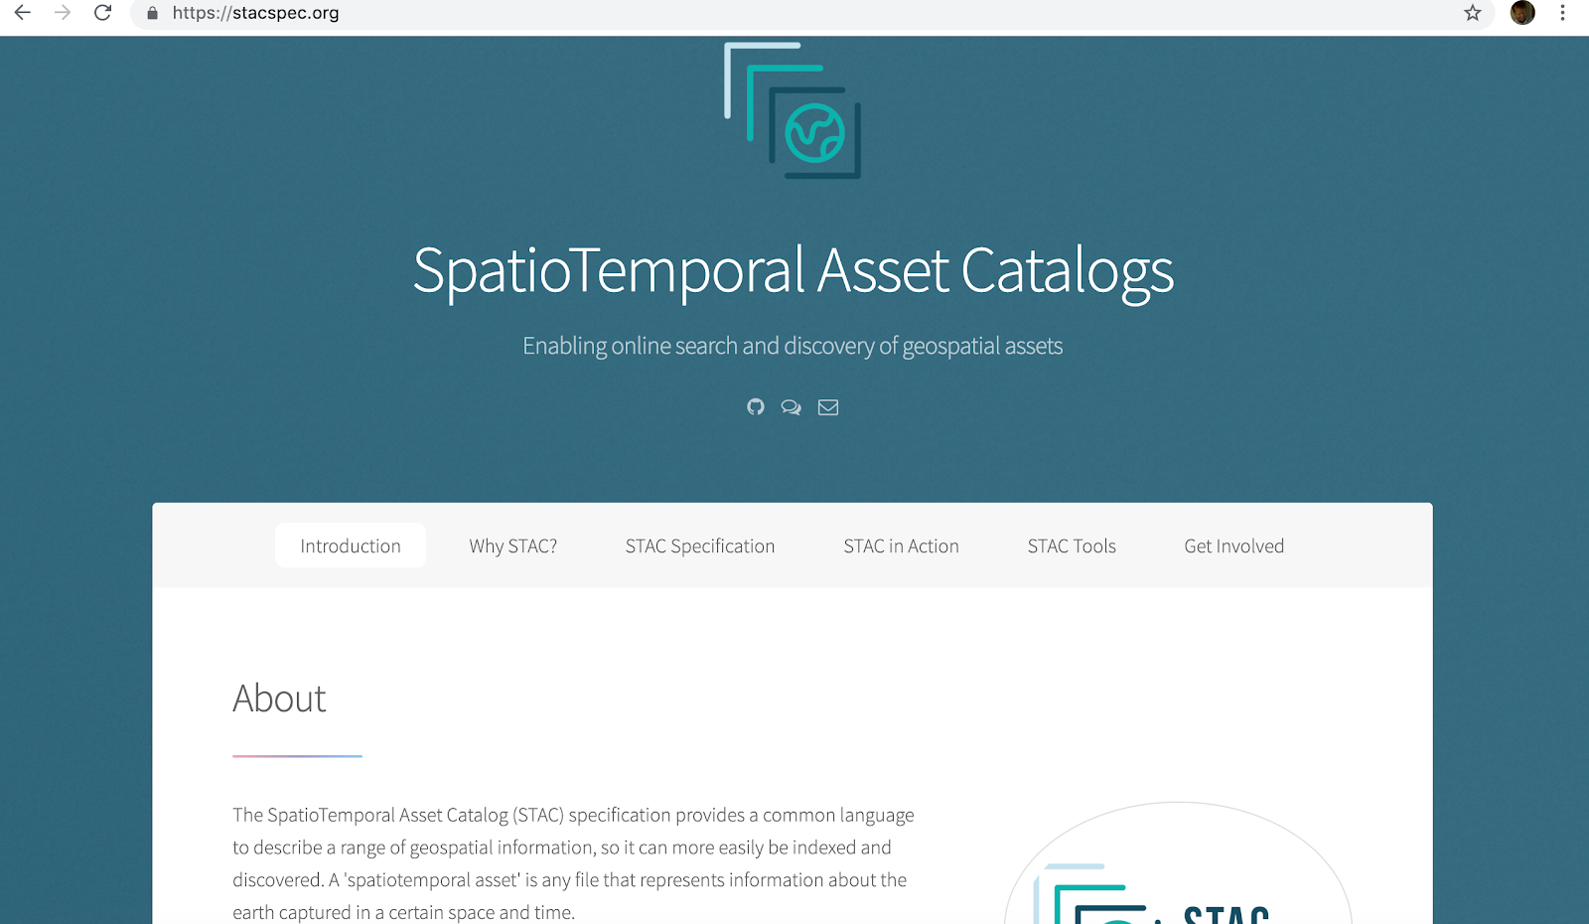
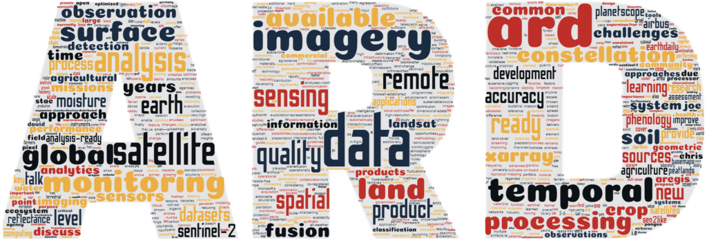
Cloud Native Geospatial
Cloud-optimized data formats
Standardized, searchable metadata
Well-characterized data

Slide 12
Deconstructing ARD
Notes:
Sections
Use to break up your presentation into logical parts
Not for images or large amounts of text

Slide 13
Processing Requirements
Geometric transforms
Atmospheric correction
Accuracy & Uncertainty
Topographic corrections
BRDF
CARD4L describes requirements for a class of workflows that require
Level 2 data (e.g., surface reflectance, temperature)
Time series

Slide 14
Workflows should determine input processing needed to produce valid output
Notes:
Quote Slide

Slide 15
Metadata Requirements
Cloud masks
Sun angle masks
Data provenance (processing history, sources)
Spectral bandpasses
QC band
Sensor parameters
Different workflows require different sets of metadata

Slide 16
Well-characterized data can be validated
Notes:
Quote Slide

Slide 17
Format Requirements
Cloud-native access
No additional format requirements are recommended
Tiling and projection decisions makes assumptions about use cases
As soon as you pick a projection, it’s the wrong one
Providers should use projection that minimizes resampling errors from raw
For harmonizing across datasets, formats will likely be different
Different tiling, pixel grids, resolutions, projections
Resampling can be done on-demand
e.g., OpenDataCube

Slide 18
Analysis Ready Metadata
Notes:
Sections
Use to break up your presentation into logical parts
Not for images or large amounts of text

Slide 19
Metadata first Workflow model
Workflows operate on metadata
Metadata in, metadata out
Metadata contains complete characterization of data
Data location and access
Data
Data
Workflow
Metadata
Metadata

Slide 20
Issues to consider
Data modalities (surface reflectance, temperature, radar backscatter)
Processing Levels
Geometric accuracy
Measurement accuracy
Calibration
Instrument characterization
Data quality
Data provenance
Versioning

Slide 21
Analysis Ready Metadata Roadmap
Create ARM repo (January)
Determine minimal set of metadata needed
Working group #1 (February-March)
Workflow surveys
ARM spec 0.1 (March)
Initial validators (April-June)
CARD4L
Working group #2 (June-September)
ARM spec 0.2
Implementations (July-December)
Data catalogs
Workflows

Slide 22
Final contact slide
Companion Blog Post:
https://element84.com/blog/deconstructing-analysis-ready-data
@GeoSkeptic
@Element84

