Slide 1
CEOS ARD
JACIE 2022
10 January 2022
Steve Labahn, USGS
Senior Advisor, Sustainable Land Imaging Partnership Development
CEOS LSI-VC Co-Lead

Slide 2
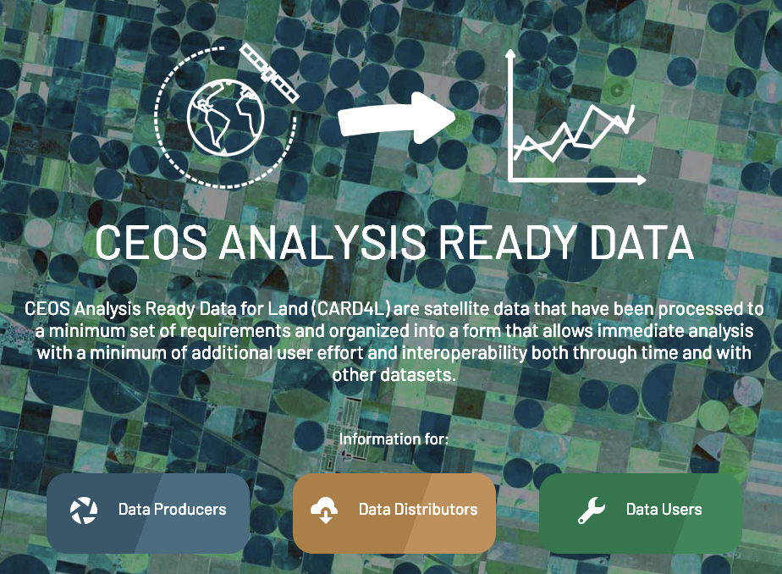
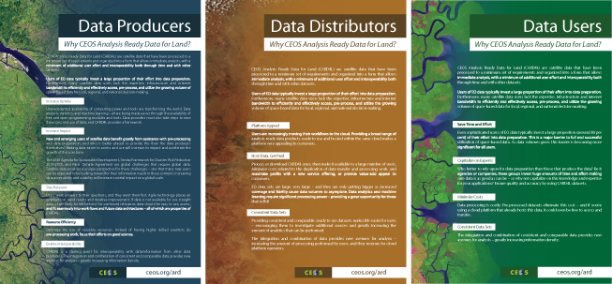
CARD4L
CEOS Analysis Ready Data for Land (CARD4L) are satellite data that have been processed to a minimum set of requirements and organized into a form that allows immediate analysis with a minimum of additional user effort and interoperability both through time and with other datasets.
CARD4L offers numerous benefits for data producers, data distributors, and data users. More info: http://ceos.org/ard/
Data Producers Increase Uptake Increase Impact Stay Relevant Increase Efficiency Enable Interoperability | Data Distributors Platform Appeal Consistent, High- Quality Data Sets | Data Users Save Time and Effort Capitalize on Experts Minimize Costs Consistent, High- Quality Data Sets

Slide 3
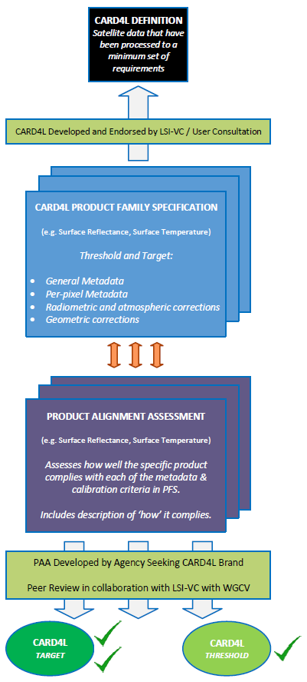
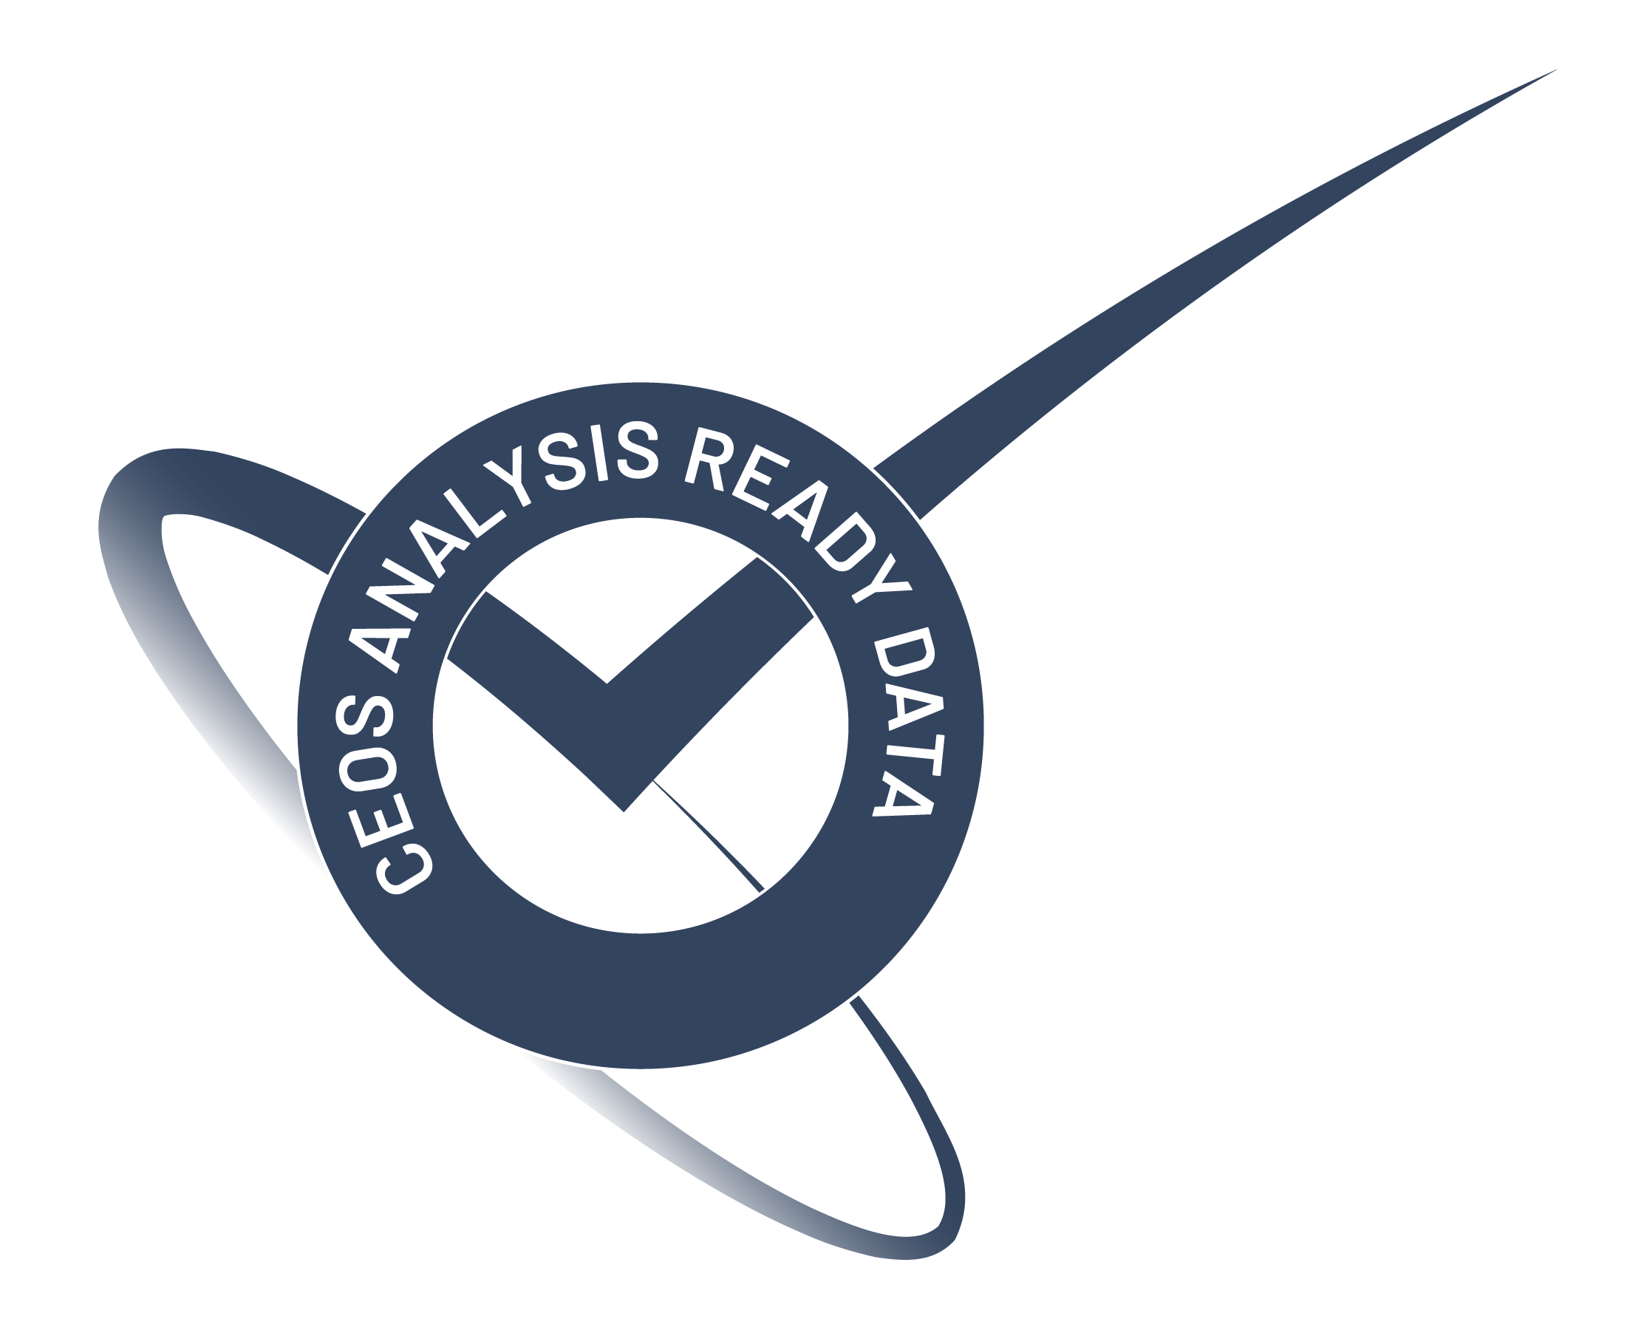
CARD4L Framework http://ceos.org/ard/
CARD4L Definition
Product Family Specifications (PFS)
Surface Reflectance (CARD4L-SR), v5.0
Surface Temperature (CARD4L-ST), v5.0
Normalized Radar Backscatter (CARD4L-NRB), v5.0
Polarimetric Radar (CARD4L-POL), v5.0
* Aquatic Reflectance (CARD4L-AR) is in-work
* Nighttime Light Surface Radiance (CARD4L-NLSR) is in-work
* Additional Radar PFSs are under consideration
* Additional LiDAR PFS is under consideration
Providers self-assess how well their products meet the specifications
Providers submit self-assessment to CEOS WGCV for peer review
CARD4L-compliant stamp!

Slide 4
CARD4L
Product Family Specification (PFS) Structure
2 Requirement Levels
  Threshold – Minimum requirements that must be met for CARD4L-compliance
  Target – Desired requirements to be met for greater interoperability
  Note: Over time, Target specifications may evolve to become Threshold requirements (thru annual review process)
4 Categories/Sections
  General Metadata
  Per-pixel Metadata
  Radiometric and Atmospheric Corrections
  Geometric Corrections

Slide 5
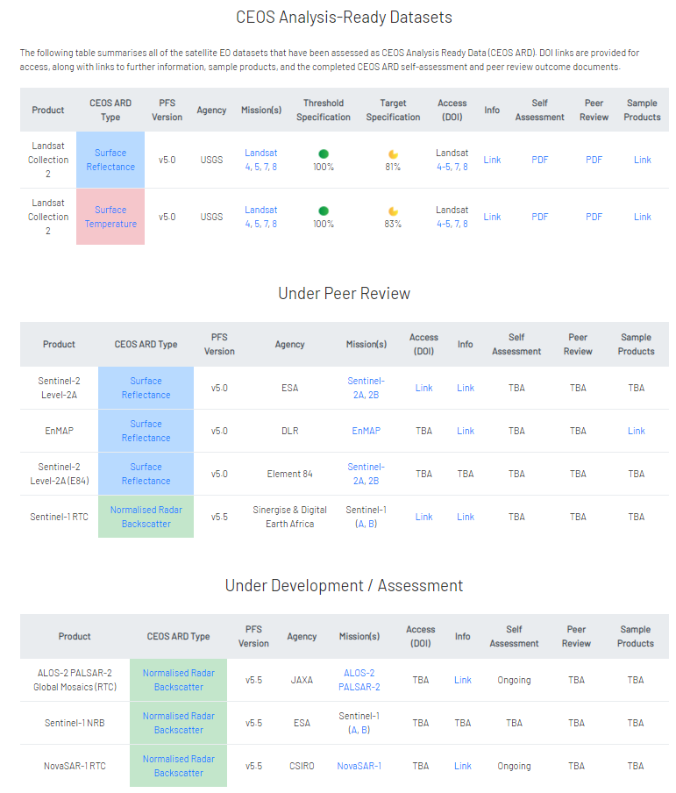
CEOS Analysis Ready Datasets https://ceos.org/ard/index.html#slide4

Slide 6
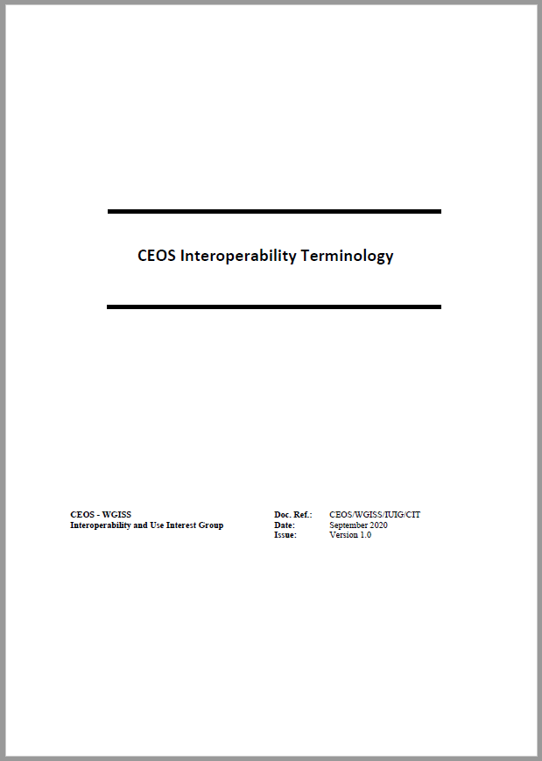
ARD & Interoperability Definitions
As it relates to Earth observation products, interoperability represents a continuum of potential compatibility for products to work in numerous information technology systems and with other like-prepared data products
  Ultimate product interoperability (i.e., a fully harmonised dataset) is achieved when products have a fully consistent spectral, radiometric, geometric, metadata, and file format implementation where applications can interact fully with the data interchangeably, automatically, and without modification
Specifically, 5 terms have been defined:
  Analysis Ready Data (ARD)
  CEOS ARD for Land (CARD4L) Products
  Interoperable Products
  Harmonised Products
  Fused Products
CEOS Interoperability Terminology Report
OGC Testbed-16: Analysis Ready Data Engineering Report
  12.1 Definitions
  12.2 Towards standardization
  12.3 Specific examples

Slide 7


CEOS Common Terminology
Multi-disciplinary collaboration across Earth Observation and geoscience domains becomes more frequent and requires a common understanding of terms and definitions
Collaboration initiated between CEOS WGCV, IVOS, and WGISS to “advance the idea of a CEOS common online dictionary, with a view to eventually reaching out to launch a broader community effort (…)” (WGCV Action Item 49-06, June 2021)
Status and way forward
  CEOS Common Terminology group established
  Work plan drafted
  Merging WGISS Data Stewardship Glossary into
  CEOS WGCV ‘Terms and Definitions’ Wiki - ongoing
  Reach out to promote initiative - ongoing
  Discuss target infrastructure - upcoming

Slide 8
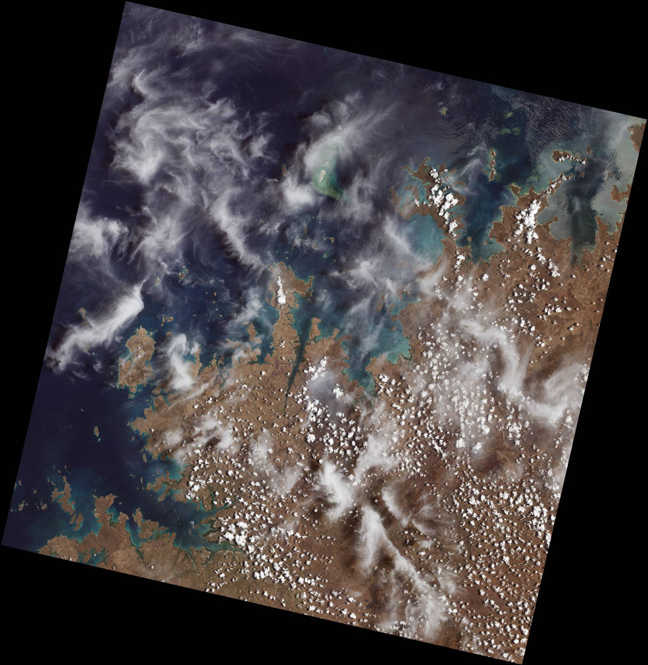
CEOS ARD Strategy 2019
CEOS has a broad ARD Strategy that it is now executing, including:
  Specification Improvements
    Annual review with input from others → broad input is welcome
    Engagement with Standards organizations
    Beyond land → ocean and atmosphere communities
    Guidance materials (with WGCV/IVOS and WGISS) to improve interoperability
  Assured Production & Access
    USGS are producing data to the CARD4L specifications, and others are in-work
    Data are moving into cloud platforms and cloud-effective formats (COG, STAC)
  Pilots & Feedback
    Africa Pilot (www.digitalearthafrica.org), with Sinergise and Element-84
    Coastal Observations, Applications, Services and Tools (COAST)
    OGC Disasters Pilot
  Communication & Promotion
    Webinars, conferences, and workshop participation (ARD21, JACIE, VH-RODA)
Mangroves are prominent along the northwest coast of Australia. The first image collected by Landsat 9, on Oct. 31, 2021, shows mangroves clustered in protected inlets and bays on the edge of the Indian Ocean. Fluffy cumulus clouds and high-altitude cirrus clouds hover nearby. The aqua colors of the shallow near-shore waters give way to the deep, dark blues of the ocean.
Credits: NASA

Slide 9
CEOS ARD Strategy 2021
CEOS ARD Strategy 2021 provides direction for the next phase of CEOS ARD activity
Focus is to ensure that CEOS data are as impactful and sustained as possible, including via an increased scope of the CEOS ARD concept beyond the land domain
Leadership, Governance, and Accessibility & Utilization are pillars of the strategy
Key objectives supported by the 2021 CEOS ARD Strategy:
  Continued oversight and maintenance of CEOS ARD ensuring that CEOS’ ARD work continues to be coordinated and guided by an appropriate governance framework
  Ensure the suitability of CEOS ARD for machine-to-machine processes employed for the application of remote sensing data
  Continued evolution of the CEOS ARD concept to consider products that are further along the production chain (‘ARD+’)
  Continue investigating further opportunities for the CEOS ARD concept to streamline user uptake of satellite Earth observation data, including new thematic domains and applications

Slide 10
CEOS ARD Governance
CEOS ARD Framework has now been broadened to go ‘beyond land’
CEOS established a CEOS ARD Governance Framework, which formalizes the process LSI-VC has used for CARD4L
  CEOS ARD Definition
  CEOS ARD Oversight Group led by CEOS SIT Chair Team (Ferran Gascon, ESA) with assistance from the CEOS Executive Officer (CEO), includes representatives from each of the CEOS Virtual Constellations, WGCV, and WGISS
  Product Family Specification (PFS) Core Elements, Ownership, Review, and Endorsement
  CEOS ARD Self-Assessment and Peer Review Process
  Classification and Promotion
  Advisory Notes
Governance framework accompanied by a CEOS ARD PFS template
JACIE 2022 Breakout Session – Thursday, 13 January 2022, 1-3:30 PM EST: Governance and Leadership of ARD/Interoperability - Definition, Distinction, and Standards

Slide 11
Backup: Additional Information

Slide 12
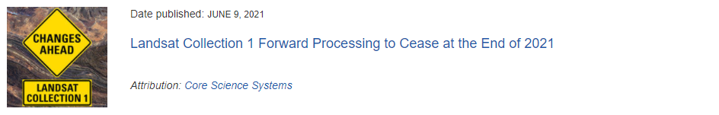
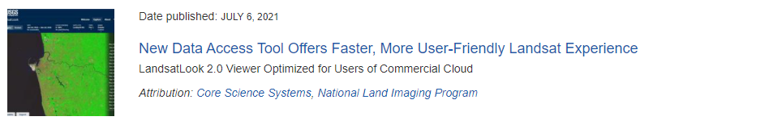
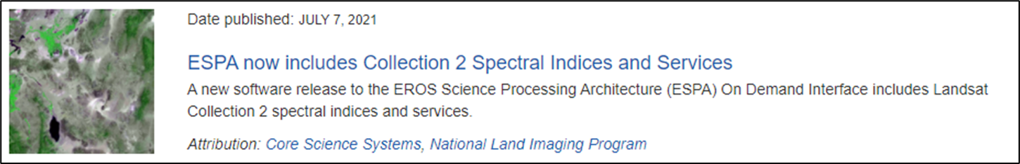
USGS Dataset, Service, & Tool Update (since April 2021)

Slide 13
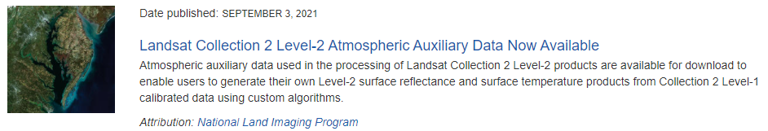
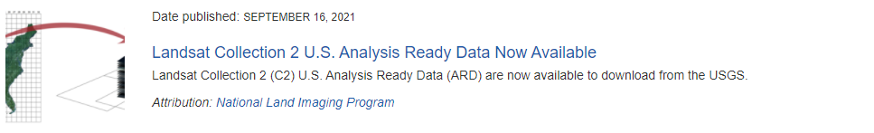
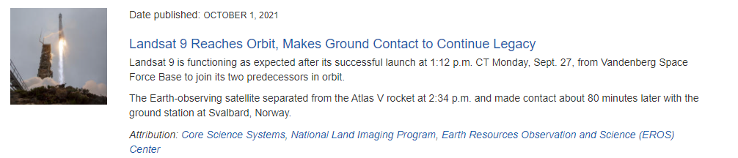
USGS Dataset, Service, & Tool Update (since April 2021) cont.

Slide 14
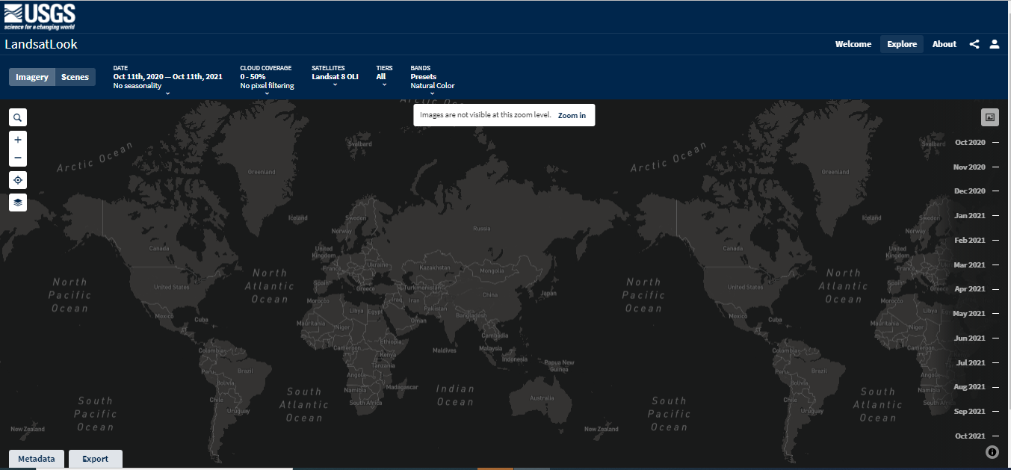
LandsatLook 2.0
Released: December 2020
https://www.usgs.gov/core-science-systems/nli/landsat/landsat-collection-2

Slide 15
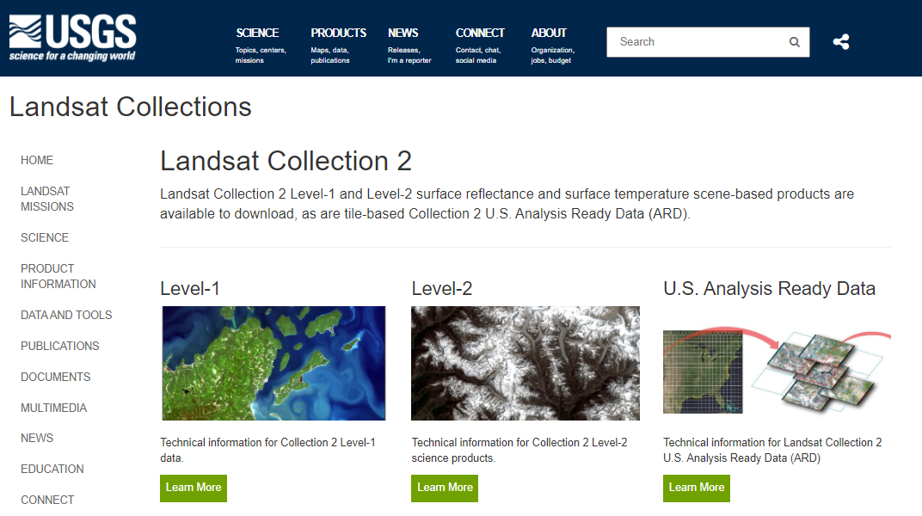
USGS Landsat Collection 2 (Level-1 & Level-2)
Released: December 2020
https://www.usgs.gov/core-science-systems/nli/landsat/landsat-collection-2

Slide 16
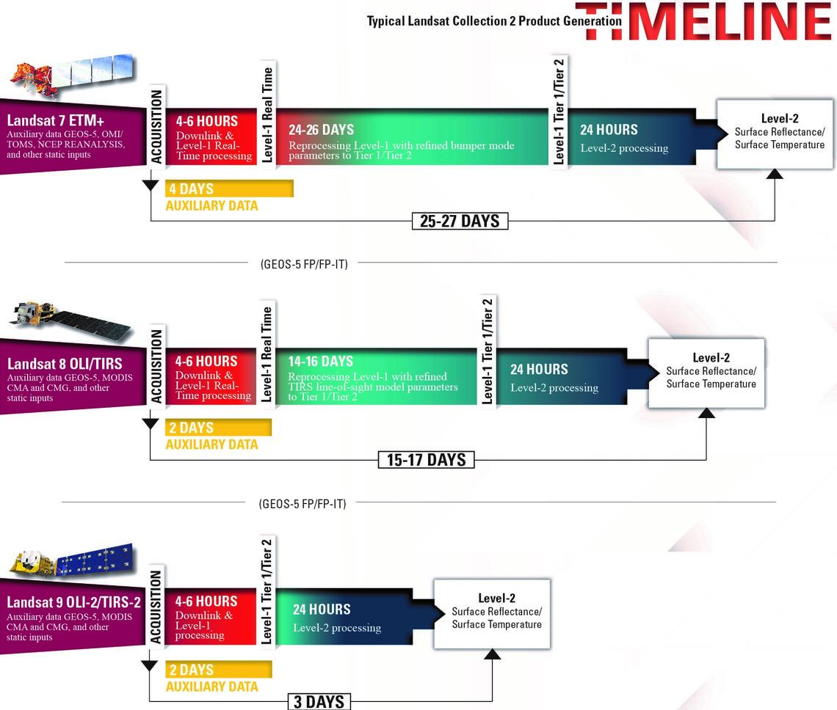
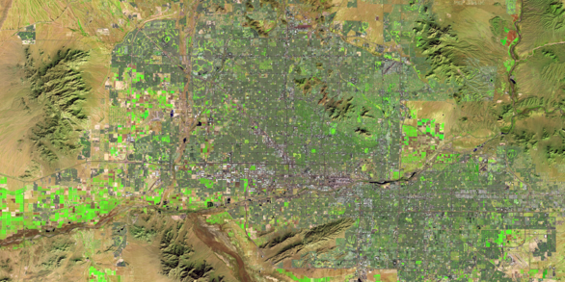
USGS Landsat Collection 2
  Cloud hosted, using Amazon Web Services
  Can be accessed & downloaded similarly to Collection 1
  Still free to the public
  Collection 1 to be maintained in parallel for 1 year

Slide 17
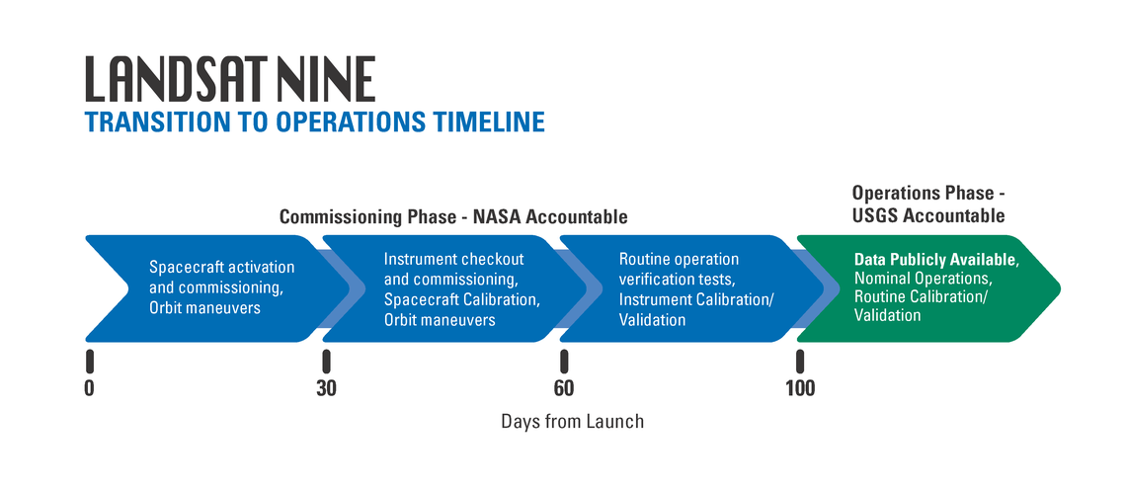
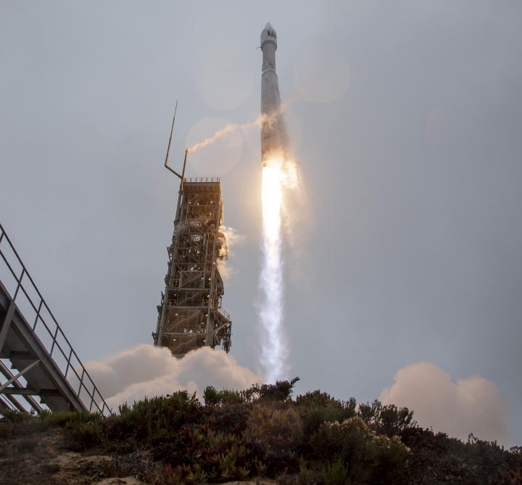
Landsat 9 (coming soon…)
Successful Launch:
Landsat 9 was launched on September 27, 2021 at 1:12PM CST from Vanden­berg Space Force Base, California. Landsat 9 carries the Opera­tional Land Imager 2 (OLI–2) and the Thermal Infrared Sensor 2 (TIRS–2).
+100 Days (early 2022):
After 100 days, the USGS conducts nominal science operations, maintains routine acquisitions, as well as performs ongoing Calibration/Validation of the data. Landsat 9 Level-1 data and Level 2 science products will then become available at no cost to all users through the USGS data portals.
Landsat 9 (usgs.gov)

