Slide 1
NAIP Geolocation Accuracy Assessment
10 January 2022
Paul Bresnahan
Photogrammetric Engineer, KBR, Inc.
paul.bresnahan@contractor.usgs.gov
KBR, Inc., contractor to the U.S. Geological Survey (USGS)
Earth Resources Observation and Science (EROS) Center, Sioux Falls, SD 57198, USA.
Work performed under USGS Contract [140G0121D0001].

Slide 2
Purpose
Assess the horizontal geolocation accuracy of National Agriculture Imagery Program (NAIP) orthoimages
To determine the suitability of NAIP imagery to replace legacy Digital Ortho Quarter Quad (DOQQ) orthoimages as a reference layer for geo-registration and accuracy assessment
NAIP is administered by USDA’s Farm Service Agency (FSA)

Slide 3
NAIP Horizontal Accuracy Specification
Has evolved over the lifetime of the program
Specification was originally with respect to reference imagery, in most cases USGS Digital Orthophoto Quarter Quads (DOQQs)
In 2003, within 3 meters CE90 for 1-meter GSD imagery
In 2005, increased to within 5 meters CE90 for 1-meter GSD imagery
From 2006 to 2009, evolved into absolute geolocation accuracy
In 2009, specification was to 6 meters CE95 to true ground
In 2016, specification was changed to 4 meters CE95 to true ground
Leaf on imagery

Slide 4
DOQQ Horizontal Accuracy Specification
10.2 meter CE90 specification according to National Map Accuracy Standard (as revised in 1947)
1/30th inch on 1:12,000 scale Quarter Quad
Typically leaf off imagery

Slide 5
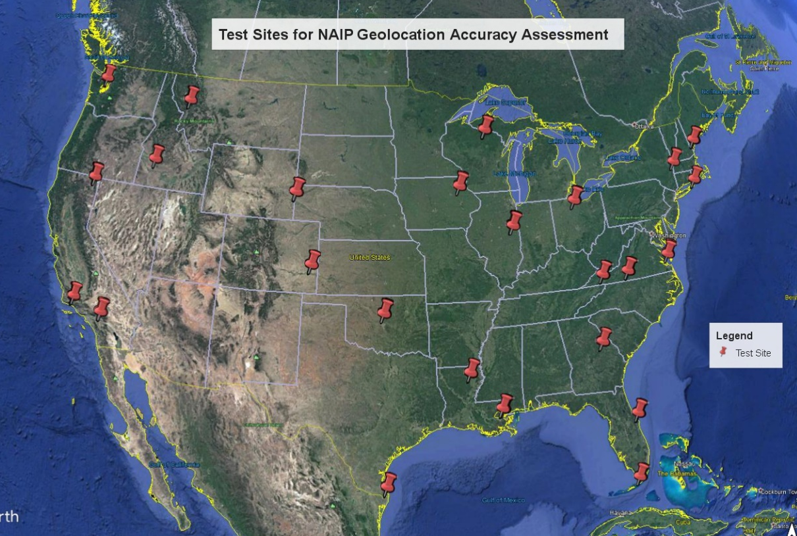
Test Sites
25 Sites
Geographic Distribution
Surveyed by National Geodetic Survey (NGS)
10-18 ground control points at each sites
Used as check points
Photo Identifiable
Difficult to find test sites with high terrain relief

Slide 6
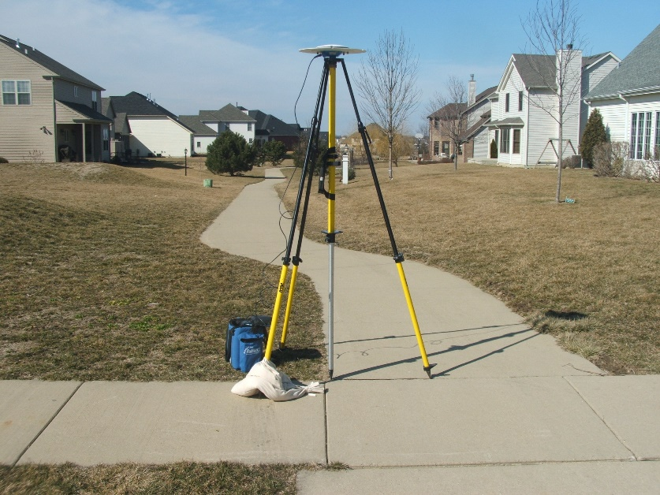
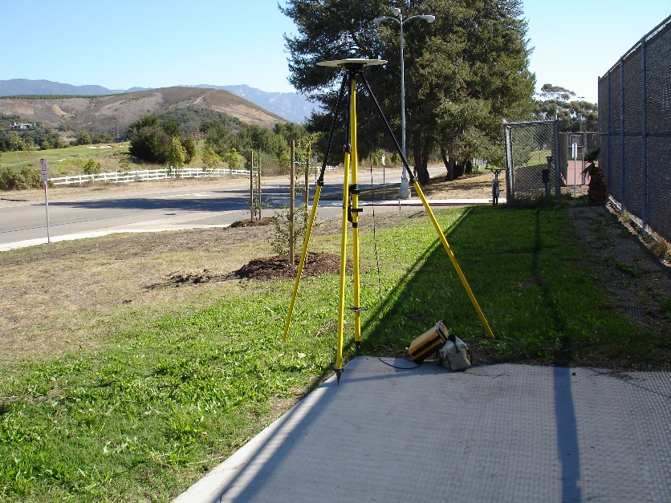
Example Ground Control Points
Champaign, Illinois
Santa Barbara, California

Slide 7
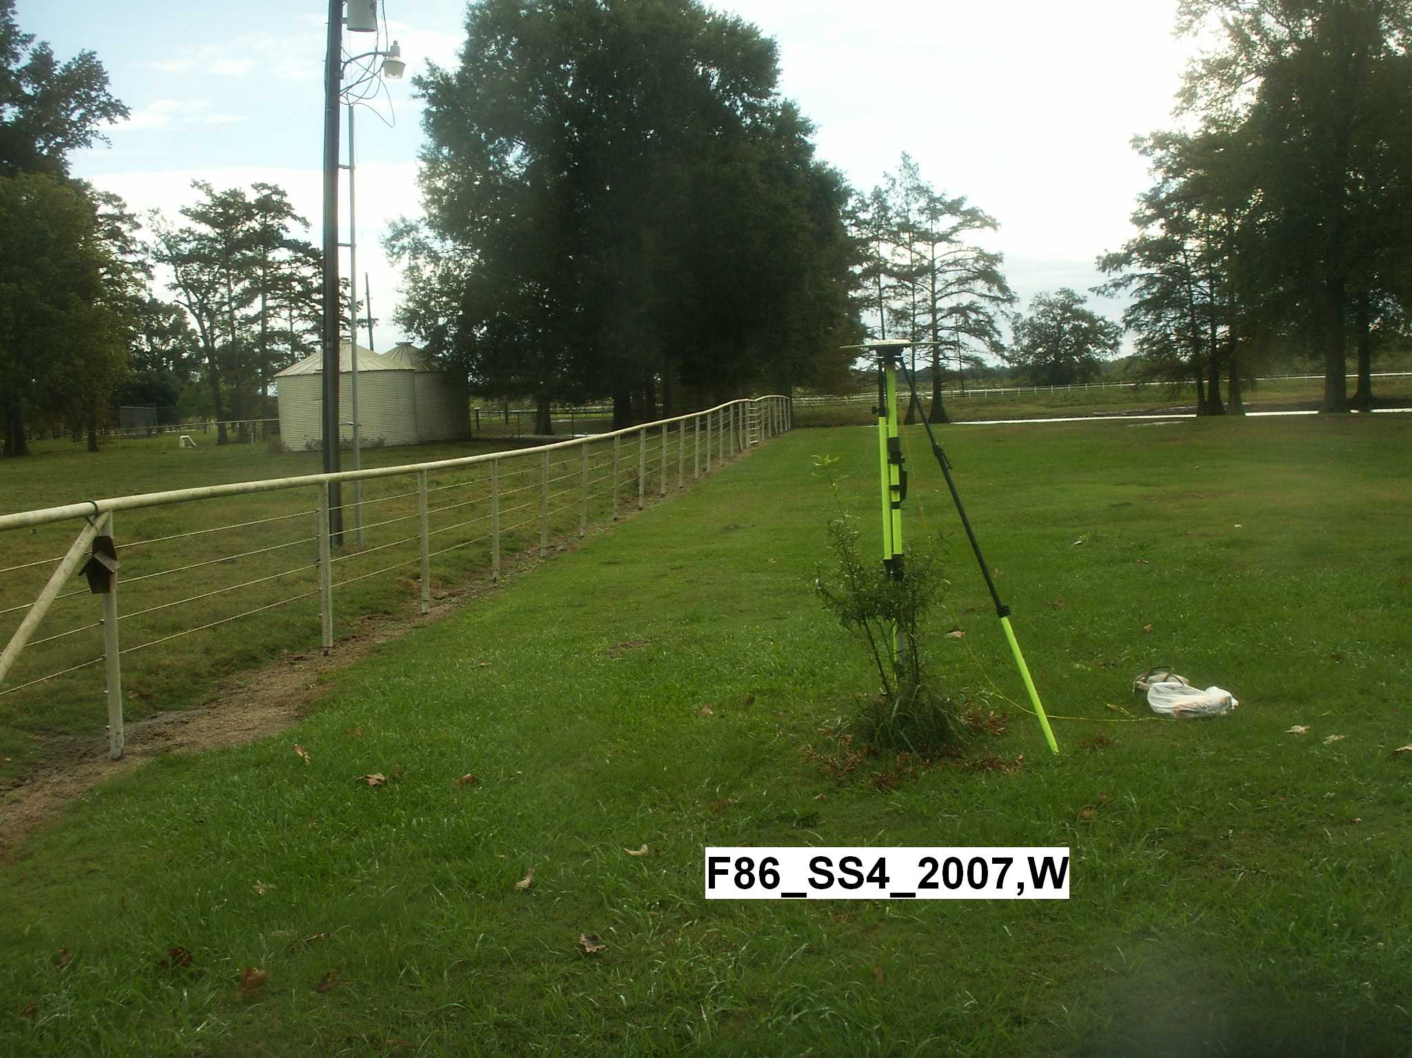
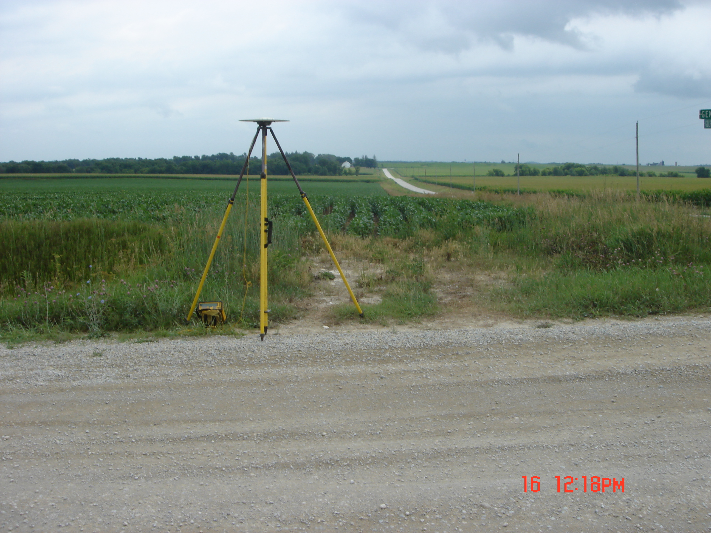
Example Ground Control Points To Avoid
Columbia, Louisiana
Independence, Iowa

Slide 8
Test Imagery
DOQQ
Late 1980s until 2006
1 meter GSD
Tested all available set of DOQQs over test sites
NAIP
Pilot in 2002
Produced since 2003
Nominally 1 meter GSD
Tested only most recent set of NAIP quarter quads over test sites
Downloaded as GeoTIFFs from USGS Earth Explorer tool:
https://earthexplorer.usgs.gov/

Slide 9
NAIP and DOQQ Test Image Sets
Test Site | State | NAIP | DOQQ | Test Site | State | NAIP | DOQQ
Alturas | California | 2020 | 1993, 1998 | Rochester | New Hampshire | 2018 | 1998
Riverside | California | 2020 | 1994, 2002 | East Hampton | New York | 2019 | 1994
Santa Barbara | California | 2020 | 1994, 2002 | Hudson | New York | 2019 | 1994
Lamar | Colorado | 2019 | 1988, 1998 | Tiffin | Ohio | 2019 | 1995
Marathon | Florida | 2019 | 1995, 1999 | Oklahoma City | Oklahoma | 2019 | 1990, 1995
Titusville | Florida | 2019 | 1994, 1999 | Brownsville | Texas | 2020 | 1996, 2002
Sandersville | Georgia | 2019 | 1993, 1999 | Abingdon | Virginia | 2018 | 1998, 1999
Mountain Home | Idaho | 2019 | 1998 | Martinsville | Virginia | 2018 | 1996
Champaign | Illinois | 2019 | 1993, 1998, 2005 | Newport News | Virginia | 2018 | 1994, 1995
Independence | Iowa | 2019 | 1994 | Bremerton | Washington | 2019 | 1990, 1994
Columbia | Louisiana | 2019 | 1998, 2004 | Rhinelander | Wisconsin | 2020 | 1992, 1998
New Orleans | Louisiana | 2019 | 1998, 2004, 2005 | Torrington | Wyoming | 2019 | 1990, 1994
Missoula | Montana | 2019 | 2003
25 NAIP image sets and 44 DOQQ image sets

Slide 10
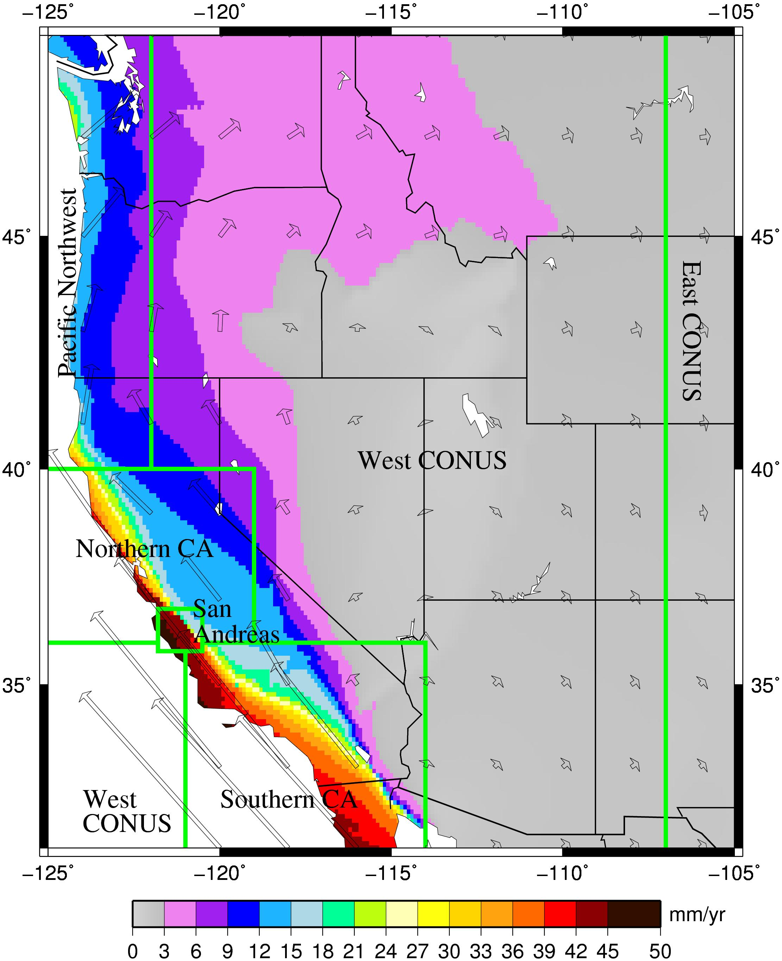
Ground Control Point Correction for Ground Motion
Due to plate tectonic motion and earthquake co-seismic and post-seismic shifts
Used NGS Horizontal Time-Dependent Positioning (HTDP) conversion tool:
https://geodesy.noaa.gov/TOOLS/Htdp/Htdp.shtml
Test Site | State | Survey Date | NAIP Date | Years | Δ East (m) | Δ North (m)
Alturas | California | 2007 | 2020 | 13 | 0.08 | 0.02
Riverside | California | 2006 | 2020 | 14 | 0.29 | 0.34
Santa Barbara | California | 2006 | 2020 | 14 | 0.38 | 0.45
Missoula | Montana | 2007 | 2019 | 12 | 0.03 | 0.02
Bremerton | Washington | 2007 | 2019 | 12 | 0.09 | 0.08

Slide 11
Test Methodology
Adjusted check point coordinates as needed, and converted to UTM coordinates
For each imagery set:
Used QGIS to measure UTM coordinates of each identifiable check point on the test imagery
Exported measured UTM coordinates
Used Excel to difference measured and check point (truth) UTM coordinates and generate statistics

Slide 12
Test Methodology
Horizontal error for each NAIP or DOQQ image set over a test site based on n measurable check points:
$$RMSE_{hor}= \sqrt{\frac{\sum_{i=1}^{n}{\left[{\left(E_{i_{meas}}−E_{i_{truth}}\right)}^{2}{+\left(N_{i_{meas}}−N_{i_{truth}}\right)}^{2}\right]}}{n}}$$
Consolidated into:
CE90 and CE95 order statistics estimates
National Standard for Spatial Data Accuracy (NSSDA) estimate
95% estimate based on zero-bias normal distributions for Easting and Northing errors
Applied to 25 NAIP and 44 DOQQ image sets, respectively

Slide 13
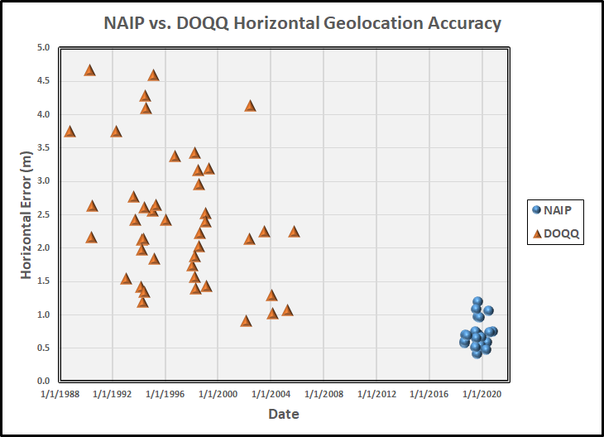
Results
 | DOQQ | NAIP
Date Range | 10/8/1988 to 10/19/2005 | 8/6/2018 to 10/29/2020
Samples (n) | 44 | 25
Min Error (m) | 0.9 | 0.4
Max Error (m) | 4.7 | 1.2
CE90 (m) | 4.1 | 1.1
CE95 (m) | 4.4 | 1.1
NSSDA95 (m) | 4.6 | 1.3

Slide 14
Conclusions
Recent NAIP imagery is more accurate than legacy DOQQ imagery
Operational imagery currently being geo-registered to DOQQ imagery would benefit from improved geolocation accuracy of recent NAIP as a more accurate reference layer
Ground movement matters
Reference imagery layers should be kept current in high movement areas

Slide 15
Questions?

