Slide 1
National Land Imaging Requirements
JACIE January 11, 2022
Greg Snyder, Branch Chief
Requirements, Capabilities, and Analysis for Earth Observations
USGS National Land Imaging
gsnyder@usgs.gov

Slide 2
USGS National Land Imaging (NLI) Program Roles and Responsibilities
As defined by Public Law and National Space Policy, to carry out the Public Interest of the United States:
Operate and maintain a National Land Imaging Archive to house a Basic Data Set of global data – for historical, scientific, and technical purposes – to include data obtained from U.S. civil, commercial and foreign satellite systems
Operate and maintain the Landsat flight and ground systems
Determine U.S. civil operational requirements for global land surface data and to conduct a national program of civil-operational land imaging
Collect, process, archive and distribute these data as Public Domain holdings of the United States
Preclude duplication of acquisition processes and capabilities
Develop civil applications and information tools using known standards and protocols and make them available to the general public

Slide 3
NLI Requirements and Capabilities Analysis Activities
Document and analyze land imaging needs and observing systems to:
Inform future Landsat missions under the USGS/NASA Sustainable Land Imaging program
Assess ability of multi-mission architectures (U.S., international, and commercial) to meet additional needs
Cross-walk land imaging needs to other planned global missions, e.g., NASA Decadal Survey Missions
Provide needs to NGA, NRO and NASA for commercial data purchase planning
Coordinate mission requirements with European Commission Copernicus Sentinel-2 program
Notes:
Third bullet

Slide 4
User Needs
The Earth observation, product, or service to meet an end user application
Tied to specific science or operational activities
Technology agnostic - Not constrained by specific platforms/sensors
Primary attributes
What: Geophysical Parameter
Where: Geographic Coverage
When/How often: Usable Observation Frequency
How quickly: Data Latency
Physical scale: Spatial Resolution
Notes:
Get a description of that point

Slide 5
User Need Elements (Cont.)
Additional information collected if applicable/known
Spectral Characteristics
Measurement Accuracy
Geolocation Accuracy
Radiometric Resolution/SNR
Conditions for Sampling (day/night, time of day, leaf on/leaf off, need for stereo, etc.)
Data Services, Access and Formats
Cloud Processing
Licensing (what is the need to further distribute commercial imagery, if relevant?)

Slide 6
Sample of Geophysical Parameters (more than 160 used)
Active Fires | Dust/Smoke
Aerosols: Optical Depth/Thickness | Emissivity
Albedo | Evapotranspiration
Aquatic Surface Reflectance | Fire Perimeter
Biomass: Vegetation | Fire Radiative Power
Burn Severity | Fuel Moisture Content
Burned Area Extent | Glacier/Ice Sheet Elevation
Canopy Bulk Density | Glacier/Ice Sheet Extent
Canopy Cover | Gross Primary Productivity
Canopy Height | Ground Freeze/Thaw State
Canopy Water Content | Lake/River Bathymetry
Cloud Fraction: Cloud Mask | Lake/River Ice Extent
Cloud Top Height (new) | Lake/River Water Level
Colored Dissolved Organic Matter | Lake/River Water Temperature: Surface
Coral Reef Extent | Land Cover
Crop Type | Land Skin Temperature
Crop/Plant Yields | Land Surface Extent
Cryosphere Surface Composition | Land Use/Land Cover Classification
(Common nomenclature based on NASA Global Change Master Directory keyword vocabularies)
Notes:
Topic/term/variable

Slide 7
Architecture Analysis Approach
Land Imaging User Needs
Scoring Tool
Architecture Evaluation
Attributes Evaluated:
Spatial Resolution
Temporal Resolution
Geographic Coverage
Geophysical Parameter/Rating [GPART]*
Analyses:
Assess overall strengths and weaknesses
Assess user need level of satisfaction over time, and limiting factors
Evaluate candidate solutions to address weaknesses
Satellite Architecture (missions selected from Satellite Database*)
*To be discussed in more detail as stand-alone tools
Notes:
Assess the suitability of multi-mission architectures to meet user needs.
The rating is primarily a component of the engine used to evaluate satellite solutions. - - however, it’s also useful as a potential enhancement to our Database which is a public-facing project spinoff.

Slide 8
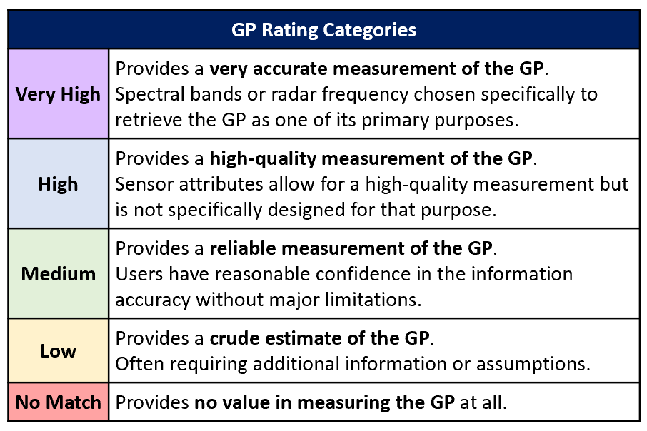
Geophysical Parameter Assignment and Rating Tool (GPART)
GPART is a tool to automatically assign geophysical parameters (GPs) and GP Ratings to sensors based on specific sensor characteristics
GPART 1.0 (fall 2021)
Sensor assigned a Rating for each Geophysical Parameter based solely on:
Spectral bands (placement, bandwidth)
SAR (radar frequency)
GPART 1.0 bins sensors into coarse relative categories
GPART 2.0 (longer-term effort)
Rating criteria will expand to incorporate more factors
Measurement accuracy
SNR
Radiometric resolution
Spectral response
Data quality
Other factors
Rating categories will expand and become more nuanced
Notes:
GPART 1.0 – Two sensors with the same spectral bands (e.g. two VNIR sensors) will get the same rating. In the future we can use additional information to refine ratings could potentially come from JACIE/ECCOE to develop more sophisticated rating rules.

Slide 9
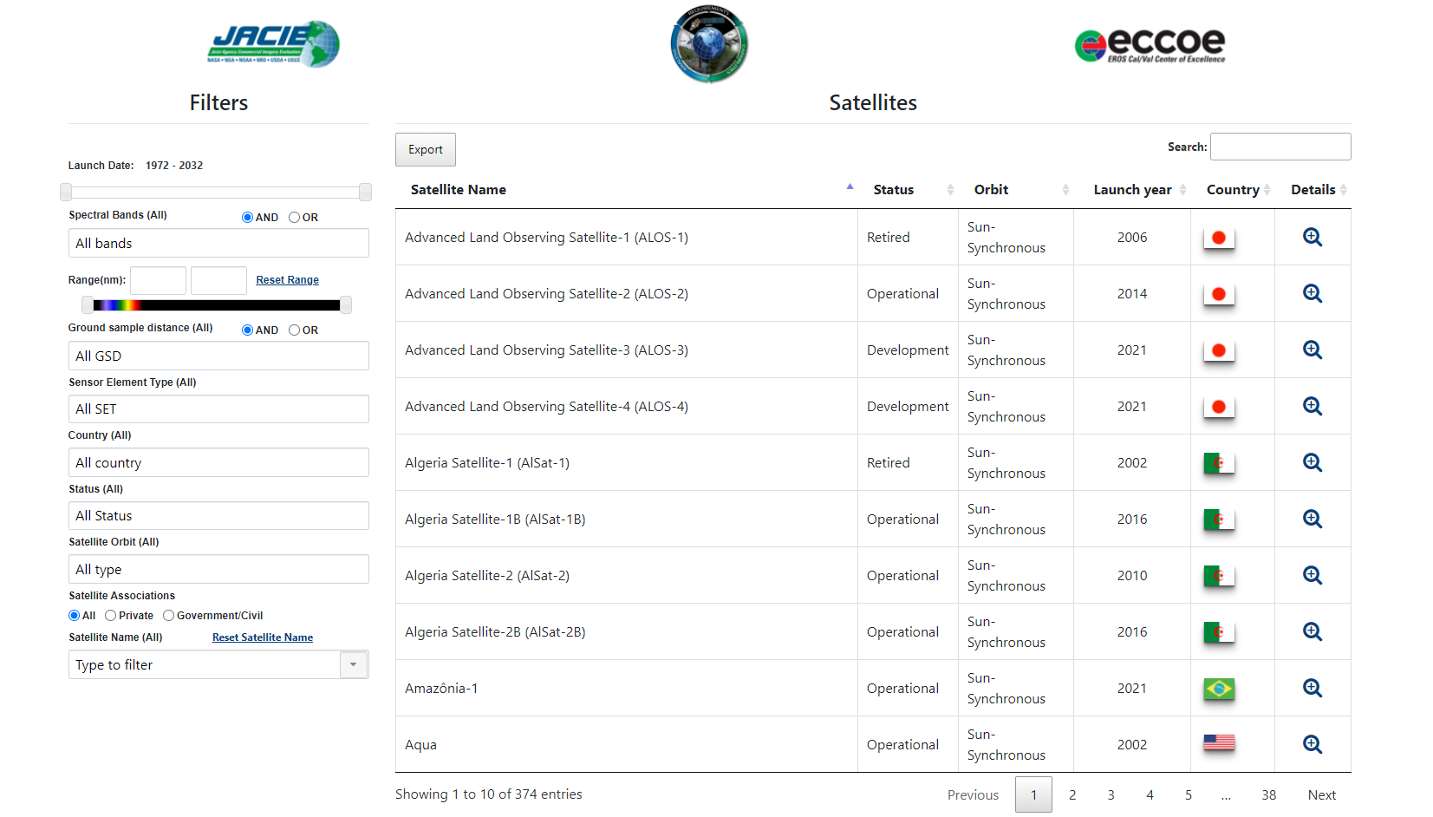
Online Compendium https://calval.cr.usgs.gov/apps/compendium
Information directly from EOS Satellite Database
Notes:
A public facing product of our work is the satellite compendium - now online

Slide 10
Fold GPART information into the compendium?
Some potential pubic-facing functionality a part of GPART or as a stand-alone tool
Show GP application groups supported by a selected sensor
Search a sensor to see what individual geophysical parameters it can observe
Search a geophysical parameter to identify all sensors that can observe it
Compare and contrast sensor ratings by GP

Slide 11
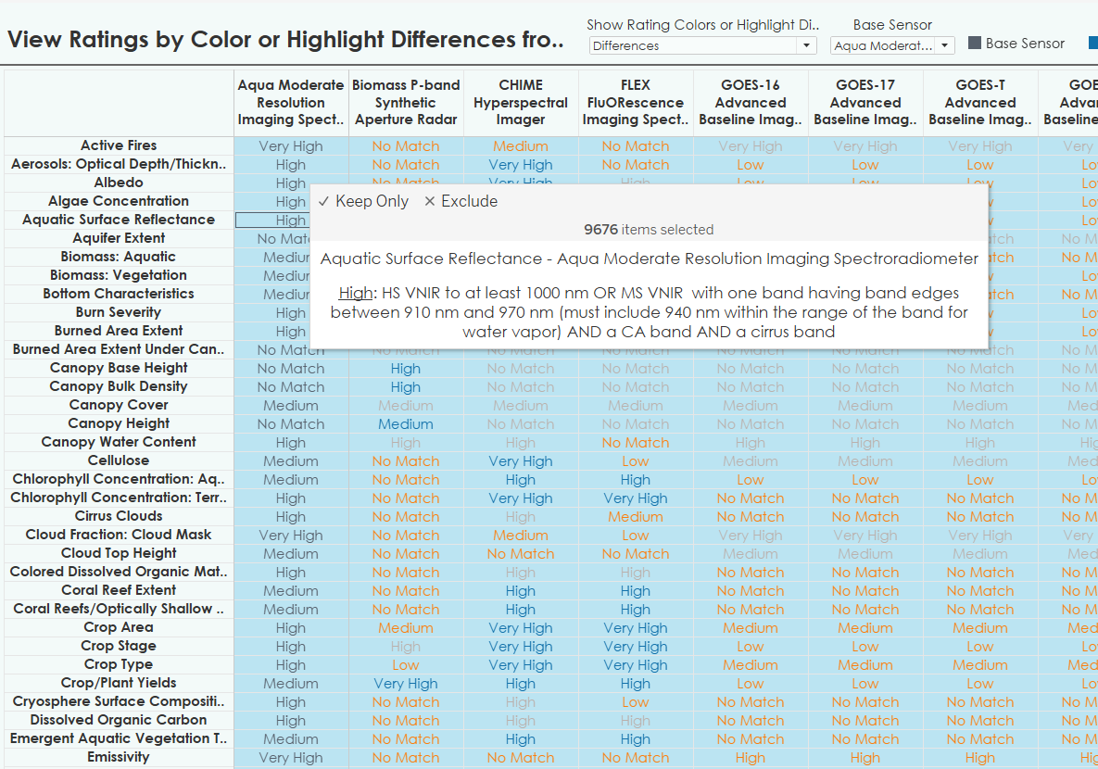
Conceptual…
New visualization tools/methods being refined to compare sensor rating by GP (based on spectral attributes)
* This is a future development; underlying GPART tool in development - further validation and refinement needed.

Slide 12
Directions in User Needs Collection and Analysis
Continuously update needs to reflect user expectations and applications to inform future Landsat missions
Model the performance of combined missions
Explore approaches to bring radiometric and data quality measures into to satellite system ratings
Collect additional needs from high-resolution electro-optical, radar and hyperspectral communities
Meet more needs of more users, by leveraging broad hybrid satellite mission architectures, though user-informed satellite development, partnerships, and commercial data access.

Slide 13
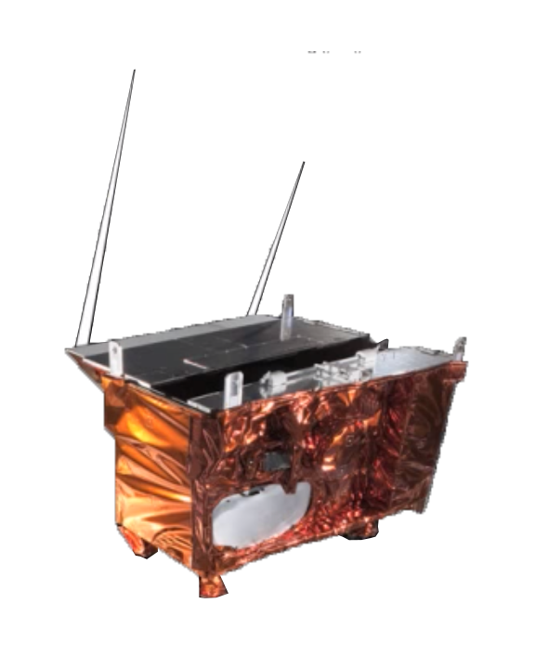
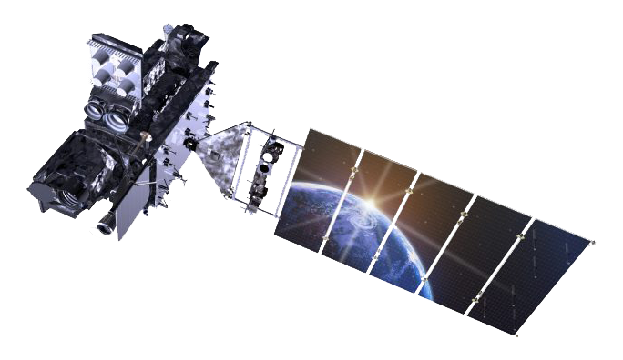
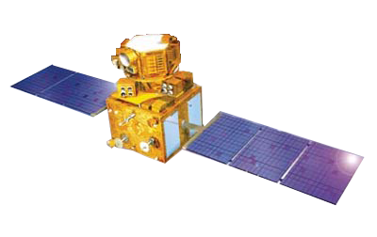
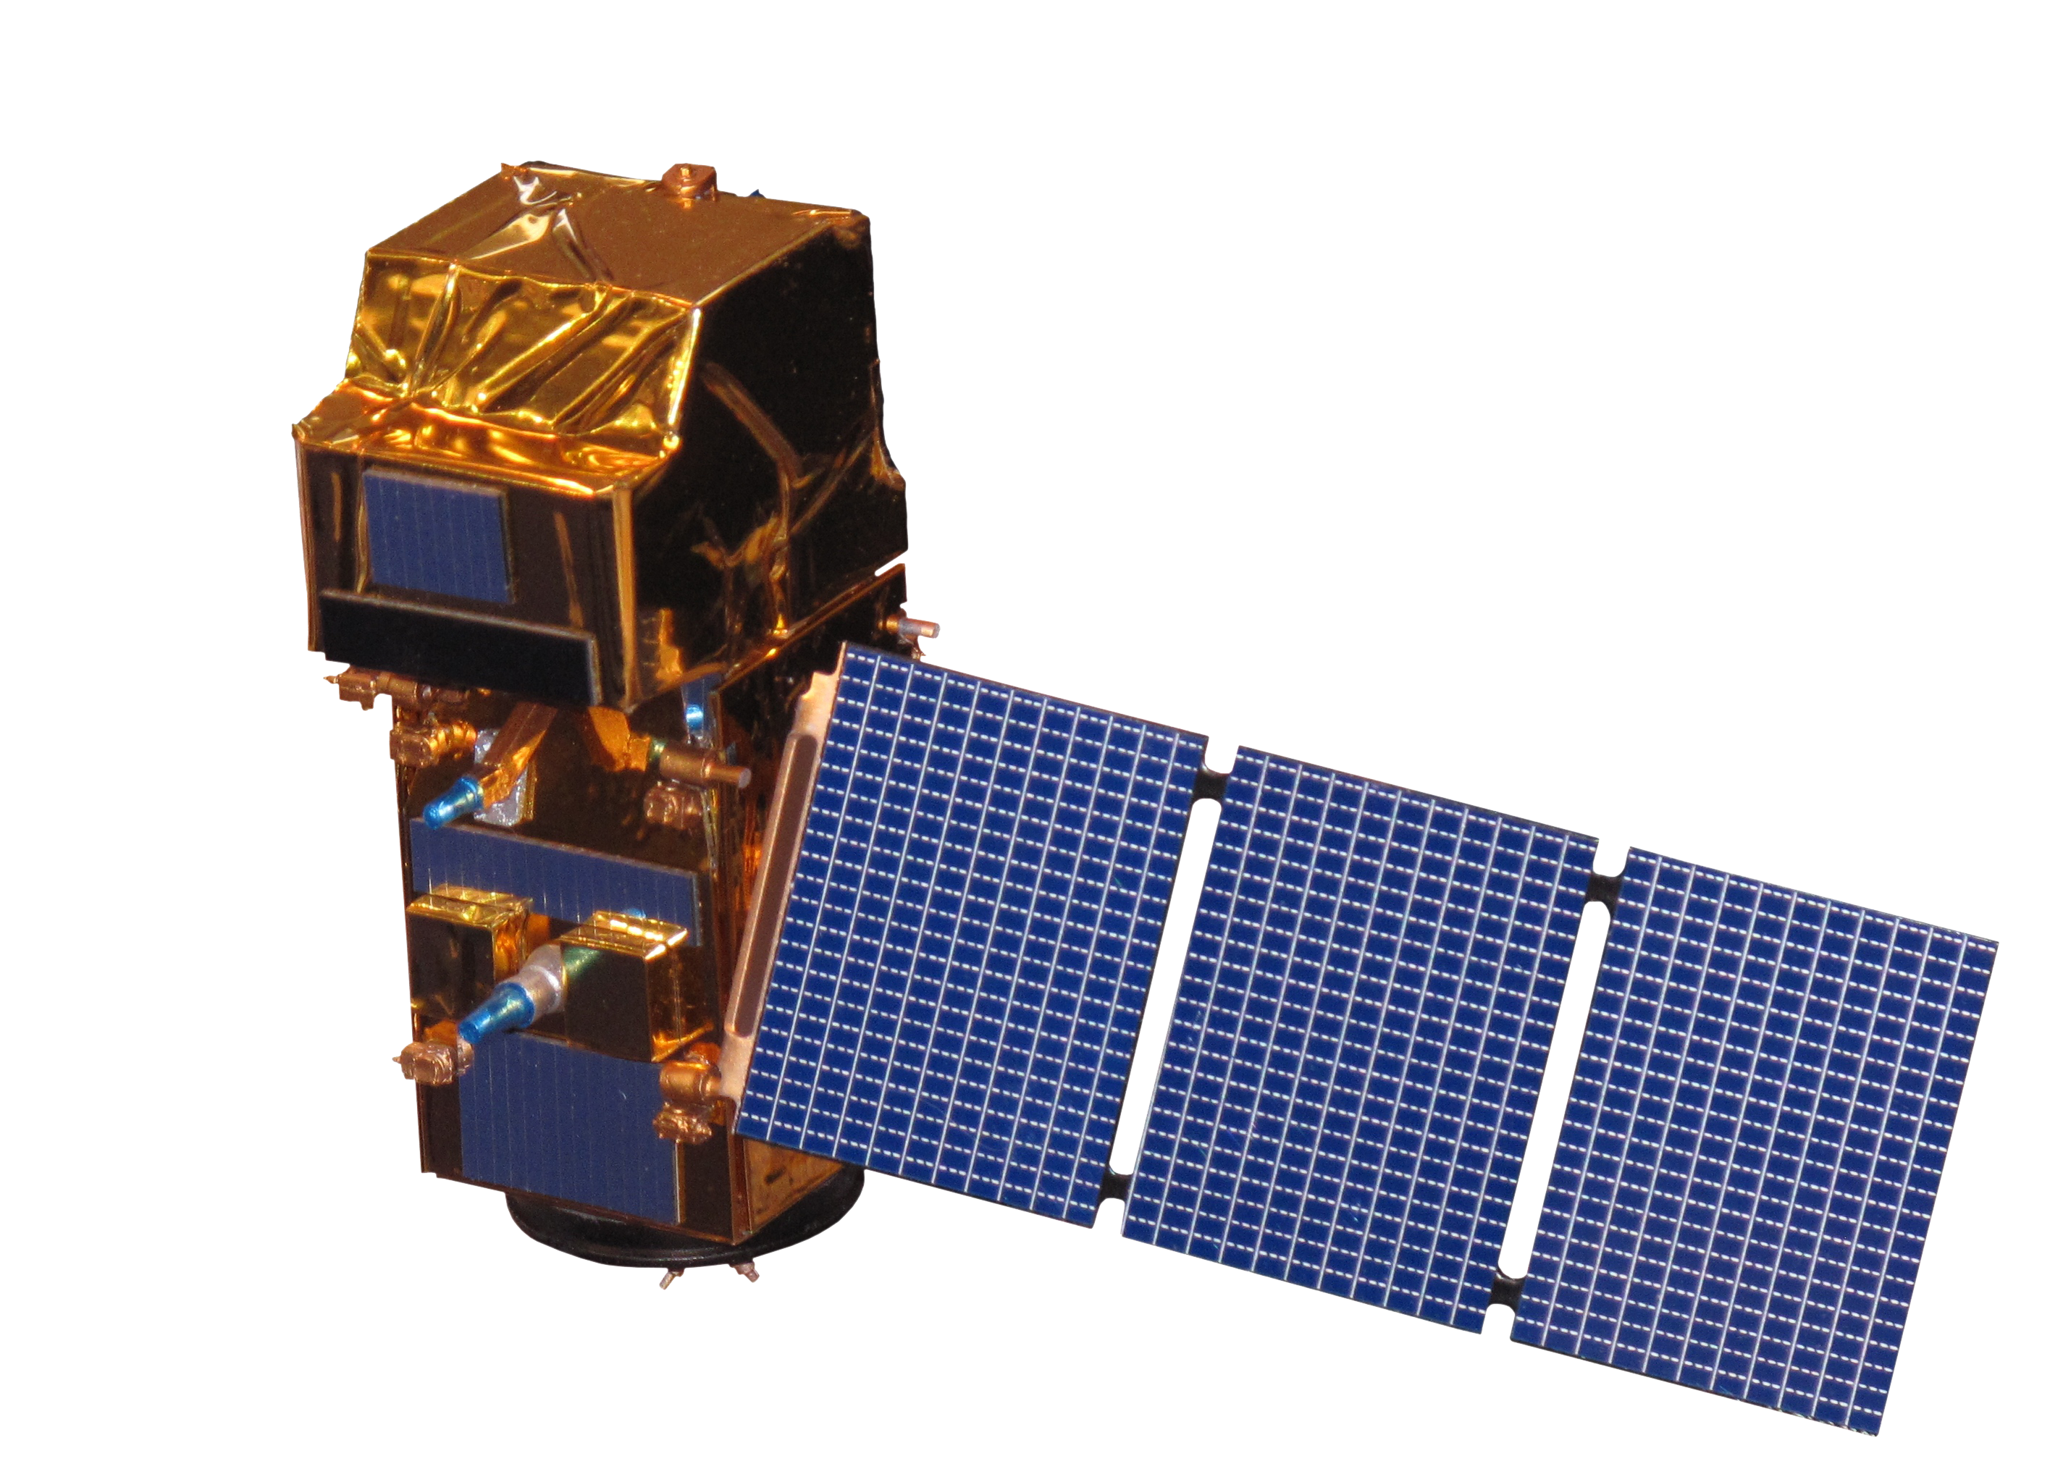
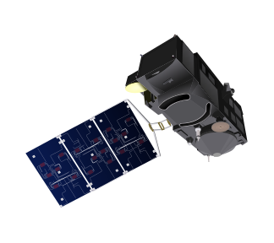
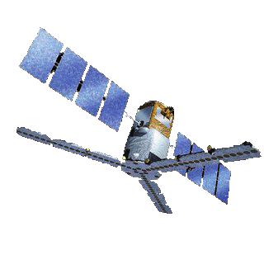
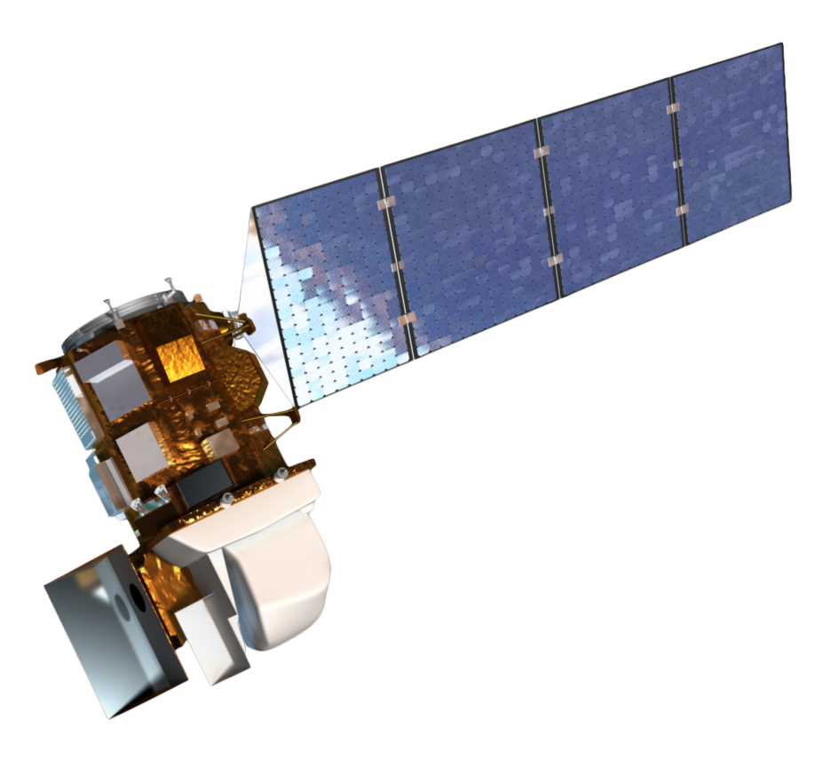
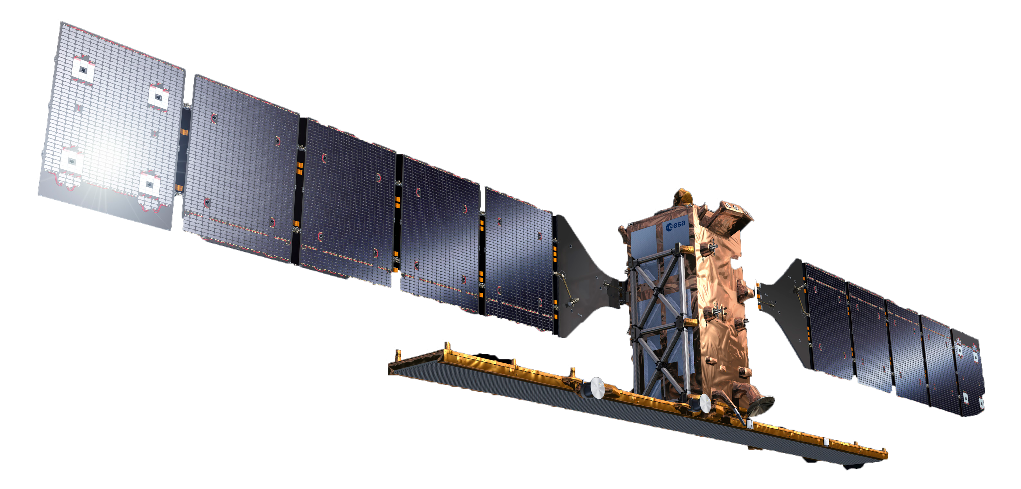
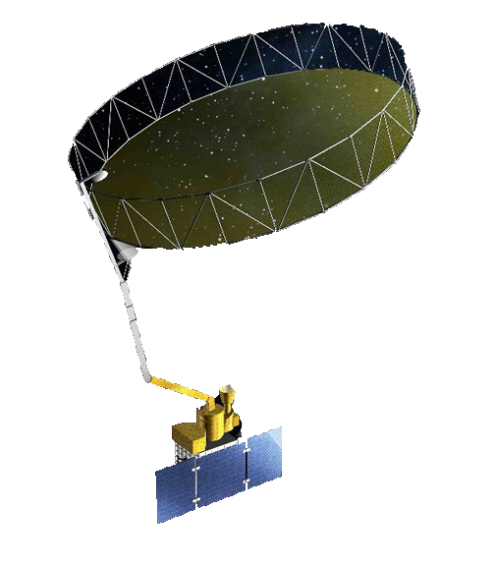
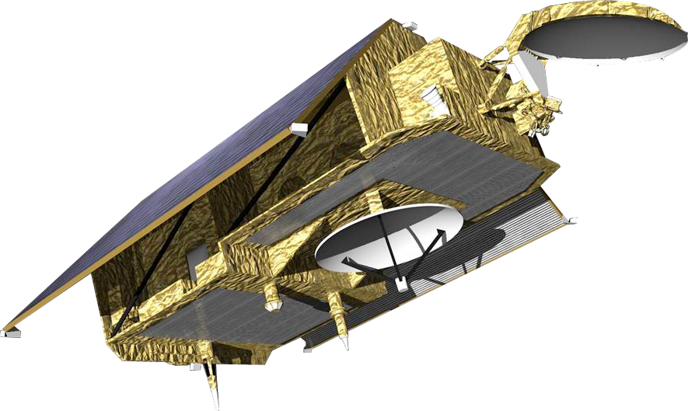
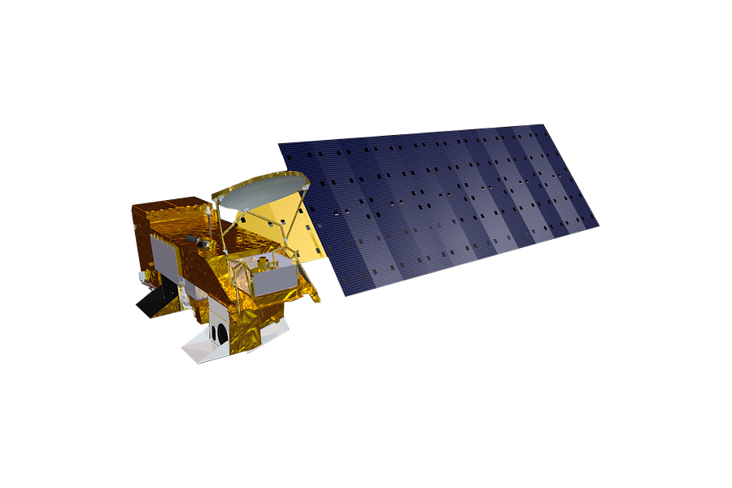
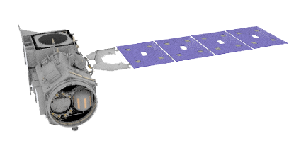
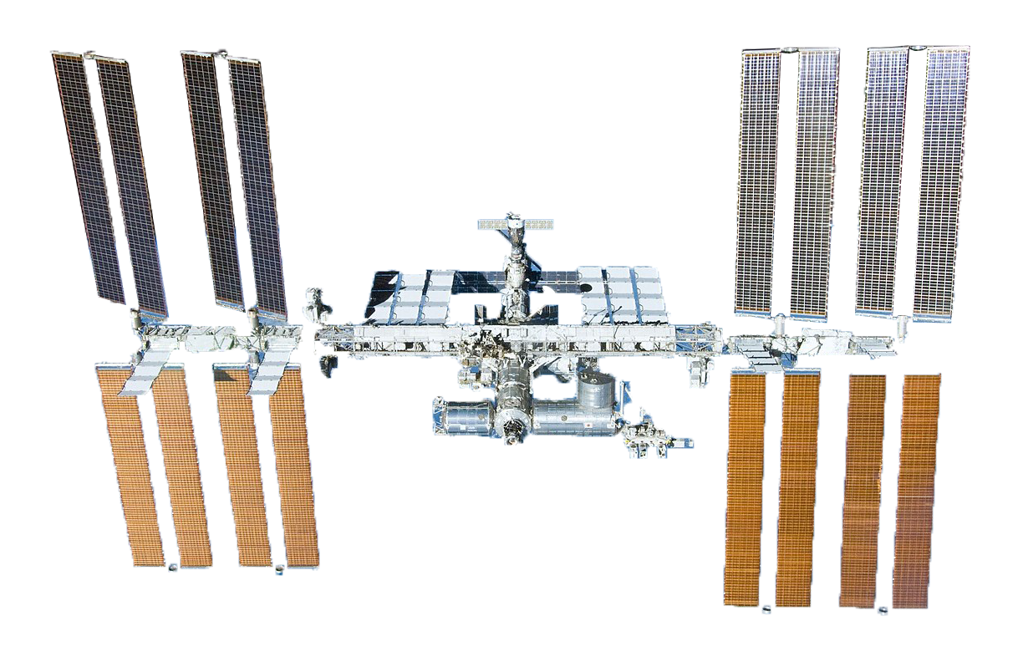
Current Land Imaging Architecture*
Suomi NPP VIIRS
~36,000 km
GOES-16 ABI
Sentinel-3A
Resourcesat 2
Sentinel-2A
GOES-17 ABI
SMOS
Landsat 8
NOAA-20 VIIRS
Sentinel-1A
Resourcesat 2A
SMAP
Sentinel-3B
Sentinel-2B
Sentinel-1B
Aqua MODIS
Sentinel-6A
(1,366km)
Terra ASTER & MODIS
Landsat 7
ICESat-2
ISS
*Examples of U.S. Government and international systems that provide free and open data
Dates are approximate and subject to change

Slide 14
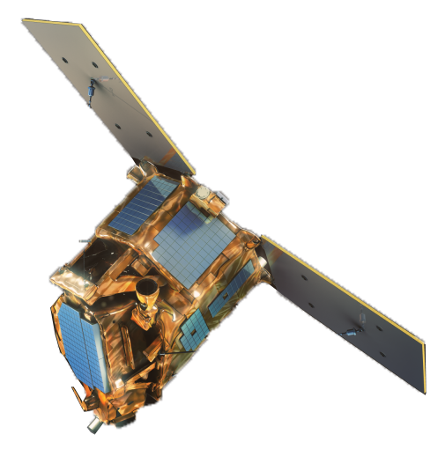
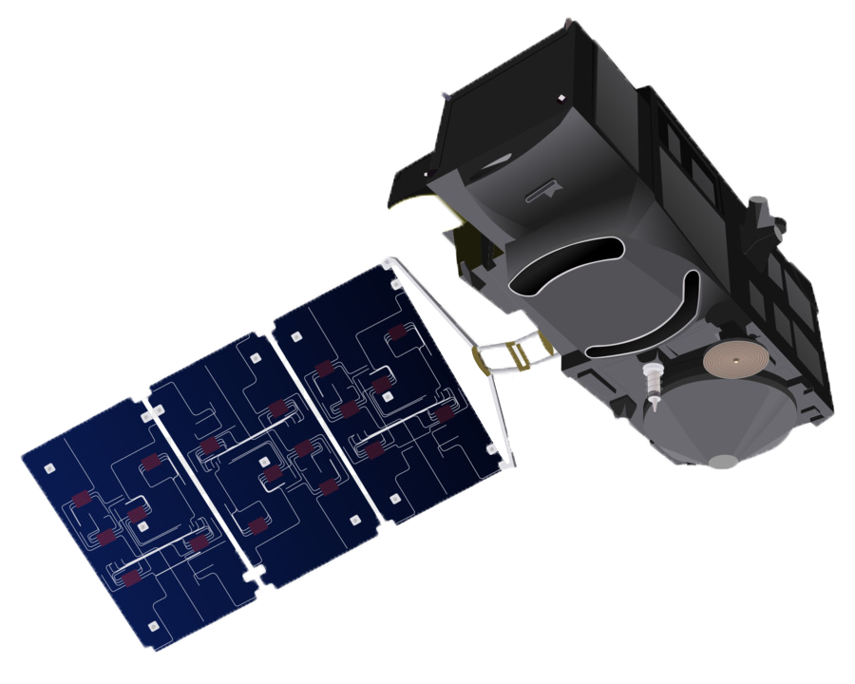
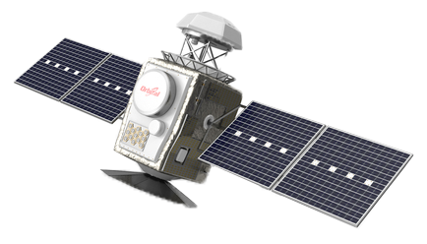
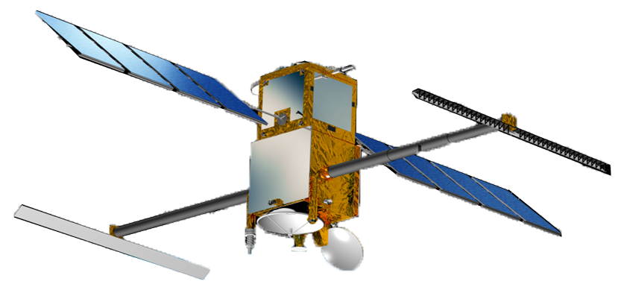
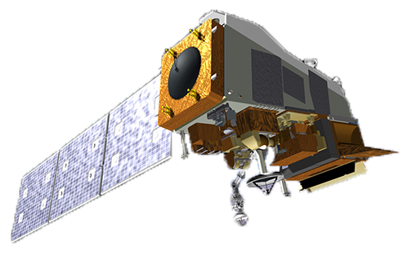
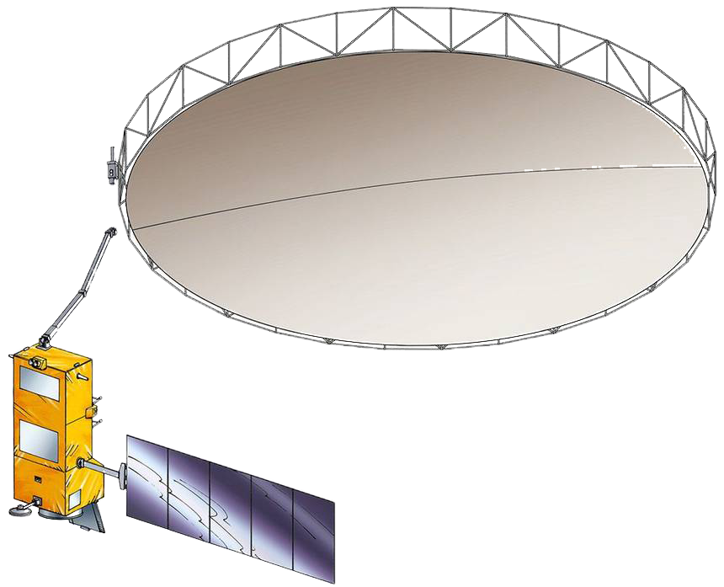
Future Land Imaging Architecture*
GOES-U ABI
~36,000 km
Sentinel-6B
(1,366km)
FLEX
Sentinel-3C
Sentinel-3D
Sentinel-2D
GOES-T ABI
JPSS-2 VIIRS
Sentinel-2C
Sentinel-1D
NISAR
Landsat Next
Surface Biology and Geology (SBG)
LSTM
CHIME
SWOT
PACE
Sentinel-1C
Resourcesat 3/3A
Biomass
Landsat 9
Surface Deformation and Change (SDC)
ISS
*Examples of U.S. Government and international systems that provide free and open data
Dates are approximate and subject to change

Slide 15
conclusion
Government systems satisfy many applications but…
Commercial satellite data augment government data, fill gaps, and provide unique solutions through high-resolution Electro-optical, radar, and hyperspectral data.
Segue to next panel on government on commercial data programs/contracts…
Questions?

