Slide 1
Open Source Software Support for the Spectral NITF Implementation Profile (SNIP)
NGA POC: Dave Case
PSU/ARL: Matt Baran, Shawn Hough, Eliza Bradley, Adam Edson
JACIE 2022

Slide 2
Problem Statement
The Spectral NITF Implementation Profile (SNIP) is a new format for spectral data
The Geospatial Data Abstraction Library (GDAL) is a widely used open source library for raster data translation, warping, and other processing
GDAL has a generic NITF driver to read/write imagery, but as of version 3.1.0, the driver did not support key aspects of the SNIP specification
Action: Update GDAL NITF driver to support SNIP
GDAL driver support will help geospatial tool developers use SNIP
A python interface would expand SNIP accessibility to python/jupyter users
Action: Create a Python package for organizing and manipulating SNIP data

Slide 3
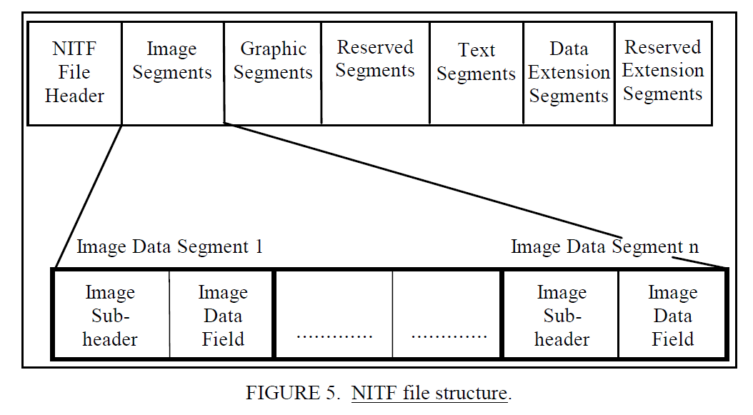
National Imagery Technical Format (NITF)
Image Credit: MIL-STD-2500C

Slide 4
SNIP File Layout
Image Credit: NGA.STND.0072_1.0_SNIP

Slide 5
The Geospatial Data Abstraction Library (GDAL)
GDAL is a translator library for raster and vector geospatial data formats that is released under an X/MIT style Open Source License by the Open Source Geospatial Foundation. As a library, it presents a single raster abstract data model and single vector abstract data model to the calling application for all supported formats. It also comes with a variety of useful command line utilities for data translation and processing.
Credit: gdal.org

Slide 6
GDAL changes to support SNIP
Added support for tagged record extensions (TRE)
ACCHZB, ACCVTB, BANDSB, CSEXRB, CSRLSB, CSWRPB, ILLUMB, MSTGTA, PIATGB, PIXMTA, PIXQLA, RSMAPB, RSMDCB, RSMECB, SECURA, SNSPSB
Added nested variable support in the xml:TRE metadata domain
Added support for variable length binary data type
Added support for conditional bitmask data fields
Implement native DES parsing
Added an xml:DES metadata domain to extract DESs from gdalinfo
Automated XML validation for NITF TRE definitions
Added support for ECS characters in NITF TREs
Added NITF creation options for binary TRE data
Added NITF creation option for DES data
GDAL TRE import was updated to support ECS characters, in accordance with GDAL RFC-5.
Add ECS support to the NITF driver for File header and Image Subheader (ISH)

Slide 7
GDAL Release Information
All PSU/ARL SNIP NITF updates are available as part of GDAL 3.3.0 and were listed in GDAL’s news
gdal/NEWS at v3.3.0 · OSGeo/gdal · GitHub:
NITF driver (3.2.0) Add support for various TREs for Spectral NITF Implementation Profile (SNIP): MATESA, GRDPSB, BANDSB, ACCHZB, ACCVTB, MSTGTA, PIATGB, PIXQLA, PIXMTA, CSEXRB, ILLUMB
Add nested variable support in xml:TRE
NITF driver (3.3.0)
Add support for SNIP TREs: CSRLSB, CSWRPB, RSMAPB, RSMDCB, RSMECB, SECURA and SNSPSB
Add xml:DES metadata domain and DES creation option (#3153)
Add support for ISO8859-1 fields in NITF TREs
Note: Recommendation to use GDAL 3.3.0 or 3.3.1 to use the SNIP capabilities and avoid errors associated with GDAL changing the way they handle invalid UTF characters in the python bindings in 3.3.2:https://github.com/OSGeo/gdal/pull/4304/files

Slide 8
Extended Character Set (ECS) support in GDAL
Unlike C, Python internals require string values to specify an encoding (ASCII, UTF-8, Latin-1, …). GDAL Python bindings import strings as UTF-8 and skip non-UTF-8 characters such as 0xB5. The error-handling mode could be extended, but it’s unknown if GDAL would accept the change since it could impact downstream python apps.
Spectral NITF Implementation Profile, Version 1.0, 07 June 2019
STDI-0002-1 v5.0, Appendix AL
µ=0xB5

Slide 9
Python interface
Design Goals
Develop a python interface to new GDAL capabilities
The interface should allow straightforward access to SNIP data and metadata
The interface should streamline the native GDAL interface by focusing on SNIP-specific organization
The interface should be compatible with common python tools, spectral exploitation libraries, plotting libraries, etc.
The interface should be easy to install and use
Accomplishments
Python parsing moved from pure Jupyter notebook to an imported package
Metadata methods to organize TRE, DES, File Header, Text, Graphic metadata
Image data loader for SNIP image segments
Band metadata loaded for image segments
Added environment.yml and README.md for quickstart
Added demo Jupyter notebook to show usage

Slide 10
Pure Jupyter converted to Python Module
…

Slide 11
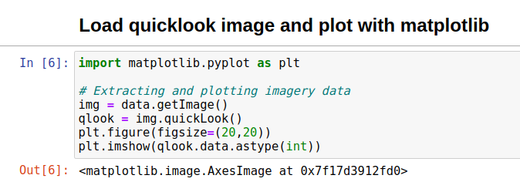
Load and display raster data
SNIP RIP 1B with
USGS EO-1 Hyperion data over Baghdad, Iraq
Publicly available imagery

Slide 12
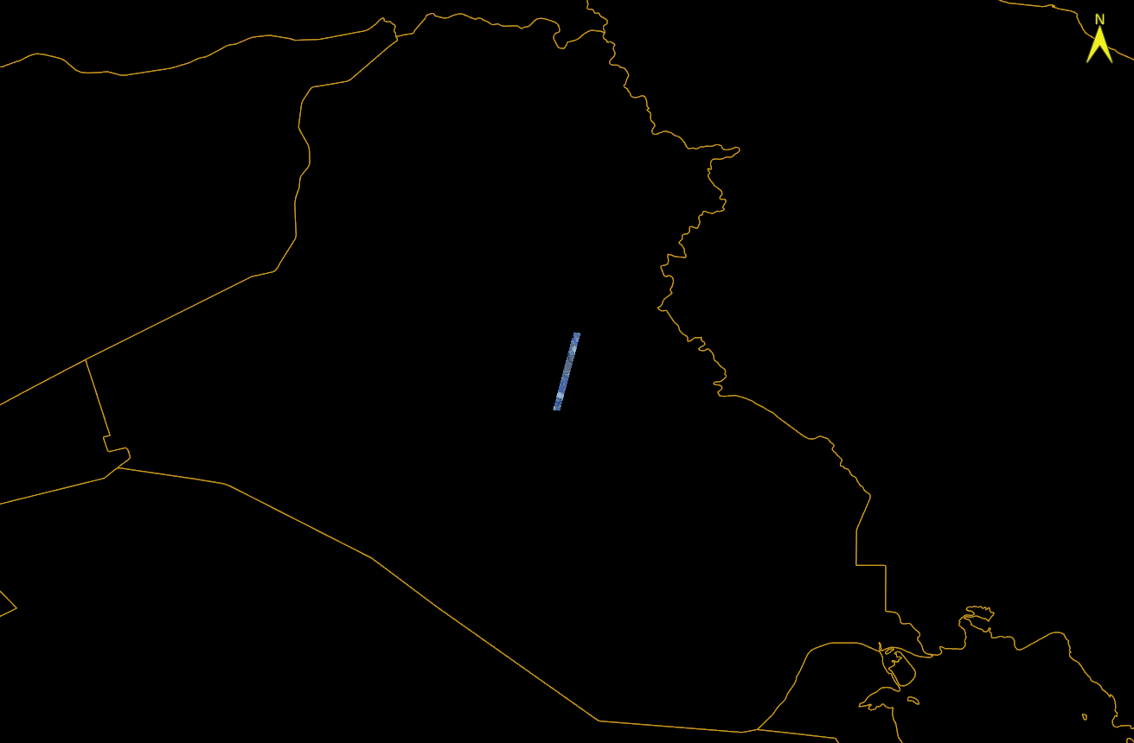
Data loader validation - RIP 1.0B Loaded into ENVI
SNIP RIP 1B with
USGS EO-1 Hyperion data over Baghdad, Iraq
Publicly available imagery

Slide 13
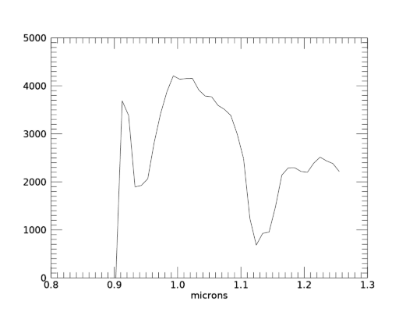
Load and plot a spectral profile
Validation Reference:
ENVI Spectral profile
Notes:
SNIP_RIP_Delivery\RIP_final\20200723-RIP1B_BIL_Final_Released\07APR2005_Hyperion_331406N0442000E_SWIR172_001_L1R-01B-BIL-GLAS.ntf
ENVI> data = raster[1].getdata()
ENVI> md = raster[1].metadata
ENVI> waves = (md['wavelength'])[1:40]
ENVI> c = plot(waves,data[150,1:40,1500])
ENVI> c.xtitle = 'microns'

Slide 14
Extract File and Image metadata

Slide 15
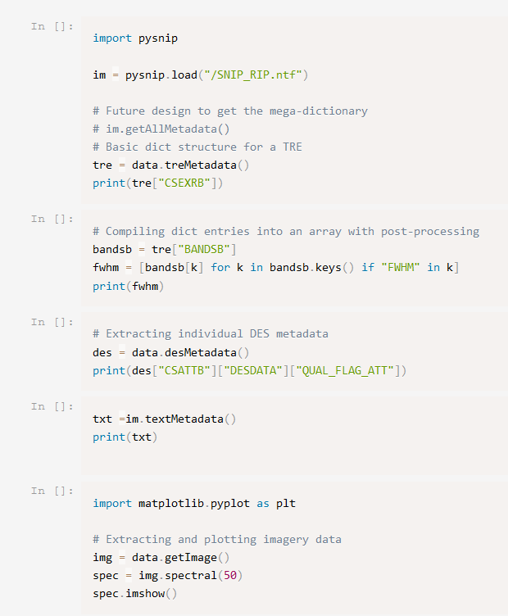
pysnip Documentation
Quickstart in README.md
Demo functionality in demo.ipynb

Slide 16
Future Work
Address the change in handling of invalid UTF characters in the python bindings for GDAL 3.3.2:https://github.com/OSGeo/gdal/pull/4304/files
SNIP GDAL TRE parsing uses ISO 8859-1 (including the micron character), look to update GDAL’s File header and Image header parsing to do the same. Those parsers still incorrectly assume UTF-8 encoding.
Validate DES parsing
Simplify metadata structures (fields -> numpy arrays, dictionaries of dictionaries, …)
Add raster warping based on geo-reference data
Add support for various types of image segment linkages
Improve data plotting interfaces (raster and spectral profile)

Slide 17
Takeaways: Open Source Software Support for the Spectral NITF Implementation Profile
The Geospatial Data Abstraction Library (GDAL 3.3.0) now supports SNIP RIP 1.0B files
Pysnip python interface expands SNIP accessibility to python/jupyter users
We are interested in beta testers and more feedback, please reach out to David.W.Case@nga.mil if interested.

Slide 18
PSU/ARL Geospatial, Image & Data Science Division Contact Info:
Shawn Hough
814-863-5307
sth104@arl.psu.edu

