Slide 1
Evaluation of FLARE during a Collaborative Campaign in Arlington, South Dakota (USA)
M. Kuester, B. Russell ª, C. Teixeira ^{b}, T. Ochoa, L. Leigh ^{b}, J. Holt ª
Maxar Technologies, Labsphere Inc.ª, South Dakota State University ^{b}
JACIE Virtual Workshop, January 10-13, 2022

Slide 2
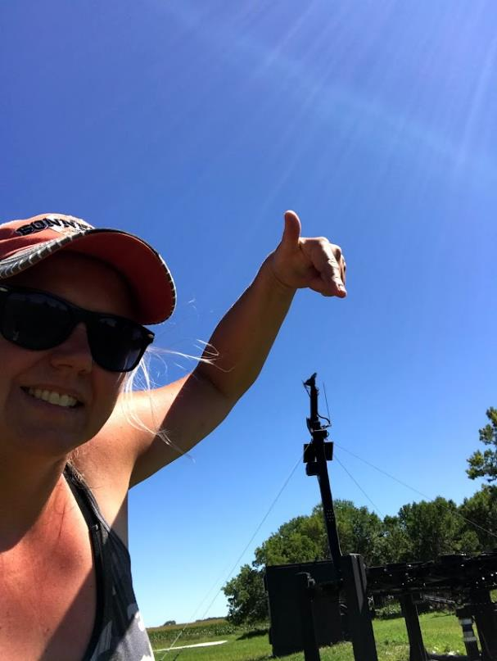
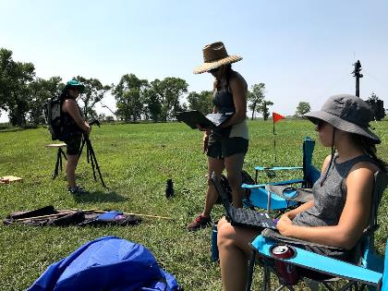
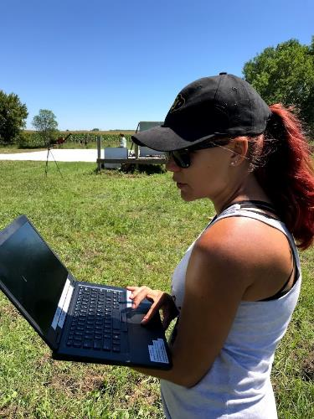
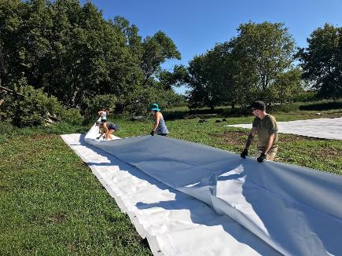
A collaborative field campaign was held in August 2021 to validate the capability of the FLARE system
Will give a campaign overview
Preliminary comparison of TOA Reflectance and Radiance with derived gains by Maxar, SDSU and Labsphere for WV02 and GE01 on campaign targets
Results from July 2021 Texas campaign for WV03
Discussion
Conclusions and next steps
JACIE Virtual Workshop, January 10-13, 2022

Slide 3
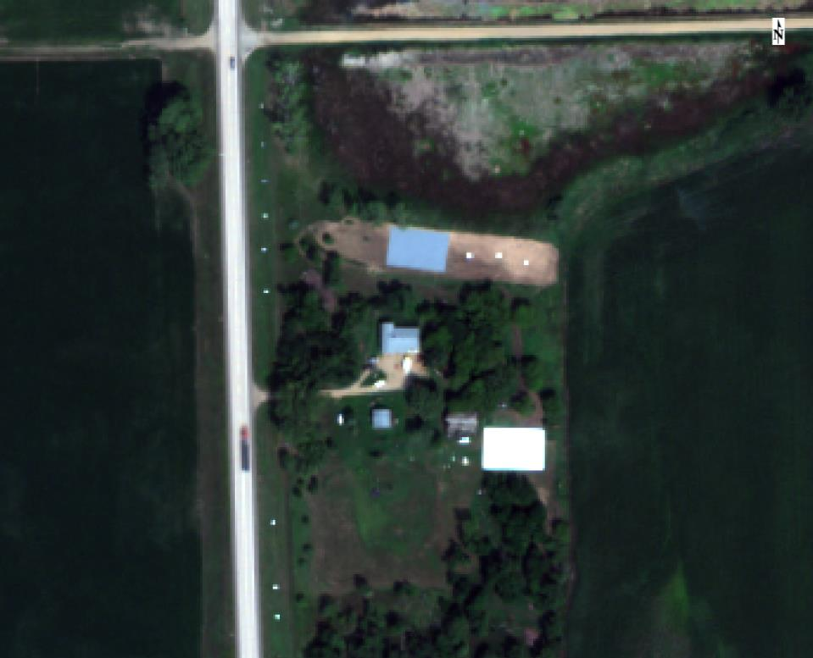
Campaign Overview
Collect concurrent calibration data with Maxar, SDSU and Labsphere’s FLARE at the Lester Aaron Homestead in Arlington, SD, USA
Compare independently derived TOA radiances over large calibration targets
Maxar utilizes calibration derived by reflectance-based method over tarps at Colorado site (2018v0)
Labsphere FLARE uses in-situ system of mirrors for radiometric calibration on-site during campaign
SDSU utilizes in-situ reflectance-based method on-site during campaign
Data collected on Aug 10 for WV03 and Aug 11 for WV02, GE01
WorldView-3 August 10 of campaign site in Arlington, SD
JACIE Virtual Workshop, January 10-13, 2022

Slide 4
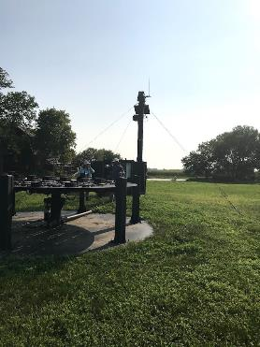
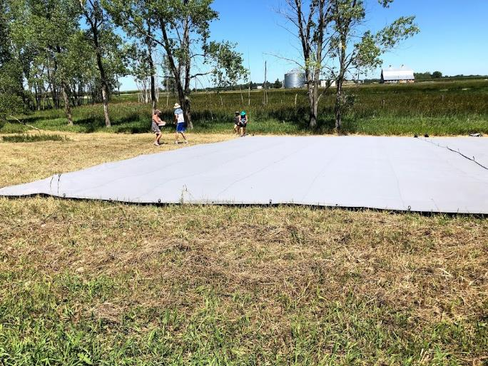
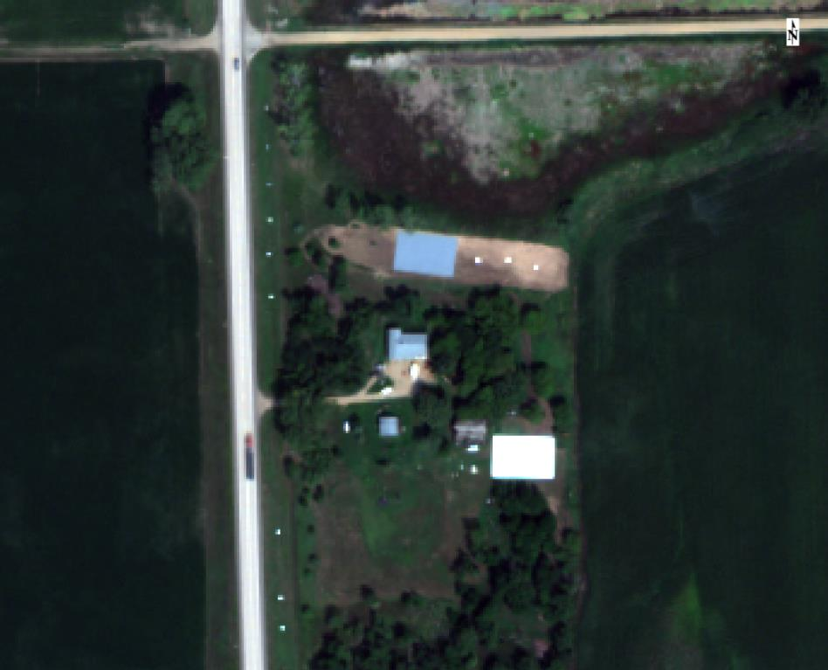
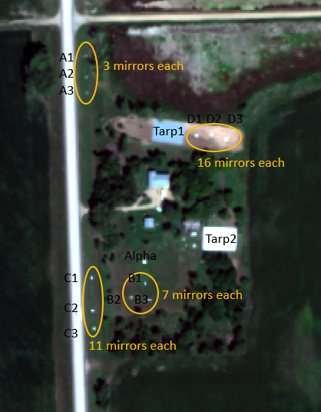
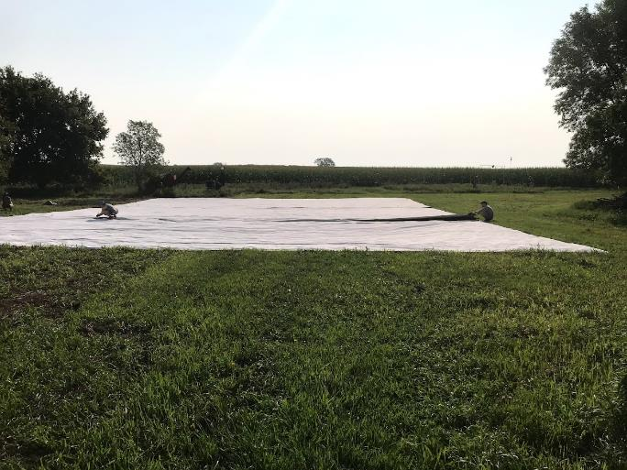
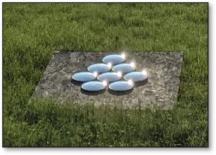
FLARE Alpha
15% Tarp
56% Tarp
FLARE Mirrors on Aug 10
Mirror set up for August 11, 2021
JACIE Virtual Workshop, January 10-13, 2022

Slide 5
Imagery Collected during the Arlington, SD campaign
Sensor | Date | Solar Az | Solar El | Sensor Az | Sensor El | ONA | meanGSD (Multi)
WV03 | Aug 10, 2021 | 149.1 | 58.0 | 176.9 | 84.3 | 5.7 | 1.248
WV03 | Aug 10, 2021 | 149.0 | 57.9 | 22.2 | 79.5 | 10.5 | 1.265
GE01 | Aug 11, 2021 | 149.2 | 57.6 | 143.3 | 85.2 | 4.8 | 1.647
GE01 | Aug 11, 2021 | 149.3 | 57.7 | 178.7 | 75.3 | 14.7 | 1.716
GE01 | Aug 11, 2021 | 149.0 | 57.6 | 32.0 | 78.5 | 11.5 | 1.687
WV02 | Aug 11, 2021 | 151.3 | 58.1 | 198.1 | 58.7 | 31.3 | 2.306
WV02 | Aug 11, 2021 | 151.1 | 58.1 | 200.8 | 72.4 | 17.6 | 1.984
WV02 | Aug 11, 2021 | 151.3 | 58.1 | 198.7 | 63.1 | 26.9 | 2.176
August 10 data not used due to poor atmospherics
JACIE Virtual Workshop, January 10-13, 2022

Slide 6
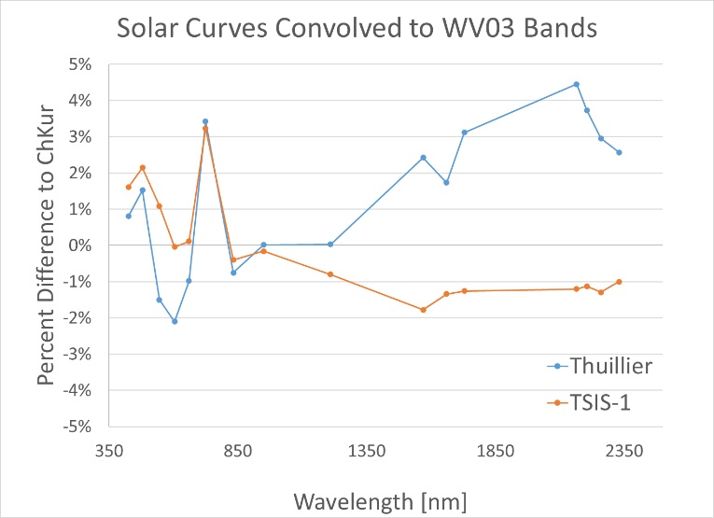
Let’s look at contributions to uncertainty
Atmospherics:
Local and continental wildfires contributing to a heterogeneous atmosphere
General atmospherics were not ideal on 7/10; but were much better on 7/11 (with continued smoke contribution)
BRDF and Angles:
SDSU TOA Radiance data was calculated at Nadir (Imagery collected at ONAs of 5 – 32⁰)
We did not hit N-S with L15 & that tarp was on a ~4-deg N-S slope
Adjacency:
Tarps were crowded by trees and structures
Each team used a different exo-atmospheric solar curve
Data is brought to TAO reflectance to try to get rid of this effect
Maxar is considering moving to TSIS-1 with their next constellation calibration update
Date | Time | Temperature | Humidity | Wind | Wind Speed | Wind Gust | Pressure | Condition
7/10/2021 | 10:30 AM CDT | 85 ⁰F ↑ | 65% ↓ | SSW | 18 mph ↑ | 26 mph ↑ | 29.37 in ↓ | Mostly Cloudy, Increasing winds
7/11/2021 | 1:53 PM CDT | 90 ⁰F ↑ | 49% | W | 10 mph ↑ | 0 mph | 29.29 in | Fair
Wunderground.com historical data for Arlington, SD
JACIE Virtual Workshop, January 10-13, 2022

Slide 7
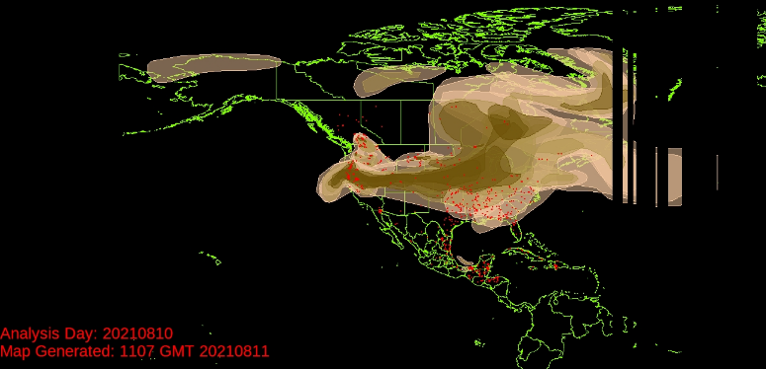
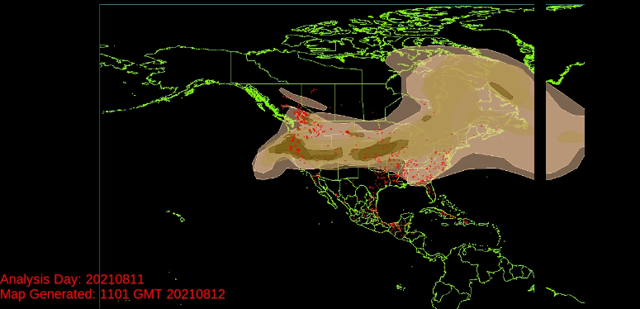
Widespread wildfires contributed to atmospherics during the campaign
Tuesday, August 10, 2021
…significant wildfire activity in central, south central, and southwestern Canada along with the northwestern and western U.S. was again visible covering…most of the U.S. …(directly over campaign site)
Wednesday, August 11, 2021
… large area of smoke…attributed to wildfires occurring in the western U.S. …(and) in southern British Columbia…Moderately dense smoke …over the Great Lakes region, the Ohio Valley region, and portions of New York and Pennsylvania (now to east of the campaign site)
NOAA Hazard Mapping System Fire and Smoke Product
JACIE Virtual Workshop, January 10-13, 2022

Slide 8
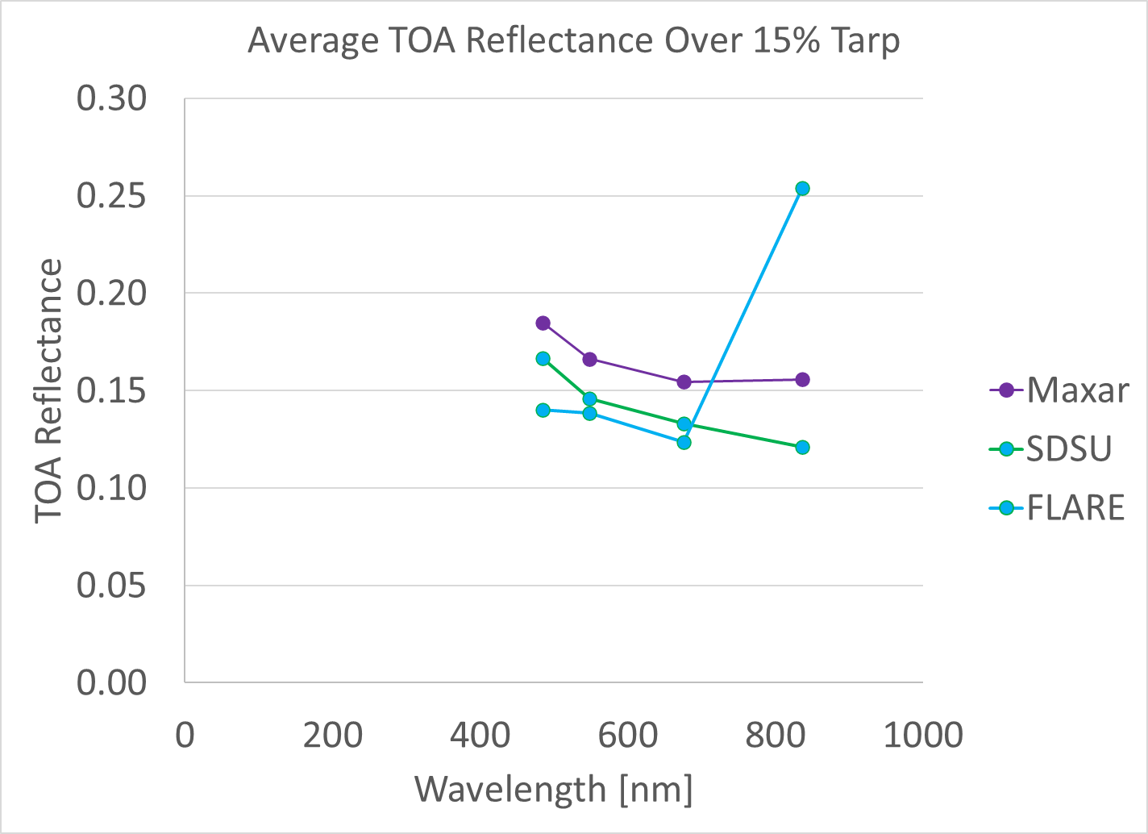
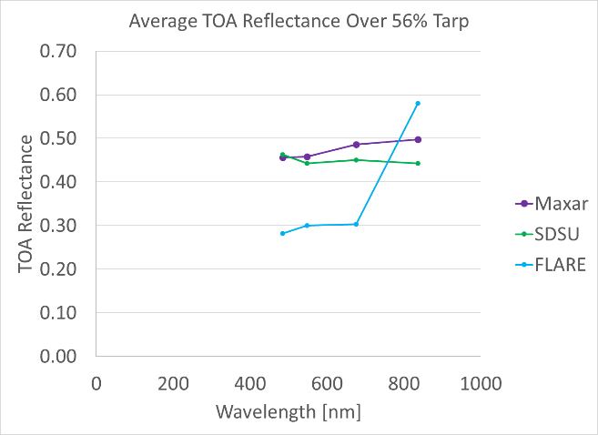
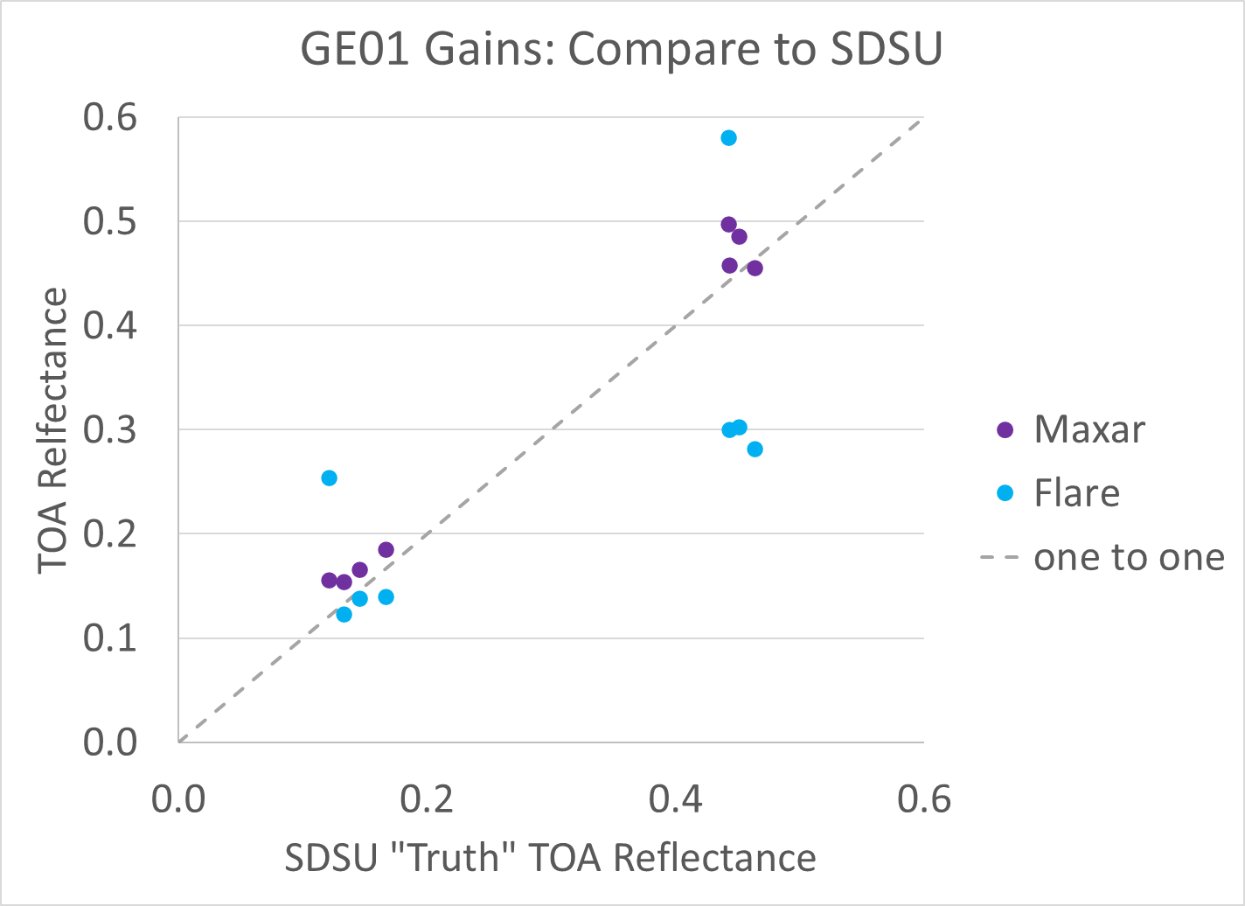
Preliminary Results show more work is needed to understand differences
Derived TOA reflectance over tarps from calibrated Maxar data, SDSU reflectance-based method and FLARE mirrors for GeoEye-1 on August 11, 2021, are shown
L56
L15
JACIE Virtual Workshop, January 10-13, 2022

Slide 9
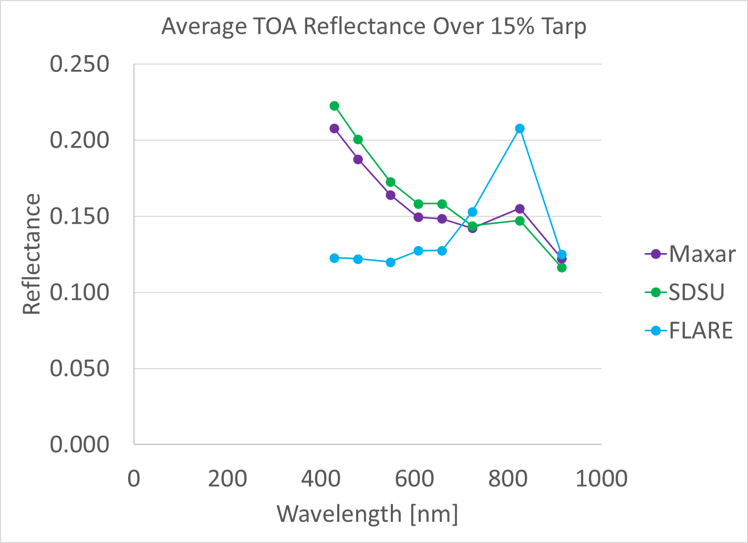
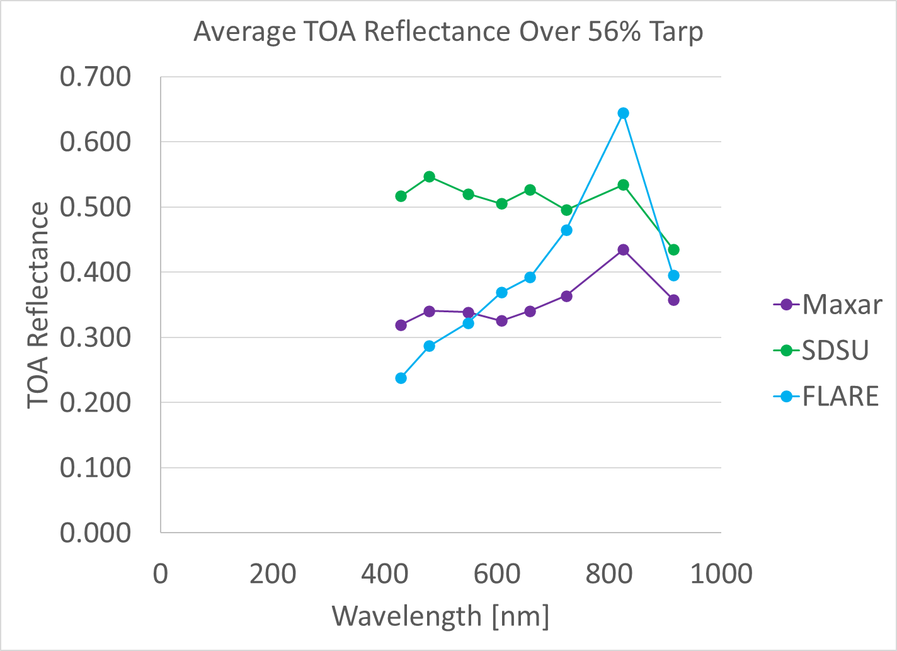
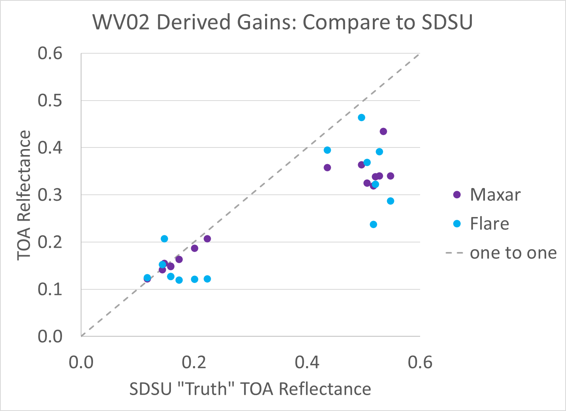
Our brighter tarp encountered more noise
Derived TOA reflectance over tarps from calibrated Maxar data, SDSU reflectance-based method and FLARE mirrors for WorldView-2 on August 11, 2021, are shown
L56
L15
JACIE Virtual Workshop, January 10-13, 2022

Slide 10
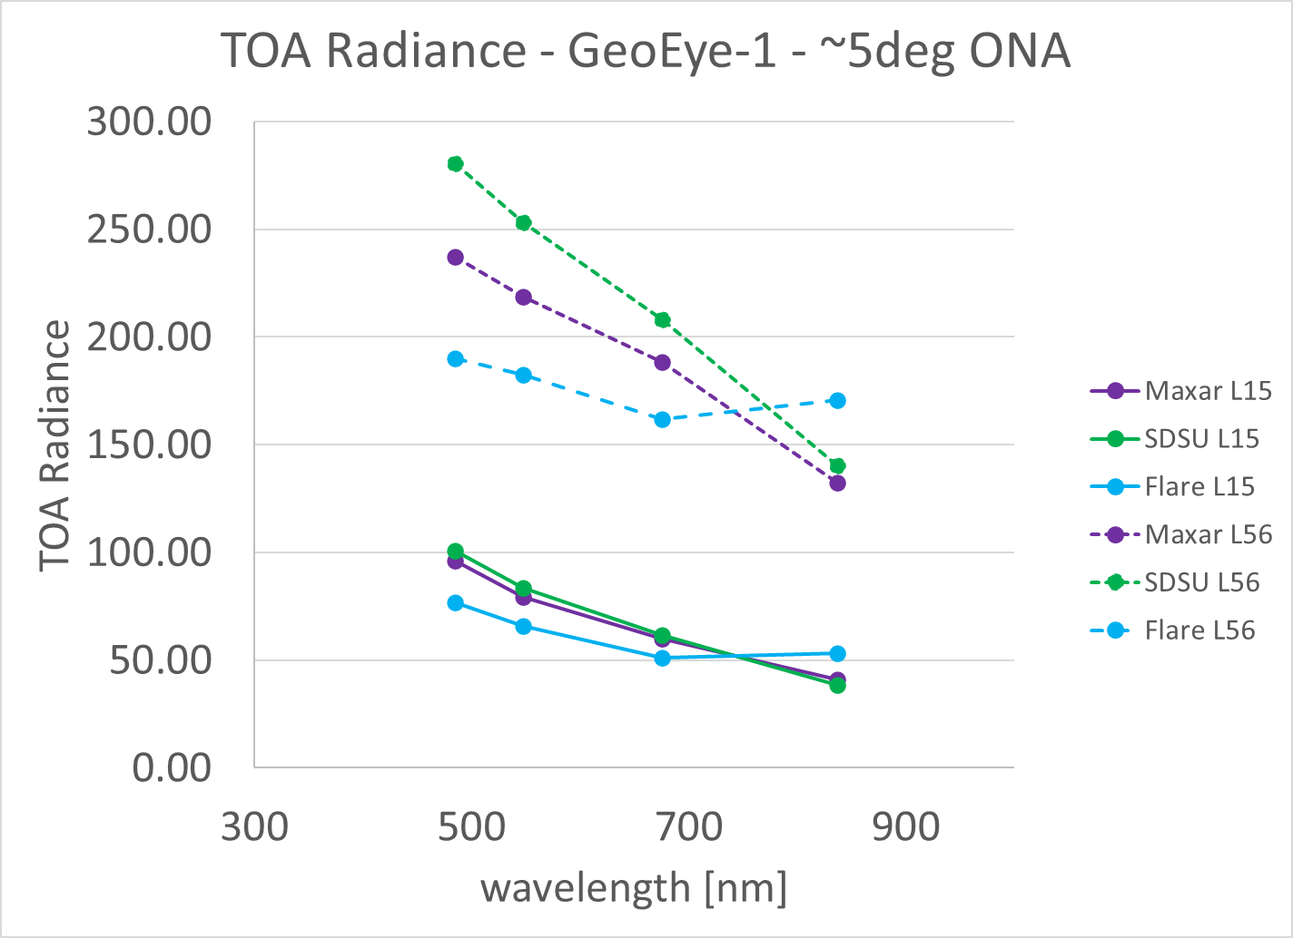
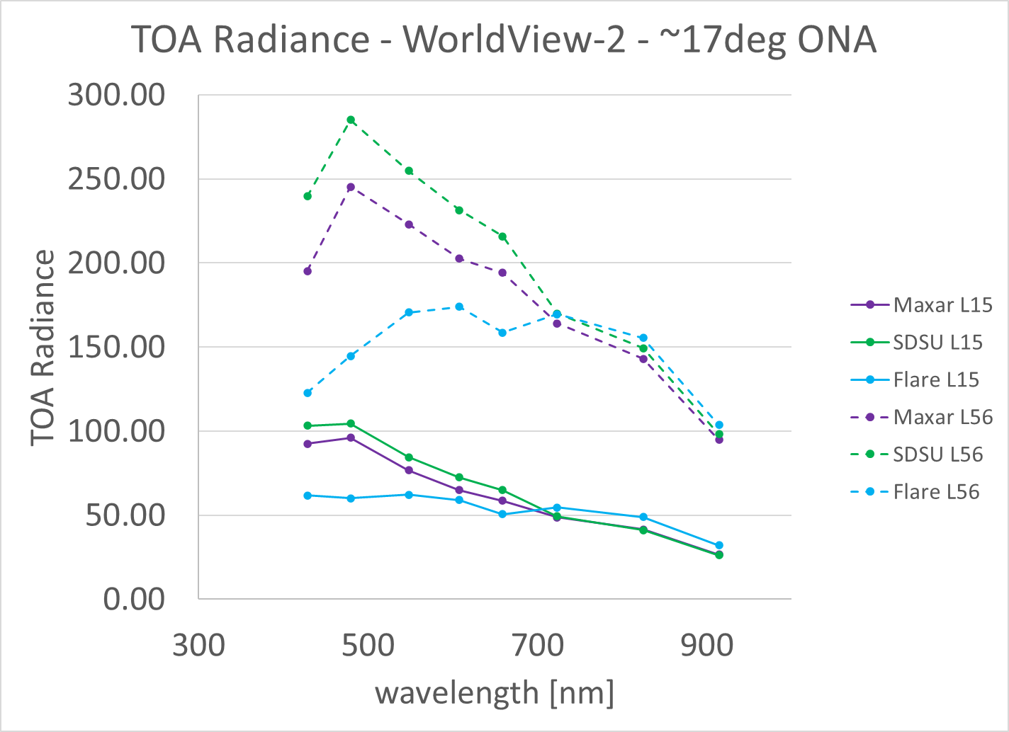
Looking at TOA Radiance as well shows same results as TOA reflectance
[ W m-2 um-1 sr-1]
[ W m-2 um-1 sr-1]
Here we are looking at images with the smallest available ONA for each sensor (recall that SDSU used NADIR inputs and parameters in MODTRAN)
JACIE Virtual Workshop, January 10-13, 2022

Slide 11
WorldView-3: Results from campaign earlier in the year in Texas (July 2021)
Derived FLARE radiometric gains for WV03 with similar campaign – gains compared using RadCalNet site RVUS (Railroad Valley, NV, USA) imagery for validation
Excellent agreement (within radiometric uncertainty) between Maxar, FLARE, and RadCalNet
JACIE Virtual Workshop, January 10-13, 2022

Slide 12
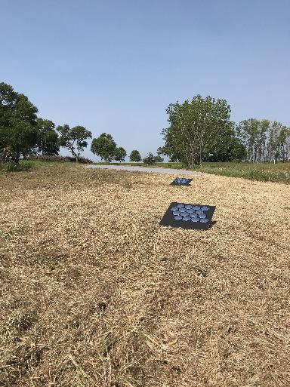
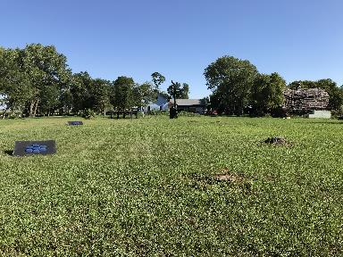
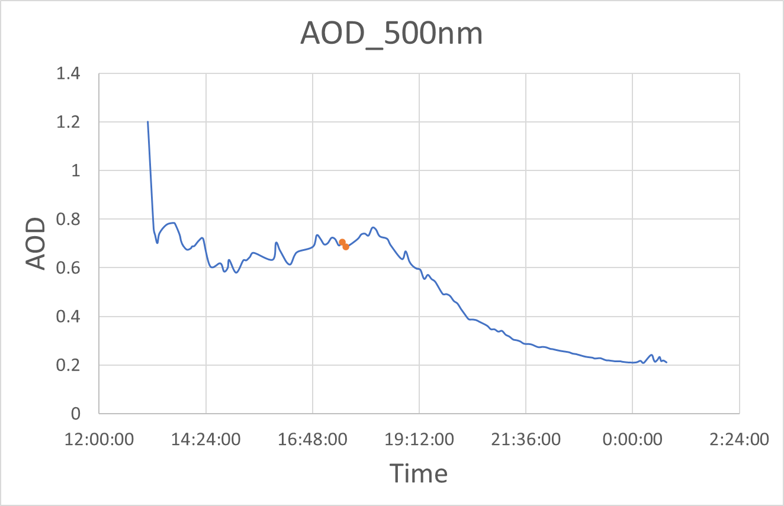
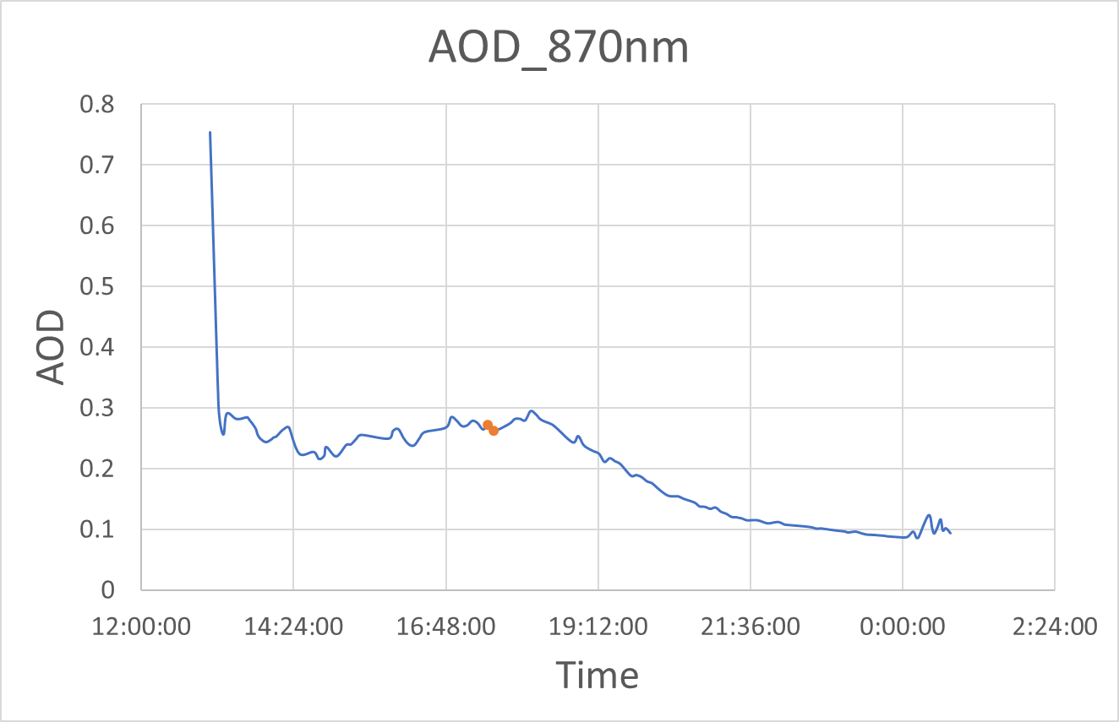
Discussion
Atmospheric Effects?
Wildfire contributions to the atmosphere made comparisons noisy
There were relatively high AOD values for a “calibration day”
Would like to compare surface reflectance and atmospheric retrievals between methods used by different groups in future
Would like to compare use of MODTRAN between groups
Adjacency Effects?
L15 on dead grass and L56 on live grass
Encroaching trees
Potential impact (bias) of processing level to mirror radiometry
WV03 (July) gains derived at lower processing level (1B) than August 11 GE01, WV02 (OR2A)
Point targets are impacted by resampling in a way that extended diffuse targets are not
Exposure (TDI) may have been too low for mirror processing
GE01 NIR band 4 were not getting enough signal on the mirrors
Still working to understand the underlying structure in the background in mirror work (especially with high resolution pixels)
No use of Maxar ground data yet in this comparison - maybe that could shed some light on anomalies
Texas results are very good and benefited from back-and-forth and reassessments of the mirror data; we will continue in that fashion for the South Dakota data
JACIE Virtual Workshop, January 10-13, 2022

Slide 13
The evaluation of new calibration methods like FLARE is important
Makes us think outside the box and re-evaluate our own methods
The use of a calibration system with similar reflectance such as FLARE has the potential to remove the bias induced when using different natural targets to create Spectral-Based Adjustment Factors (SBAFs) for cross-calibration of sensors (Future work after general comparisons are completed)
FLARE gives ability to scatter more calibration sites in different regions of the world (increases access to calibration sites)
FLARE can be used for sensors with small or large ground sample distance or pixel size
A consistent calibration target for sensors with varying resolutions
FLARE has potential as an interesting augmentation method to primary calibration methods
Consistent accuracy of FLARE being confirmed
Methodology still in flux (the team is still learning as they work with different types of sensors)
Need to confirm why some measurements are off (what caused it and how can we get better?)
Evaluation is on-going, we are learning a lot with the summer 2021 collaborations and will continue this research
JACIE Virtual Workshop, January 10-13, 2022

Slide 14
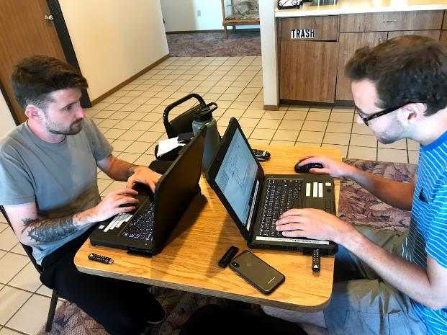
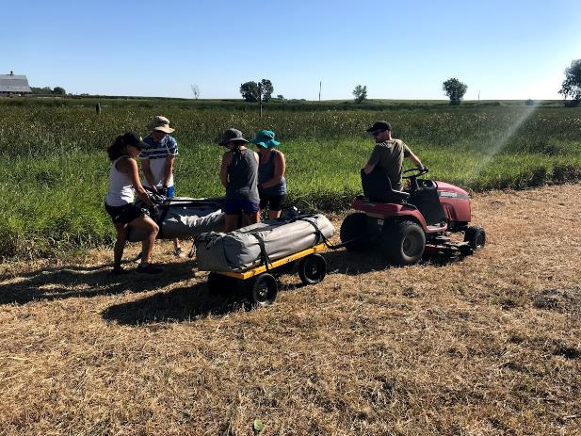
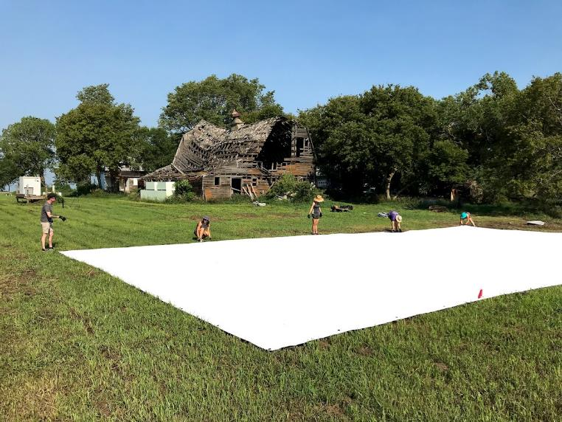
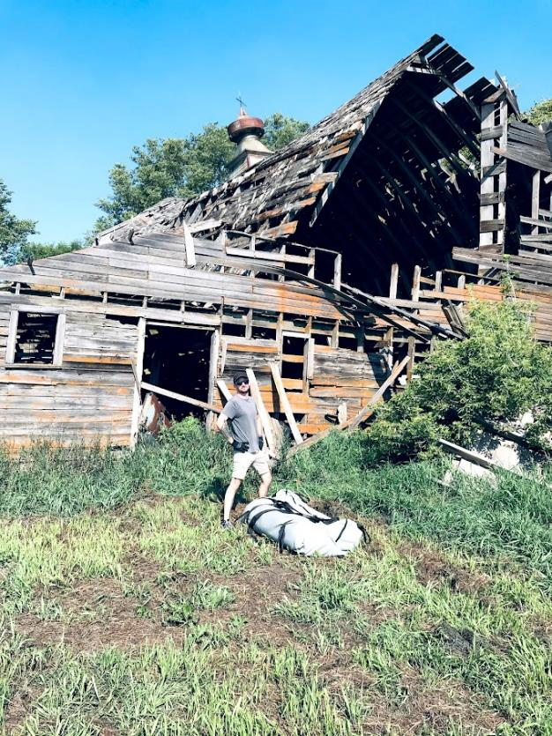
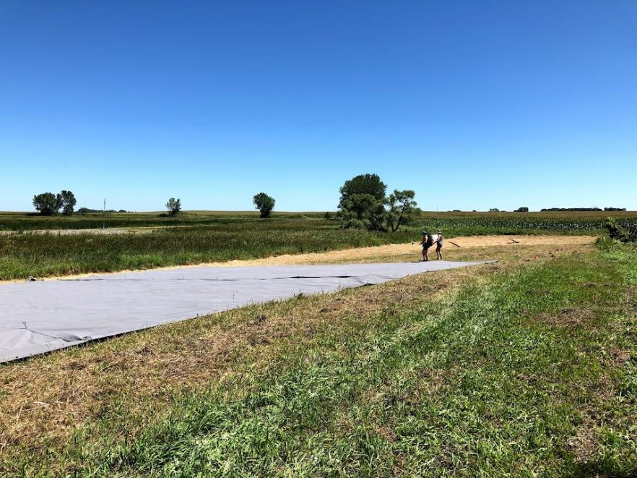
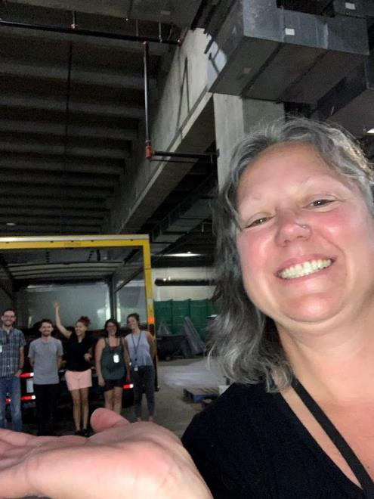
pics

