Slide 1

Satellite Cross-Calibration Radiometers (SCR)
Presentation to JACIE 2022
January 2022
Dr Medhavy Thankappan and Dr David Hudson

Slide 2
Context

Slide 3
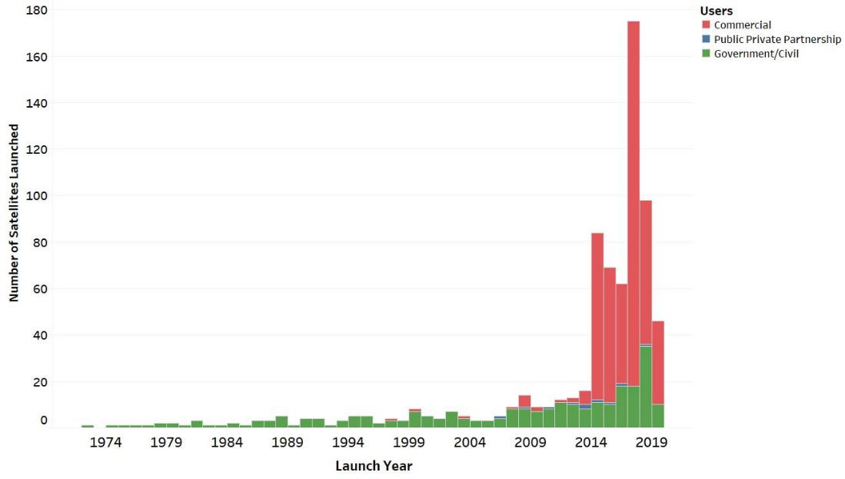
Smallsats are here

Slide 4
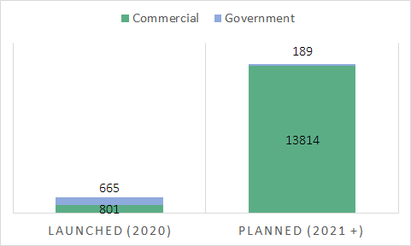
Smallsats are going to grow even more

Slide 5
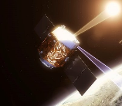
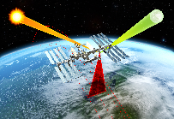

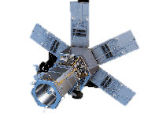
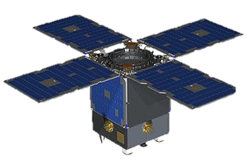
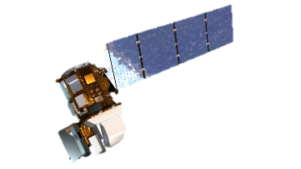

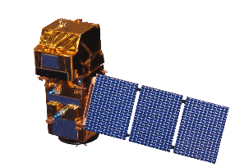
USGS Concept
TRUTHS
CLARREO Pathfinder
Primary Calibration Layer
Transfer Calibration Layer
(SCRs)
Imaging Layer

Slide 6
USGS SCR specification presented at JACIE 2019
Requirement |  | Specification
Spatial | Spatial resolution -GSD (m)
 | VNIR/SWIR | 100
 | TIR | 300
 | Swath-all bands (km) | 60
Spectral | Spectral range (nm)
 | VNIR/SWIR | 400-2400
 | TIR | TBD
 | Centre wavelength spacing (nm)
 | VNIR/SWIR | 5
 | TIR | 5
 | Number of bands
 | VNIR/SWIR | 400
 | TIR | TBD
 | Spectral resolution (FWHM) - Dl (nm)
 | VNIR/SWIR | 8
 | TIR | TBD
Radiometric | Radiometric resolution
 | NEDL (mW-m⁻²sr⁻¹nm⁻¹ ) | TBD
 | NEDT (K) | 0.15
 | Radiometric accuracy
 | VNIR / SWIR (%) | 1
 | TIR (K) | 0.3
 | Signal-to-Noise Ratio | 300:1

Slide 7
Australia’s path to date

Slide 8

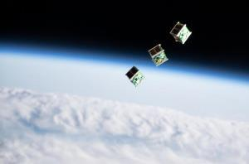

Australia’s strategic objectives
Securing our access to data
Uplifting our satellite manufacturing capability
Growing our app development industry

Slide 9
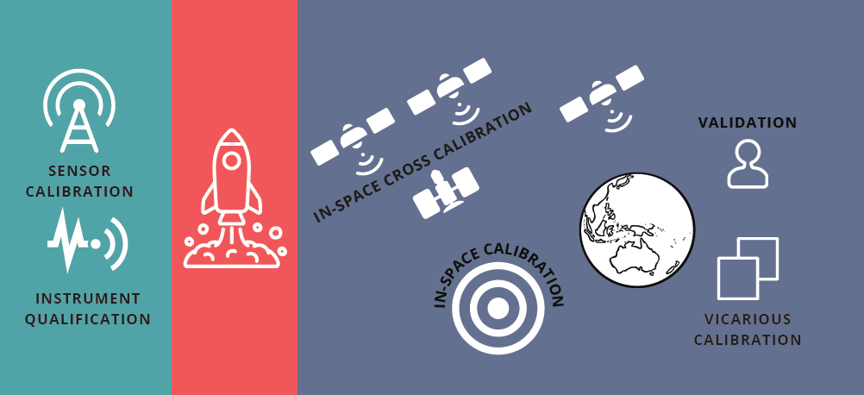
Australia’s history in calibration and validation

Slide 10

AusCalVal:
Establishing Australia as a Global Leader in Delivering Quality Assured Satellite Earth Observation Data
Building on Australia’s global reputation in satellite Earth observation calibration and validation there are active discussions across Australia about a proposal to codify this position and developing AusCalVal. This strategy has four components:
a coordination body to oversee operations, communication and access to data, facilities and expertise;
a comprehensive, operational and research network of calibration and validation facilities across Australia;
an open source suite of quality assurance tools leading to a data integrity monitoring service for all satellite operators; and,
an Australian owned and operated series of Satellite Cross-Calibration Radiometers to provide improved accuracy and consistency between optical satellites.
https://frontiersi.com.au/auscalval/

Slide 11
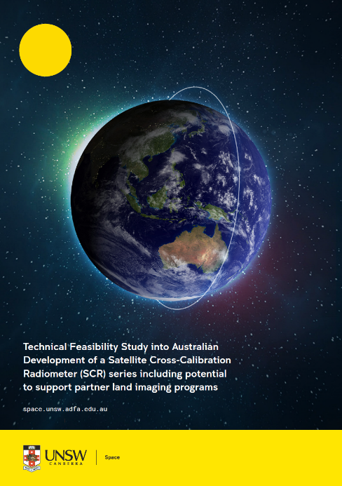
A feasibility study
University of New South Wales’s Australian National Concurrent Design Facility (ANCDF)
From December 2020 to March 2021 a total of 40 experts from 13 organisations were consulted or participated in the study
Aussie style findings:
  Sure we could give that a crack
  Be kinda hard though, we might need help
https://unsw.adfa.edu.au/our-research/facilities/ancdf

Slide 12
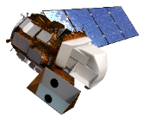
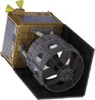
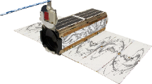

SCR Operations Concept Overview
Target satellites for cross calibration
Potential targets:
Europe’s Sentinel 2 series (2-4 satellites)
India’s Cartosat, IRS and Resourcesat series (15+ satellites)
South Korea’s Optical Kompsat series
Plant’s Doves (105+ satellites)
Many other private sector smallsat constellations including Maxar, BlackSky, Satellogic, SpaceWill, Earth-i, Orbital Sidkick and LatConnect60
Calibration sources
(CLARREO-PF, TRUTHS, Landsat-8, Landsat-9)
SCR satellites
SCR satellites
Coincident Image Acquisition (+- 20 minutes)
Coincident Image Acquisition (+- 20 minutes)
Calibration Source Data
SCR Hyperspectral Data
SCR Hyperspectral Data
Target Data
Synthetic Image
Synthetic Image
Stable and calibrated SCR ready for transfer
Corrections provided to target satellite operator for them to improve their data

Slide 13
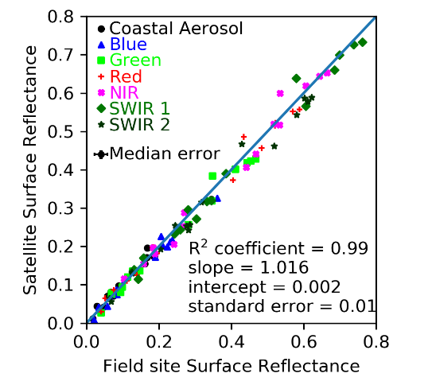
Recent cross-calibration: Landsat 9 underfly
Once in a mission opportunity to cross-calibration Landsat 8 & 9 in November 2021
Teams were deployed across the continent
Thanks to:
  Federal agencies (Geoscience Australia, CSIRO)
  State governments (Queensland, NSW and WA)
  Research (Monash University, Curtin University, FrontierSI)
  Land owners and locals (Avondale Station, Dunedin Park, Narromine Shire, Lake Yanga Station, Borambula Wines, Narromine Rifle Range, Warrawong on the Darling and Wilcannia)
Overpass date
Spectrometer
Suitable field site
Good weather

Slide 14
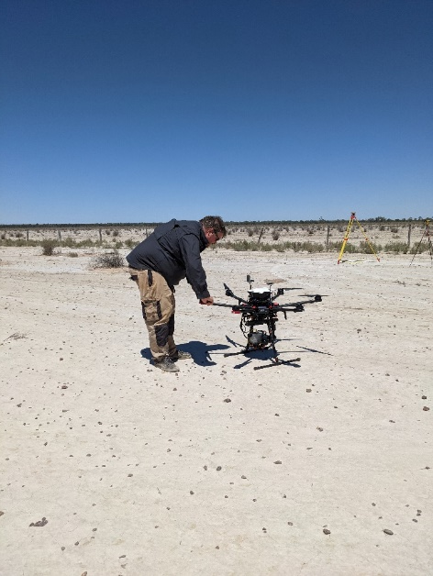
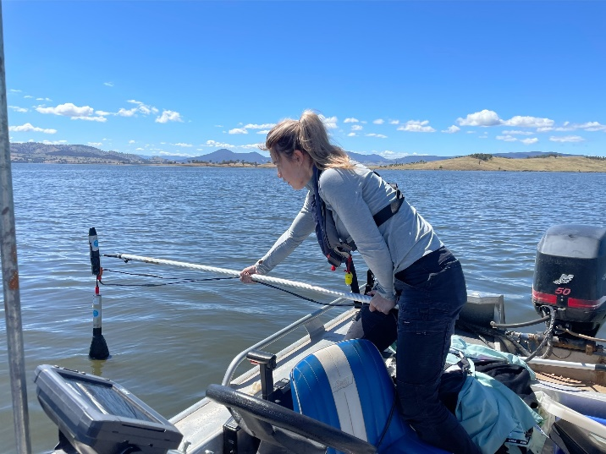
Recent cross-calibration: Landsat 9 underfly
Oz Underfly Tally
Perth 1*
Cunnummala 1
Wilcannnia 2
Narromine 2*
Lake Hume 1*
-------------------------------
Total 7
-------------------------------
* 15% overlap swaths

Slide 15
Where are we up to?
Working toward the MCR and KDP-A in March
Keen to hear from potential client satellites to understand user demand.

Slide 16
Discussion

