Slide 1

EarthDaily Analytics - Delivering Scientific Imagery of our Planet for a Sustainable Future
Dr. Keith Beckett – Senior Tech Manager – Cal/Val
JACIE - January 12, 2022
Notes:
Hi everyone, I’m honoured to be speaking here with so many esteemed colleagues and speakers from government, academia and industry.
I’d like to start by thanking the organizers for allowing me to present here today.
I’m Keith Beckett … Senior Technical Manager – Cal/Val at EarthDaily Analytics.
I’ve spent the last 30 years developing and delivering Earth Observation systems all around the world … RADARSAT, RapidEye, GeoEye, WorldView, UrtheCast, Planet and many others.
Today … I’m going to talk about some of our offerings and our upcoming satellite constellation that will capture daily scientific imagery of our planet to help build a more sustainable future.
For those of you who don’t know EarthDaily Analytics, we’re a software and information services space company specializing scientific satellite processing and analytics using earth observation . I’m presenting from Vancouver Canada where we focus on cloud-based image processing and value-added products, but we also have offices around the world with most of them specializing in agriculture using earth observation data. Unfortunately, we don’t yet have any India so I am hoping that will change sometime in the near future which a would so I can have the pleasure to visit your beautiful country.
Bio:
Dr. Keith Beckett is the Senior Technical Manager for Cal/Val at EarthDaily Analytics, leveraging an engineering, research and product management career spanning well over 30 years in remote sensing, working on multiple international projects for a range of customers. He led key roles in the Ground Segment development and mission commissioning for RapidEye, GeoEye, DigitalGlobe (now MAXAR), to name just a few.
EarthDaily Analytics will soon have a constellation of satellites capable of observing the earth every day in a wide range of spectral channels, and serving multiple vertical applications with science-grade imagery and analytics. He is leading the development of the cal/val capabilities for our upcoming constellation, and our EarthPipeline partners.

Slide 2
EarthDaily’s Data and Analytics Services for ECCC
Introductions
Company Update
Why EarthDaily Analytics?
EarthDaily Constellation
EarthPipeline
EarthMosaics
EarthPlatform
Discussion

Slide 3
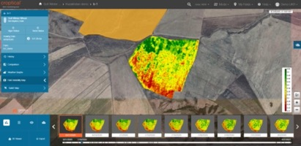
Who we are
I’m presenting from here in Vancouver, BC
We are a software and information services space company developing world-first technologies in data services, satellite processing, machine learning and actionable insights from Earth Observation data.
Global Operations
Agriculture Analytics Platform
Notes:
For those of you who don’t know we’re a software and information services company specializing if data and satellite processing, and analytics with our main analytics focus in the area of agriculture.

Slide 4
Company Overview
EarthDaily Analytics (EDA)
  Established in 2021 by Antarctica (NY Private Equity) spin-out from UrtheCast
    Substantial amount of cash equity invested already and more committed
Current services businesses:
  Provider of satellite imaging, data processing, mosaics and analytics for our customers in the Agriculture industry through our Geosys (“EarthDaily Agro”) division
  Provider of highly calibrated scientific quality image data processing services though our ground-breaking, fully cloud native EarthPipeline
In 2023, EarthDaily Analytics will launch the EarthDaily Constellation (EDC), the world’s first earth observation system designed from the ground-up to produce scientific-quality imagery of the entire earth every day
  Development already underway

Slide 5





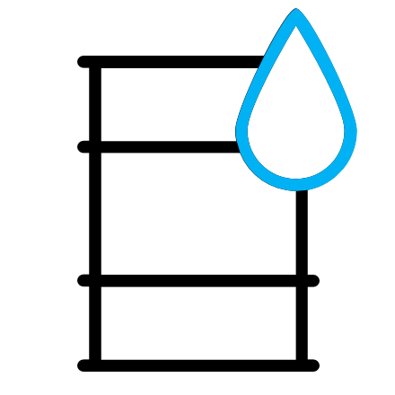


A Pressing Need: for Global Monitoring
  Many of the greatest challenges that the world faces require high-cadence, scientific-quality satellite and AI-derived monitoring, change detection alerting, and predictive analytics, at scale: Decision Ready Insights
  Food security and farm soil protection
  Water optimization
  Climate change and carbon trading
  Deforestation of tropical rain forests
  Habitat protection
  ESG reporting and corporate accountability
  Disaster response
  National and allied security
Forestry
Environment
Agriculture
Disasters
Insurance
Commodities
Natural Resources
NGOs
The company that can deploy a system capable of delivering the data sets for these challenges will enable significant economic value creation
Notes:
We're heavy users of satellite data for our current business and we see the urgent need for global daily monitoring with scientific quality data. The science missions like Sentinel, Landsat, Resourcesat all provide fantastic data quality, but the coverage, latency and resolution isn't always adequate for many pressing applications. If we could take scientific data and improve it’s resolution, coverage, and frequency, this data stream could tackle many of the greatest challenges that the world faces today like improving water management based on drought and flooding conditions, rapid forest fire detection or risk assessment, or alerting for oil spills and illegal deforestation to name just a few applications.
No mission today has the scientific quality of large government missions combined with daily global higher resolution coverage. For this reason, EarthDaily Analytics is creating a mission designed from the ground up to specifically address this need and help global environemental challenges.

Slide 6
The Solution: the EarthDaily Satellite Constellation
The world’s first super-spectral satellite system with daily global coverage & optimized for AI/ML applications with unprecedented change detection capabilities
9 satellites (plus 1 in-orbit spare) image the world every day with many bands at 5 m GSD and with spectral bands covering key wavelengths for analytics: Visible-NIR, SWIR, MWIR and LWIR
World-leading cloud-native ground processing system called the ”EarthPipeline” uses proprietary IP to generate ultra-high quality “Analysis-Ready” image products & value added products in a fully automated manner – built for huge scale
Image products support “direct-to-algorithm” enterprise grade applications utilizing AI and ML and require no humans in the loop
High Image Quality
Daily Coverage of the World
Scientific grade SNR & radiometric calibration
High geo-location accuracy
Super-spectral imager optimized for analytics
>150 M km² of imagery captured at the same time every day
Covers the Earth’s land mass & large maritime areas every day
EarthDaily Constellation
Low Latency Delivery
Consistency and Reliability
Fully automated tasking, collection, downlink, backhaul and data processing, cataloguing and delivery
Lifetime of constellation is 10 years ensuring a consistent data stream that guarantees long-term value
Infinitely scalable SaaS business model

Slide 7
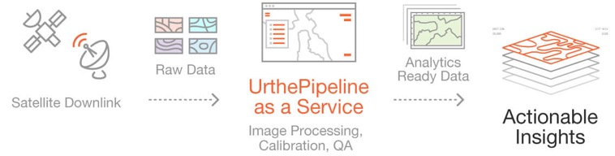
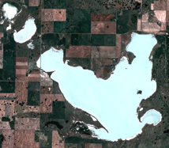
The EarthDaily System is Fully Vertically-Integrated
Upstream
Midstream
Downstream
Raw Downlinked Data
Analysis Read Data
EarthPipeline as a Service
EarthPipeline as a Service
Downlinked Satellite Data
Value-Added Services
Commissioning, Image Processing, Calibration and QA
Raw Downlinked Data
Analysis Ready Data
Analysis Ready Mosaics
Notes:
To do this, the EarthDaily system is a fully vertically integrated solution. On the upstream side we have 9 satellites acquiring 92% of the earth’s land mass and maritime areas each day with 23 superspectral bands designed for many different applications. These are good sized satellites designed to produce scientific quality data with a highly controlled orbit to ensure the same imaging time every day over a long 10 year design life.
->This consistency of seeing world the same way each day is key to automated change detection that can reliably drive environmental or business critical decisions at scale
->In the Midstream, we have the world’s first processing service that can transform raw downlinked data as shown on the left into ultra high quality Analysis Ready Products at scale in the cloud, fully automatically and at scale without any operations touch labour. Midstream also includes our patented EarthPlatform which provides data discover, access and analytics capabilities for our customers.
On the downstream side we have a wide variety of analytics including our recently released EarthMosaics service that can dynamically create large scale cloud-free mosaics as well as a many upcoming environmental focused services for water management, forest fire detection and agriculture.
---
There is also three pillars of our technology. On the upstream side we’re currently underway building the EarthDaily constellation which will will deliver enterprise grade change detection services, and it leverages our midtream EarthPipeline service which automatically transform their raw downlinked data into highly calibrated and accurate Analysis Ready Data products. This EarthPipeline SaaS offering is also available commercially and is used by external satellite operators to generate very high-quality products with low-latency for their customers. On the downstream we deliver value added services for example Analysis Ready Mosaics as well as a wide variety of Agriculture analytics. My colleagues will also dive into these technologies in later sessions.

Slide 8


The EarthDaily System is Fully Vertically-Integrated
Upstream:
Data Capture
Midstream:
Cloud Processing & Platform
Downstream:
Analytics Products & Services
Satellite Constellation:
9 satellites (plus 1 in-orbit spare) with scientific spectral bands
Daily coverage of the Earth’s landmass
Ultra-high pointing stability that enables high geometric accuracy
10-year design life to ensure data consistency over an extended period
Precise orbit control enabling accurate cross-calibration to Sentinel-2 and LandSat-8/9
Ultra-high scientific quality daily imagery that is optimized for change detection, alerting and predictive analytics
EarthPipeline:
World’s first fully automated EO data processing, calibration and quality system to extract highest quality at scale.
Creates first ever automated “Analysis-Ready Data” that is capable to use directly in algorithms
EarthPlatform:
Provides data discovery and distributes data to customers via on-demand API’s
Offers “Bring Your Algorithm to the Data” service for customers
Brings together other complementary data
Value-Added Products:
Automated generation of info products:
  Cloud Free Analysis-Ready Mosaics
  Dynamic Land Cover Maps
  Land Heath (e.g., Crop Health Status)
Big Data Analytics Services:
Creation of new large scale change detection and predictive analytics, e.g,:
  Ag – Yield Forecasts through-out season
  Fintech – automated damage assessment for crop insurance, land valuation
  D&I – Change detection alerts for situational awareness

Slide 9
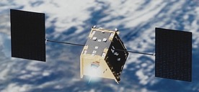
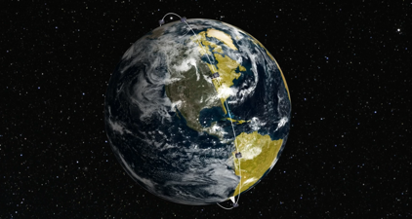
EarthDaily Satellites – Launching in 2023
The EarthDaily Constellation has 9 satellites plus 1 in-orbit spare, equi-spaced around a sun-synchronous orbit with a 10:30 a.m. equator crossing time
  Proven satellite bus with substantial flight heritage
  Proven cameras and sensors, leveraging many years of commercial + government investment
    In the process of finalizing the exact spectral channels required to serve a wide range of applications
  Lifetime: 10+ year mission design
Extensive pre-launch calibration campaign and continuous in-orbit cross calibration to government science satellites
(e.g., Landsat-9 & Sentinel-2) will ensure scientific grade quality
Notes:
What’s really unique about satellites is that we’re the first New Space company developing a constellation of scientific quality small sats. They are 200kg mass roughly the size of a large oven, have 11 spectral bands or colours in visible and Near Infrared spectrum, 6 bands in Short wave infrared and 6 bands in the thermal spectrum. This range in spectral modalities allows us to see subtle signals on the ground, globally every single day.
-> The long 10 year mission life is important for a few reasons: 1) we have long, consistent data archive can be used for long-term trending and predictive analytics and 2) our customers will know that the algorithms that they develop with our data can be used for a long time. Our customers can invest 100’s of thousands of even millions of dollars on proprietary algorithms and have confidence those algorithms can be used for a long time.
-> We are also doing something very unique – we're using the same rigorous techniques as NASA science missions for our pre-launch sensor characterization of our cameras. This is like measuring a strand of hair with ruler versus microscope, we can get to a whole other level of quality when measuring the responsivity of our cameras at a 1 nm level. And this is key to delivering scientific grade quality.

Slide 10
EarthDaily Optical Payload Performance
The Spectral Bands and Scientific Class Quality are Key Differentiators
Spectral bands selected to be interoperable with end users existing satellite applications
  matching Sentinel-2 and Landsat-8/9 bands
New bands added to enable future innovative applications
  Carbon cycle monitoring, water cycle monitoring, soil moisture, methane detection, wildfire detection and characterization
Additional bands for ultra-high quality atmospheric correction and accurate cloud masks
  critical for reliable AI/ML applications, minimizes false positives in change detection applications.
The “Analysis-Ready” quality eliminates end user data preparation stage for analytics - traditionally a big part of cost for application dev’t (e.g., 80%)
EarthDaily is Unique in the Market – No other commercial system can serve the broad range of applications

Slide 11
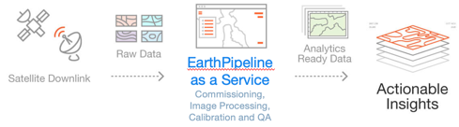
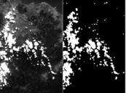

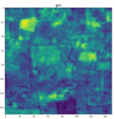
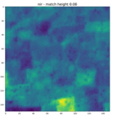
EarthDaily Constellation is Backed By World’s Most Advanced Ground Processing: EarthPipeline
The EarthPipeline provides automated cloud-based SaaS data processing to our Customers
The EarthPipeline Applies the Latest Breakthroughs in Computer Vision and Machine Learning to Remote Sensing
Accurate Cloud Masking Driven by Deep Learning
Image
Cloud
Mask
EarthPipeline automatically transforms raw downlinked data into Analysis Ready Data to power automated actionable insights
Proprietary computer vision algorithms ensure high-quality band registration even for challenging scenes and spectral bands
Raw Data
Analytics Ready Data

Slide 12

EarthPipeline is the Leading Cloud-Native Ground Segment Satellite Processing Technology
~$30M invested in over 8 years of development
US DoD Space Challenge winner - selected as one of 26 technologies, out of ~800 space companies, that are expected to revolutionize the space industry
Certified ISV SaaS solution within AWS and showcased by Microsoft
Backed by proprietary algorithms and several patents and leverages rigorous physical modelling and the latest advancements in computer vision and ML
Developed by team of experts who have worked on past world-class ground segments including the WorldView, RapidEye and RADARSAT-1/2 and RCM
Connects seamlessly with patented EarthPlatform data discovery, access and analytics engine
EarthPipeline
World’s only Ground Segment Pipeline Software as a Service

Slide 13
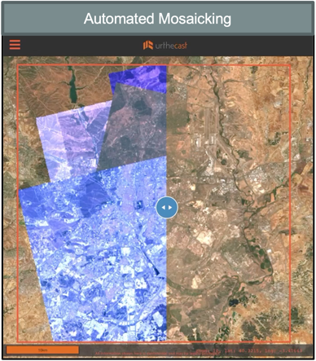
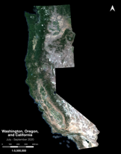
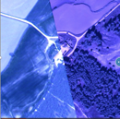
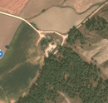
EarthMosaics: Powerful Tool for Large Scale Analytics
Analysis Ready Mosaics
Seamless large-area scale mosaics
Cloud, shadow, & haze free
Rapidly generated and ready for change detection and analytics
Uncorrected
(Geometric / Radiometric issues)
Corrected
(Analysis-ready)
13

Slide 14
EarthMosaics: Powerful Tool for Large Scale Analytics
Fire scars in Australia – using SWIR
Analysis Ready Mosaics
Can analyze broad fire impact with large-scale mosaics
14

Slide 15
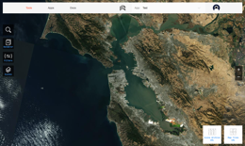

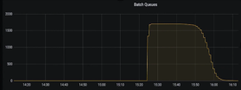
EarthPlatform: a Rich Set of Services
EarthPlatform’s cloud-based APIs, services and tools power a range of applications and derive insights
Areas of Interest
Archive
Analytics
Track and monitor points, lines or polygons
Unique ID used across EarthPlatform services
Global search engine for all archived products
Search by date, sensor, cloud coverage, season, sun angle and other metadata
Cloud based data lake – ready for analytics, no data transfer required
Cloud-based ML/AI tools available for use directly on Analytics Ready Data
Patented API based product delivery and on-the-fly analytics
Events & Subscriptions
Ordering
Platform Integration
Monitor activity over an AOI, e.g. new collected imagery
Download and ingest data products
Specify desired AOI and bands
Designed for developers and platform-to-platform integration
Easy to use APIs
Scalable on-demand cloud-based automated processing integration

Slide 16
EDA is a Software and Information Services Space Company
EarthDaily Analytics is positioned for rapid high-margin analytics growth leveraging the constellation’s unique enterprise grade imagery of the entire planet
Upstream Sector
Midstream
Analytics Sector
Agriculture
Environment
Satellites
Processing
Analytics
Insurance
Commodities
EDA Constellation generates a global, content-rich, proprietary dataset, updated every day
EarthPipeline
Cloud-based SaaS processing engine generates ultra-high quality image products at scale
EarthPlatform hosts Cloud-based APIs and services to drive insights across multiple verticals
Natural Resources
ESG
EarthDaily Analytics will provide highly automated, scalable, and profitable big data software and analytics B2B services, powered by a proprietary dataset, enabled by “best-in-class” upstream and midstream infrastructure

Slide 17
Thank you!
Contact me at: kbeckett@earthdaily.com

