Slide 1
JACIE 2022 and the future
Jan 13, 2022
Virtual Meeting
Greg Stensaas, U. S. Geological Survey, Earth Resources Observation and Science (EROS) Center, Sioux Falls, SD 57198
chanderson@usgs.gov / stensaas@usgs.gov
https://www.usgs.gov/land-resources/eros/calval;
https://www.usgs.gov/core-science-systems/nli/rca-eo
https://www.usgs.gov/core-science-systems/eros/calval/jacie

Slide 2
JACIE Team
JACIE information
  JACIE Web page - https://www.usgs.gov/core-science-systems/eros/calval/jacie
  Confluence Page - https://my.usgs.gov/confluence/
Membership
  Stakeholders: NASA - Kevin Murphy, Brad Doorn; NGA - Frank Avila; NOAA: Mitch Goldberg; NRO: Peter Muend, Jeremy Banik; USDA: Claire Boryan, Bob Tetrault; USGS: Tim Newman, Greg Snyder
  Management: NASA: Kurt Thome, NGA: Dave Case, Jim Vrabel, Christa Johnson; NOAA: Kevin Gallo, Changyong Cao; NRO: NEW , USDA: Dath Mita; USGS: Greg Stensaas, Cody Anderson, Kimberly Casey, Jon Christopherson
  Technical Team: Continues to grow, working on a more dedicated approach, need dedicated agency lists
  New JACIE Outreach and Collaboration and Administrator – Manaal Ali (USGS EROS TSSC – KBR)
Team enhancement and Integration planning
  Need help and discussion among stakeholders

Slide 3
20 years of JACIE
1st JACIE High-Resolution Commercial Satellite Imagery (CSI) Sensor Workshop - March 19-21, 2001 – Greenbelt, MD
  3 full days focused on IKONOS only
2nd JACIE High-Resolution Commercial Satellite Imagery (CSI) Sensor Workshop - March 25-27, 2001 – Reston, VA
  3 full days focused on IKONOS and a Quickbird-2 presentation
Past JACIE Information
  https://www.usgs.gov/calval/past-jacie-workshops.

Slide 4
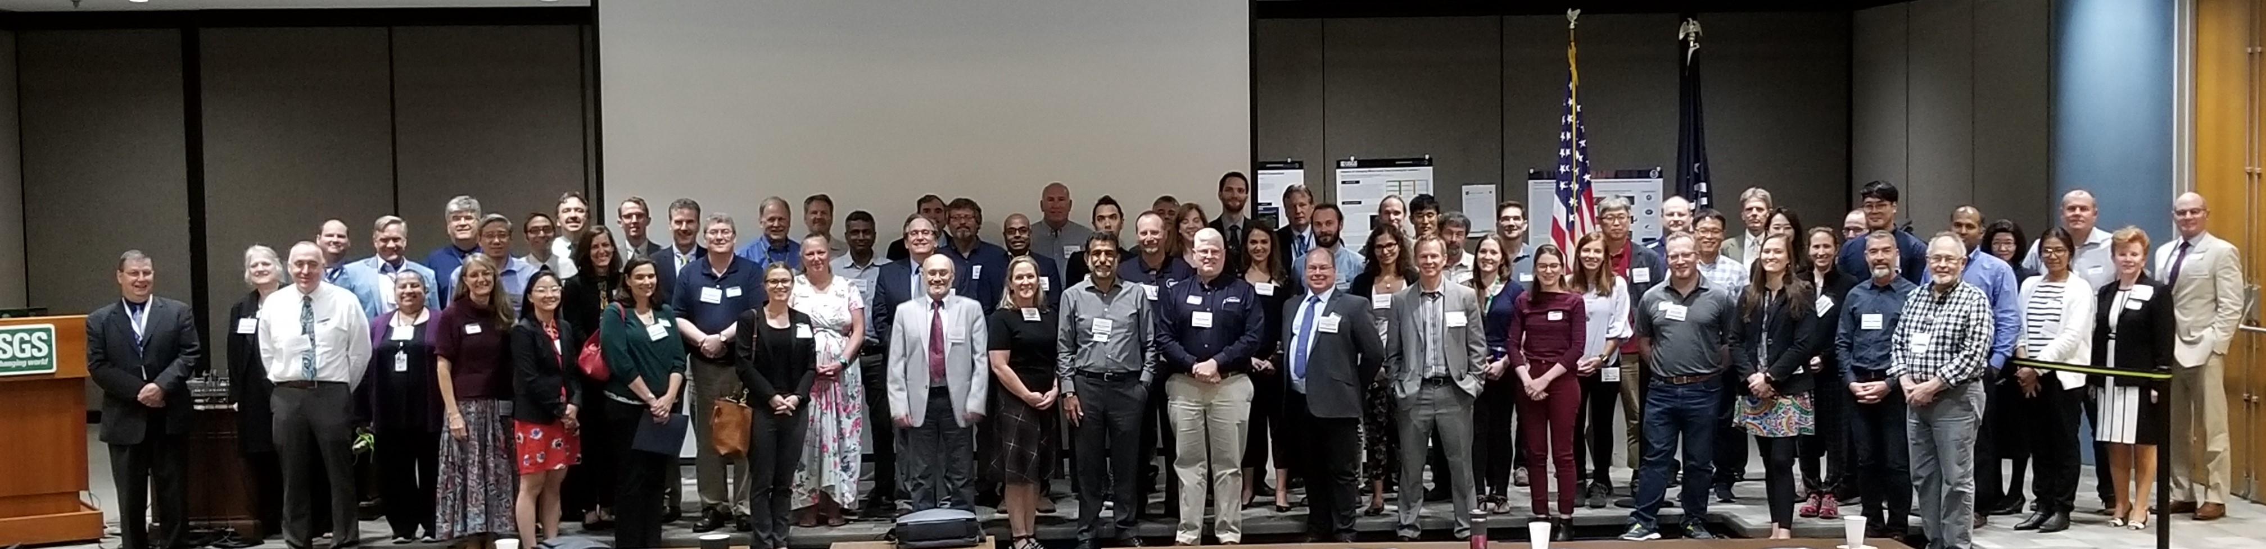
2019 JACIE 18th Annual Workshop
143 (free) registrants, 117 attendees
38 speakers
  17 Gov’t, 20 Commercial, 1 Educational
  33 from USA, 1ea from Australia, France, Italy, S.Korea, UK
  US Agencies: NASA, NGA, NOAA, NRO, State, USDA, USGS
  Foreign Gov’t: ESA-ESRIN, GeoScience Australia, KARI, NPL, CNES
  Commercial: I2R, KBR, L3Harris, Labsphere, MAXAR, Planet, Raytheon, SSAI
Good cross-section of remote sensing community
18th Joint Agency Commercial Imagery Evaluation (JACIE) Workshop – Sep 24-26, 2019

Slide 5
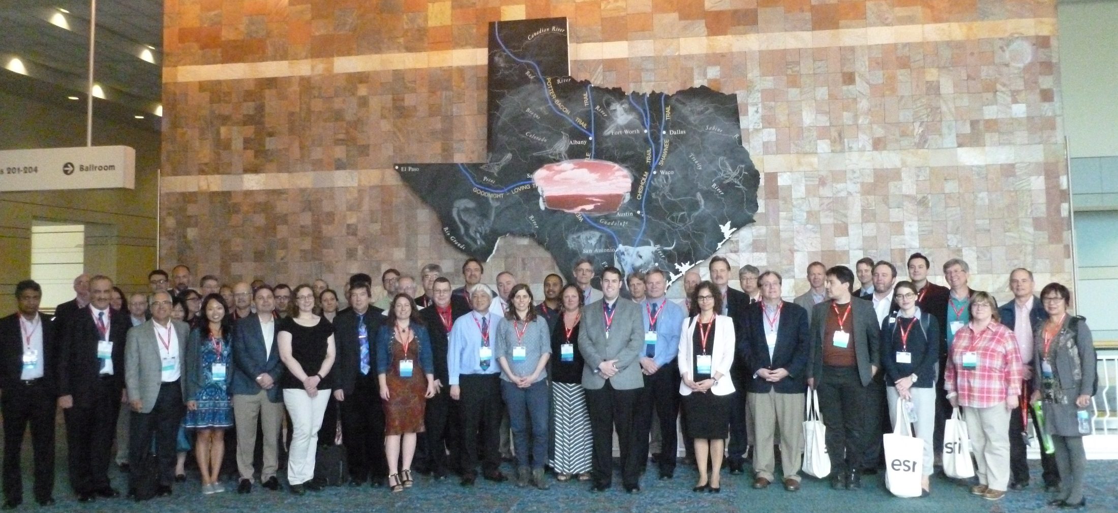
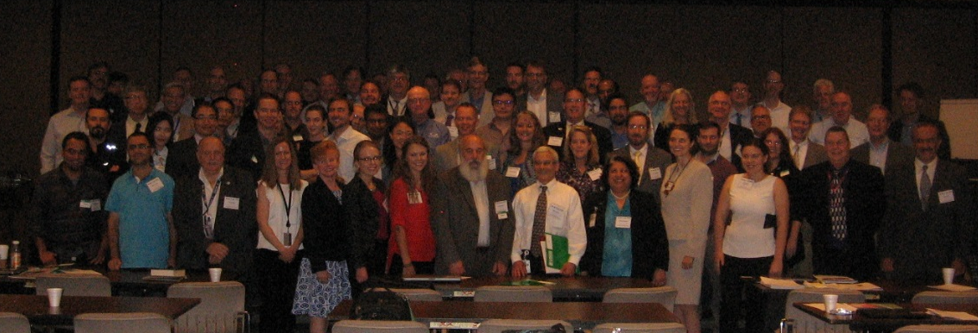
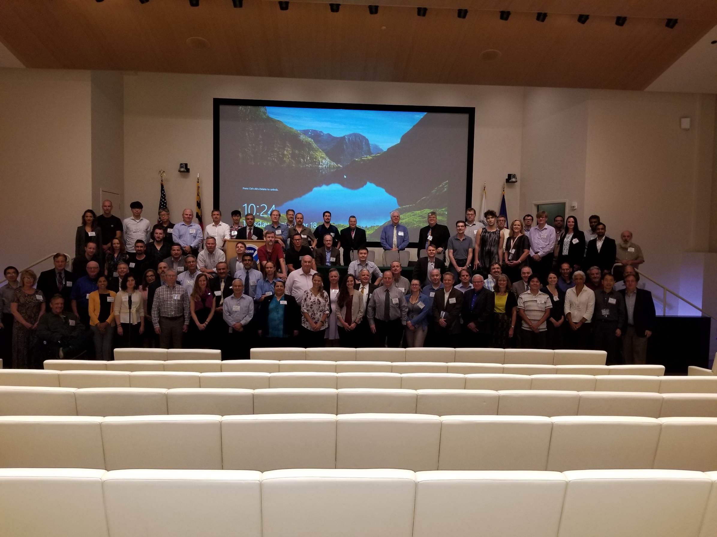
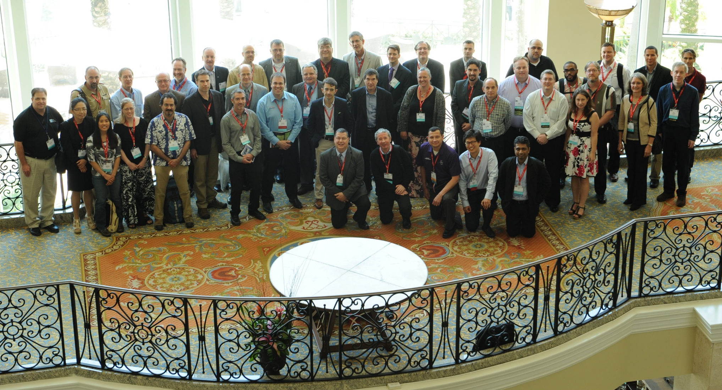
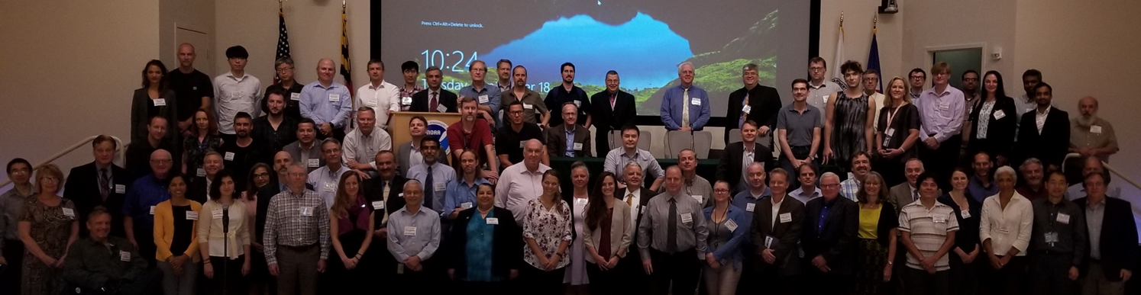
JACIE 2014 – Louisville, KY (ASPRS)
Grow and learn from the past
JACIE 2016 – Ft Worth, TX (ASPRS)
JACIE 2017 – Reston, VA (USGS)
JACIE 2015 – Tampa, FL (ASPRS)
JACIE 2018 – College Park, MD (NOAA)
JACIE 2018 – College Park, MD (NOAA)

Slide 6
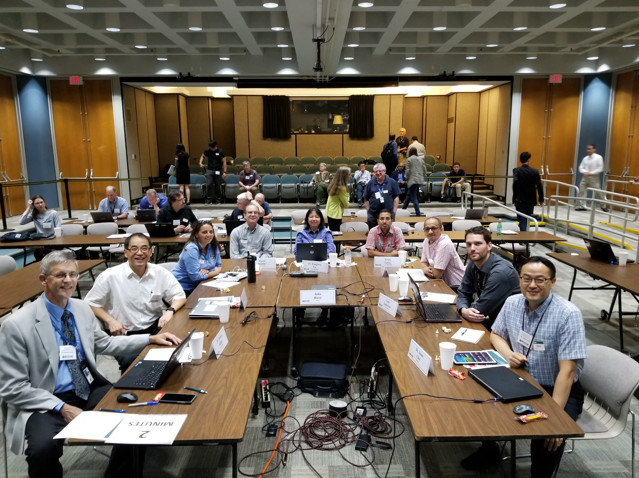
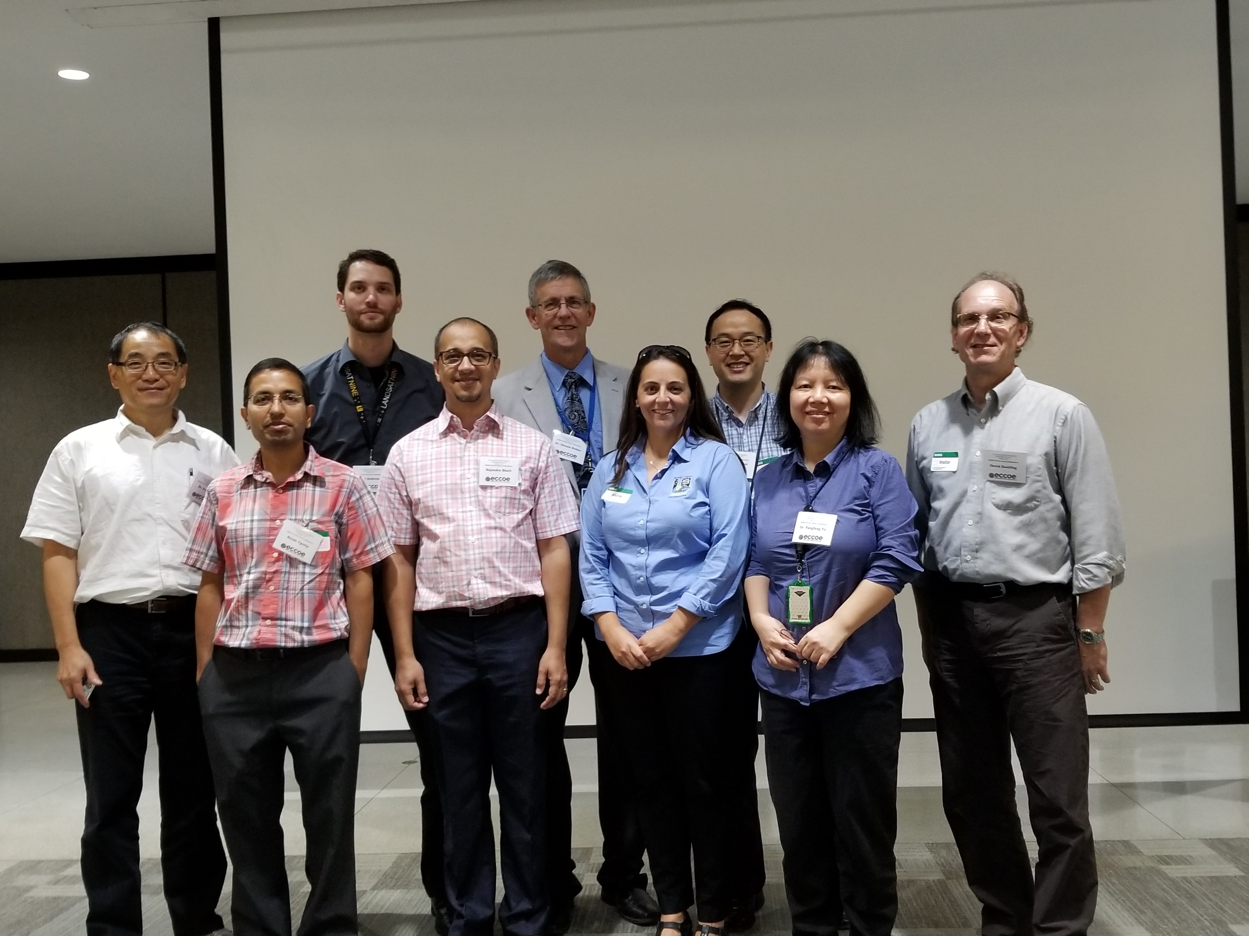
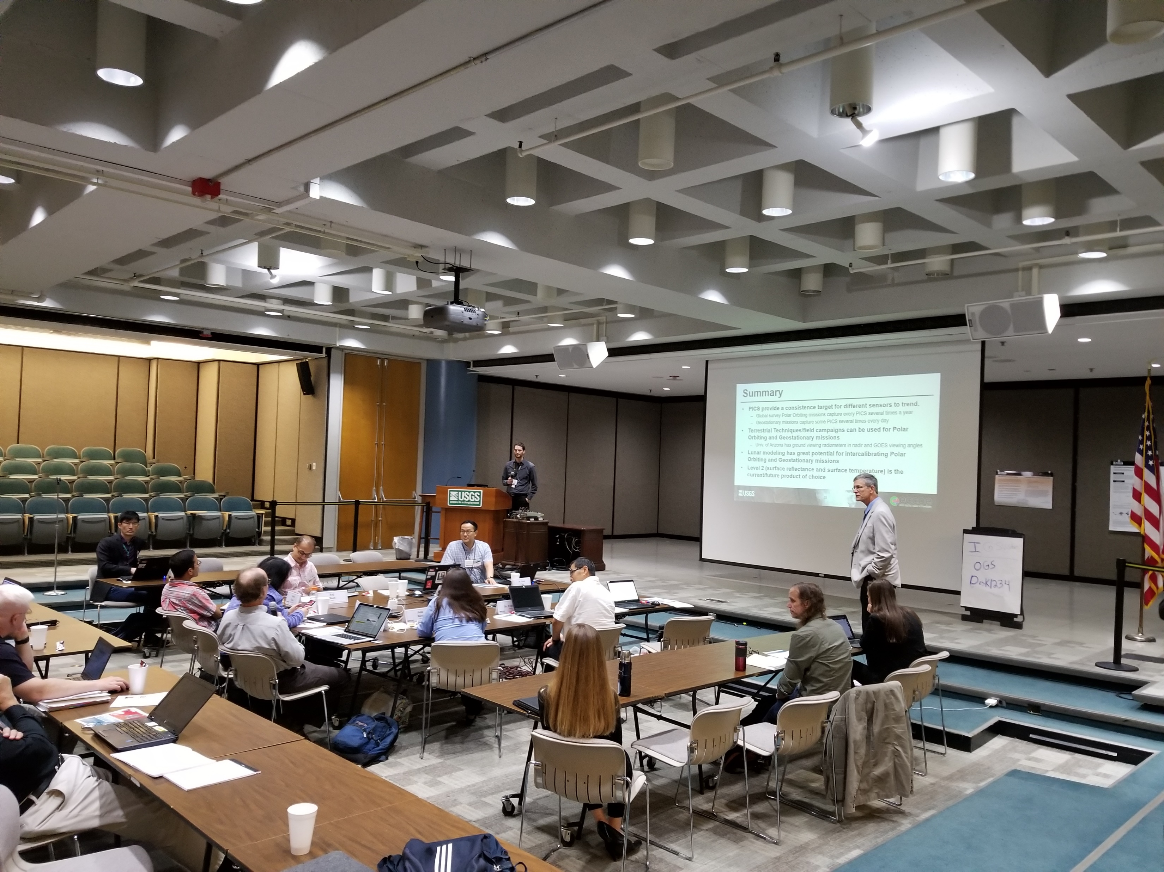
4th ECCOE Workshop on ARD/Interoperability this week
3rd EROS Calibration Center of Excellence (ECCOE) Workshop collocated with JACIE
  A focused “deep-dive” into a single calibration topic with invited speakers
  2019 Topic: “Calibrating Sun-synchronous and Geosynchronous Satellites: Sharing Best Practices”
50 (free) registrants, 40 attendees
Key findings:
  Consistent need for common processes and information
  Common well-defined Test sites
  Spectral – hyperspectral data
  Use of data at various scales
ECCOE Workshop Information
  https://www.usgs.gov/calval/eccoe-workshops
3rd EROS Cal/Val Center of Excellence (ECCOE) Workshop – Sep 23, 2019

Slide 7
ECCOE Workshops
2017- Observations and Recommendations for the Calibration of Landsat 8 OLI and Sentinel 2 MSI for Improved Data Interoperability
  https://www.mdpi.com/2072-4292/10/9/1340
2018 - Observations and Recommendations for Coordinated Calibration Activities of Government and Commercial Optical Satellite Systems
  https://www.mdpi.com/2072-4292/12/15/2468
2019 - Calibrating Geosynchronous and Polar Orbiting Satellites: Sharing Best Practices
  https://www.mdpi.com/2072-4292/12/17/2786
Future ECCOE workshop
  “Geometric Calibration: Achieving Interoperability Across Multiple Scales”
ECCOE Workshops seek to deep dive into advancing radiometric, geometric, and spatial characterization and calibration of optical remote sensing systems to improve the accuracy and precision of all derived data products

Slide 8
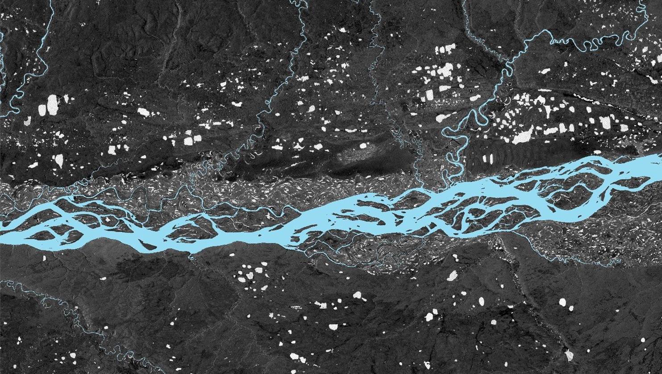



National Land Imaging Future Directions
Leveraging the diversity of Earth Observations to meet the Diverse Needs of Science & Operational Users
Improve Operational Capabilities
Enhance Research, Development and Innovation
Expand Product and Service Usability
Ensure Community Engagement
Compliments to Tim Newman and the NLIP for continuing to have the strong strategic vision for the need of calibration, data quality, JACIE and Interoperability
Landsat Next
Cross-Calibration of sensors
Hyperspectral Technology Investigations
International & Commercial Partnerships
Landsat 9
Sentinel/Landsat Ops & Data Harmonization Investigate new science and technologies
National Security Space Data & Services
Land Change Monitoring Assessment and Projection / EarthMAP Analysis Ready Data
Thoroughly understand user needs and capabilities available to meet them
Landsat 8 Flight & Ground Operations

Slide 9
USGS is committed to remote sensing data quality and JACIE
Landsat “gold standard heritage”
Aerial orthoimagery and camera calibration
Partnerships – US and International, Government, Academia and Industry
  JACIE, ASPRS/ISPRS, CEOS, GEO, NDOP, FGDC, ISO/TC211, …,
Established Cal/Val Center of Excellence at the USGS Earth Resources Observation and Science (EROS) Center - https://www.usgs.gov/calval

Slide 10
Combined Cal/Val/JACIE efforts and tools are important
Landsat Collection 2
  https://www.usgs.gov/core-science-systems/nli/landsat/landsat-collection-2
USGS-ASPRS Calibration Guidelines
RCA-EO analysis tools
  https://www.usgs.gov/core-science-systems/nli/rca-eo
Spectral Response Library / Spectral Response Comparison
  https://landsat.usgs.gov/spectral-characteristics-viewer
Digital Imagery Guideline
  https://www.usgs.gov/media/files/guide-digital-imagery-spatial-resolution
Land Product Characterization (LPCS)
  https://www.usgs.gov/centers/eros/science/land-product-characterization-system-lpcs
Updated Test Site Catalog
  https://calval.cr.usgs.gov/apps/test_sites_catalog
Lunar/ROLO
  https://astrogeology.usgs.gov/moon-cal/
Many other tools: Geospatial, Image to Image (I2I), and Band to Band (B2B) assessment tools; System Characterization tools, EROS Visualization (ELVIS) tool, Lidar Data Quality Measure (DQM) tool, …,

Slide 11
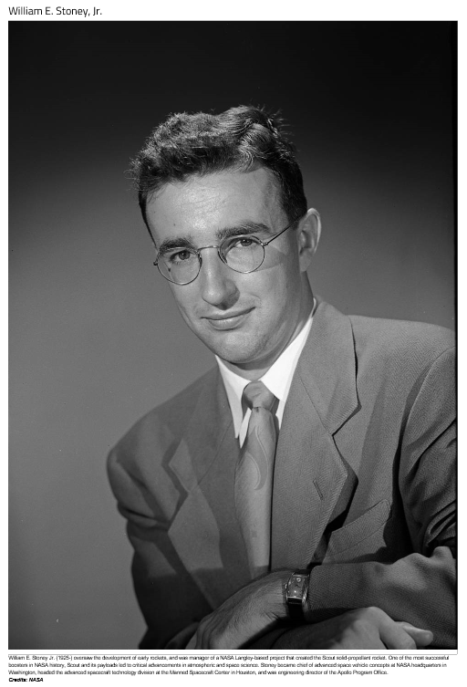
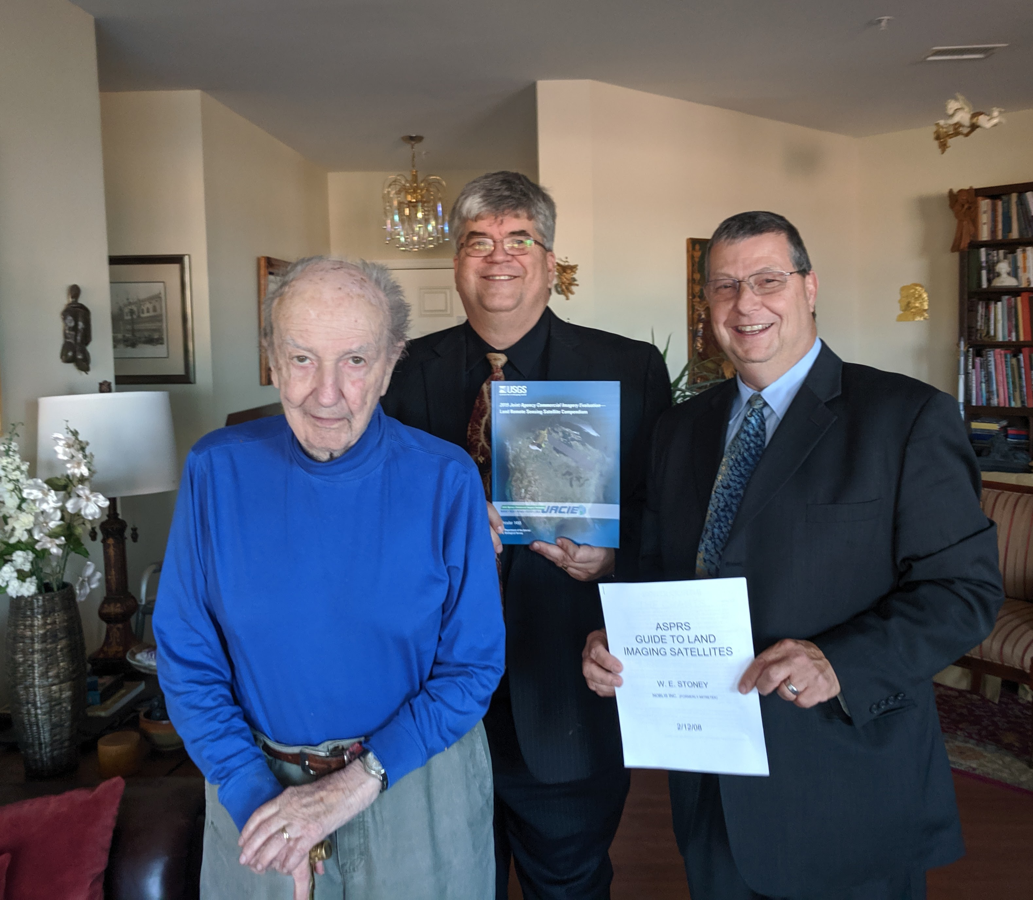
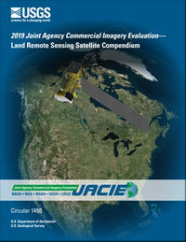
How to keep track of so many systems
William E. Stoney, "Bill“: https://www.nasa.gov/langley/100/ten-people-you-wish-you-met
1949: Started prior to NASA being called NASA, development of autonomous pilotless aircraft;
1961-1994: Led development of SCOUT rocket program;
Chief of Advanced Space Vehicle Concepts at NASA HQ
1963-1968:headed the Advanced Spacecraft Technology Division at the Manned Spaceflight Center, Houston
1968: Director of Engineering for the Apollo Program Office;
1969: Awarded the NASA Exceptional Service Medal for his work on Apollo.
1973: Director of NASA's Earth Observations Programs, including the Landsat series of satellites
After NASA, Bill maintained a list of all of the new remote sensing satellites, and he published it for ASPRS.
We were inspired to pick up the mantle he started, and we recently published the JACIE Compendium.
2019 and 2020 Joint Agency Commercial Imagery Evaluation (JACIE) Land Remote Sensing Satellite Compendiums: https://pubs.er.usgs.gov/publication/cir1455
Notes:
William E. Stoney, "Bill" --“Top Ten NASA People You Should Know”
Starting in 1949, before NASA was even named NASA, Bill worked on pilotless aircraft (a bit ahead of his time) , then led the development of the SCOUT rocket which, for 33 years from 1961 thru 1994, lofted satellites into orbit. Then Bill became Chief of Advanced Space Vehicle Concepts at NASA HQ, then headed the Advanced Spacecraft Technology Division at the Manned Spaceflight Center in Houston from 1963-1968. In 1968 Bill became Director of Engineering for the Apollo Program Office and in 1969 was awarded the NASA Exceptional Service Medal for his work on Apollo.
Then in 1973 Bill was named director of NASA's Earth Observations Programs, including the Landsat series of satellites, for which the USGS EROS was established.
We didn’t know any of that, having only known Bill after his retirement from NASA when he was still a remote sensing enthusiast. Bill maintained a list of all of the new remote sensing satellites being launched, the "Bill Stoney List”. After Bill stopped publishing his list a few years back, we were inspired to pick up the mantle he started, and we recently published the JACIE Land Remote Sensing Satellite Compendium.
Bill is now 94 years old and still quite a character. Today Greg Stensaas, Mike Choate, and Jon Christopherson got to call on Bill Stoney and give him his own copy of the JACIE Compendium while telling him how he had inspired its creation and how he continues to inspire us.
It was a good day.

Slide 12

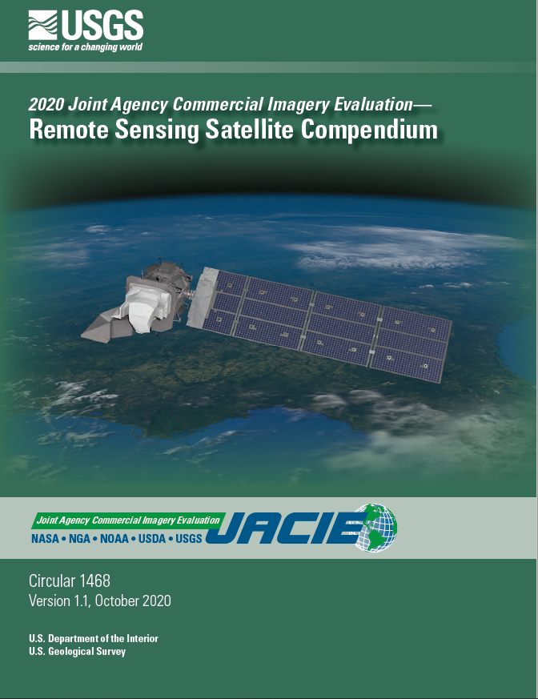
JACIE Satellite Compendium
2019 - First published
2020 - 2nd Edition
2021 - Online Compendium
  https://calval.cr.usgs.gov/apps/compendium
  Future print editions likely, but TBD
Published with JACIE Partners
2020 Compendium
  https://pubs.er.usgs.gov/publication/cir1468
  2019 Version:
    https://pubs.er.usgs.gov/publication/cir1455

Slide 13
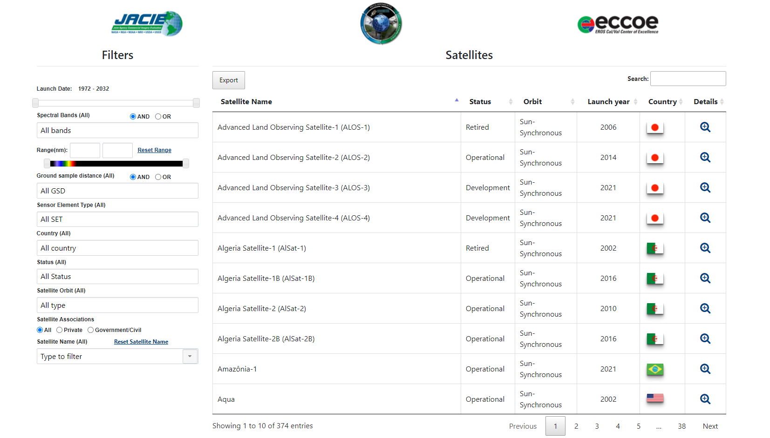
Online Compendium https://calval.cr.usgs.gov/apps/compendium
Information directly from EORES Database

Slide 14
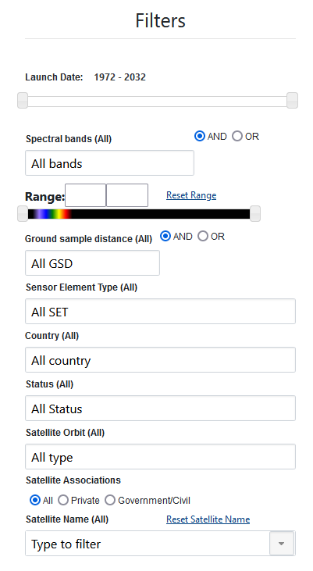
V2.0 compendium enhanced
Same satellite/sensor content
Expanded filtering and usability
Will filtering by:
  Spectra band type (Red-Edge, NIR, SWIR1, TIR, etc.)
  Spectral Range
  Country
  Sensor Type (Radiometer, thermal, hyperspectral...)
Always open to more suggestions & ideas!

Slide 15
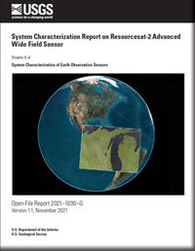
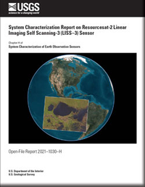
System Characterization
Underway for 20+ years now
  Began with JACIE efforts and IKONOS
  Measures Geometric, Radiometric, and Spatial performance
  Results delivered at annual JACIE Workshops
    PPTs online: https://www.usgs.gov/calval/past-jacie-workshops
Improved System Characterization Reports in 2020
  Now official USGS publications in Open File Report
  https://pubs.er.usgs.gov/publication/ofr20211030
  Looking at linking JACIE performance information into EORES
  How do we determine what systems to assess first?

Slide 16
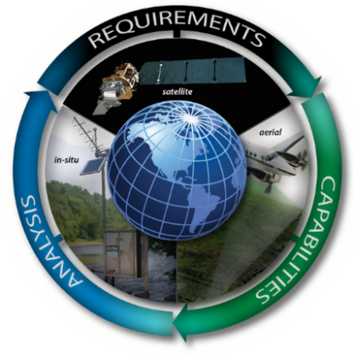
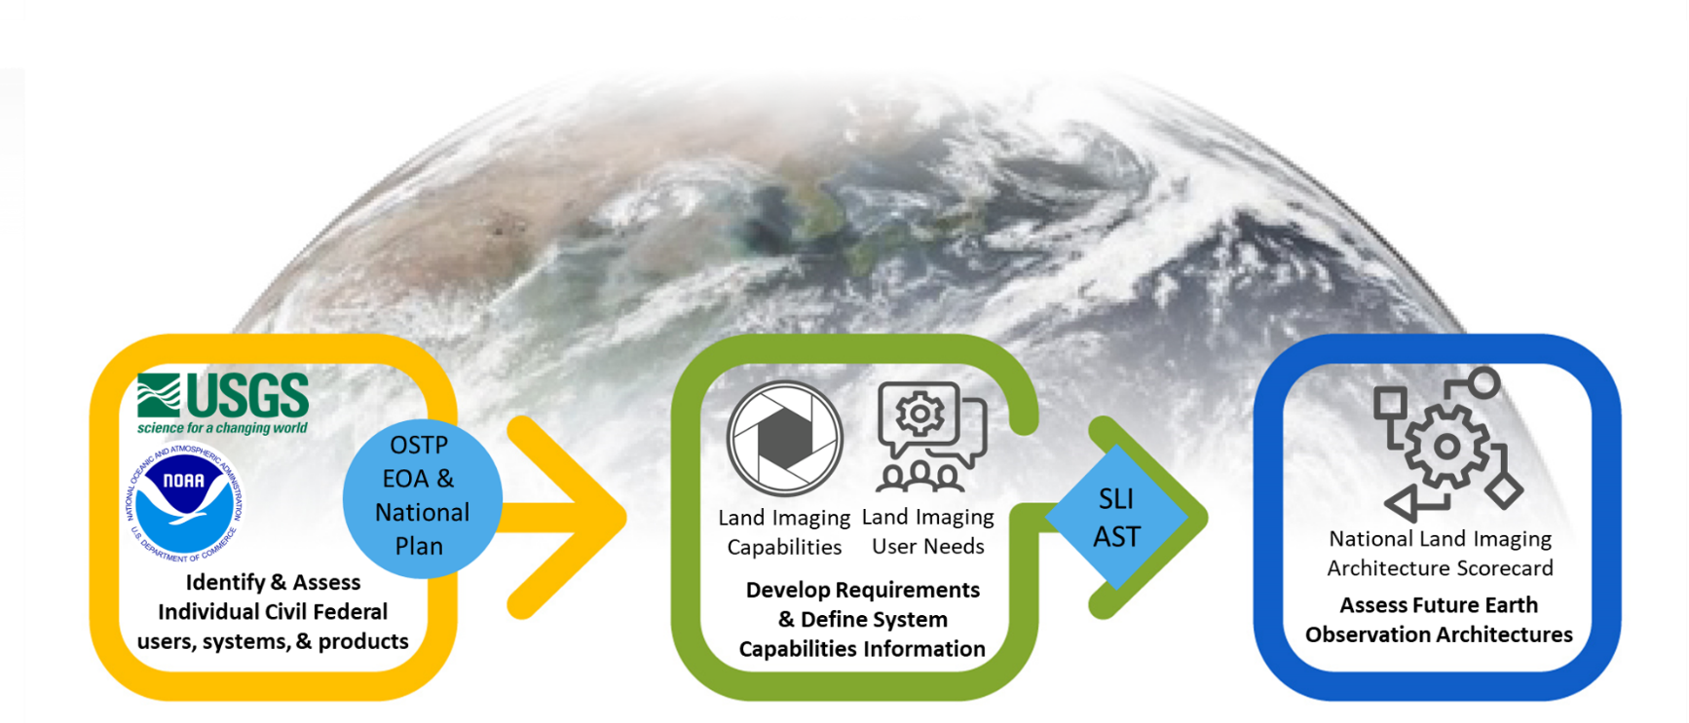
Requirements Capabilities and Analysis for Earth Observation (RCA-EO)
Earth Observation Requirements Evaluation System (EORES) and Analysis
Comprehensive list of Federal Civil EO product value, user requirements, capabilities, & associated analysis tools
https://www.usgs.gov/land-resources/nli/rca-eo
EORES
Requirements
Capabilities
Analysis
RCA-EO Process
Value
Tree
*
**
**
* Office of Science and Technology Policy Earth Observation Assessment
** Sustainable Land Imaging Architecture Study Team

Slide 17
Need common definitions and methods
JACIE Best Practices

Slide 18
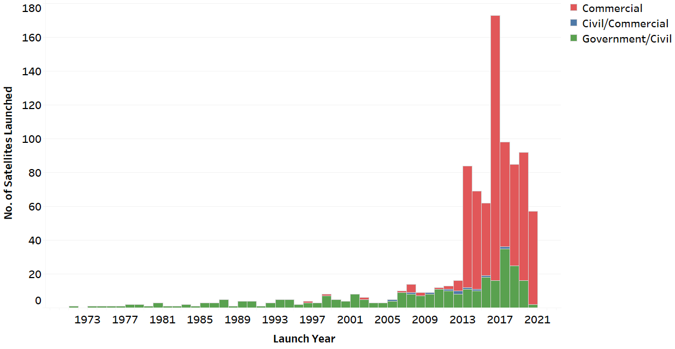
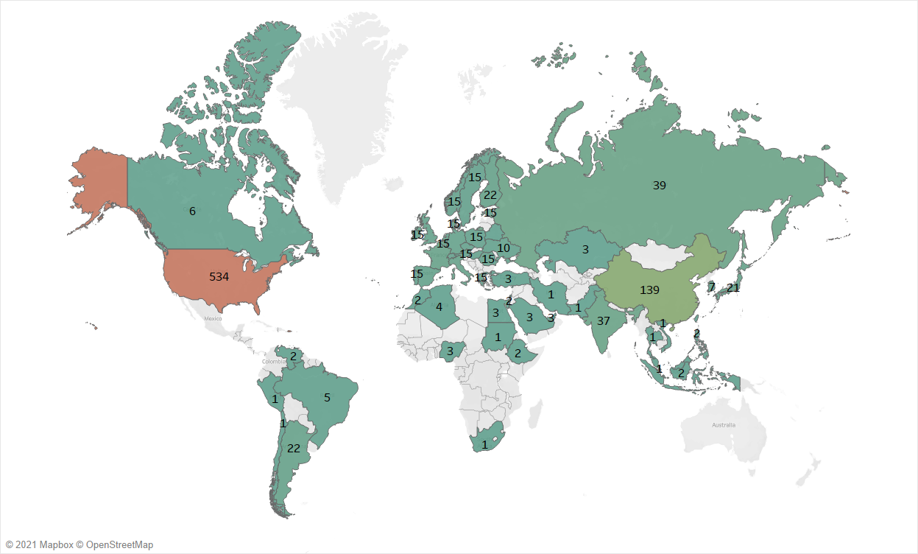
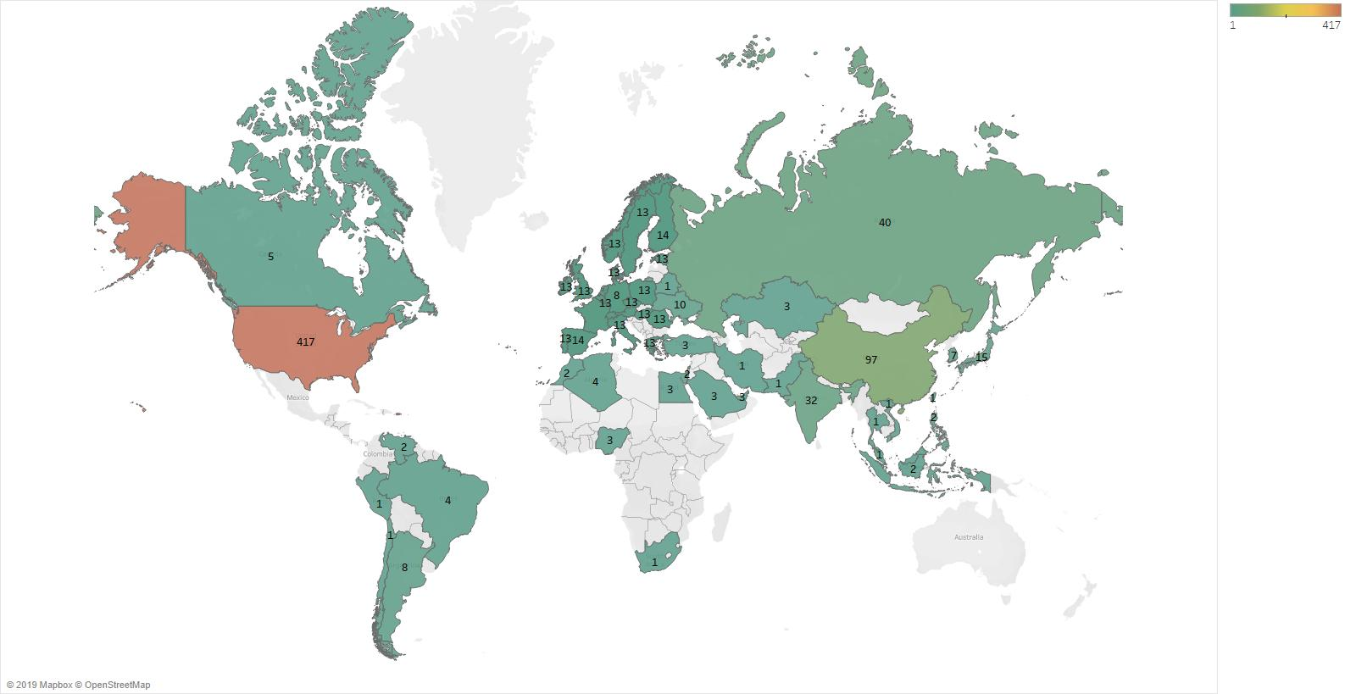
Remote Sensing is Growing, More data than ever, the World is changing
More satellites, greater coverage
Better temporal, spatial, spectral resolution
Over 50 countries with EO satellites
Commercial is growing fast
Land Imaging Optical Satellites

Slide 19
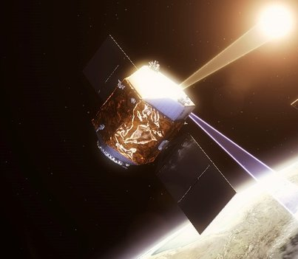
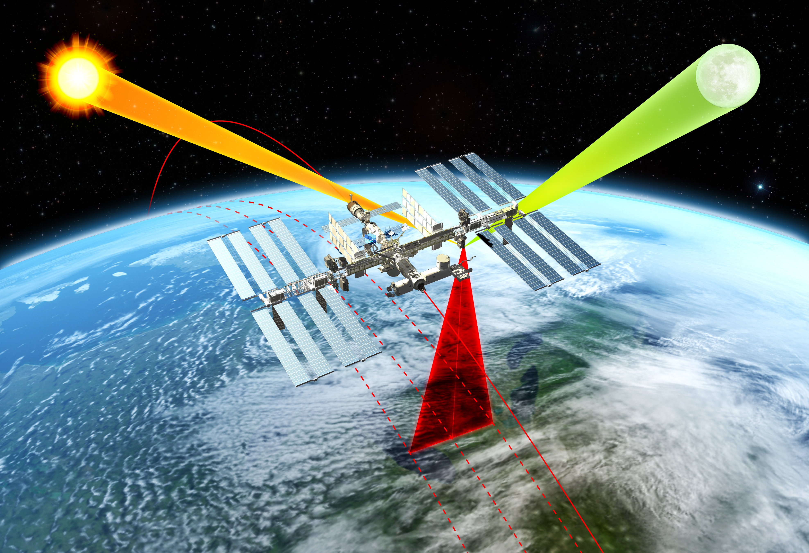
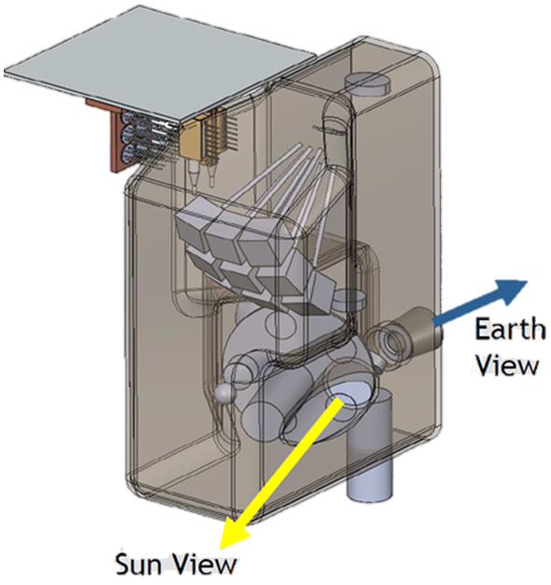
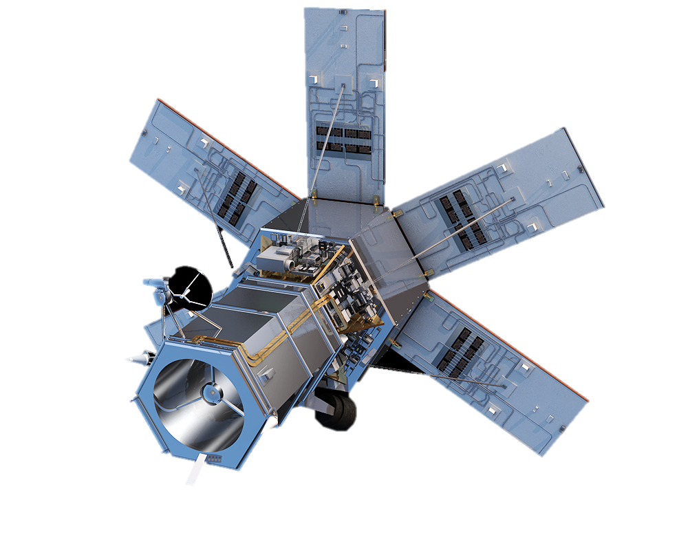
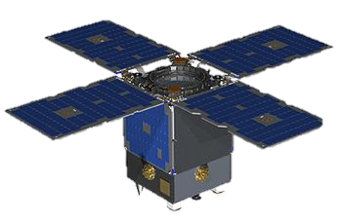
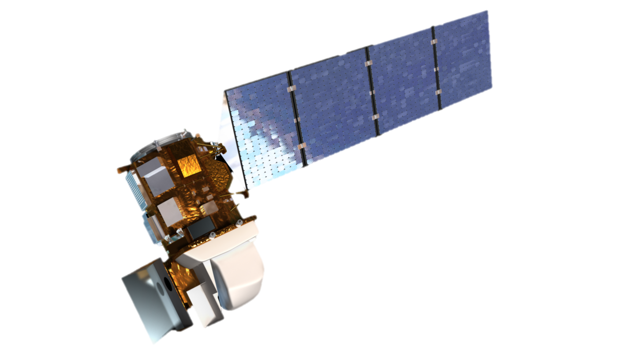
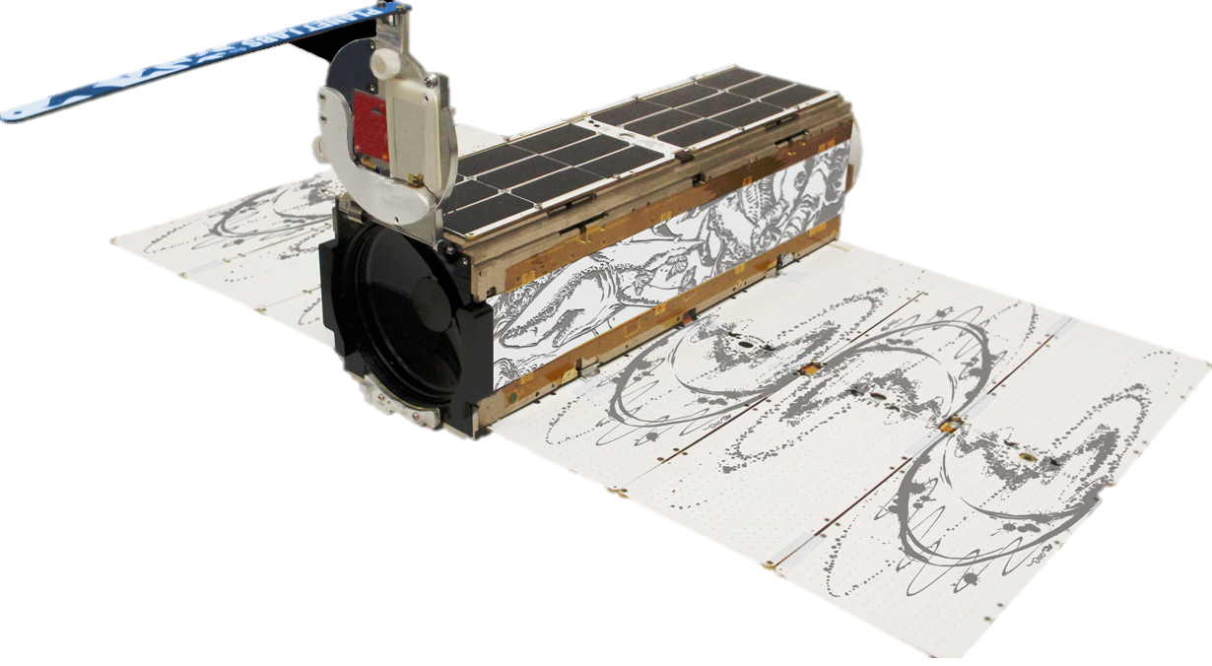
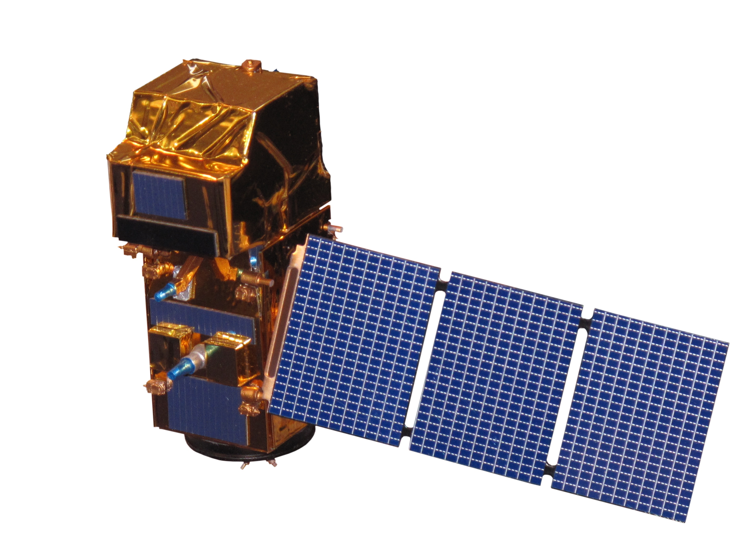
Satellite Cross-calibration Radiometer (SCR)
Well calibrated source, i.e., Landsat, Sentinel-2, future systems, …
Absolute Source –
complimentary calibration -
CLARREO Pathfinder & TRUTHS
Primary Calibration Layer
Transfer Calibration Layer
SCR
SCR
SCR
SCR
Imaging Layer

Slide 20
SCR is important
To understand and quantify optical imaging systems radiometric accuracy
Driven by user applications needs for harmonization of disaggregated systems
Look at current and future Australia studies and plans
  https://unsw.adfa.edu.au/sites/default/files/documents/GA_ASA_SCR_Public_2.pdf
  https://frontiersi.com.au/auscalval-report/
  Preliminary design concepts suggest small hyperspectral package, ‘low-cost’ instrument on smallsats
SCR provides needed transfer radiometry layer between TRUTHS/CLARREO and optical imaging systems
  Moves large observatories to greater absolute radiometric accuracy
  Particularly useful for systems with short lifetimes or poor stability
Huge benefit plus for conventional, smallsat and cubesat optical systems
Large interoperability data component to be able to create long term record of spectral radiometric differences of 100s of remote sensing systems

Slide 21
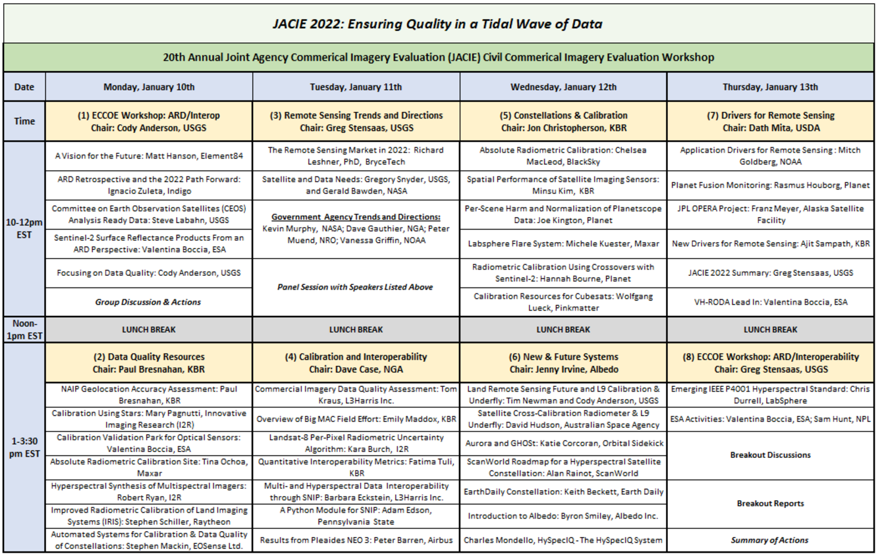
Agenda

Slide 22
Why is JACIE so important
Huge advances in sensor and platform technology
  Ability for anyone to have a system in space – Optical, SAR, Thermal, Hyperspectral, …
  Incredible airborne and in situ collects happening
  Multi-scale, Multi-sensor/platform, Multi-science interfaces
The information availability
  1) Storage, 2) Processing, 3) Data transport – network and data transfer solved
The next paradigm shift has been happening for years – but growth is now exponential
  Cloud integration/Machine learning
    data use and format changes,
    new large data-based methods
    calibration and data quality
    science process and products changes
Allowing science that we have not been able to do before!
Notes:
SDSMT – 2008 – 5 nm microprobes
UAS and miniaturization sensors

Slide 23
JACIE Workshop Take-aways
JACIE is seeing a strong driving focus to data cubes, sensor and data fusion, and enhancement of Analysis Ready Data (ARD).
  JACIE needs to help technically advance the ARD and interoperability definitions.
  Strong driving focus to data cubes, sensor and data fusion, and enhancement of ARD and new variations of ARD
JACIE and ECCOE Workshop is a great follow-up to the Analysis Ready Data (ARD) 21 Workshop
  Many presentations from payloads to data fusion and interoperability.
  https://www.ard.zone/
  JACIE will be posting a summary document with survey results by end of the month.
20th JACIE Civil Commercial Imagery Evaluation Workshop will be followed by VH-RODA and ARD Workshops

Slide 24
JACIE success for the future
Continue focus on calibration and data quality
Don’t forgot:
  Engineering Measurement 101 - measurement = (best estimate ± uncertainty) units
Define best practices, test sites, services, and methods
Define baseline fields for common human and machine use
Understand integration into big data calibration techniques
Utilize ML/AI as a friend
  there are 100s of widgets and tools and soon to be 1000s; use and build on them
  Understand the impacts and advantages of integrated data and Interoperability
Support calibration systems; CPF, TRUTHS, SCR, FLARE, RadCalNet, PICS, etc., …
Continued collaboration, make needs known, group needs are strong

Slide 25

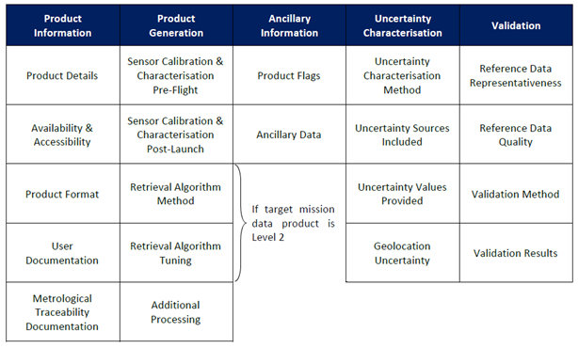
Collaboration on Workshops
Very High-resolution Radar and Optical Data Assessment (VH-RODA)
  ESA VH-RODA is a European version of JACIE, https://earth.esa.int/web/guest/content/-/article/vh-roda-very-high-resolution-radar-optical-data-assessment-workshop
  Global community working quality and
  interoperability common definitions
ESA’s Earthnet Data Assessment Pilot (EDAP) https://earth.esa.int/web/sppa/activities/edap
Maturity matrix began at NOAA – John Bates, moved to CEOS WGC and into CEOS WGCV and ESA
Notes:
JACIE 2020 Topics include:
Calibration methods, techniques, and tools
Calibration Test Sites, Reference Datasets, and other resources
Calibration of operating and future missions
Radiometric, Geometric, and Spatial Characterization
Cross Calibration, Fields campaigns, and other validation methods
Product Validation methods and results
Artificial Intelligence and other ideas for future Calibration/Validation
Interoperability, Harmonization, and Analysis Ready Data (ARD): Working with multi-source data

Slide 26
Follow the community needs
Breakouts Sessions for JACIE ECCOE ARD/Interoperability Workshop on Thursday
Calibration, data quality, and accuracy and traceable uncertainty.
Lead/Facilitators: Cody Anderson / Valentina Boccia, Arin Jumpasut (Planet), Nigel Fox (NPL), Jon Christopherson (KBR), Brandon Russell (Labsphere), Bob Ryan (I2R)
2. Implementation for Geospatial Workflows – machine learning, metadata, software, and tools.
Lead/Facilitators: Speaker: Ignacio Zuleta (Indigo) / Pete Doucette (USGS), Fabio Pacifici (Maxar), Jim Vrabel (KBR), Wolfgang Luck (Pink Matter), Chris Rampersad (EarthDaily Analytics), Matthias Mohr (UNIVERSITY OF MÜNSTER / Radiant Earth), Ajit Sampath (KBR)
3. Governance and Leadership of ARD/Interoperability - Definition, Distinction, and Standards.
Lead/Facilitators: Matt Hanson (Element84) / Ferran Gascon (ESA), Steven Labahn (USGS), Greg Stensaas (USGS), Chris Durell (Labsphere), David Case (NGA), Medhavy Thankappan (Geoscience Australia), Michele Kuester (Maxar), Mary Pagnutti (I2R), George Percivall (IEEE)

Slide 27
The Real Success of JACIE
Continue to collaborate and surround yourself with the best system engineers and scientists (the JACIE experts)
  The experts: remote sensing system developers, Cal/Val and data quality engineers and scientists, and remote sensing data users
That is, YOU! The group of people who attend JACIE!
  You, make things happen
  You, are driven ensure the data is right
  You, are driven to make sure the data meets the need
  You, are part of the large JACIE team (community) who can be heard
  You, are the success of JACIE!
Keep up the good work!

Slide 28
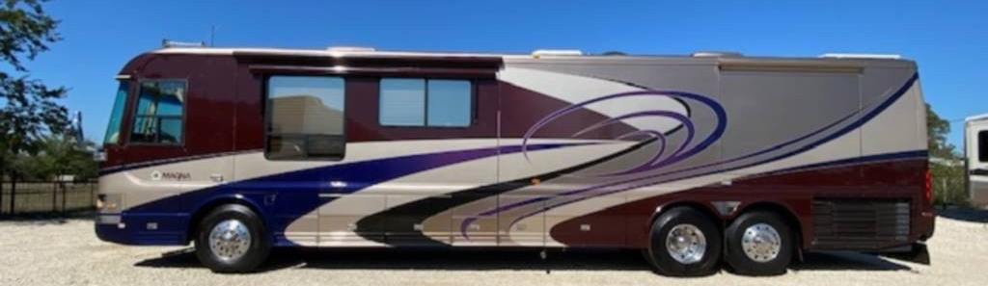
Greg’s future
There is rumor that I am going to retire from a career that focused on data quality after 38 years
  Government Service - 32 years
  16 JACIE Workshops out of 20 since 2004
That rumor is true, I am retiring in May this year
  I will help out as a retired emeritus with USGS
  I am sure you will see me once in awhile; maybe from a new office ☺
Thank you, JACIE friends and experts, you are the best!
New Office
after May

Slide 29
thanks
Thank you!

Slide 30
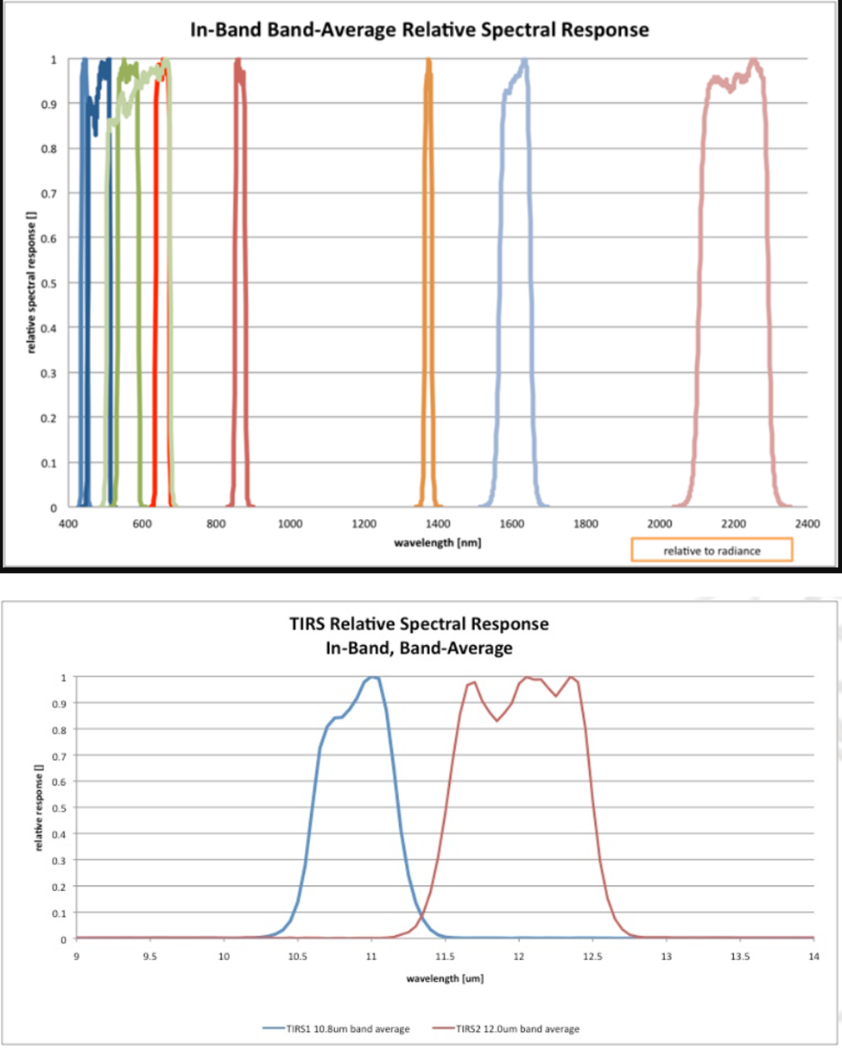
System Characterization
Contains all info in EOS, plus....
  Processing levels
  Compression, corrections, etc.
  Performance
Data access portal Planned for:
  Radiometric Resolution (bit depth)
  Signal-to-Noise Ratio (SNR)
Attached
  Relative Spectral Response (RSRs)
Other Information can be appended in EOS notes
  Geodetic accuracy
  Band-to-Band

