Slide 1





































Status of the IEEE P4001 Working Group for
Standardization in Hyperspectral Imaging
Christopher Durell, Labsphere Inc.
Dr. Torbjørn Skauli, University of Oslo & Norwegian Defense Research Establishment (FFI)
Dr. John R. Gilchrist, Clyde Hyperspectral Imaging & Technology Ltd

Slide 2
Why a hyperspectral imaging standard?
Wide and growing range of applications
Rapidly growing market
Large and growing range of hyperspectral camera types
(incl. compact, lower cost, innovative designs)
Wide span of use cases: remote sensing, field, UAV, lab, industry, medical, ...
The P4001 standard aims to be a common reference frame
for the growing range of users

Slide 3
IEEE Standards Development Process
The IEEE Geoscience and Remote Sensing Society (GRSS) Standards Committee
  Operates under the IEEE Standards Association (IEEE SA) policies and procedures
  Closely aligned with the GRSS Standards for Earth Observations (GSEO) Technical Committee
Development is carried out in Projects initiated by Working Groups (WGs)
  WGs and Sub-WGs operate under a Policy and Procedures document
  Openness and fairness is paramount
Membership
  Anyone can participate → Unlimited number of voting members
  Join the group to have your voice heard
  Voting members need to register in IEEE myProjects (no cost)
  Must join IEEE Standard Association (SA) to be a Project officer

Slide 4
IEEE P4001 WG status January 2022
240 members, 39 Voting Members, with usually >33+ meeting attendees
Manufacturers, users, government labs, and academia represented
Links to other standard groups: EMVA 1288, ISO 19124-1 TC211, SNIP and IEEE P4005
30 meetings held – Trying to meet every 4-6 weeks, plus weekly sub-group meetings
Timeline completed as of Dec 31, 2021: 12 month extension requested
Officers:
  Chair: John Gilchrist, Clyde HSI & Technology
  Co-Chair: Torbjorn Skauli, Univ. of Oslo and FFI
  Secretary: Chris Durell, Labsphere
  Webmaster: Alex Fong, Hinalea Imaging
  GRSS Chair: Dr. Siri Jodha Khalsa, National Snow and Ice Data Center
P4001 Website: https://sagroups.ieee.org/sagroups-hyperspectral/

Slide 5
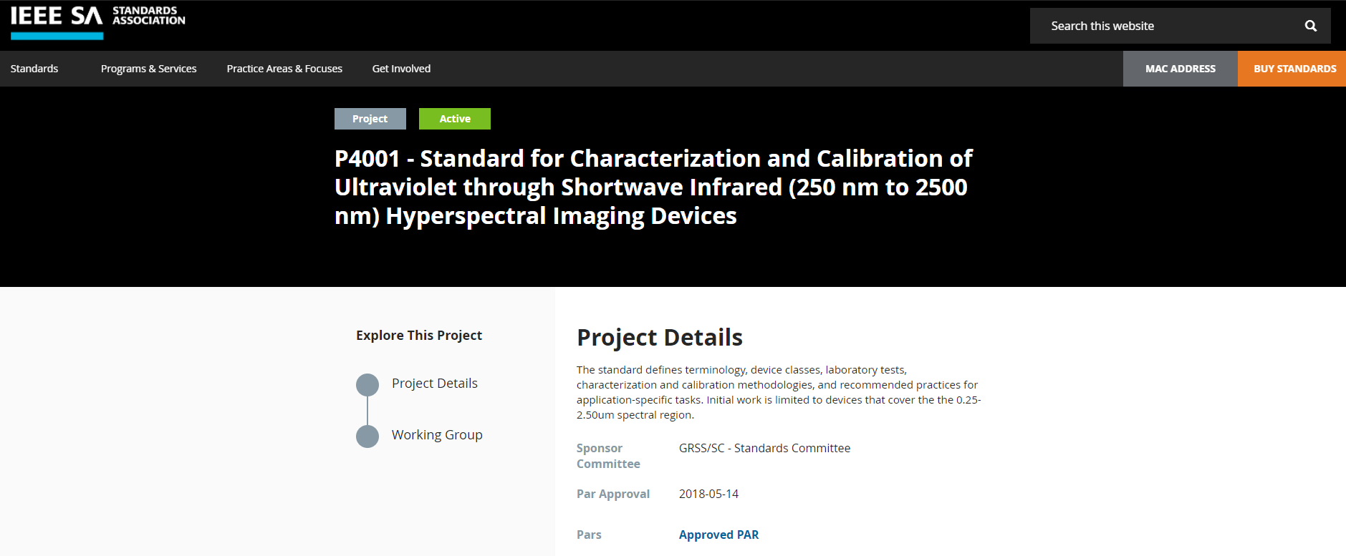
An ambitious charter
https://standards.ieee.org/project/4001.html

Slide 6
P4001: A many-faceted effort
Camera performance characteristics
Test methods
Use cases
Data and metadata
Terminology

Slide 7
Camera characteristics - principles
Camera characterized as a "black box"
Enables comparison between camera types
Need to identify adequate and appropriate
characteristics for a "black box" camera
Characteristics defined as physical quantities
(rather than results of a particular test method)
Recognizing that hyperspectral imaging is imaging spectroscopy
(leads to somewhat different characteristics than for imaging of spatial contrast)
Spec should convey the actual performance
All aspects of performance to be covered
Worst-case values should be included
Input
light
Output data
Entrance aperture
plane
A black box camera

Slide 8
Extensive set of characteristics needed
Spatial: resolution, field of view, geometric accuracy
Spectral: resolution,spectral range, wavelength accuracy
Radiometric: light collection, noise, dynamic range, radiometric accuracy
Coregistration: spatial, spectral, temporal, and interdependencies
Stray light: spatial and spectral
Imperfections: dead pixels, polarization dependence, nonlinearity, ...
Other: SWaP, environmental, interface, ...

Slide 9

Example: Spatial resolution characteristics
Because we do spectroscopy:
  Emphasize spectral purity rather than preservation of spatial contrast
Enclosed energy: weight of nominal pixel
area in the spectrum
Effective number of pixels: sum of enclosed
energy over all pixels
Additional characteristics for spatial resolution
are still open for discussion, possibly:
  CIE 233 definition of effective FWHM (less sensitive to peak shape)
  4-sigma diameter (sensitive to extent of PSF tails)
Enclosed
energy
Enclosed
energy
SPSF
effective
FWHM
SPSF
SPSF
FWHM
Tails
Pixels
Pixels
Pixels
Point spread function for a pixel
(illustration in 1D)

Slide 10
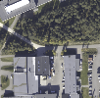
Example: Spatial coregistration characteristic
Because we do spectroscopy:
  Integrity of the spectral shape is paramount
Normal assumption: all bands see
the same pixel area
Optimal coregistration
Point spread function
of a pixel

Slide 11
Example: Spatial coregistration characteristic
Because we do spectroscopy:
  Integrity of the spectral shape is paramount
Reality: bands do not overlap, but differ in
  offset (=keystone)
  sharpness
  PSF shape
→ Generalized characteristic for coregistration error
Coregistration error
Point spread function
of a pixel

Slide 12
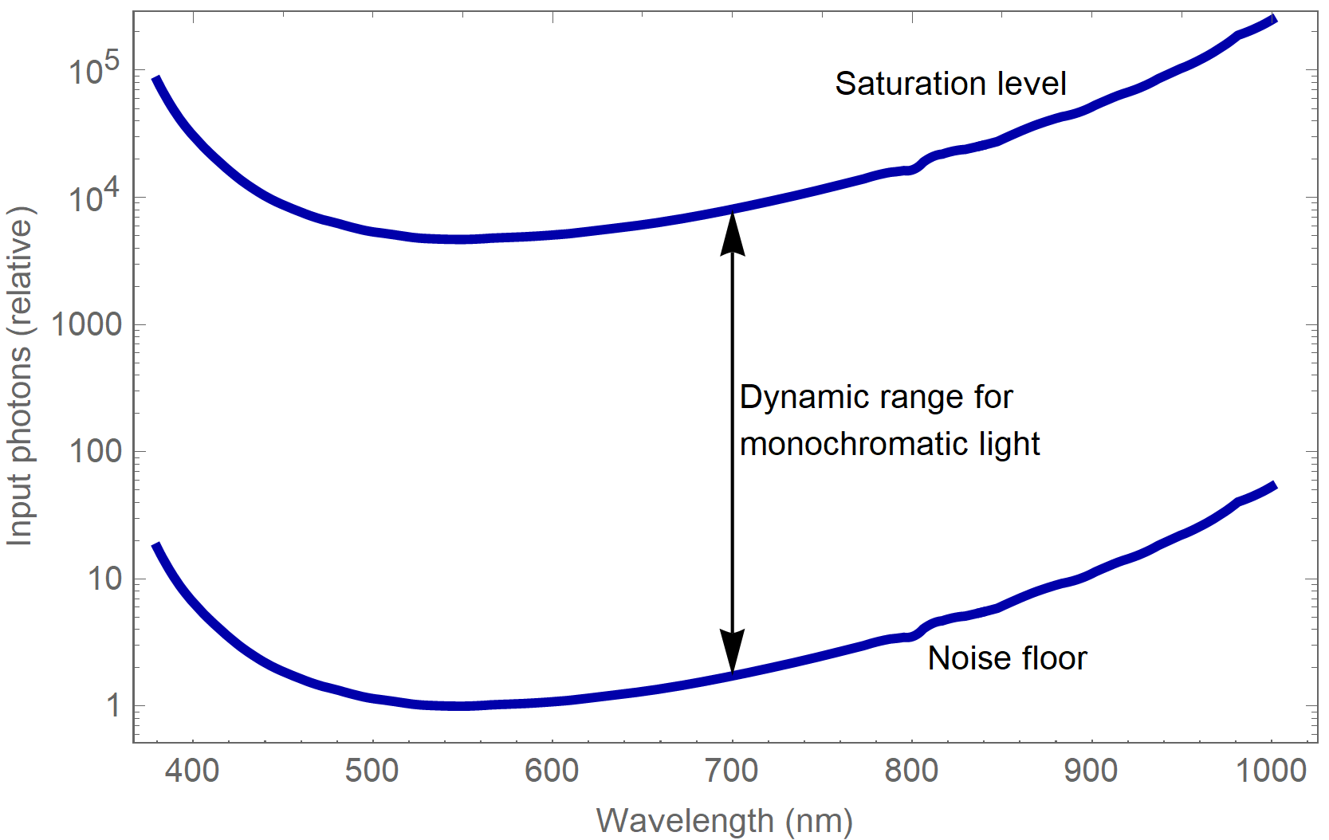
Example: Dynamic range characteristic
Because we do spectroscopy:
  Illumination and sensitivity varies across spectral range
Nominal dynamic range: from
noise floor to saturation
Noise floor and saturation level (example case)

Slide 13
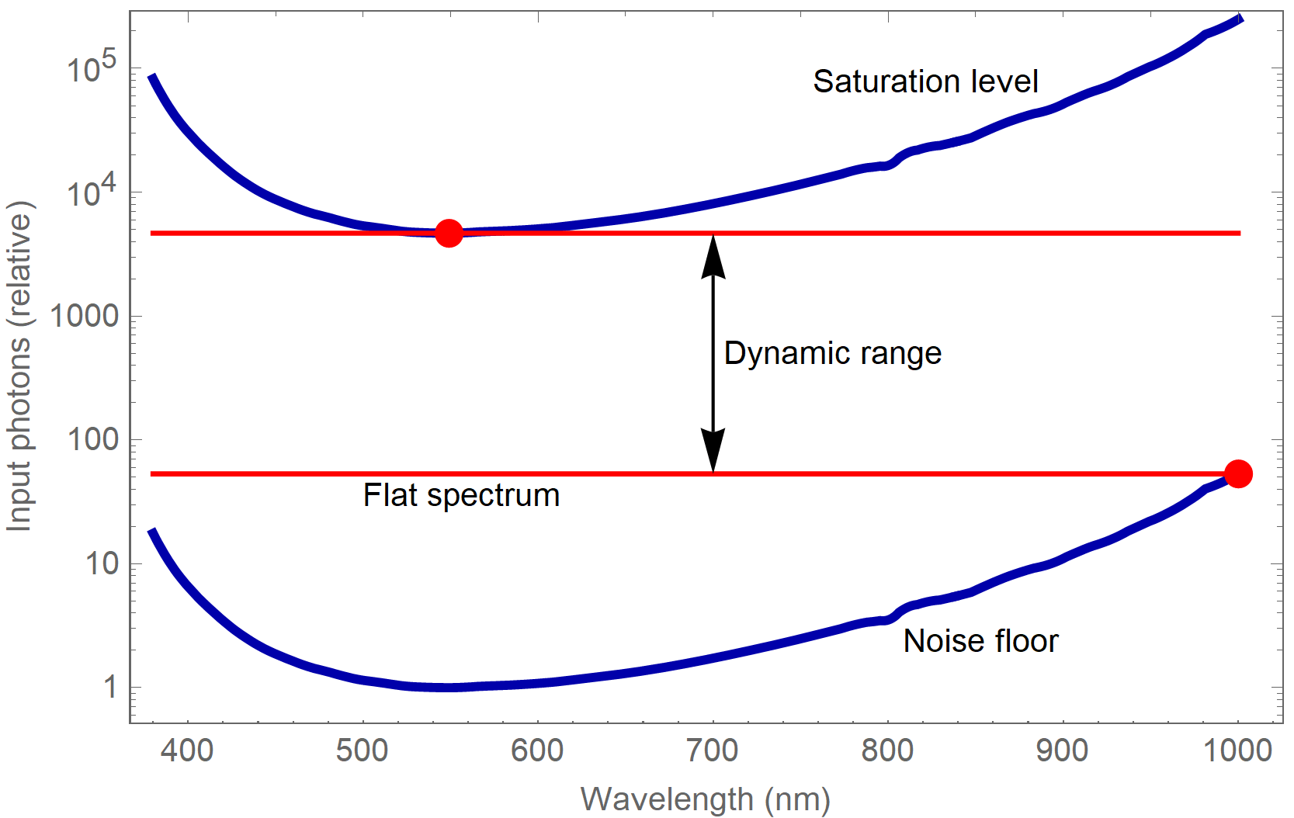
Example: Dynamic range characteristic
Because we do spectroscopy:
  Illumination and sensitivity varies across spectral range
Noise floor and saturation vary
across spectral range
Noise floor and saturation level (example case)

Slide 14
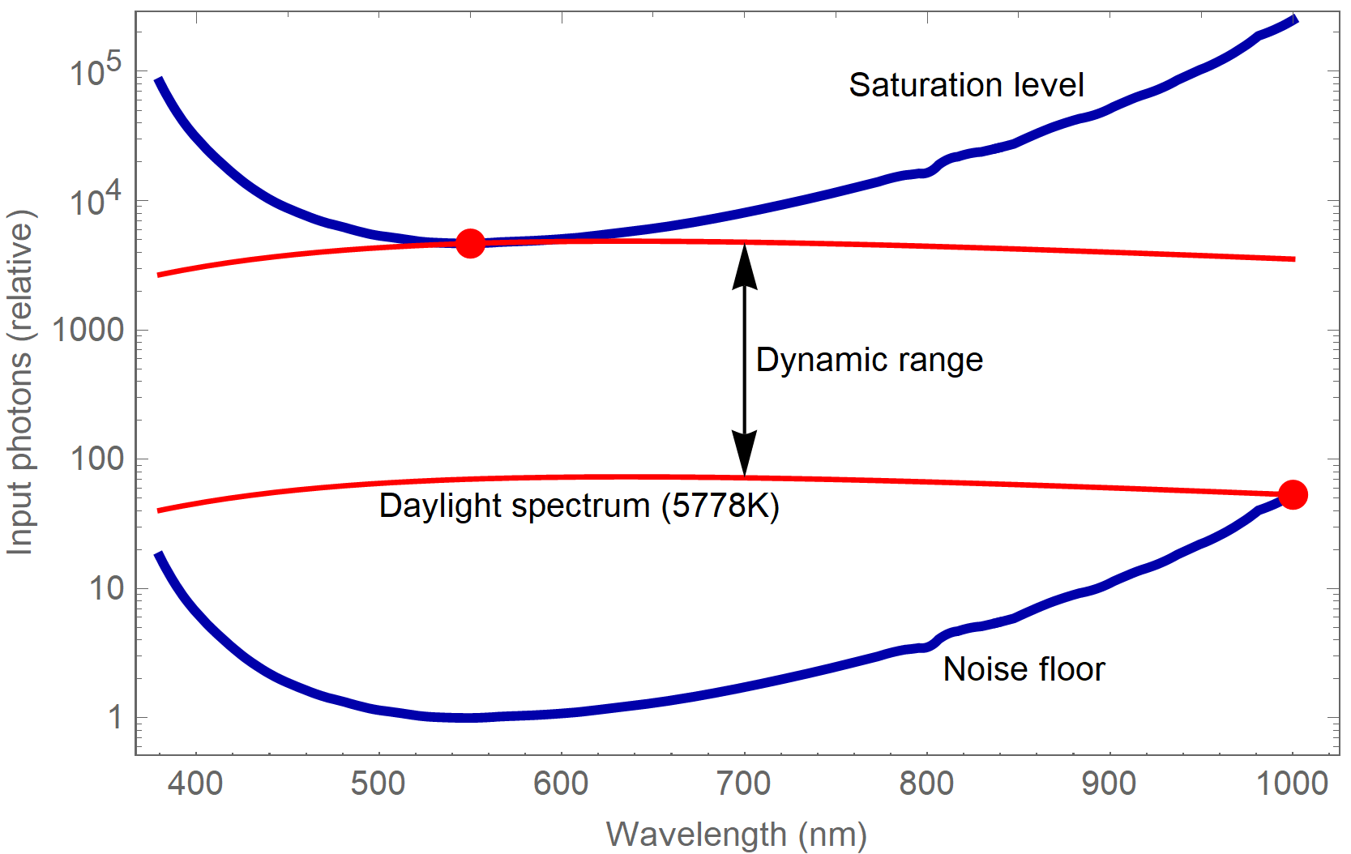
Example: Dynamic range characteristic
Because we do spectroscopy:
  Illumination and sensitivity varies across spectral range
For a given illumination: what is the
possible range of variation?
Noise floor and saturation level (example case)

Slide 15
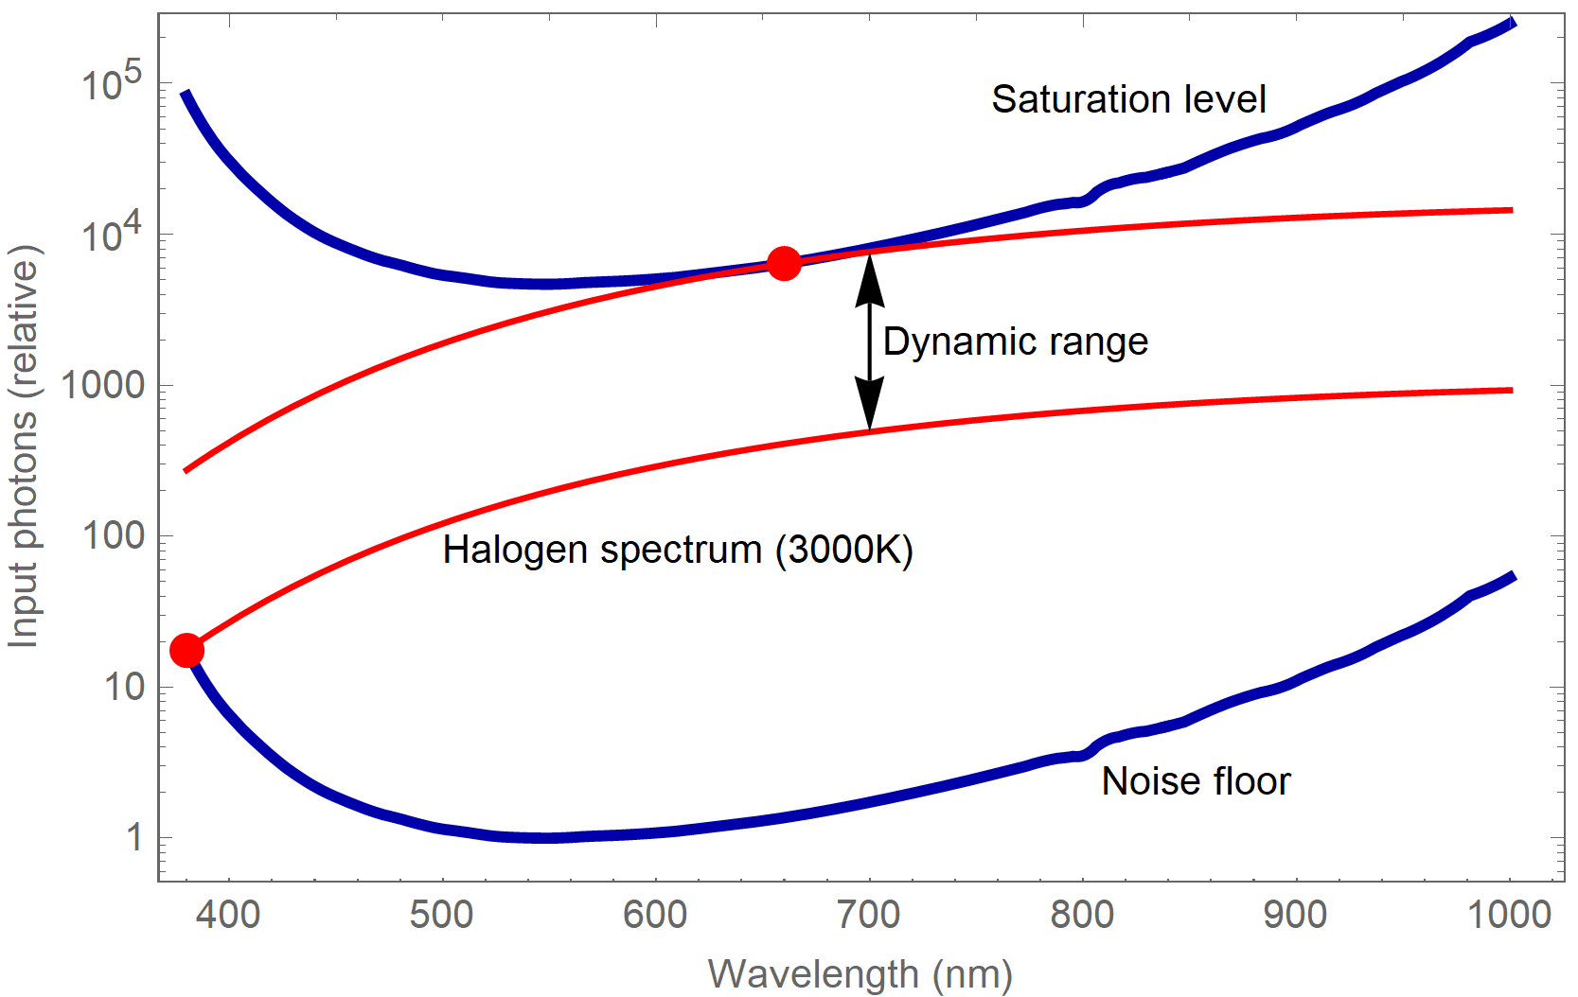
Example: Dynamic range characteristic
Because we do spectroscopy:
  Illumination and sensitivity varies across spectral range
Dynamic range must be specified
for given illuminant spectra
Noise floor and saturation level (example case)

Slide 16
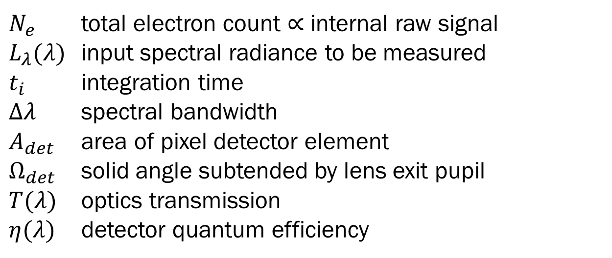
Example: Light collection characteristic
Conventional camera signal model:
=
Camera internals
$N_{e}$ total electron count $∝$ internal raw signal
$L_{λ}(λ)$ input spectral radiance to be measured
$t_{i}$ integration time
$Δλ$ spectral bandwidth
$A_{det}$ area of pixel detector element
$Ω_{det}$ solid angle subtended by lens exit pupil
$T(λ)$ optics transmission
$η(λ)$ detector quantum efficiency

Slide 17
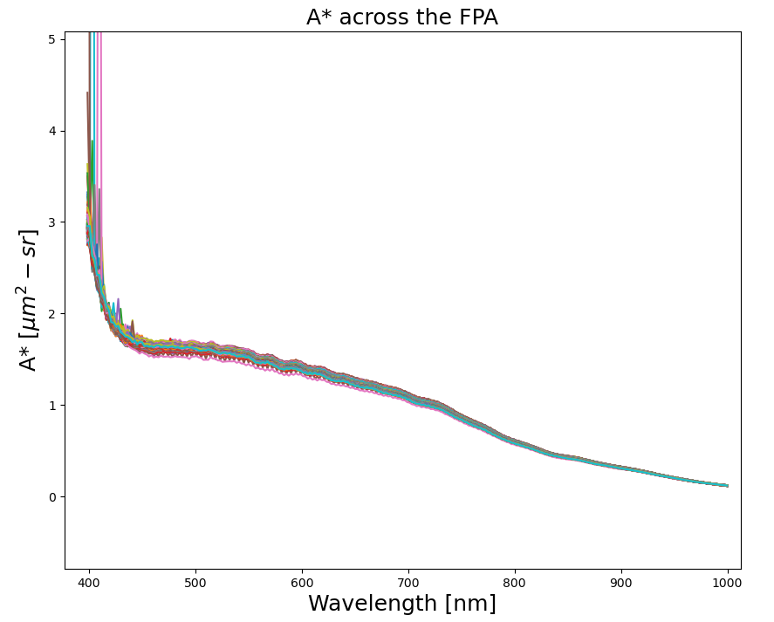
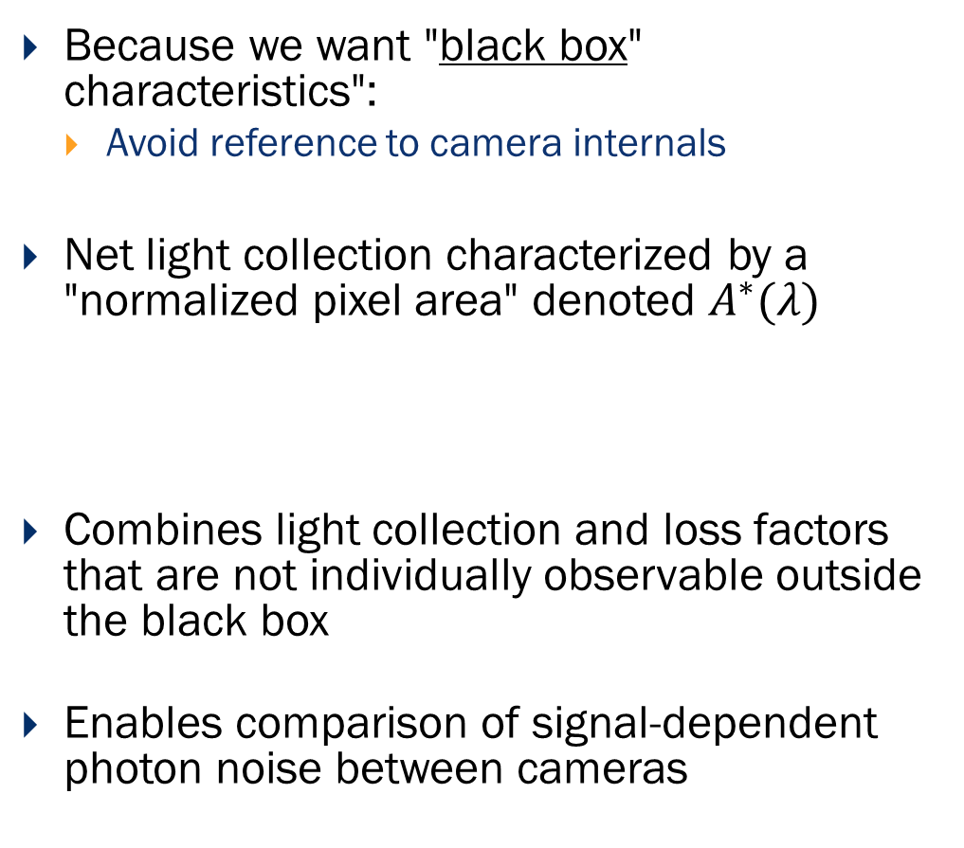
Example: Light collection characteristic
Because we want "black box" characteristics":
  Avoid reference to camera internals
Net light collection characterized by a "normalized pixel area" denoted $A^{∗}(λ)$
Combines light collection and loss factors that are not individually observable outside the black box
Enables comparison of signal-dependent photon noise between cameras
A* Preliminary Results courtesy of D. Conran, RIT

Slide 18
Camera testing - principles
P4001 will describe a set of methods to verify the defined characteristics
Other test methods may be equally valid, since characteristics are defined as physical quantities
Testing should not require excessive time or exotic equipment
In production, manufacturers may use simplified methods for acceptance test
Because we do spectroscopy: Detailed characterization of spectral and spatial response functions is needed

Slide 19
Required tests
Four working groups for testing and specification created:
  Radiometric: Variable broadband source (Linearity), Dark test, Non-Uniformity, RSR
  Spatial resolution: point or line source to measure point spread function
  Spectral resolution: monochromator, laser, or atomic line spectra
  Stray light: bright source having application-relevant spectrum, blocking filters
Calibration as needed by the application: spectral, spatial and radiometric

Slide 20
Test development in P4001
Characteristics defined for testability at the outset
Setting up task groups to work out draft test procedures
Testing the procedures in labs of volunteering members
Status January 2021:
  Stray light: Labsphere, Headwall, NIST, Spectral Solutions and others
  Spectral / Spatial: RIT, WPAFB, Univ. of Edinburgh (NERC), NEO-Hyspex and others
  Radiometric testing: RIT, NRC, Headwall, NEO-Hyspex, NIST, WPAFB and others.

Slide 21
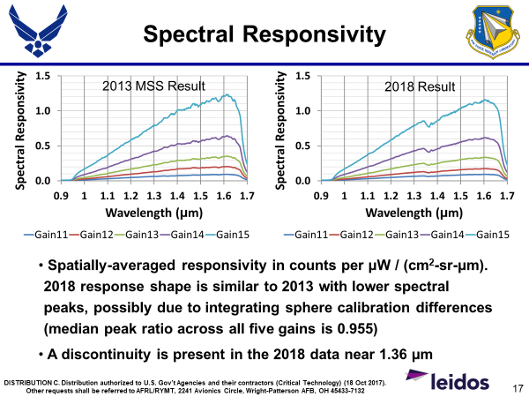
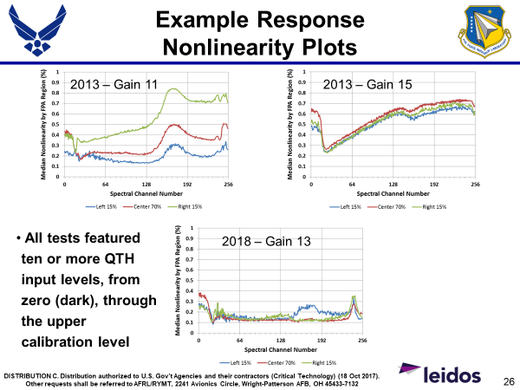
Radiometric Testing – Work in Progress
Example results courtesy of AFRL & Leidos:
“CASH Sensor Characterization Tests for the TOPHAT Field Exercise”
August 2018 – D. Perry

Slide 22
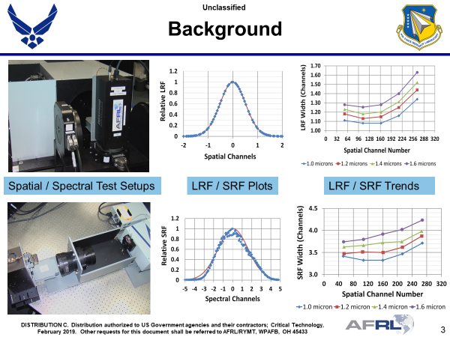
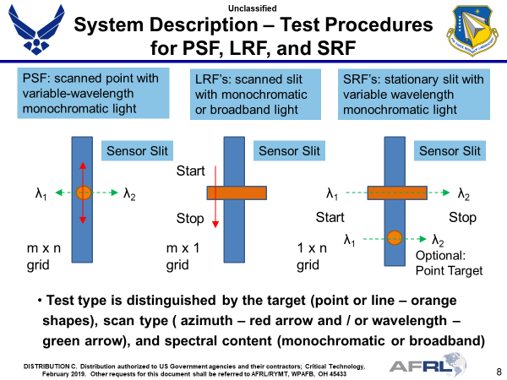
Spectral/Spatial Testing – Work in Progress
Example results courtesy of AFRL & Leidos:
“An Automated Spatial-Spectral Test Fixture for Laboratory Evaluation of Passive Hyperspectral Sensors”
MSS February 2019 – D. Perry, N. Wurst, J. Meola et al

Slide 23
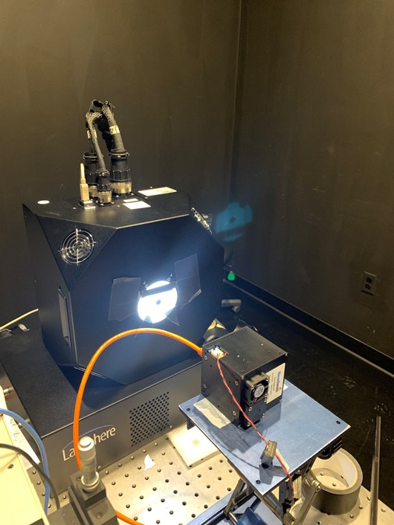
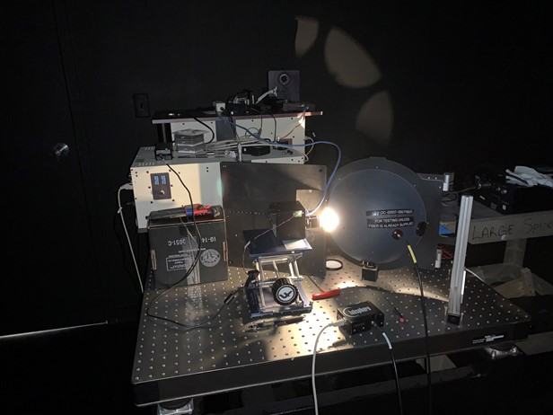
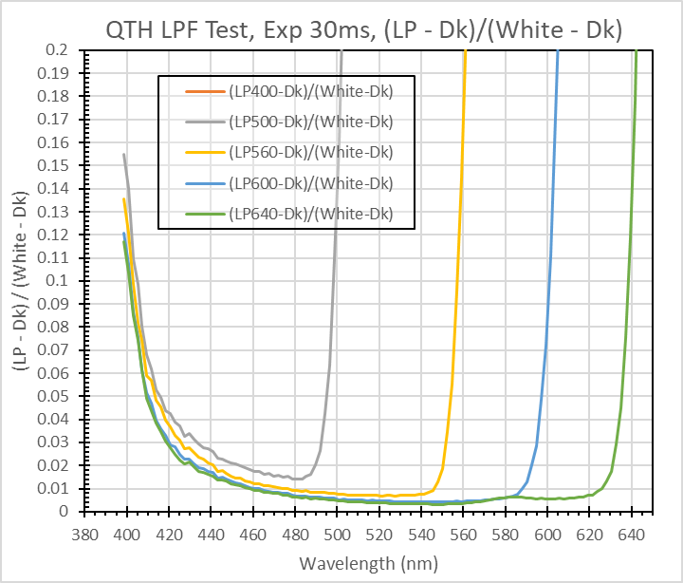

Stray light testing – Work in Progress
Partially based on ISO-9358:1994 (Veiling Glare Index), ISO 18844:2017 and CIE-233:2019
Main features:
  Light source representing practical illuminants: daylight, halogen, ...
  "Black dot" test: Spatial stray light into a masked part of FOV – 9358 and 18844.
    18844 test more relevant to imagers – re-tested (Dec) and evaluating results.
"Black dot" test,
≈6000K illumination
"White dot" test with blocking filters,
≈2856K illumination
"White dot" test, example results, shown as "apparent reflectance contribution"

Slide 24
P4001 Use Cases
Different applications require different sets of
  camera specifications
  data corrections
  metadata
P4001 will define a set of prototypical use cases defined by mandatory and optional elements
Camera specifications conformant to P4001 should contain all mandatory elements for a given use case
Image data conformant to P4001 should have the mandatory metadata and corrections for a given use case

Slide 25
Current use cases - work in progress
Remote sensing / Geoscience
  Emphasis on high data quality
  Radiometrically and spatially calibrated
  Rich metadata
Laboratory
  Emphasis on reflectance spectroscopy
  High data quality
Industrial
  Custom systems, emphasis on speed and cost
  Data quality adequate for the application

Slide 26
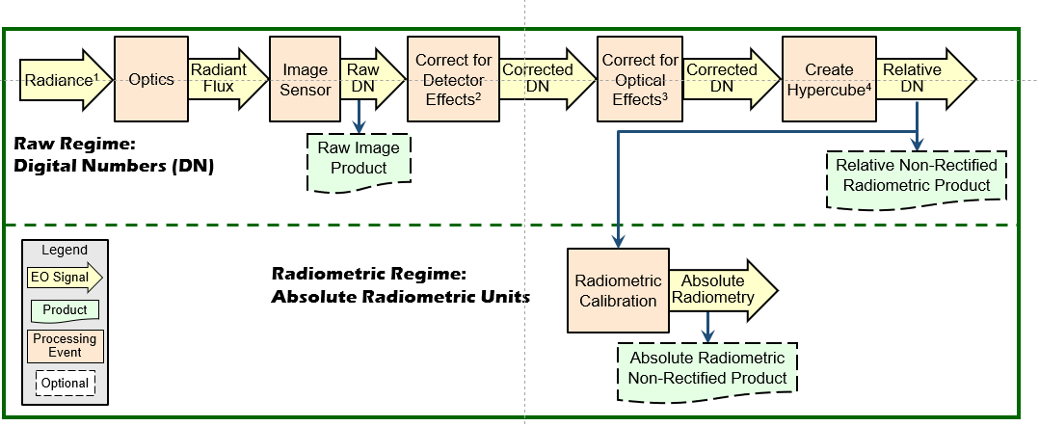
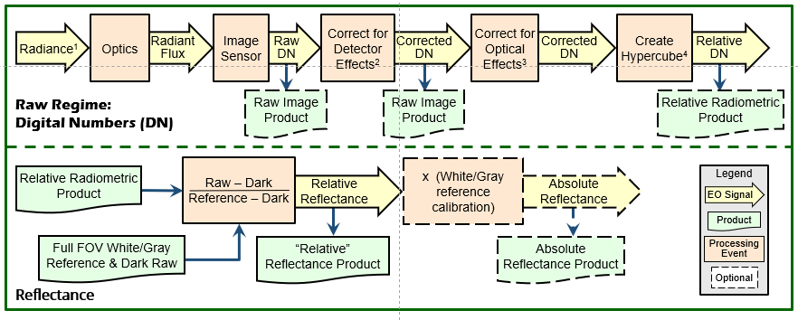
Data flow
Use cases require different data flow
  Industrial: uncorrected raw data
  Remote sensing: corrected, calibrated radiance
P4001 will describe data flows as far
as they pertain to the camera.
Data flowchart, geoscience use case
Data flowchart, lab/industrial use cases

Slide 27

P4001 Metadata specification - principles
Scope according to the "camera demon":
  Include metadata pertaining to the camera
  Exclude metadata pertaining to the application
  (geolocation, target info, illumination, weather, ...)
  Generic description of image data, consistent with
  "black box" approach
Metadata should be adequate for a given use case
High-end use case: metadata for extracting
  radiance
  signal-dependent noise
  magnitude of residual systematic errors
The demon inside the camera knows nothing about the outside world. From this perspective, the demon does its best to provide information about image data, expressed in a generic form suitable for a "black box" camera.

Slide 28
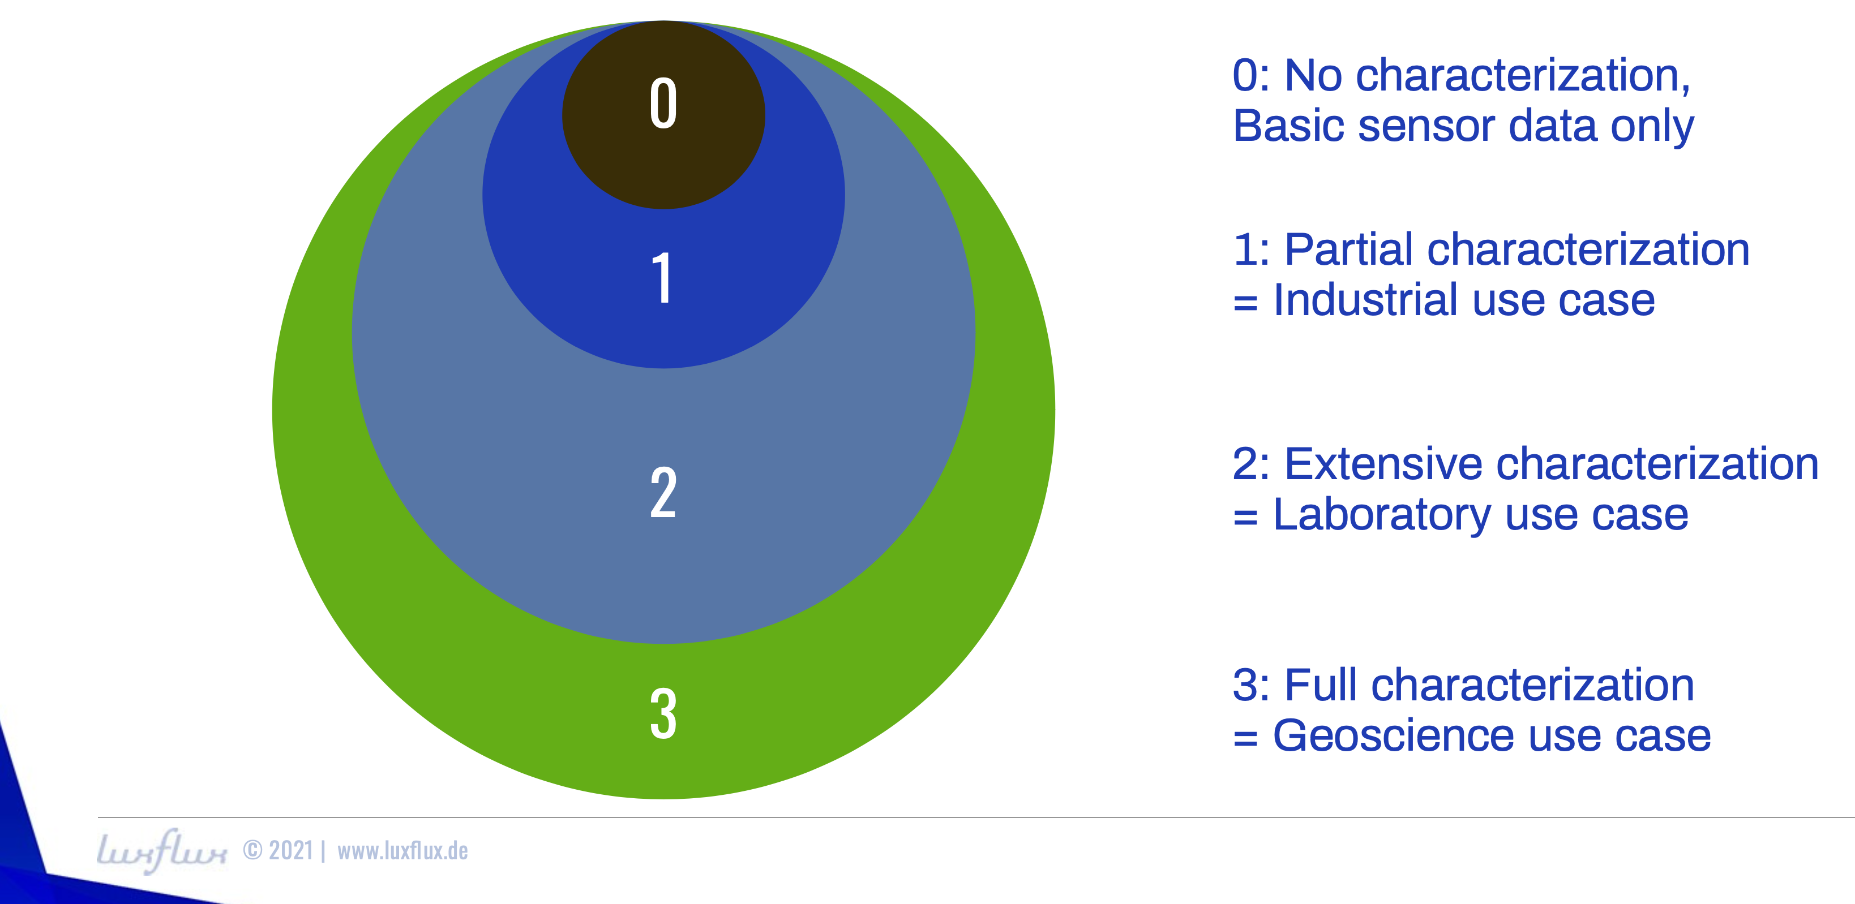
Metadata - use cases
Mandatory metadata: use cases contained within each other

Slide 29
Metadata lists
Compiling and categorizing metadata is a work in progress
CAMERA PROPERTIES
Category | Name | Data type | Use Case
Camera Basics
 | Camera Identifier | Text | I, L, G
 | Camera Type | Enumeration | I, L, G
 | Camera Manufacturer | Text | O
 | Camera Model | Text | I, L, G
 | Camera Serial Number | Text | I, L, G
 | Lens Manufacturer | Text | I, L, G
 | Lens Model | Text | I, L, G
 | Lens Serial | Text | I, L, G
 | Aperture Setting | Number | I, L, G
 | Focal Length | Number | I, L, G
Spatial
 | Focus setting | Number | L
 | Geometric Sensor Model | Vector of Numbers | G
 | Width and height of slit / FPA | Number | I
 | Modulation Transfer Function
 | SPSF Width | Matrix of Numbers | G
 | Effective pixel pitch | Number | I, L, G
 | Spatial ROI | Number pair | I, L, G
 | Spatial Binning Factor | Number | I, L, G
Spectral
 | Band Center Wavelengths | Vector of Number | I, L, G
 | Band (SRF) Width | Vector of Number | L
 | Band Profiles | Matrix of Numbers | G
DATA PRODUCT PROPERTIES
Category | Name | Data type | Use case
 | Data Product Identifier | String | I, L, G
 | Product Type | Enumeration | I, L, G
Spatial
 | X | Number | I, L, G
 | Y | Number | I, L, G
 | Spatial co-registration error | Number | G
Spectral
 | Bands | Number | I, L, G
 | Band Wavelengths | Vector of Numbers | I, L, G
 | Spectral co-registration error | Number | G
Temporal
 | List of time stamps for each frame | Vector of Numbers | G
 | Start & End Collection Time | Number | L, G
 | Temporal co-registration error | Number | G
Radiometric
 | Radiometric Unit | Enumeration
 | Zero Point Handling | Enumeration | O
 | Zero Point Value | Number | O
 | Saturation handling | Enumeration | O
 | Upper Bound reserved value | Number | O
 | Saturation map | Matrix | O

Slide 30
Terminology
What do you mean by "hyperspectral"?
  "For the purposes of the P4001 effort, addressing systems operating within 250nm - 2500nm, a hyperspectral imaging system or data set is defined as one in which pixel spectra are measured over a specified spectral range without gaps and with a maximum spectral sampling interval not exceeding 1/30 of the spectral range.”
For a standard, many terms need precise definitions
A separate P4001 subgroup works on terminology

Slide 31
Conclusions
A clear and urgent need for standardization in hyperspectral imaging
P4001 defines characteristics for hyperspectral cameras
  covering all aspects of performance
  emphasizing the needs of imaging spectroscopy
P4001 defines a possible set of verification tests
Specification of metadata in accordance with different use cases
P4001 will include definition of required terminology
Standard Finalization will continue into spring of 2022…join the effort

